Slide 1
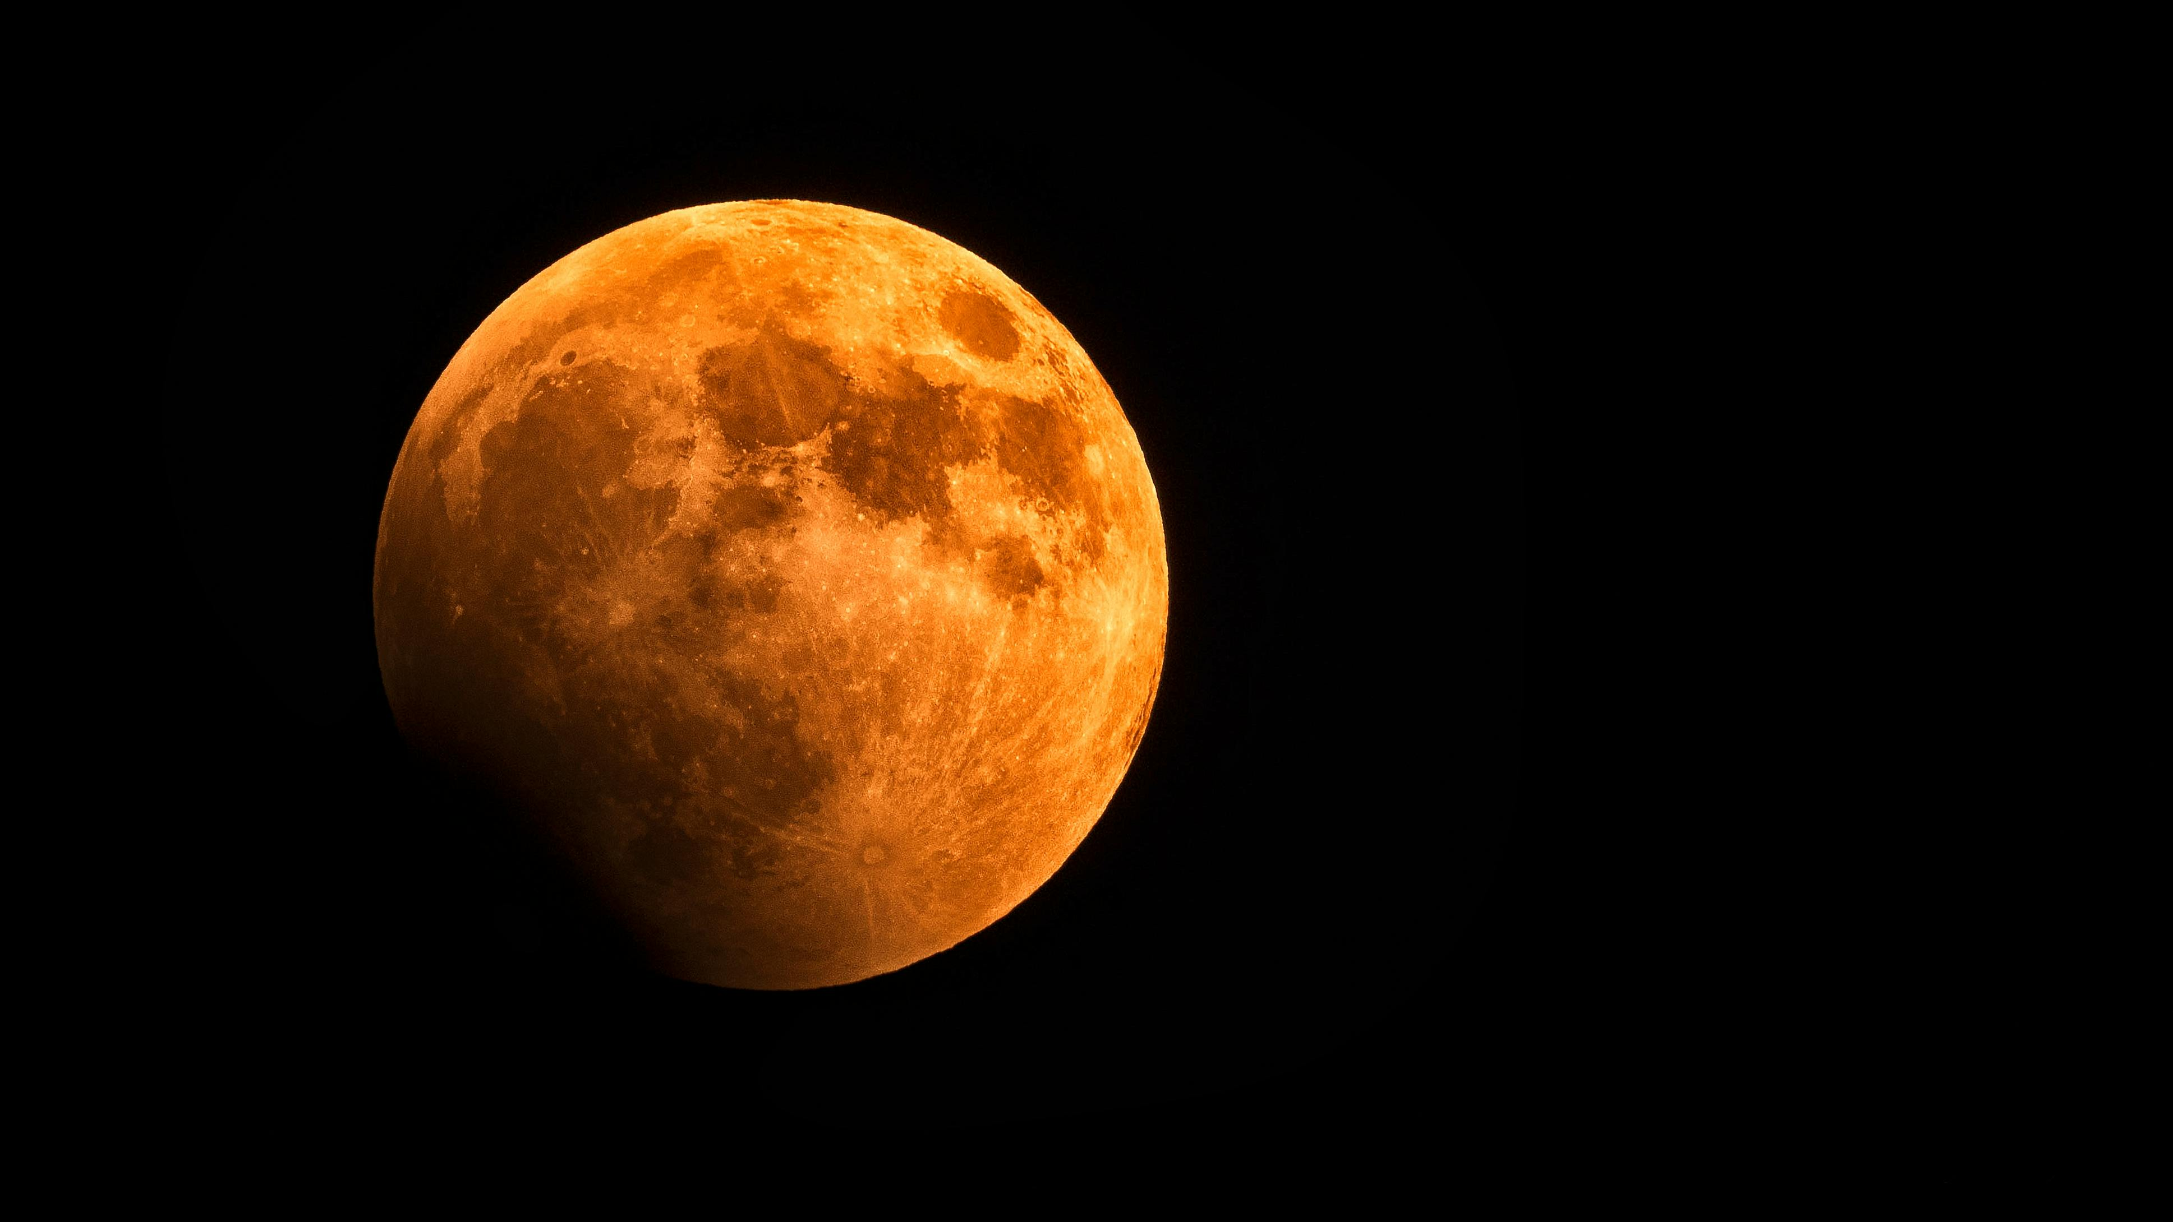
Olympus Tech 2.0
CubeSat Conquest
Team Members:
Ahmad Faraaz Baba
Malay Dave
Sarvadhnya Chaure

Slide 2
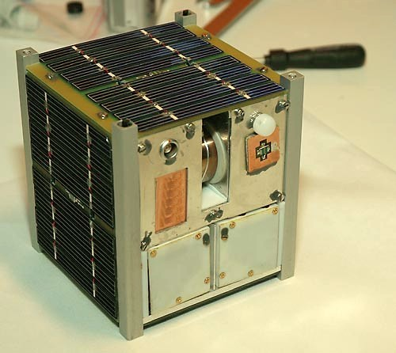
The dimension, orbit and objective of the satellite
The designed CubeSat has the dimensions of 15cm X 15cm X 15xm.
The objective of this particular satellite in space is to study the atmosphere of Venus, the second planet in our solar system.
As it needs to study the atmosphere of Venus, it needs to be close to the surface, and for such situations, a low Earth orbit (LEO) (or should I call it a low Venus orbit ?) is the most suitable one.
15cm
15 cm
15cm

Slide 3
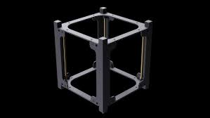
Components in the satellite
Material and structure
The body of the CubeSat is made of an aluminum alloy, making it lightweight and durable in harsh space conditions.
The structure is designed in such a way that it protects other components in the satellite.
All the components of the satellite must be packed in the satellite in such a way that all the space in the satellite is used most effectively.
The frame of the CubeSat is made of the aluminum alloy AL6061 and its total weight is 0.29 kg
Frame of the CubeSat

Slide 4
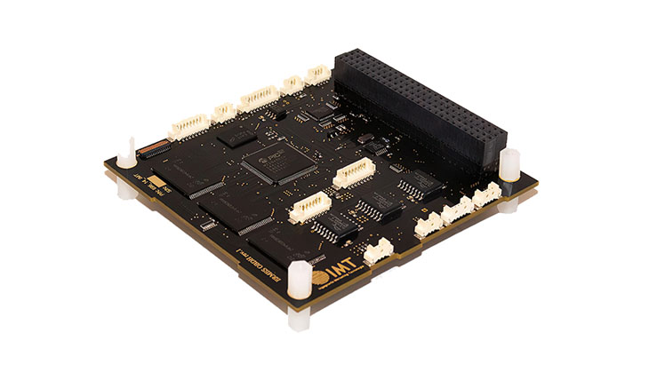
Onboard Computer
The onboard computer controls all the satellite’s processes. It is a very important component of the satellite and should function properly in the harsh conditions of space.
It will control all the operations in the satellite; that is, it acts as a CPU.
The material should be light, robust, and compact.
Details:
Weight | 0.038 Kg
Power Consumption | 0.3 W
Dimensions | 96mm x 90mm x 10mm
Onboard Computer

Slide 5
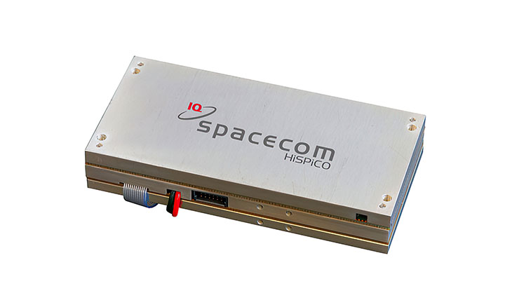
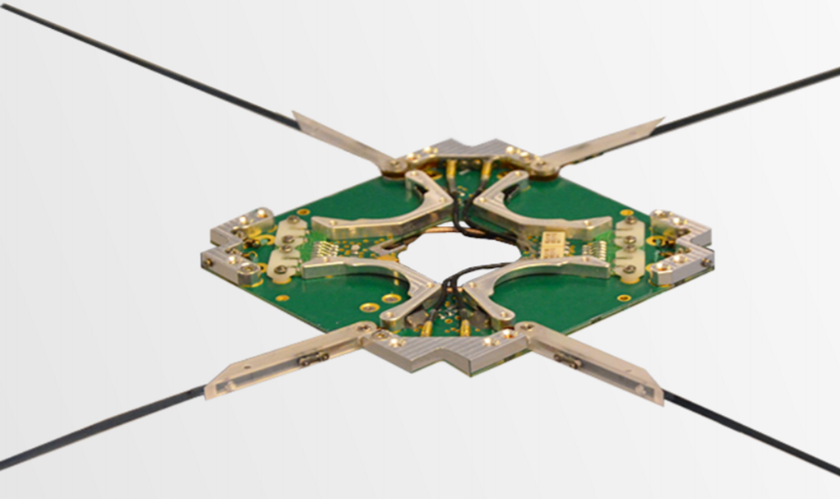
Communication system
As we need to study the planet's atmosphere, we must receive the data from the satellite.
For a one-way communication, we will use a transmitter.
Details:
The antennas are needed to transmit and receive data over large distances and are hence necessary.
Details:
Mass | 0.1 Kg
Power Consumption | 5.0 W
Frequency Band | UHF
Transmitter
Weight | < 0.1 Kg
Power Consumption | Nominal: < 40 mW During deployment: 2 W
Antennas

Slide 6
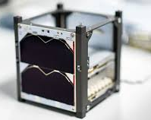
Power System
A major part of a satellite is its power system; other satellite components won’t work without it.
Our satellite uses solar panels mounted on the surface to generate the required electricity. Their typical weight is about 0.048 Kg; as we will attach them on four sides, leaving the top and bottom, the total weight for solar panels will be 0.192 Kg.
This energy is stored in the batteries on the satellite for use when it is not in direct sunlight.
The batteries are connected to the solar panels and all the other components of the satellite to transfer the power.
Specifications of the battery.
Solar panels
Type | Lithium-ion
Material | Lithium Polymer
Capacity | 30 Wh
Dimensions | 90.89 X 90.17 X 21.55 mm
Weight | 0.268 Kg
Lithium-ion Battery

Slide 7
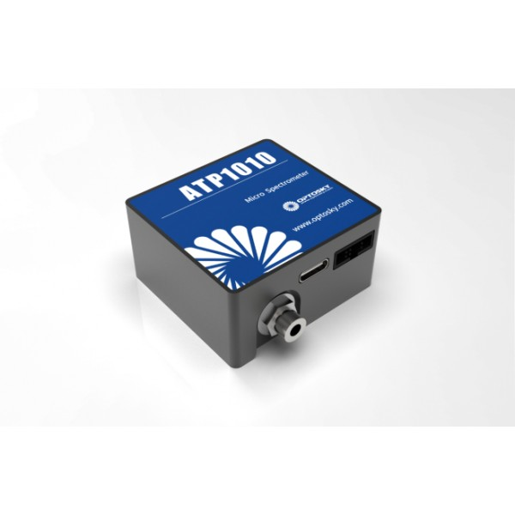
Payload
The purpose of this satellite is to study the atmosphere of Venus.
Different methods can be used; we will use a spectrometer and a radiometer in this satellite.
The spectrometers will analyze the light emitted or reflected by the atmosphere, revealing its composition, temperature, and other properties.
The radiometer will measure thermal radiation emitted by the planet, providing information about its temperature profile.
For this purpose, we will use this miniature spectrometer, which does UV gas measurement and spectral analysis and has a radiometer.
Weight | 0.06 Kg
Power Consumption | 1.1 W
Dimensions | 45mm x 24mm x 40mm
Spectrometer

Slide 8
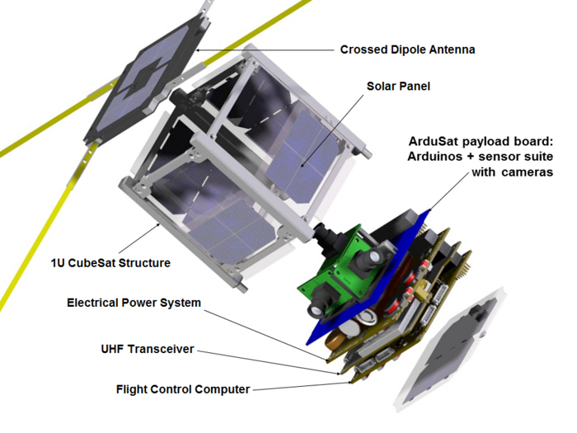
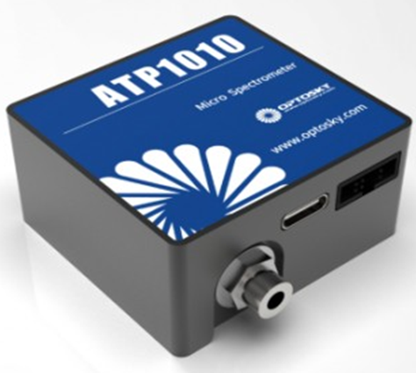
Integrating all the components
Spectrometer
UHF Transmitter
Onboard Computer

Slide 9
The weight distribution of the satellite
Systems | Weight
Power | 0.46 Kg
Communication | 0.15 Kg
Payload | 0.06 Kg
Onboard computer | 0.038 Kg
Frame | 0.29 KG
Total Weight | 0.998 Kg
(Weight is under 1 Kg)

Slide 10
Systems | Consumption (in watt)
Communication | 7
Payload | 1.1
Onboard computer | 0.3
Total Consumption | 8.4

Slide 11
So, this is our approach to a CubeSat
THANKS FOR GOING THROUGH IT ALL

