Slide 1

Seasonal Agriculture Performance Analysis
Faraaz Ahmad
MAULANA AZAD COLLEGE OF ENGINEERING AND TECHNOLOGY
AICTE STU ID : STU6a6caa6654c4e1785506406

Slide 2

PROBLEM STATEMENT
(Agricultural activities are influenced by seasonal variations in environmental conditions, farming practices, resource availability and market conditions. As a result, agricultural performance may differ from one season to another. However, raw agricultural data does not clearly explain how agricultural performance changes across seasons or what patterns can be observed in different seasonal conditions. The problem is to analyze the given agricultural dataset and investigate seasonal differences in agricultural performance by identifying meaningful patterns, trends, relationships and variations within the available data.

Slide 3
Project Description This project, titled 'Seasonal Agriculture Performance Analysis', is a major data analytics endeavour focused on the agricultural domain. The primary goal was to investigate how agricultural performance varies across different seasons, identifying meaningful patterns, trends, relationships, and variations within a given dataset. The analysis addressed the problem of how seasonal variations in environmental conditions and farming practices impact agricultural outcomes. My objectives included understanding the dataset's structure, cleaning and preparing the data, exploring seasonal patterns, performing statistical analysis, and investigating relationships among relevant variables to compare agricultural performance across seasons and other meaningful groups. Through this work, key revelations emerged regarding seasonal impacts on profitability, crop-specific performance, and resource utilization efficiency, leading to data-driven insights and recommendations for enhanced agricultural sustainability and profitability.

Slide 4

WHO ARE THE END USERS?
The end-users for this seasonal agriculture performance analysis would primarily be:
Farmers: To help them make informed decisions on crop selection, resource allocation, and risk management based on seasonal profitability and yield volatility.
Agricultural Policy Makers and Government Bodies: To guide decisions on subsidies, crop support programs, irrigation infrastructure, and sustainable farming practices.
Agricultural Scientists and Researchers: To provide a foundation for further research into crop optimization, environmental impacts, and new agricultural technologies.
Financial Institutions and Insurance Companies: To develop tailored loan products, crop insurance schemes, and risk assessment models for the agricultural sector.
Input Suppliers: Such as fertilizer and pesticide companies, to understand demand patterns and optimize their product offerings.
Market Analysts and Traders: To predict supply and pricing trends for various crops across different seasons.

Slide 5

Technology Used
The primary technologies used for this project are Python, along with the libraries Pandas, NumPy, Matplotlib, and Seaborn.

Slide 6
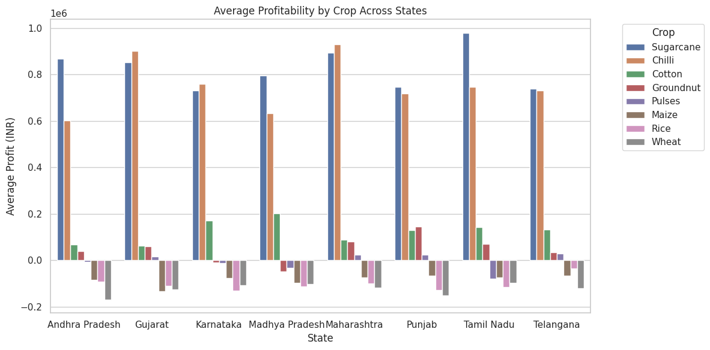
RESULTS

Slide 7
RESULTS
Graph Summary
High-Profit Crops: Sugarcane and Chilli consistently yield the highest average profit across all featured states, reaching up to 800,000–1,000,000 INR. Tamil Nadu displays the highest overall profit peak for Sugarcane.
Moderate-Profit Crops: Cotton and Groundnut generate modest positive returns (under 200,000 INR) in most regions.
Negative-Profit Crops: Wheat, Rice, and Maize consistently show negative average profits (falling between -50,000 and -180,000 INR) across all states, indicating potential net financial losses for these staple crops in the dataset.

Slide 8
RESULTS
Code Summary
Aggregation: Groups the dataset by State and Crop to calculate three metrics: mean yield (Average_Yield), mean profit (Average_Profit), and total yield (Total_Production).
Formatting: Rounds values to two decimal places and sorts results alphabetically by State, then by Average_Profit in descending order.
Visualization: Plots a grouped bar chart using Seaborn (sns.barplot), setting State on the x-axis, Average_Profit on the y-axis, and grouping by Crop.

Slide 9
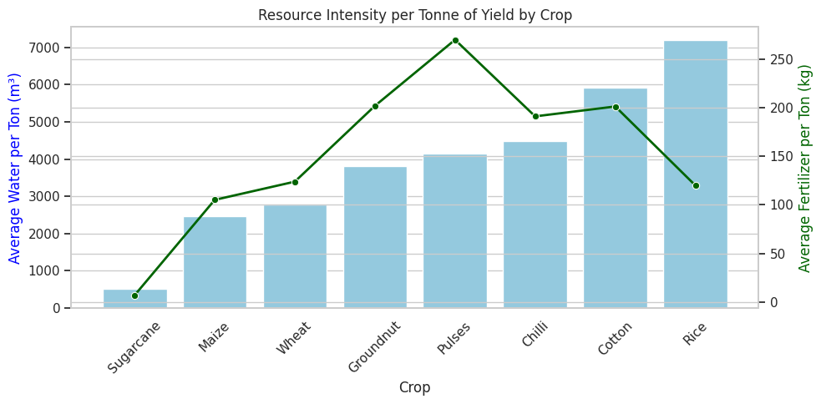
RESULTS

Slide 10
RESULTS
Graph Summary
Most Efficient Crops: Sugarcane is the most resource-efficient crop per tonne produced, requiring the lowest water (<500 m³) and fertilizer (~10 kg) per unit of yield.
High Water Intensity: Rice and Cotton are the most water-intensive crops, with Rice consuming over 7,000 m³ of water per tonne.
High Fertilizer Intensity: Pulses require the highest fertilizer input per tonne (~270 kg/ton), followed by Groundnut, Cotton, and Chilli (around 190–200 kg/ton).

Slide 11
RESULTS
Code Summary
Feature Engineering: Calculates normalized efficiency ratios per tonne by dividing total water (Water_Used_m3) and fertilizer (Fertilizer_kg_ha) by crop yield (Yield_Tonnes_Ha).
Aggregation: Groups by Crop to calculate the mean water usage per ton, mean fertilizer usage per ton, and average overall inputs.
Sorting & Plotting: Sorts crops by ascending Avg_Water_per_Ton and generates a dual-axis chart—a light blue bar chart (left y-axis) for water usage and a dark green line plot (right y-axis) for fertilizer consumption.

Slide 12
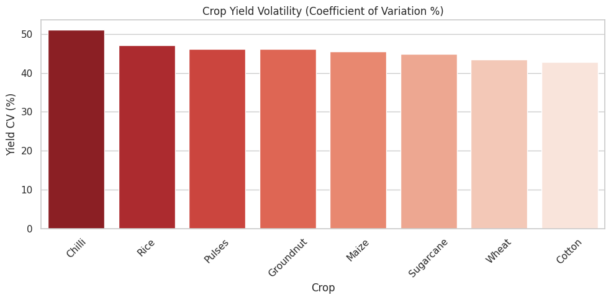
RESULTS

Slide 13
RESULTS
Graph Summary
Highest Volatility: Chilli exhibits the highest yield volatility, exceeding a 50% Coefficient of Variation (CV).
Moderate to High Risk Cluster: Rice, Pulses, Groundnut, and Maize display relatively high yield unpredictability, tightly clustered between 45% and 47% CV.
Lowest Relative Volatility: Sugarcane, Wheat, and Cotton showcase the lowest relative yield volatility in the dataset, ranging from ~43% to 45% CV.

Slide 14
RESULTS
Code Summary
Risk Metrics Calculation: Groups the dataset by Crop and calculates mean yield, standard deviation of yield, raw count of loss-making instances (Profit_INR < 0), and the loss rate percentage (Loss_Rate_Pct).
Feature Engineering: Computes the Coefficient of Variation (Yield_CV_% = (Std_Dev / Mean) * 100) to evaluate relative yield unpredictability independent of crop scale.
Sorting & Plotting: Drops standard deviation, rounds figures to two decimal places, sorts crops by descending Yield_CV_%, and generates a Seaborn bar chart with a reversed red color palette (Reds_r) to emphasize risk gradient.

Slide 15
Future scope
Building upon the foundational analysis of seasonal agricultural performance, future investigations could delve deeper into several critical areas. Firstly, integrating external datasets such as granular climate projections and real-time market prices would enable more dynamic predictive modeling for optimal crop selection and yield forecasting. Secondly, a more detailed spatial analysis, perhaps down to the sub-district or village level, could uncover localized micro-climates and soil conditions that significantly impact agricultural outcomes, allowing for hyper-targeted recommendations.
Furthermore, exploring the socio-economic factors influencing farmers' decisions, such as access to credit, education levels, and government schemes, could provide a holistic understanding of profitability drivers beyond environmental and operational variables. Finally, the development of interactive dashboards would empower stakeholders to explore these complex relationships and simulate various scenarios for improved decision-making and policy formulation.

Slide 16
GitHub Link
https://github.com/FaraazAhmad71125/-Seasonal-Agriculture-Performance-Analysis.git

Slide 17

VOIS Course completion certificate - Course name- Data Visualization

Slide 18
Thank you
.
.

