Slide 1
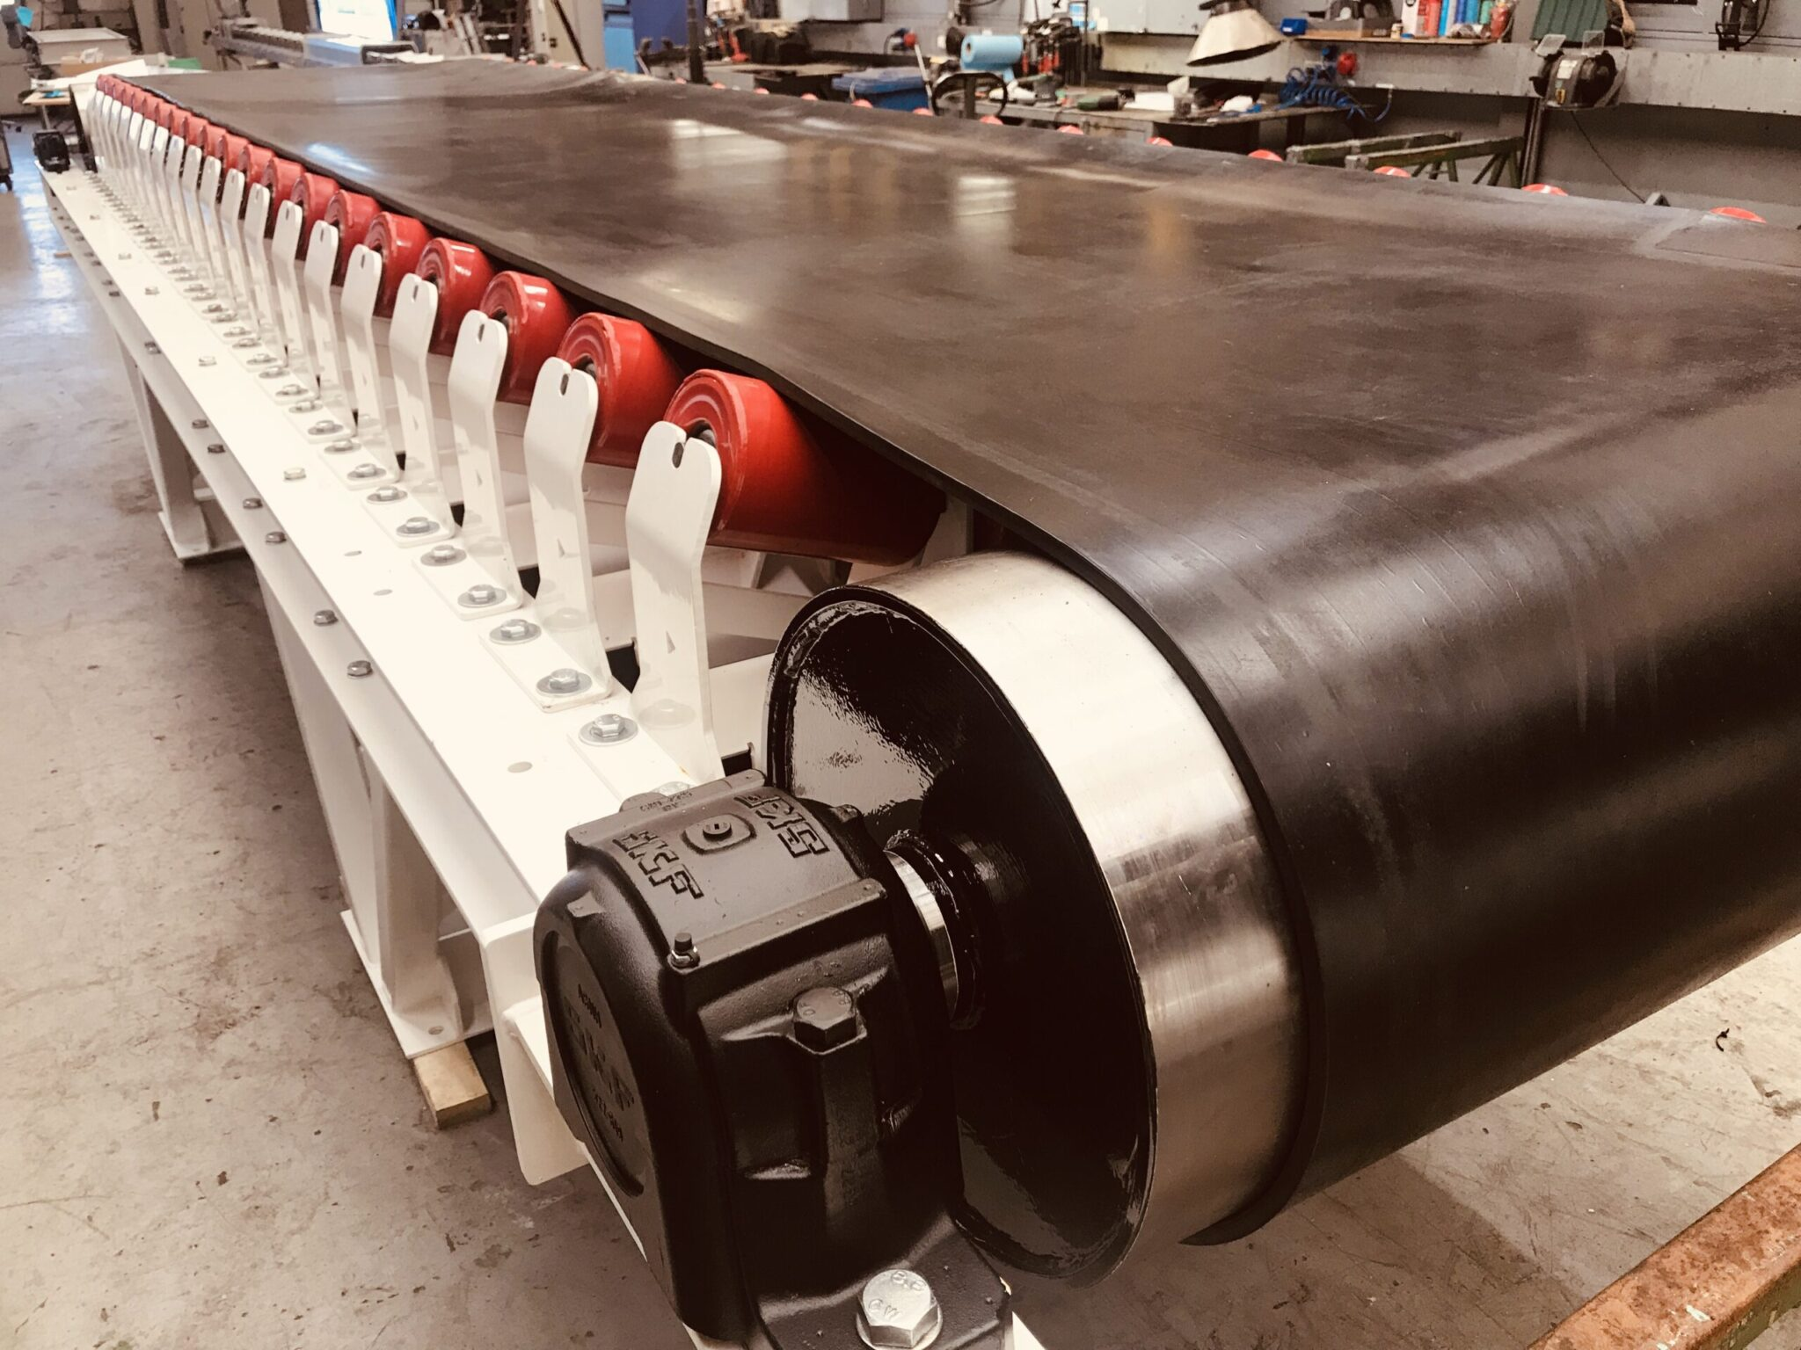


Conveyor Belt with Automated Storage and Retrieval System (ASRS) with Fault Detection
Presented By
Punno Chandra Saha (2005002)
Md. Rafiul Islam (2005004)
Md. Ferdaous Al- Farabe (2005023)
Habibur Rahman Alamin (2005025)
Ifte kharul Islam Nahid (2005034)
Rupok Islam Avi (2005058)

Slide 2
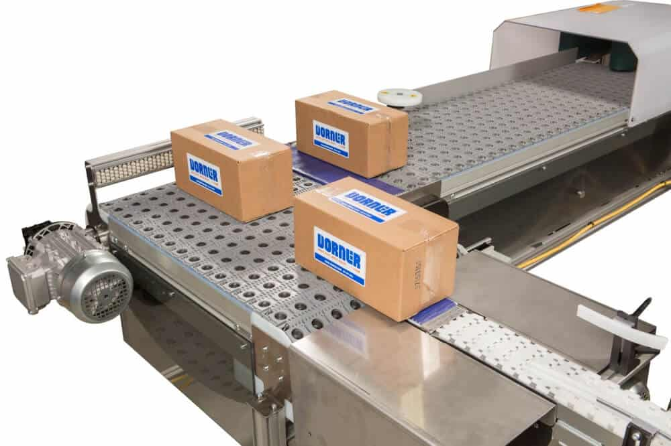
Introduction
This project presents a m0niaturized Automated Storage and Retrieval System (ASRS) integrated with a conveyor belt, color and fault detection. Controlled by an Arduino Uno with low-cost motors and sensors, the system automates sorting and storage of objects based on color. Position and fault detection modules enhance reliability, making it a practical platform for learning in instrumentation, robotics, and mechatronics.

Slide 3

Problem Statement
Manual handling, sorting, and storage are still common in small-scale industries and labs as well as increase labor costs, reduce accuracy, and waste time and space.
A compact, affordable, sensor-driven system is needed for automation such a system should provide automated transport, sorting, storage.
The proposed prototype reduces human effort and enhances efficiency and safety.

Slide 4
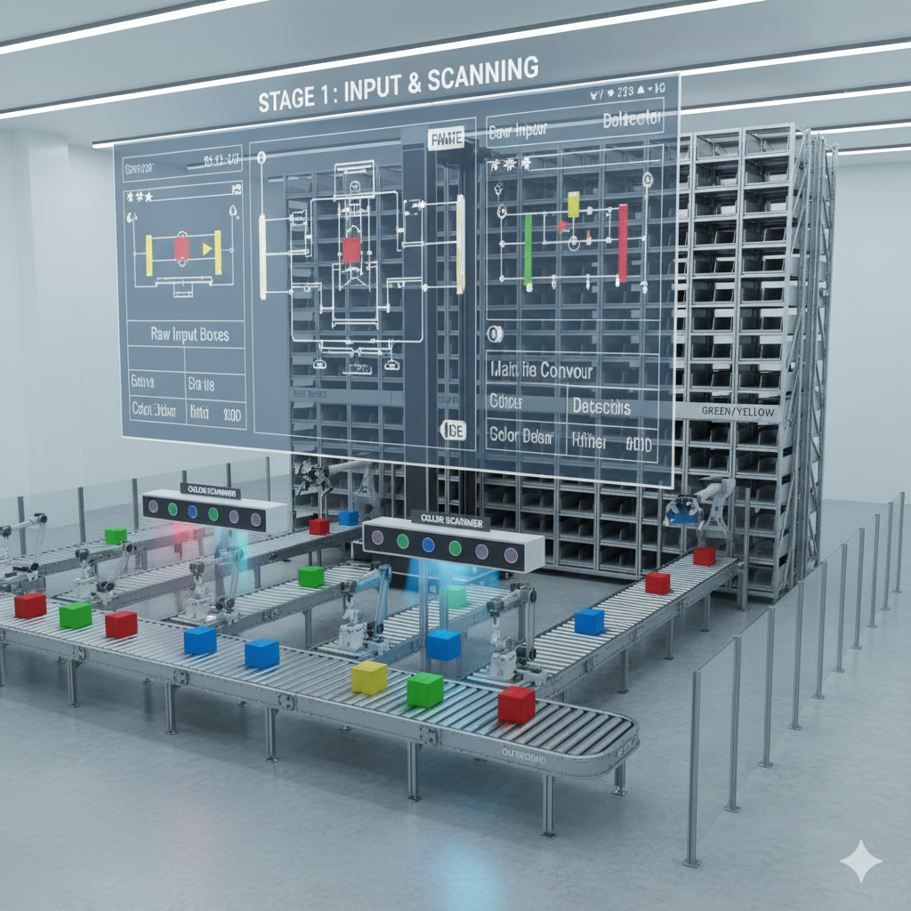
Objectives
Develop a compact and affordable ASRS prototype integrated with conveyor belt and color-sorting functionality with faulting detection
Implement sensor-based automation (IR, ultrasonic, and TCS3200) for object detection and color classification .
Provide a practical learning platform for automation, instrumentation, and mechatronics applications

Slide 5
Literature Review
References | Key Findings
(Choy et al., 2021) | Demonstrated ASRS can improve accuracy, reduce costs, and optimize space utilization in warehouses..
(Kumar & Balamurugan, 2020)] | Developed an Arduino-based ASRS prototype with conveyor and robotic components for low-cost automation..
(Khan & Ali, 2019) | Created a color sorting system using TCS3200 sensor and Arduino to distinguish objects by RGB values..
(Singh et al., 2020) | Applied color sensors in conveyor-based automation for packaging industry object sorting.

Slide 6
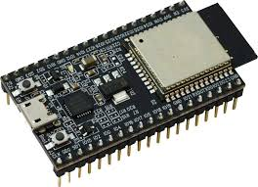
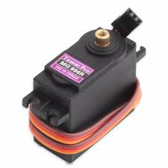
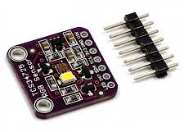
System Components
Component Name | Function | Figure
ESP32 Microcontroller | Acts as the central controller, executing logic, managing sensors, and coordinating conveyor operations.
Servo Motor MG996 | Enables precise angular positioning for lifting, shifting, or locking items.
Color Sensor TCS725 | Detects and identifies item colors for sorting and fault detection.

Slide 7
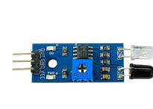
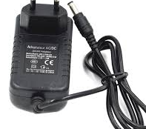
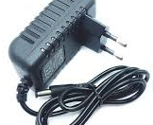
System Components
Component Name | Function | Figure
IR Sensor | Senses object presence or obstruction for position tracking and safety.
12V 2A PSU | Powers motors and high-voltage mechanical drives.
5V 2A PSU | Supplies regulated power to microcontroller and sensors..

Slide 8
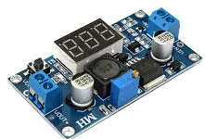
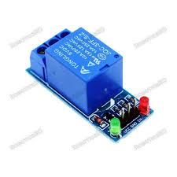
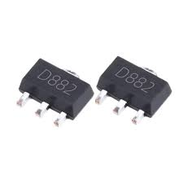
Component Name | Function | Figure
Buck Converter | Steps down higher voltage to safe levels for electronics.
Relay 5V | Switches high-power loads using low-power control signals..
D882 Transistor | Amplifies signals and drives current for relays or motors.

Slide 9
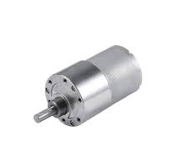
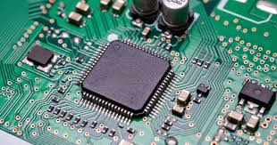
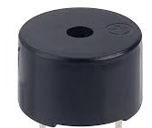
Component Name | Function | Figure
Gear Motor | Provides high torque and low-speed drive to move the conveyor belt with controlled force.
PCB | Hosts and interconnects control circuits in a compact design..
Buzzer | Produces an audible alert by buzzing when the storage bucket fills up.

Slide 10
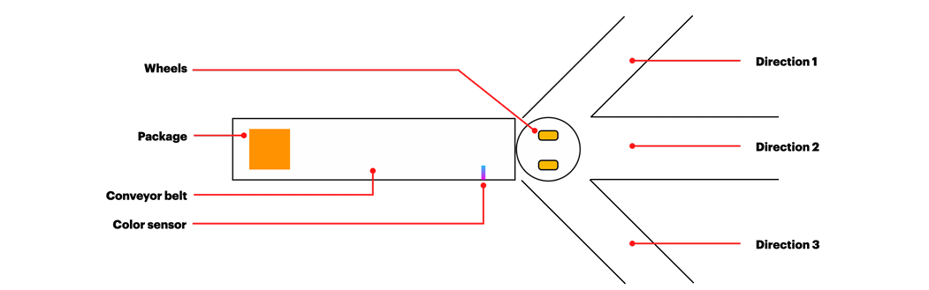
Working Procedure
Motor-1
STORAGE -1
STORAGE -3
Motor-2
STORAGE -2
Motor-3
Fault detection

Slide 11
Working Procedure
Start
Arduino Uno Microcontroller ON
Servo Motor ON
Operates wheel
Different colour identify
Operates main conveyor
Fault Detected
Object moves through conveyor
Servo Motor OFF
MISSION
Object and Color sensor reads data
No
Main conveyor OFF
Yes

Slide 12
Working Procedure
Read Data
G+20, B+20, <100
=Black
Read data
>G+50, >B+50, >150
=RED
Read Data
G-30, B-30, > 200
=WHITE
time delay, t = 2s
time delay, t = 2s
time delay, t = 2s
Servo turns to 45° position
Servo turns to 45° position
Servo turns to 45° position
Black Container Fills Up
Red Container Fills Up
White Container Fills Up
MISSION
NO
YES
NO
NO
YES
YES
DC MOTOR 1
ON
DC MOTOR 2
ON
DC MOTOR 3
ON
Motor -1 operates corresponding conveyor
Motor -2 operates corresponding conveyor
Motor -1 operates corresponding conveyor
Boxes Stored to storage -1
Boxes Stored to storage -2
Boxes Stored to storage -3

Slide 13
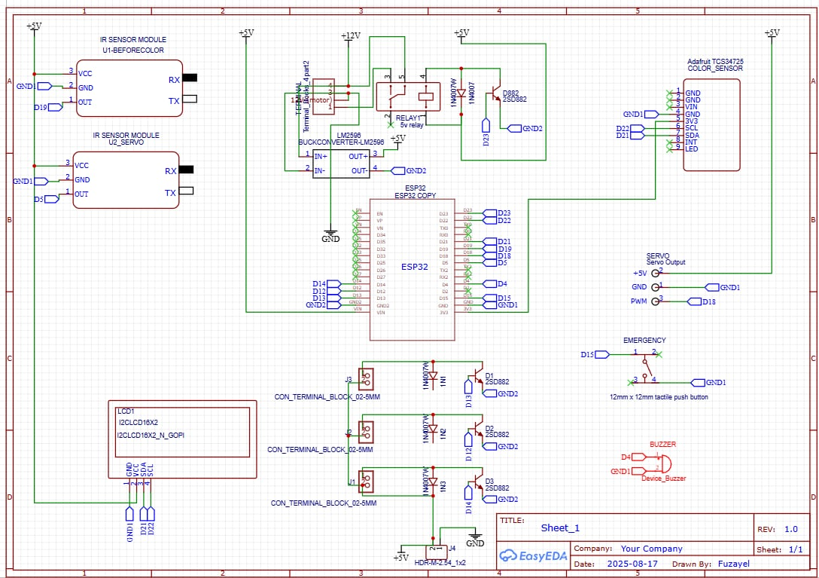
Circuit Diagram
MISSION

Slide 14
Cost Analysis
Cost of Components
First phase :
SL | Component | Qty | Unit Price (Tk) | Total (Tk)
1 | Eps32 microcontroller | 1 | 800 | 800
2 | Gear motor | 1 | 1000 | 1000
3 | Servo motor mg996 | 2 | 600 | 1200
4 | DC motor | 3 | 80 | 240
5 | Color sensor tcs725 | 1 | 600 | 600
6 | IR sensor | 2 | 150 | 300
7 | Belt | 1 | 300 | 300
8 | Power cable | 1 | 80 | 80
9 | 12V 2A PSU | 1 | 550 | 550
10 | 5V 2A PSU | 1 | 450 | 450
MISSION

Slide 15
Cost Analysis
Cost of Components
11 | Buck converter | 1 | 200 | 200
12 | Roller | 2 | 600 | 1200
13 | Bearing | 4 | 150 | 600
14 | 3D printed parts | 1 | 350 | 350
15 | Wood frame | 1 | 800 | 800
16 | Wire | 1 | 200 | 200
17 | PCB | 1 | 600 | 600
18 | Male-Female rail | 4 | 30 | 120
19 | PVC board | 1 | 200 | 200
20 | Relay 5V | 1 | 60 | 60
21 | D882 transistor | 3 | 15 | 45
22 | Buzzer | 1 | 25 | 25
23 | Others | 1 | 300 | 300
 | Total Cost |  |  | 10,220
MISSION

Slide 16
Cost Analysis
Cost of Components
Second Phase:
SL | Component | Qty | Unit Price (Tk) | Total (Tk)
1 | 3D printed Conveyor belt | 1 | 4500 | 4500
2 | Gear motor | 1 | 1000 | 1000
3 | Servo motor mg996 | 1 | 600 | 600
4 | Microcontroller | 1 | 80 | 1000
5 | Wood frame | 1 | 200 | 200
6 | Wires, cables |  | 400 | 300
7 | Power supply |  | 500 | 400
 | Total Cost |  |  | 8000
MISSION

Slide 17
Code:
MISSION

Slide 18
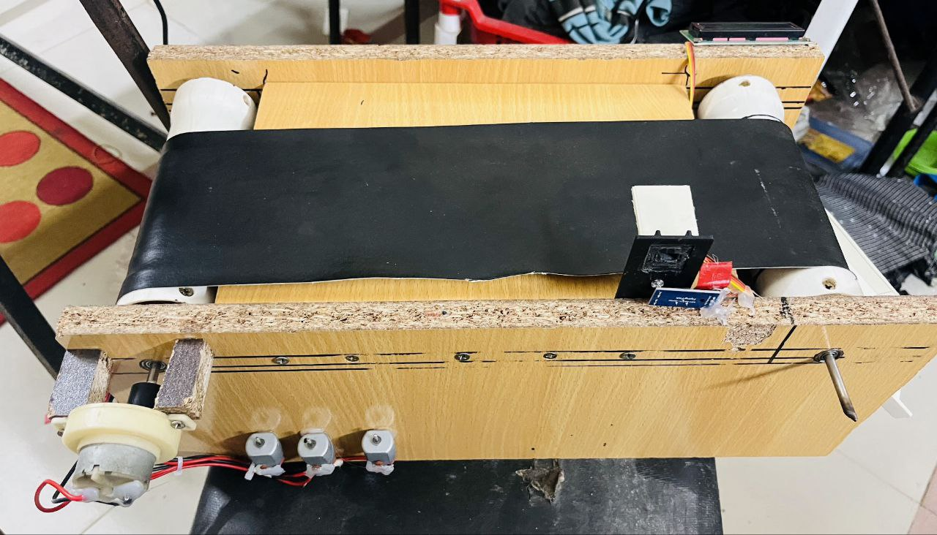
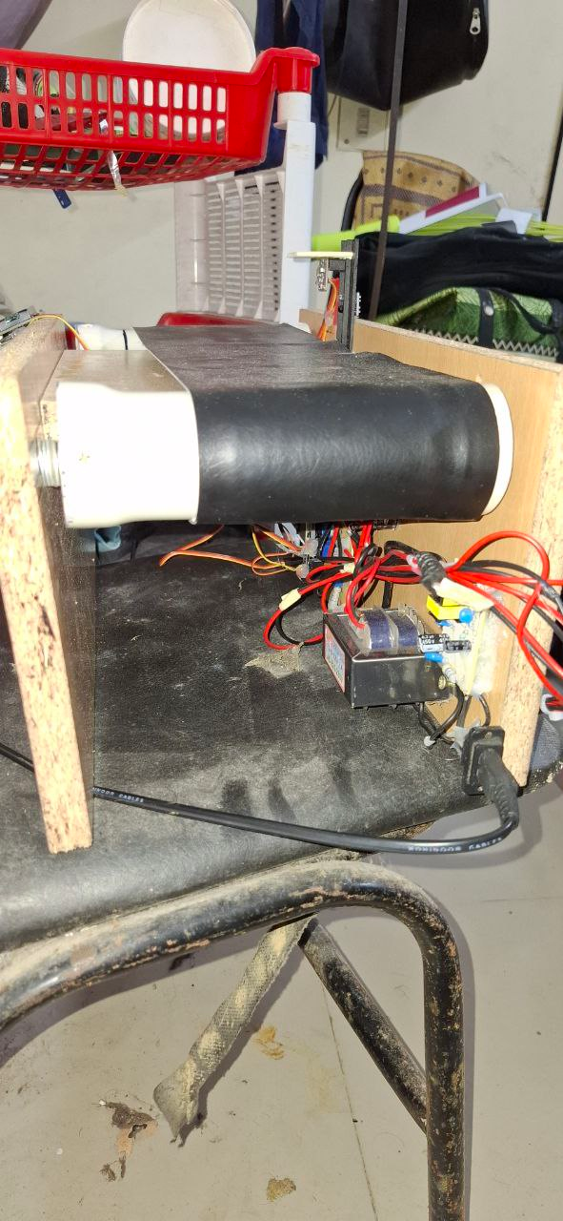
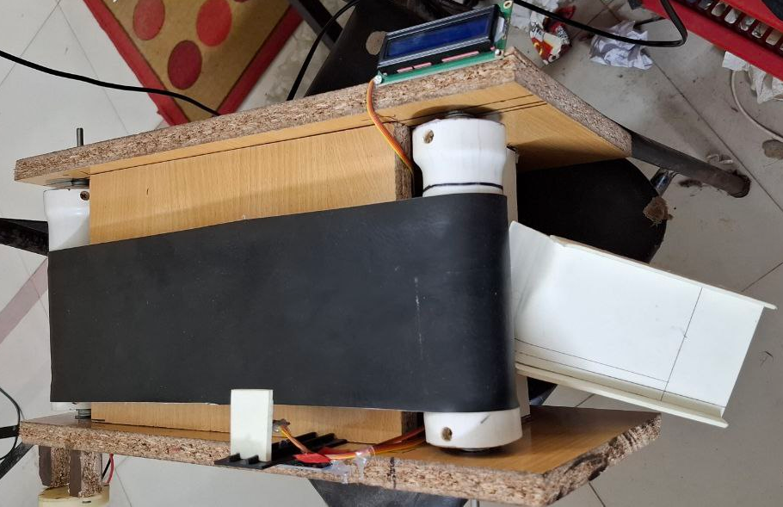
Our Prototype
MISSION

Slide 19
Our Prototype
MISSION

Slide 20
THANK YOU

