Slide 1
Designing Applications in Python
Lecture 7 – Django app dev part 1
Shynggys Kairatuly Alshynov
MSc in IT
alshynov@gmail.com
CE&T department, Room 409

Slide 2
Objectives
Database setup
Models
Create
Activate
API Intro
Django Admin Intro
Create
Admin page
Modify app from admin’s page

Slide 3
Learning outcomes
If someone is still reading these slides with learning outcomes then you are great!
You will improve your skills from previous lecture!

Slide 4
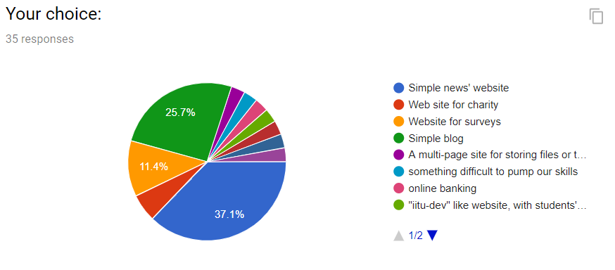
Project Choice

Slide 5
Database Setup
To create our database we need to use the command python manage.py migrate in the project folder.
This command looks at the INSTALLED_APPS in settings.py file and create necessary database tables.

Slide 6
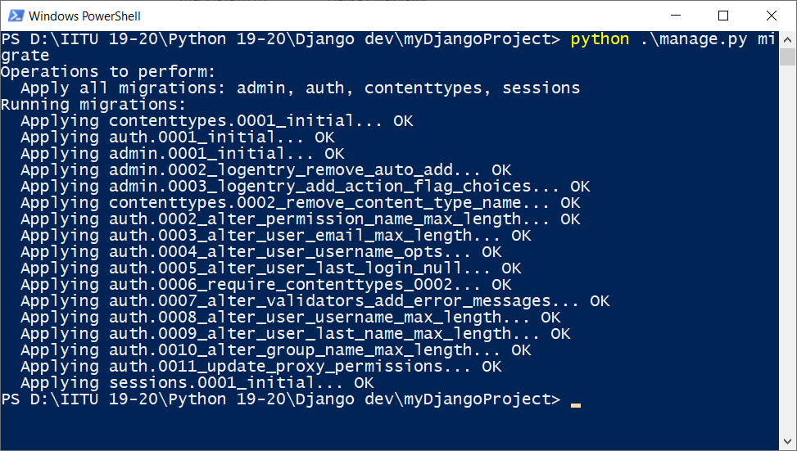
Migration results
Notes:
PYTHON IS CASE SENSITIVE DO NOT FORGET ABOUT IT

Slide 7
Models
A model is the single, definitive source of truth about your data. It contains the essential fields and behaviors of the data you’re storing. Django follows the DRY Principle. The goal is to define your data model in one place and automatically derive things from it.
Notes:
django-admin is Django’s command-line utility for administrative tasks. This document outlines all it can do.

Slide 8
Model Creation
Go to your application folder and open models.py
Then start defining your model:
# Our first model
class Article(models.Model):
article_id = models.CharField(max_length=9999)
article_text = models.TextField()
article_date = models.DateTimeField(‘date published’)
class Editor(models.Model):
editor_name = models.CharField(max_length=100)
editor_surname = models.CharField(max_length = 100)
editor_id = models.CharField(max_length = 1000)
Notes:
In addition, manage.py is automatically created in each Django project. It does the same thing as django-admin but also sets the DJANGO_SETTINGS_MODULE environment variable so that it points to your project’s settings.py file. It is a specification that describes how a web server communicates with web applications, and how web applications can be chained together to process one request.

Slide 9
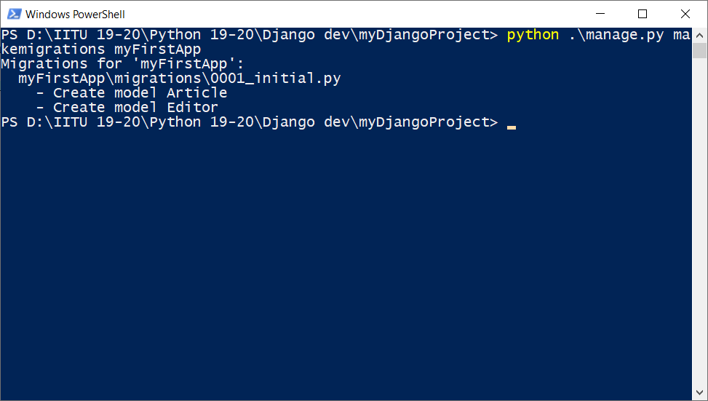
Model makemigrations
To apply our models to the database we need to run this command:
python manage.py makemigrations myFirstApp

Slide 10
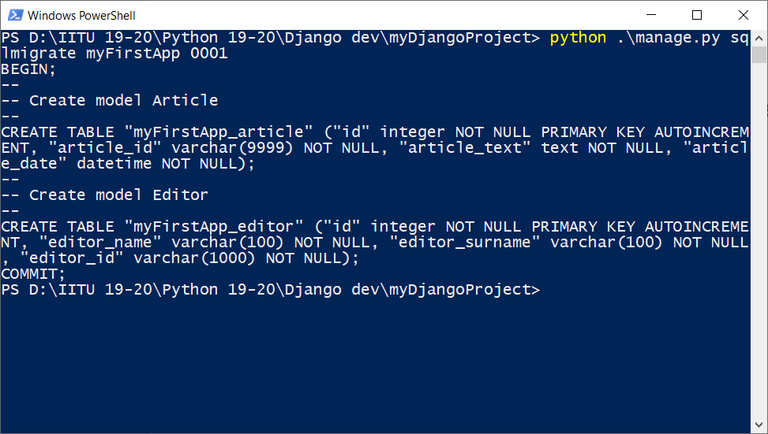
sqlmigrate command
The sqlmigrate command takes migration names and returns their SQL.
python manage.py sqlmigrate myFirstApp 0001
Notes:
Your apps can live anywhere on your Python path. we’ll create our app right next to our manage.py file so that it can be imported as its own top-level module, rather than a submodule

Slide 11
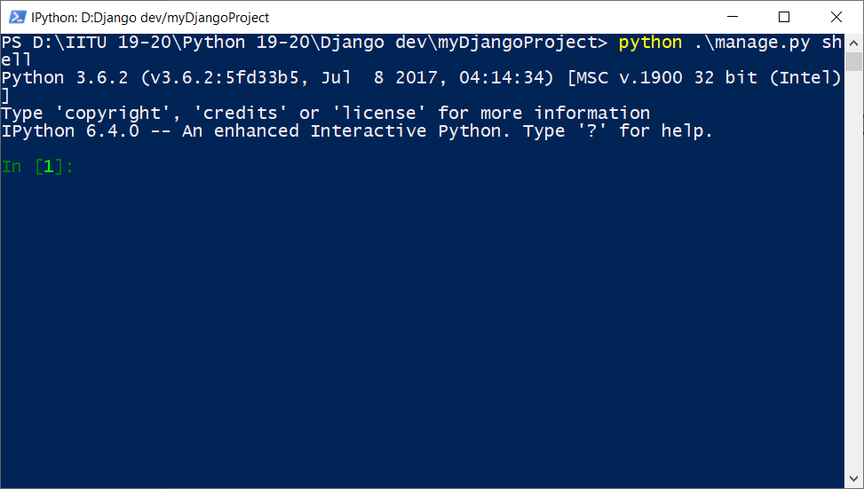
Playing with API
Let’s try to do something with our db using free Django API:
To do so, run python manage.py shell; You will enter to python shell

Slide 12
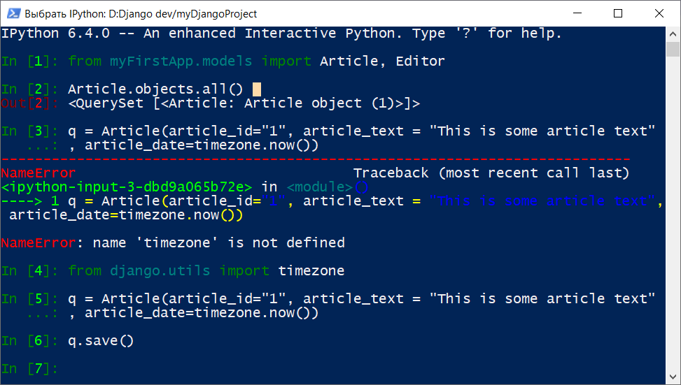
Playing with API

Slide 13
Django Admin
Generating admin sites for your staff or clients to add, change, and delete content is tedious work that doesn’t require much creativity. For that reason, Django entirely automates creation of admin interfaces for models.
Django was written in a newsroom environment, with a very clear separation between “content publishers” and the “public” site. Site managers use the system to add news stories, events, sports scores, etc., and that content is displayed on the public site. Django solves the problem of creating a unified interface for site administrators to edit content.
The admin isn’t intended to be used by site visitors. It’s for site managers.

Slide 14
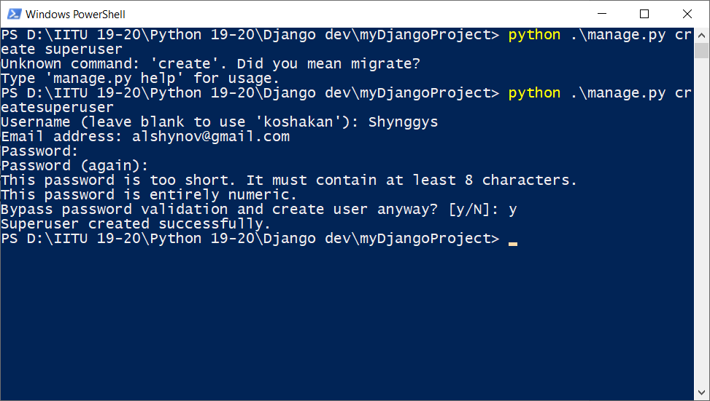
Django Admin - superuser
To create a superuser you need to run this command:
python manage.py createsuperuser
and then enter the data

Slide 15
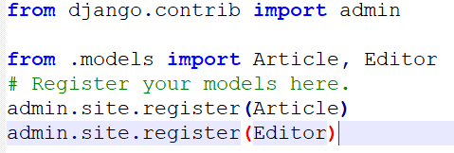
Make our app to be modifiable
Register our models in admin.py
from . models import Article, Editor
Notes:
The include() function allows referencing other URLconfs. Whenever Django encounters include(), it chops off whatever part of the URL matched up to that point and sends the remaining string to the included URLconf for further processing.

Slide 16
Finally, run our development server
python manage.py runserver
In clinet (browser), localhost:8000/admin
Enjoy!
Notes:
The include() function allows referencing other URLconfs. Whenever Django encounters include(), it chops off whatever part of the URL matched up to that point and sends the remaining string to the included URLconf for further processing.

Slide 17
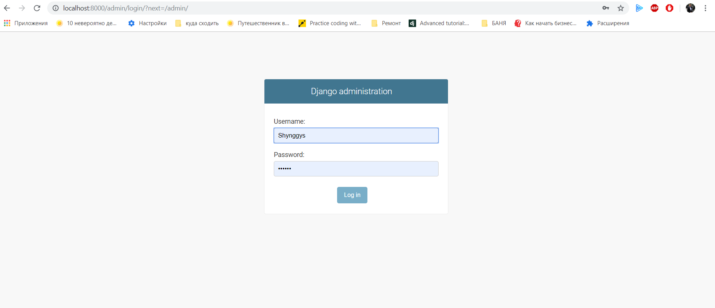
Our Admin login page
Notes:
The path() function is passed four arguments, two required: route and view, and two optional: kwargs, and name

Slide 18
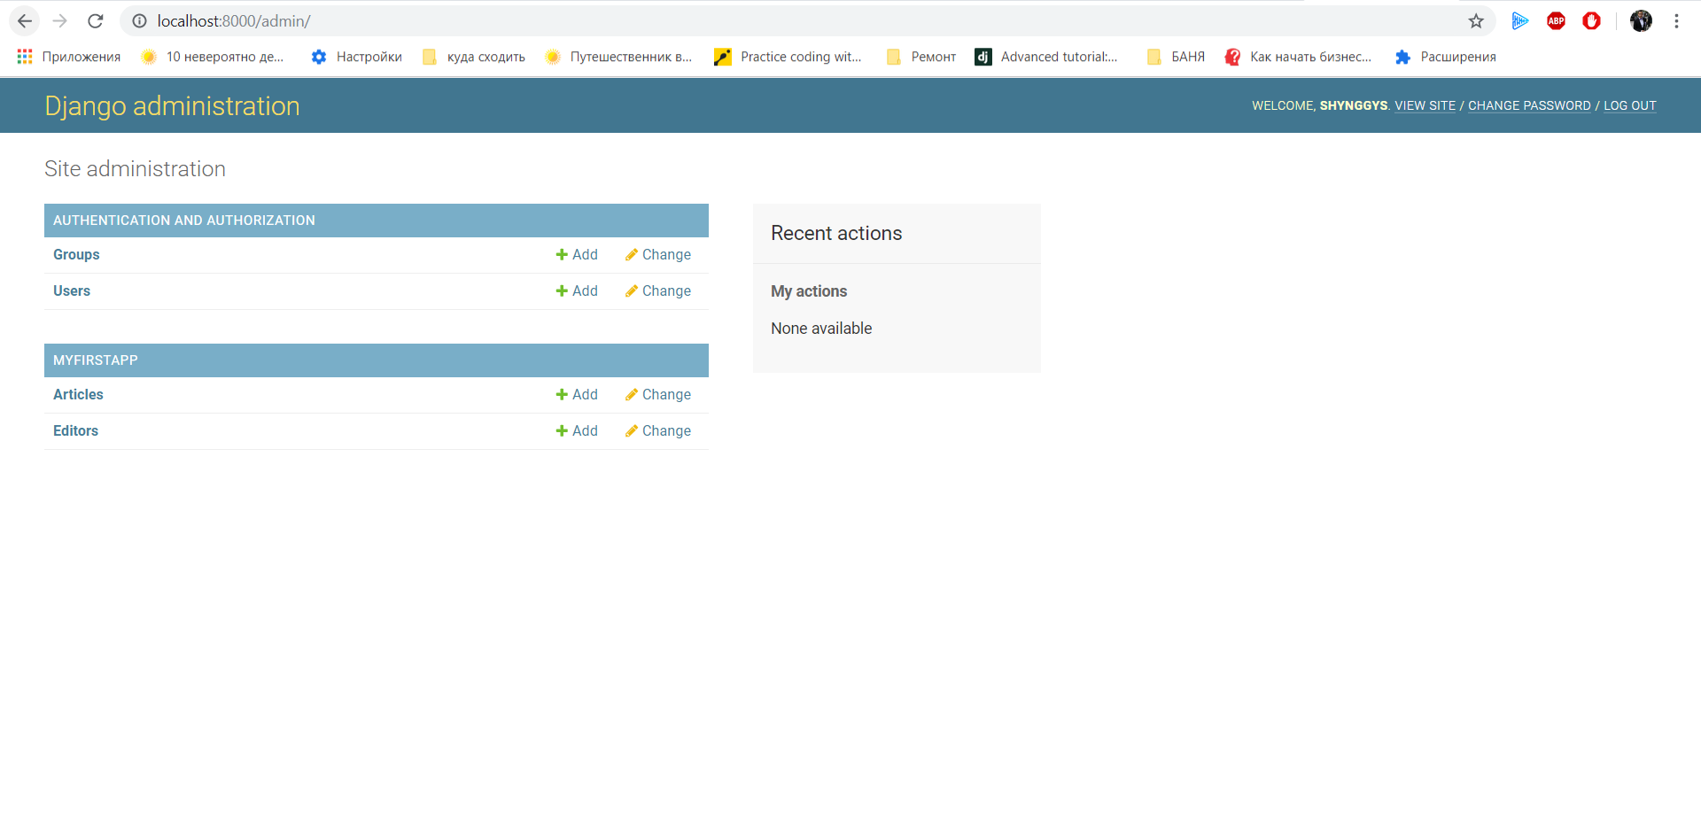
Our Admin working space
Notes:
The path() function is passed four arguments, two required: route and view, and two optional: kwargs, and name

Slide 19
Summary
Now you know more than you need to know, but the less you know the better you sleep ☺

Slide 20
Code examples
Make serious faces, please. Even if it is hard for you.

Slide 21
Thank you for your attention!
Python is still Victorious!! ☺

