Slide 1
VP_A380 Platform Quick Start
PBS

Slide 2
Agenda
A380 Hardware
VP_A380 EVB and Jumper Setting (FEVB_IP_FIE3380_VIRTUAL_PLATFORM_A380)
VP_A380 Software Package
Recommended Debug Tools
Booting Sequence
Quick Start with Linux OS

Slide 3
VP_A380 Hardware

Slide 4
A380 Overview
Processors
Dual-core ARM Cortex-A9
FA626TE
External memories supported
DDR3, SRAM, NAND/NOR Flash
SDHC/SDXC card
Connectivity
USB2.0 (host, OTG) with PHYs
SGMII, PCIe G2, SPI, I2S, I2C and UARTs
Peripherals & FPGA connections
AHB extension bus
Process
UMC 40nm LP

Slide 5
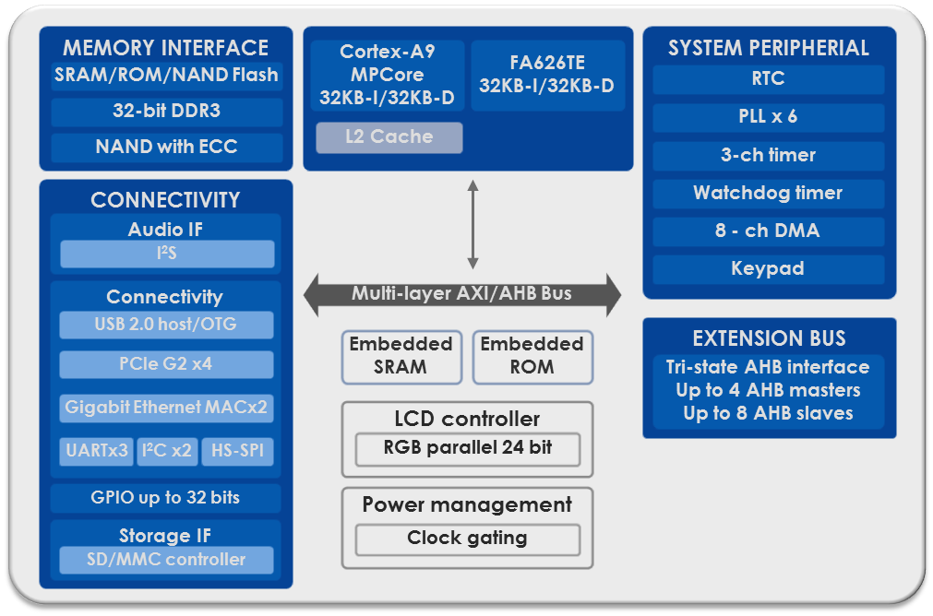
A380 Block Diagram

Slide 6
VP_A380 EVB and Jumper Setting

Slide 7
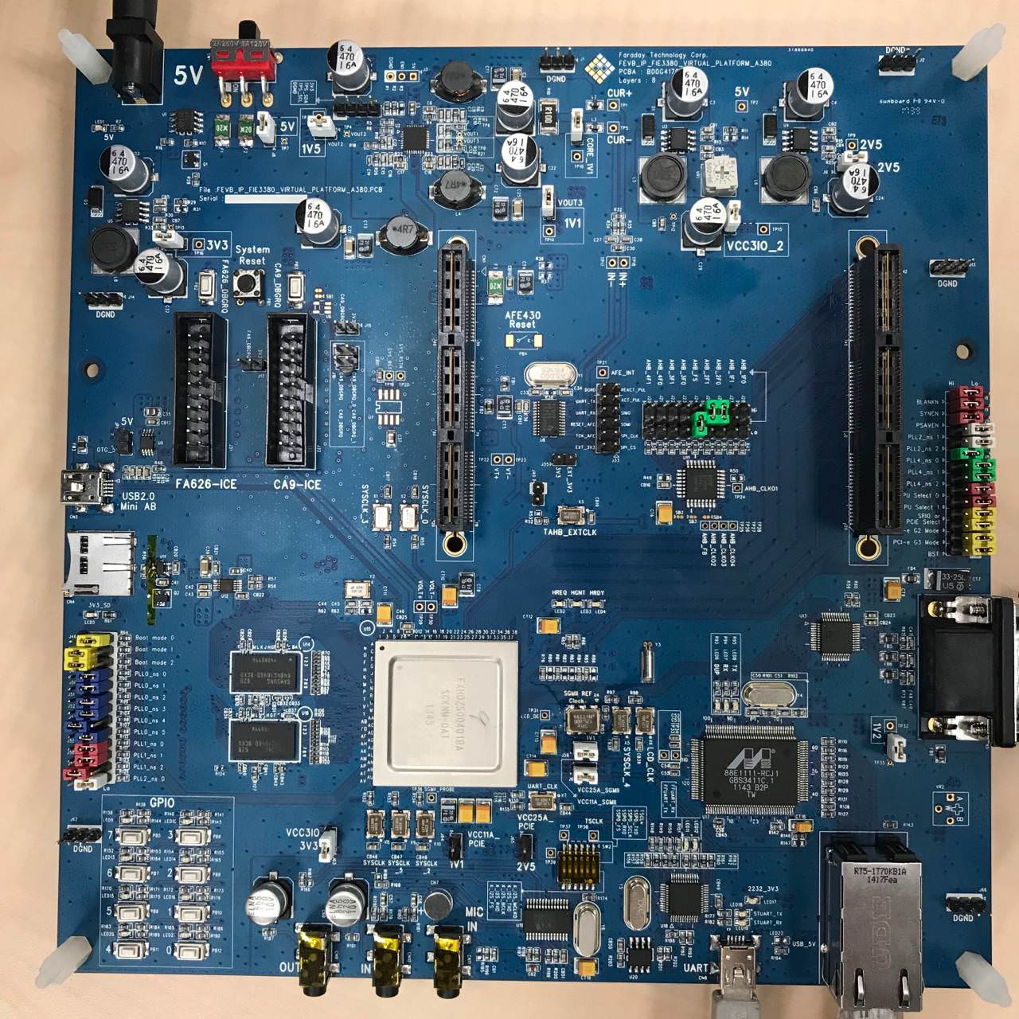
VP_A380 EVB Top View
Power Switch
DC 5V input
AHB HCLK
Skew Setting
CA9 ICE Port
FAS626 ICE Port
CPU &
PLL Setting
Micro SD Card Socket
D-SUB connector
Boot Mode &
PLL Setting
UART Console
Gigabit Ethernet

Slide 8
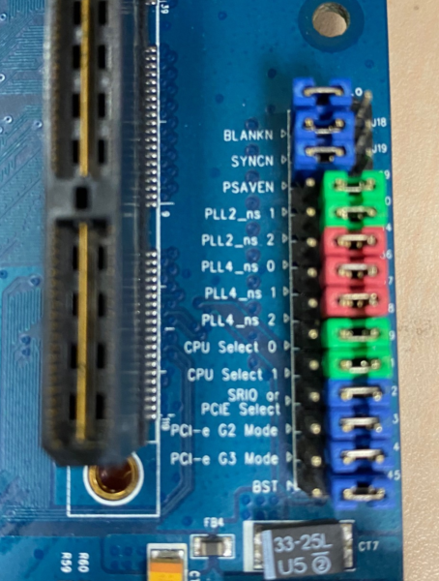
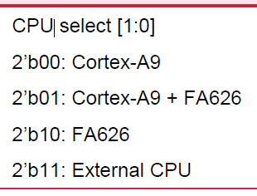
VP_A380 CA9 Jumper Setting
CPU select:
CPU_SEL[1:0] = 2’b00
Clock Setting (PLL4 jumper)
PLL4_NS[2:0] = 3’b000

Slide 9
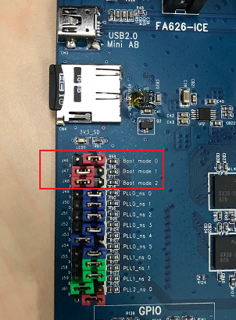
VP_A380 Boot mode Setting
Use Manual mode
{J48, J47, J46} = Boot_mode[2:0] = 3’b110

Slide 10
VP_A380 Software Package

Slide 11
Software Package Contents
Document
A380 Hardware datasheet
FIE3380 Linux User Guide
FIE3380_VP_EVB User Guide
Software Packages
CVD script & SPL
VP_A380.cmm
Boot.bin
Toolchain
arm-linux-gnueabi-gcc (Ubuntu/Linaro 7.5.0-3ubuntu1~18.04) 7.5.0
U-boot source code
U-boot.tar.gz
Linux source code
Linux.tar.gz
Images(Prebuilt mages)
Bootloader/u-boot/zImage_dtb

Slide 12
Recommended Debug Tools

Slide 13
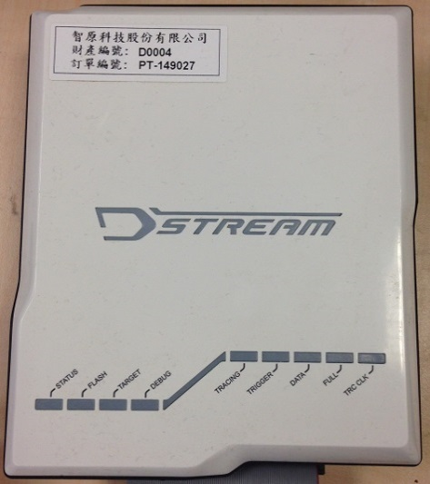
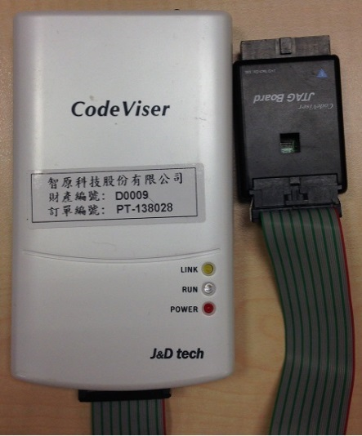
Recommended ICE and Debugger
Debugger : ARM DS
ICE : ARM D-Stream
(http://ds.arm.com)
Debugger : JnD CVD
ICE : CodeViser
(http://jndtech.com/main/)
Recommended: Use JnD CVD ICE

Slide 14
Booting Sequence

Slide 15
VP_A380’s Booting Sequence
emROM Code
(IPL)
nonos
Boot mode
: From ICE
SPL
DDR init
OS
u-boot
zImage
3’b110
VP_A380.cmm
Booting Mode Setting
J48,47,46

Slide 16
Quick Start with Linux OS

Slide 17
Getting Started Guide with Linux OS
Refer to FIE3380_Linux_User_Guide.pdf

Slide 18
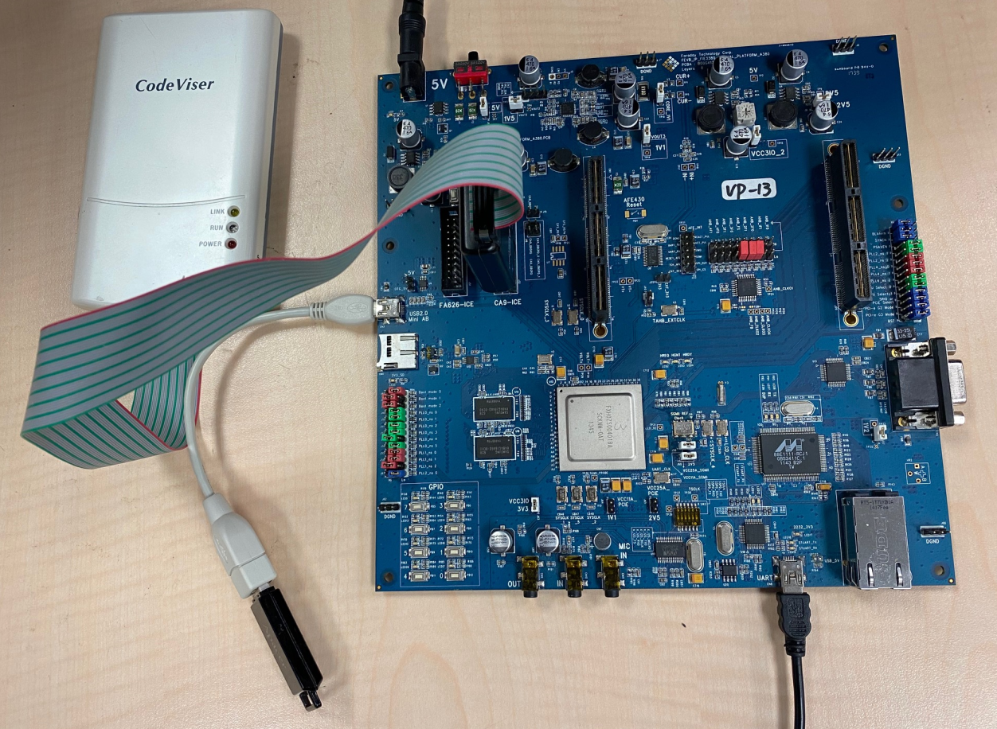
Pre-Work for Running Linux
②
USB-to-Serial Cable
DC-5V Power Adapter
ICE for CA9
USB miniA to StdA
USB pen drive
③
④
⑤
①

Slide 19
How to Compile U-boot
Install GCC tool chain
Install from Ubuntu 18.04:
# sudo apt update
# sudo apt install gcc-arm-linux-gnueabi
Compilation procedures
Step1: Unpack the file “U-boot.tar.gz”
Step2: Build code
# make a380_defconfig;make CROSS_COMPILE=arm-linux-gnueabi-
U-boot.bin Image will be placed at “$TOP_DIR/”

Slide 20
How to Compile Linux (1/2)
Install GCC tool chain
Install from Ubuntu 18.04:
# sudo apt update
# sudo apt install gcc-arm-linux-gnueabi
Compilation procedures
Step1(just run once): Load the default CPU/memory/IP test settings
# make a380_defconfig
Step2: Customize the test items by using the configuration system
# make menuconfig

Slide 21

How to Compile Linux (1/2)
Compilation procedures
Step3(just run once): Add Ram disk Path to kernel
Untar the rootfs.gz to some folder
# make menuconfig
Enter General setup
Enter filesystem path
Step4: Build code
# make a380_defconfig;make ARCH=arm CROSS_COMPILE=arm-linux-gnueabi-
# cat arch/arm/boot/zImage arch/arm/boot/dts/faraday-a380.dtb> zImage_dtb
Linux zImage_dtb will be placed at “$TOP_DIR/arch/arm/boot”

Slide 22
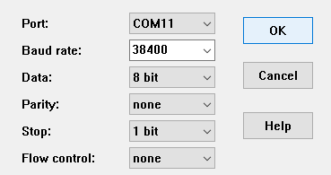
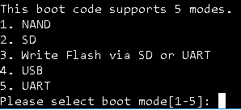
Run Linux – Using ICE Script to Load Linux Image
Step1 : Serial Port parameter setting
on your computer
Step2: Turn on the VP_A380 EVB power,
you will see right screen, please don’t
chose any number.
Step3 : Execute CVD IDE(Depend on debugger tool used)

Slide 23


Run Linux – CVD usage
Step4 : Open “Run Script File” and program will be executed
VP_A380.cmm is placed in ICE_script\
Step5: Start to download U-boot & Linux Image
After downloading Linux Image, U-boot is running
See next page
Note : Before run script file, please modify image path in the script file : zImage_dtb,u-boot.bin,boot.bin

Slide 24
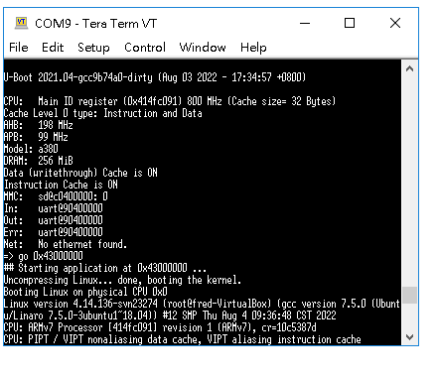
U-boot booting
Step6: Enter go command to boot Linux
# go 0x43000000

Slide 25
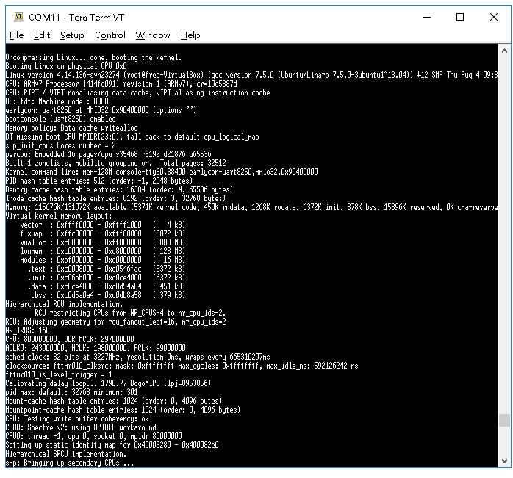
Linux Booting

Slide 26
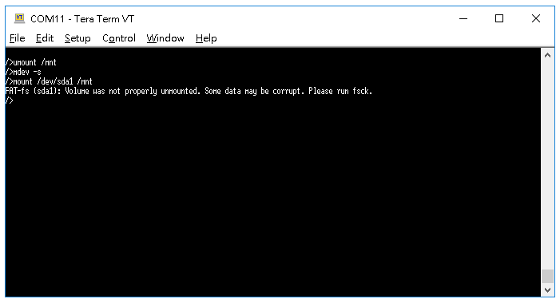
USB Disk mounting

Slide 27
Confidential information
The material is being disclosed to you pursuant to a non-disclosure agreement between you or your employer and Faraday. Information disclosed in this presentation may be used only as permitted under such an agreement.
Legal notice
The information contained in this presentation is intended to provide a general guide as to which product is suited for a given requirement and shows suggested product applications. Specified functions and properties for products are only valid when handling instructions and other stated conditions and recommendations have been considered and followed. All descriptions, illustrations and dimensions in the information represent general particulars and do not form part of any contract. All information is provided “as is”, with no guarantee of completeness, accuracy, timeliness or of the results obtained from the use of the information, and without warranty of any kind, express or implied, including but not limited to warranties of performance. All information is subject to change without prior notice. Faraday assumes no responsibility whatsoever for any errors or inaccuracies about the information.

