Slide 1
Evaluating Randomization Efficiency: Advanced Bioinformatics and AI Approaches for Genome-Wide Prediction of Non-Coding RNA Structures

Slide 2
Table of contents
What is RNA and ncRNA ?
Aim of the master thesis
Pipeline & Tools
Results
What AI Tool?

Slide 3
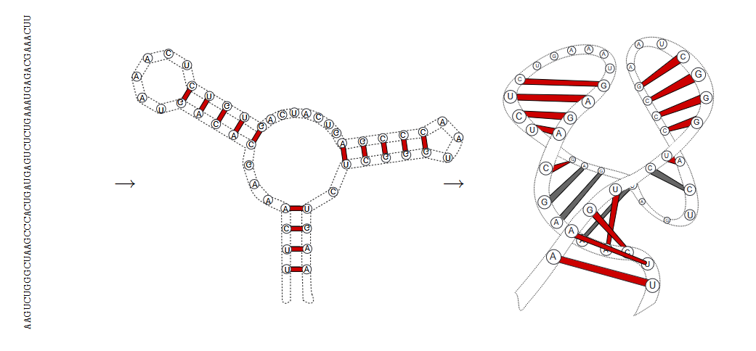
What is RNA?
Notes:
Transport Genetic information
Single Stranded
Examples like mRNA and tRNA
Bases like DNA but have Uracil for Thymin

Slide 4
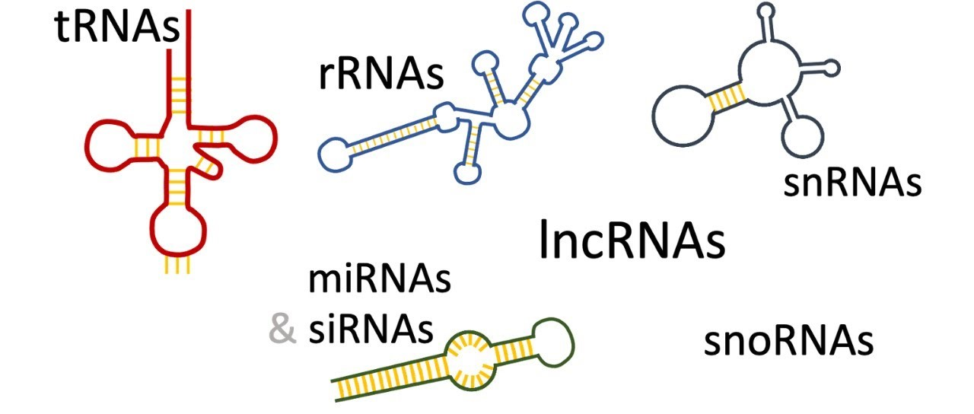
What are non-coding RNAs?
Notes:
Not code for Proteins
are responsible for the development of cancer
Examples:
microRNA
Inhibit translation of mRNAs or promote their degradation
Long non-coding RNA
all above 200 Nucleotides
Involved in cancer, neurologic disease
Small interfering RNA
Double stranded RNA Molecules (ca. 20–25 Nukleotide)
Bind on mRNA and degrade

Slide 5
Aim of the master thesis
Performance, efficiency, and accuracy:
SISSIz (simulation) vs. Multiperm/aln-shuffle (shuffling).
✓
Difference between SISSIz/RNAz.
Can AI methods outperform SISSIz/RNAz?
Can SISSI/SISSIz generate suitable negative training data for AI methods?
Randomized
~
Prediction
O
Notes:
Performance of the randomisation/simulation and shuffling
Comparison of Prediction Tools
AI vs other Tools
Generate training data for AI
Difference between real and randomized Data
What differences were identified in the analysis of data from randomized trials compared to real data?

Slide 6
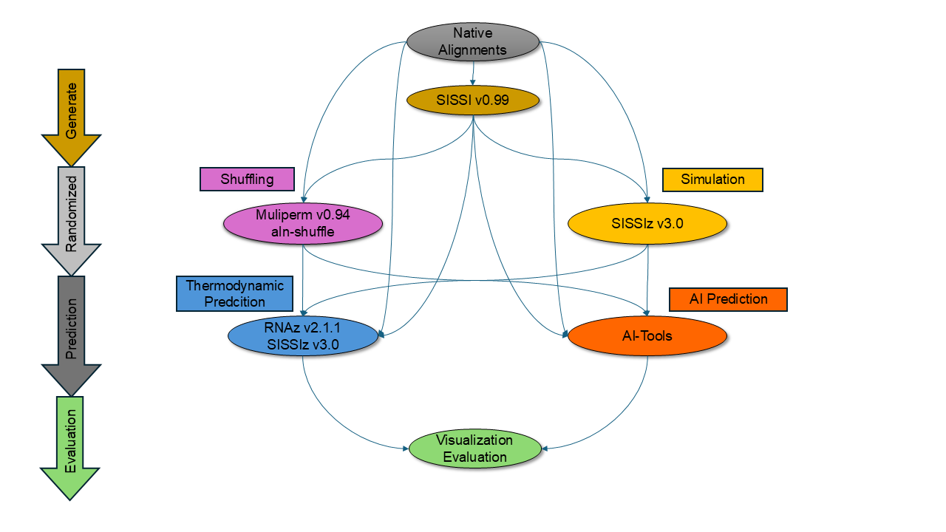
Pipeline
Notes:
First:
Generate positive Samples with SISSI
destroy RNA structure with simulation and shuffling
Predict if RNA structure was not destroyed
Visualization and Evaluation with Python
Second:
Find native Alignments and destroy the RNA structure with simulation and shuffling → skip SISSI
Predict if RNA structure was not destroyed
Visualization and Evaluation with Python

Slide 7
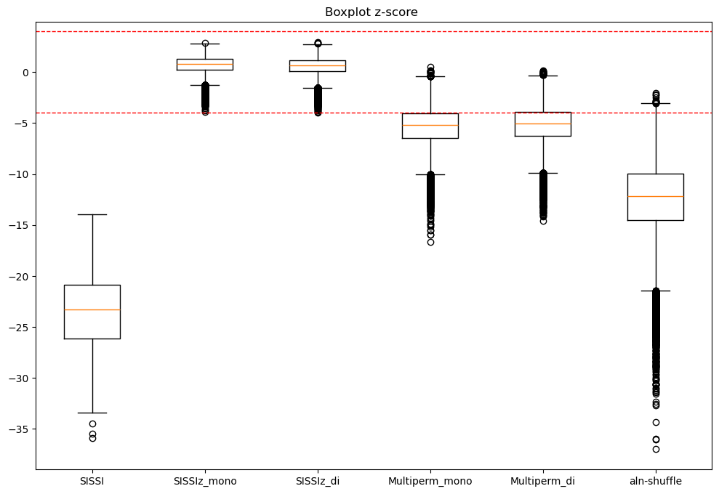
SISSIz Prediction

Slide 8
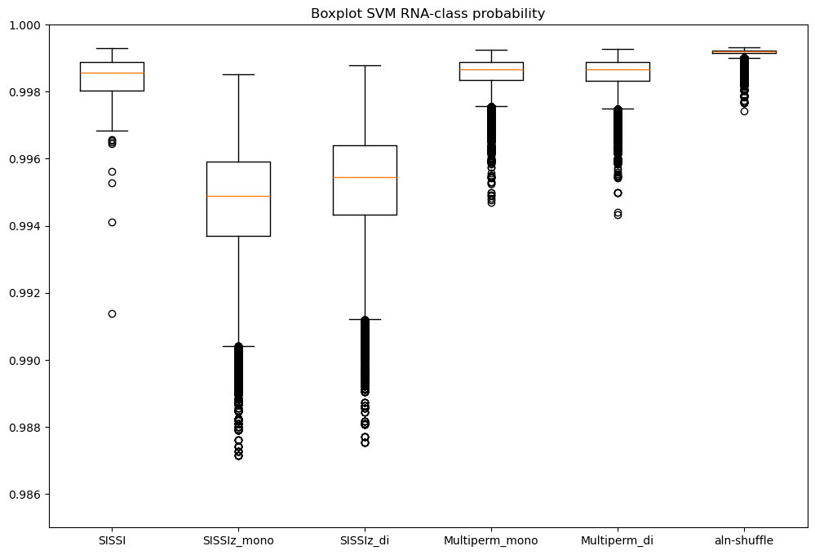
RNAz Prediction

Slide 9
Conclusion: First Results
Simulation more efficient than shuffling
Working on Prediction

Slide 10
Next Steps: AI Tools?
DeepFoldRNA
SPOT-RNA2

Slide 11
Server Condition
Operating system: Linux
Programms: Python, TenserFlow/PyTorch, CUDA, Biopython, Numpy
CPU: 16
RAM: 64-128
GPU: NVIDIA A100 80GB
Space: 1TB

Slide 12
End of Presentation
THANK YOU FOR YOUR ATTENTION
Notes:
Performance of the randomisation/simulation and shuffling
Comparison of Prediction Tools
AI vs other Tools
Generate training data for AI
Difference between real and randomized Data
What differences were identified in the analysis of data from randomized trials compared to real data?

Slide 13
Appendix

Slide 14
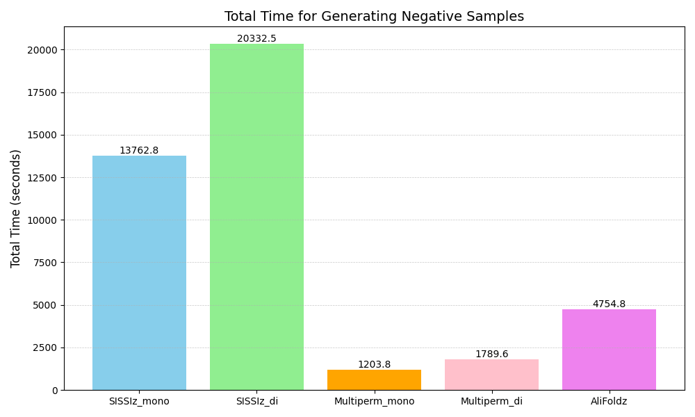
Total Time to generating negative samples

Slide 15
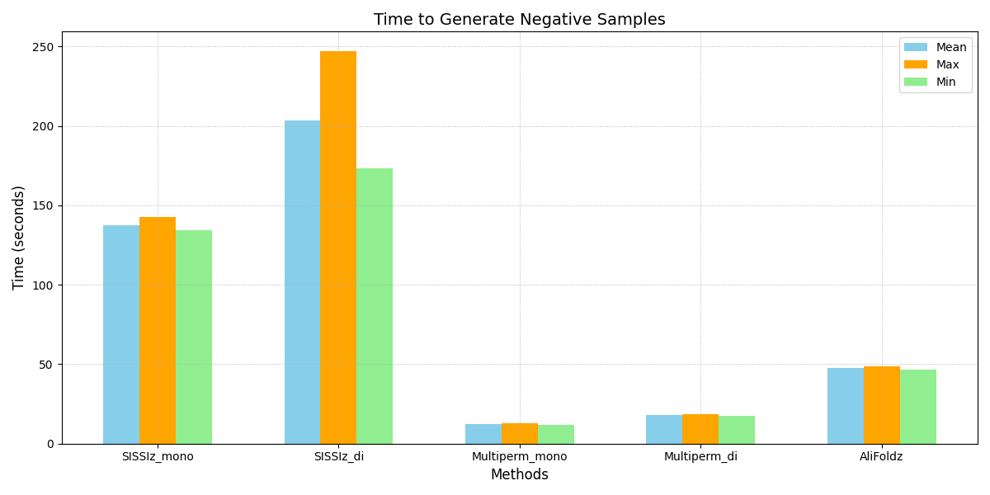
Time to generating negative samples

Slide 16
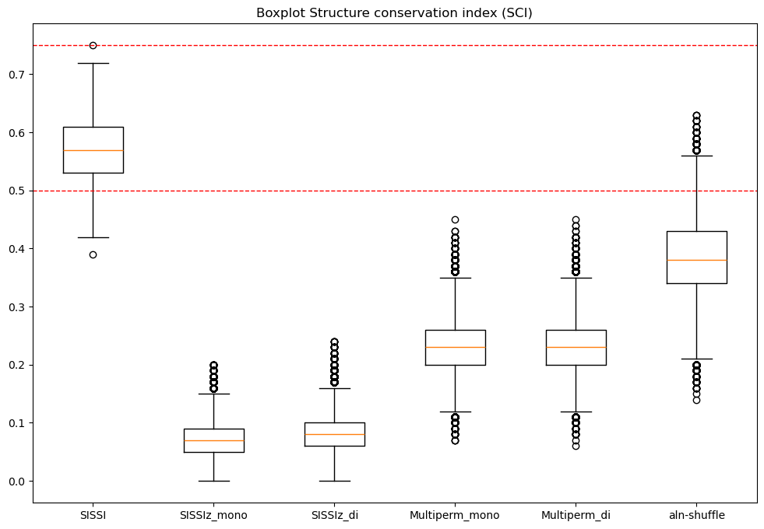
RNAz SCI

Slide 17
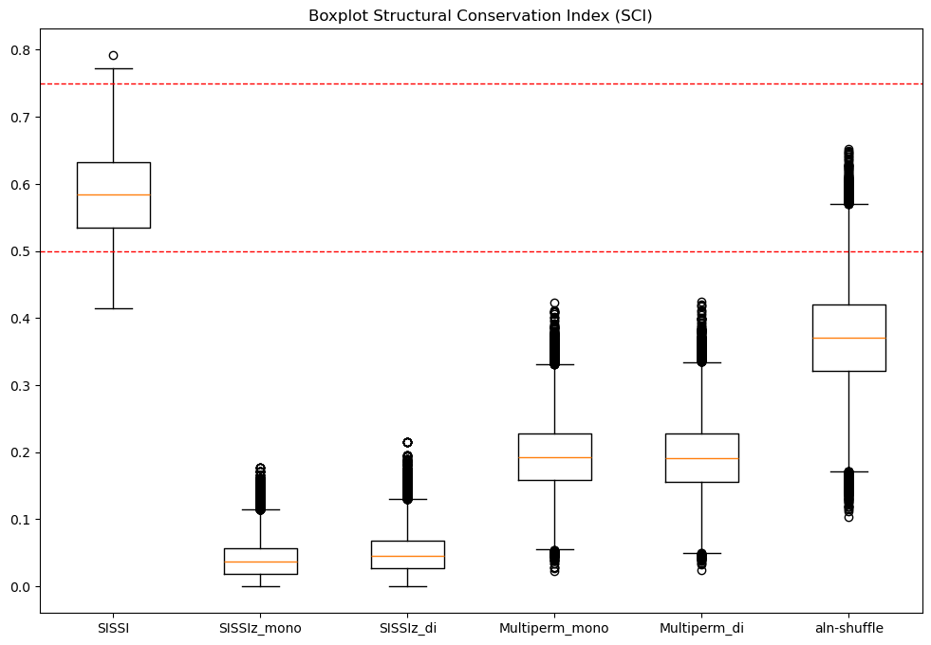
SISSIz SCI

