Slide 1
AUTOMATION TESTING PROJECT
Toolshop
E-Commerce Platform
Testing & Quality Assurance
Farah Saleem • Ahmad Basheer • Monira • Hassan
May 2026 | Version 1.0

Slide 2
0:00–2:30
Project Overview
What We Tested
Team & Roles
Application: Toolshop — a realistic Angular e-commerce sandbox at practicesoftwaretesting.com Modules in Scope:
• User Registration & Authentication
• Product Search & Catalog Filtering
• Cart Item Management & Price Totals
Out of Scope:
• Performance, Load & Stress Testing
• Security & Penetration Testing
• CI/CD Pipeline & Payment Gateways
Farah Saleem
1
Test Lead, Framework & Security
2
Ahmad Basheer
Co-Lead, All Modules Support
3
Monera AlMashni
Catalog & Search (Module 1)
4
Hassan
Product & Cart (Module 2)

Slide 3
Test Plan Highlights
UI
UI Testing
FA
Functional Automation
Explore system, discover edge-case bugs, validate form inputs & UI layout vs SRS.
Selenium WebDriver end-to-end execution across all 3 modules.
NG
Negative Testing
RG
Regression Testing
Invalid logins, missing form fields — error message verification automated.
Full TestNG suite re-run after every code merge to prevent breakage.

Slide 4
Requirements & Modules
SRS defines 3 core modules — each mapped to test cases in the RTM
M1 — Catalog & Search
M2 — Product Details & Cart
M3 — User Account Management
M1-FR-01 – M1-FR-23 (23 requirements)
M2-FR-01 – M2-FR-15 (15 requirements)
M3-FR-01 – M3-FR-22 (22 requirements)
Home page product grid loads
Product image display & thumbnail carousel
Registration with full field validation
Dynamic keyword & partial-match search
Quantity selector (min 1, non-numeric rejected)
Login / Logout flows & session clearing
Category, brand & multi-filter combinations
Add to Cart with correct count & badge update
Duplicate email & weak password rejection
Sort by Name A–Z / Z–A, Price Low–High / High–Low
Toast/confirmation on cart action
Profile view, edit & password change
Pagination: Next / Previous / jump to page
Out-of-stock → Add to Cart disabled
Protected route redirect after logout

Slide 5
M1 — Catalog & Search
Data Grid Verification
Query Mapping
Case Insensitivity Handling
Partial String Matching
Numeric Inputs.
Empty Space Safeguards .
Pagination Boundary Rules

Slide 6
M2 — Product Details & Cart
Quantity Adjustment Checks
Zero/Negative Quantity Guard
Bulk Cart Loading
Cart Badge Reactivity

Slide 7
M3 — User Account Management
UI Matrix Completeness
Blank Submission Errors
Profile Input Sanitization.
Email Format Constraints
Credential Logic Matrix.
Duplicate Entry Protections
Password Modification Safeguards.
Future Date Limits
Password Complexity Rules
Historical Integrity Checks

Slide 8
Automation Framework Architecture
TestNG
Project Structure
Test Runner — assertions, sequencing, report generation
📁 src/main/java
Selenium WebDriver
└─ Page Object Classes
Browser automation — Chrome driver, element interactions
└─ Locators & Actions
Page Object Model (POM)
📁 src/test/java
Locators in src/main/java — separate from test logic
└─ TestNG Test Classes
└─ Assertions & Logic
Maven + pom.xml
Dependency management — Selenium, TestNG auto-downloaded
📄 pom.xml
└─ All dependencies
Java JDK 11+
Language — Eclipse IDE, M2E plugin, GitHub push
📄 testng.xml
└─ Suite runner config

Slide 9
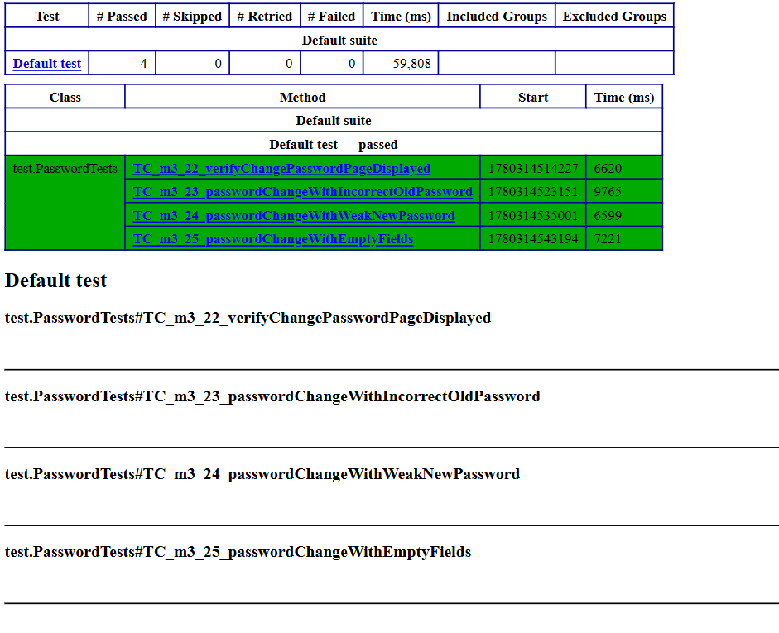
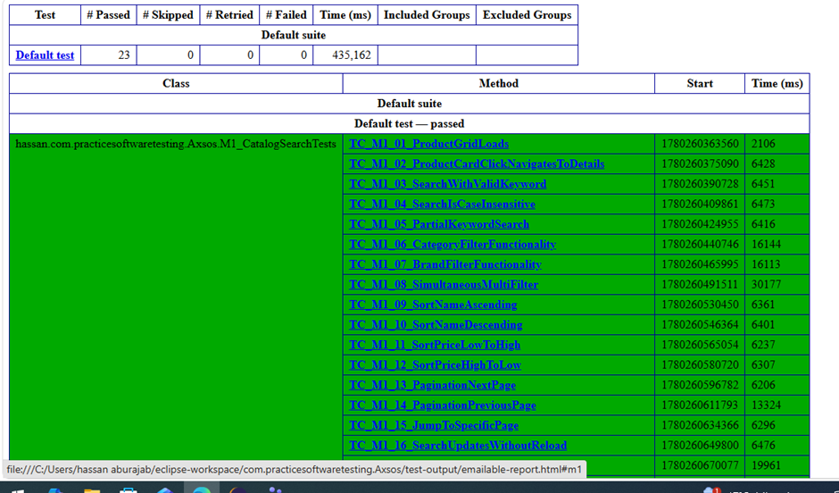
Summary Report

Slide 10
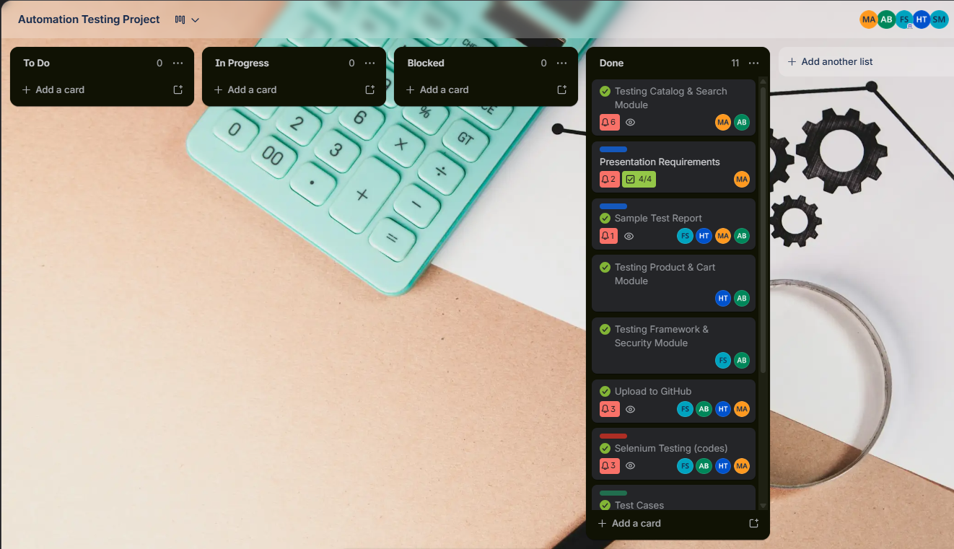
Trello

Slide 11
Test Cases & RTM Coverage
63
61
2
0
Total Test Cases
Passed (97%)
Blocked
Failed
TC ID
Module
Test Summary
Status
TC_M1_01
Catalog & Search
Verify product grid loads on home page
Passed
TC_M1_06
Catalog & Search
Verify Category filter functionality
Passed
TC_M1_08
Catalog & Search
Verify simultaneous multi-filter
Passed
TC_m2_10
Product & Cart
Verify adding default quantity to cart
Passed
TC_m2_02
Product & Cart
Verify image thumbnails/carousel is interactive
Blocked
TC_m3_10
Framework & Sec
Successful Authentication — valid login
Passed
TC_m3_15
Framework & Sec
Post-Logout browser back navigation blocked
Passed

Slide 12
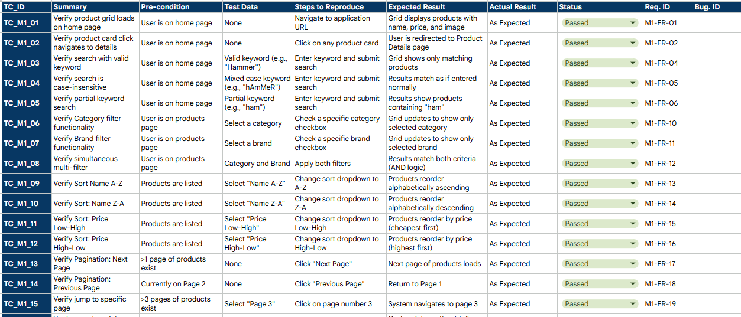
Test Cases Sample

Slide 13
RTM Alignment & Blocked Cases
Requirements Traceability Matrix
Module
Req Range
TCs Mapped
Status
Catalog & Search
M1-FR-01–23
23 TCs
✓ Done
Product Details
M2-FR-01–15
15 TCs
✓ Done
User Account
M3-FR-01–22
25 TCs
✓ Done

Slide 14
Test Results & Deliverables
97%
SRS Document
Full functional requirements across all 3 modules
Test Plan v1.0
Strategy, scope, environment & pass/fail criteria
Overall Pass Rate
RTM
61 passed | 2 blocked | 0 failed
All requirements traced to test cases — 100% mapped
Java/Selenium Source
POM-based code pushed to GitHub, runnable via testng.xml
Test Summary Report
Results documented with screenshots & recommendations

Slide 15
Conclusion & Next Steps
The Toolshop platform performed well across all tested functional areas. Core user flows — product discovery, cart management, and account security — all function correctly under positive and negative conditions.
All Exit Criteria Met
2 Blocked — Not Failed
Recommended Next Steps
100% of core RTM cases automated in Java
TC_m2_02 & TC_m2_03 blocked by environment
Seed test env with multi-image product
Suite runs fully in Eclipse via testng.xml
Root cause: no multi-image product in test data
Expand to Checkout & Payment flow (next phase)
All bugs documented with reproducible steps
Code logic is correct — environment fix needed
Consider CI/CD pipeline integration for regression
Thank you • practicesoftwaretesting.com • Farah Saleem | Ahmad Basheer | Monira | Hassan • May 2026

Slide 16
Thank you for listening

