Slide 1

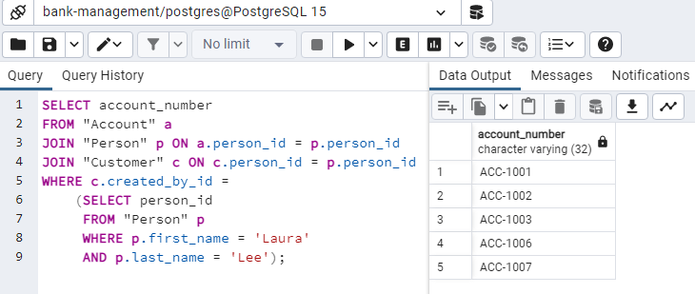
Step Five : Related Queries
Account number of all accounts opened by Laura Lee

Slide 2
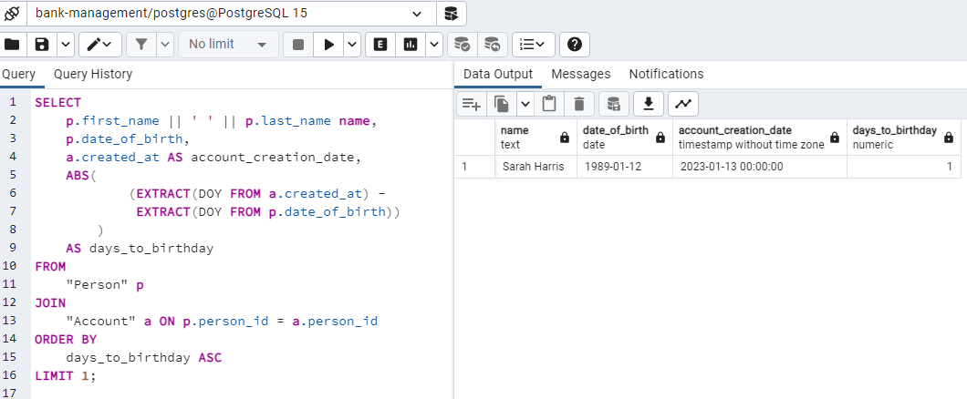
Step Five : Related Queries cont.
Find a person who created an account very close to or on the same day as their birthday

Slide 3
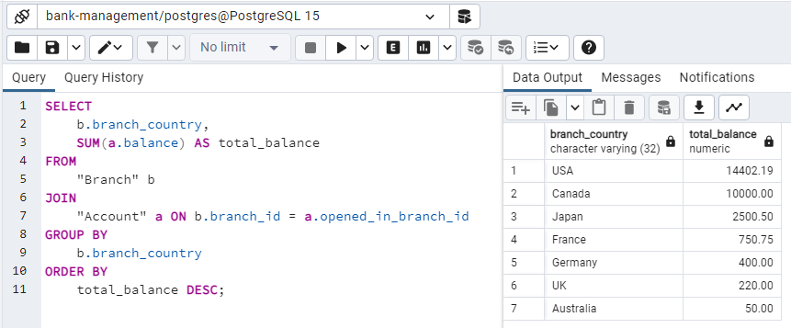
Step Five : Related Queries cont.
Find out which country has the highest total account balance by grouping accounts by countries

Slide 4
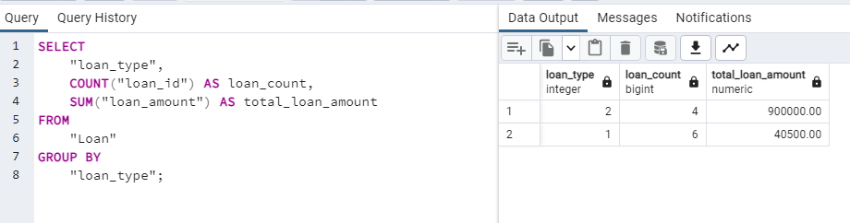
Step Five : Related Queries cont.
Find the number of loans taken and the total loan amount by loan type

Slide 5
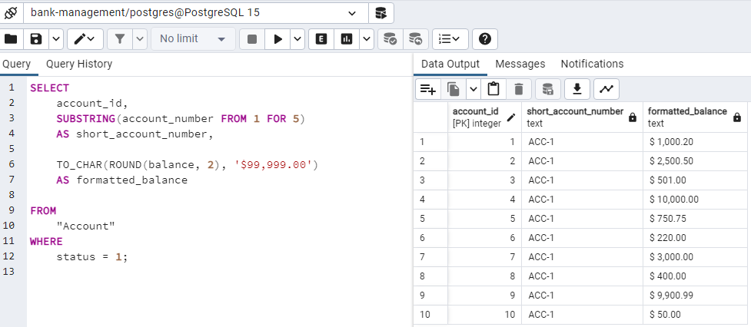
Step Five : Related Queries cont.
List the shortened version of the account number (first 5 characters), and the formatted balance of all active accounts.

Slide 6
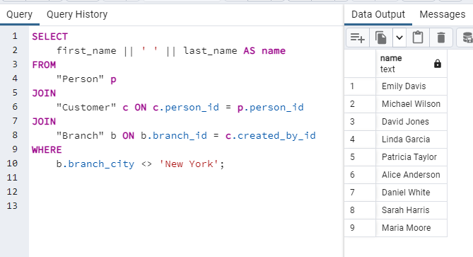
Step Five : Related Queries cont.
List the name of all customers who haven't opened account in New York

Slide 7
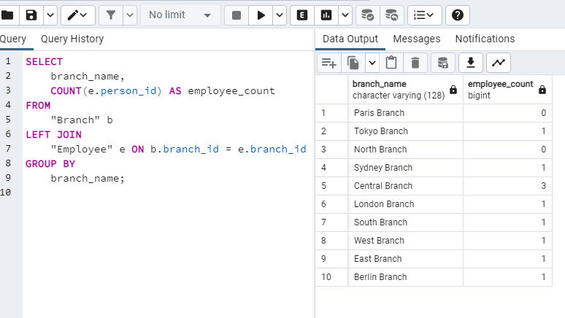
Step Five : Related Queries cont.
List all branches with the number of employees in each branch

Slide 8
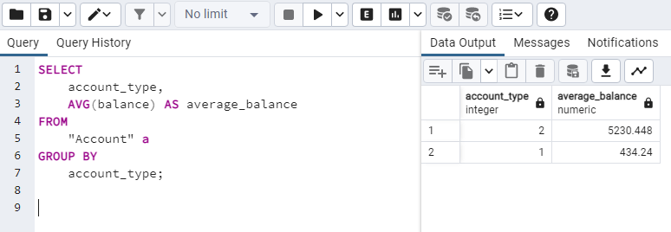
Step Five : Related Queries cont.
Calculate the average account balance by account type

Slide 9
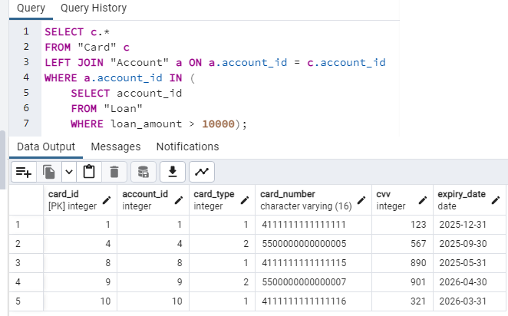
Step Five : Related Queries cont.
List card information of all customers with an outstanding loan above 10000

Slide 10
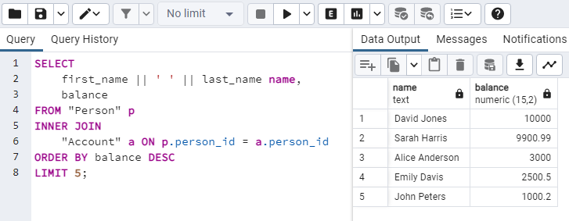
Step Five : Related Queries cont.
Find the top 5 customers with the highest account balances

Slide 11
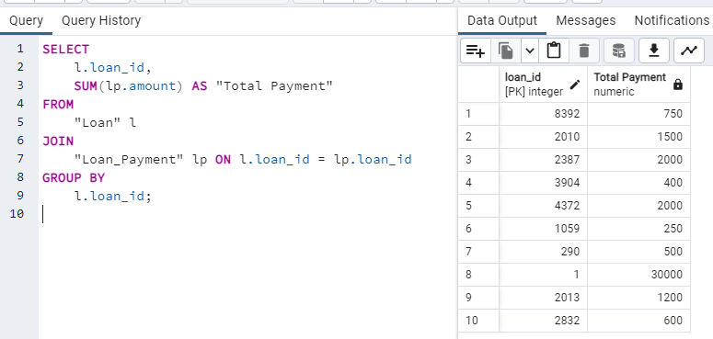
Step Five : Related Queries cont.
Display the total loan payments made for each loan.

Slide 12
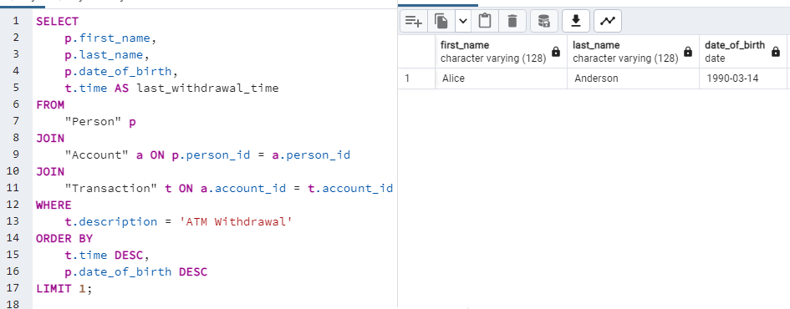
Step Five : Related Queries cont.
Find the last transaction of youngest person who withdrew money from an ATM

Slide 13
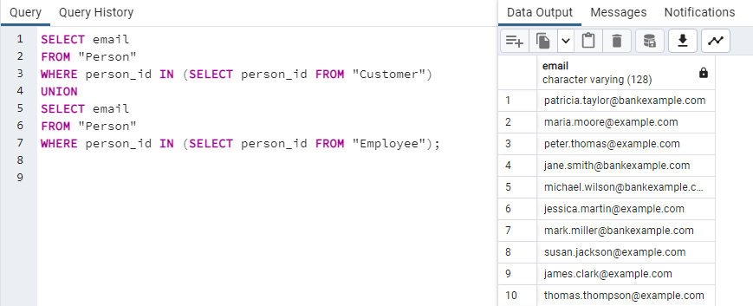
Step Five : Related Queries cont.
Combine Customers and Employees' Emails

Slide 14
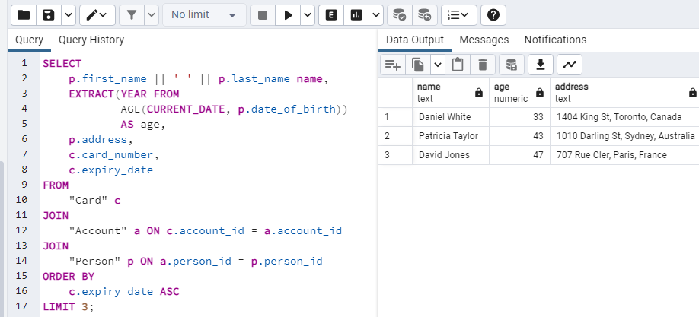
Step Five : Related Queries cont.
Find the name, age, and address of cardholders for the three cards expiring soonest

Slide 15
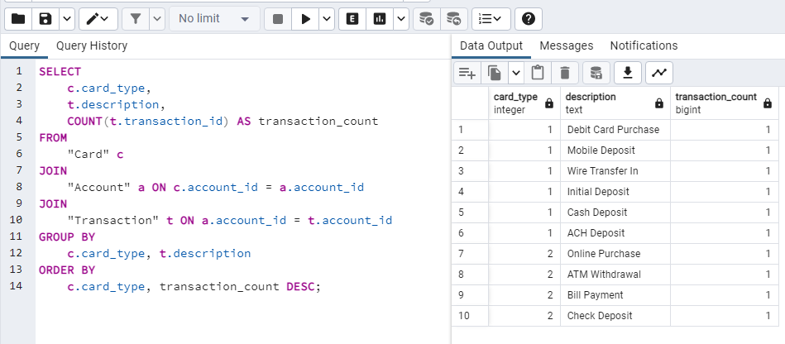
Step Five : Related Queries cont.
Group cards by their type and finds the most common transaction type for each card type

