Slide 1

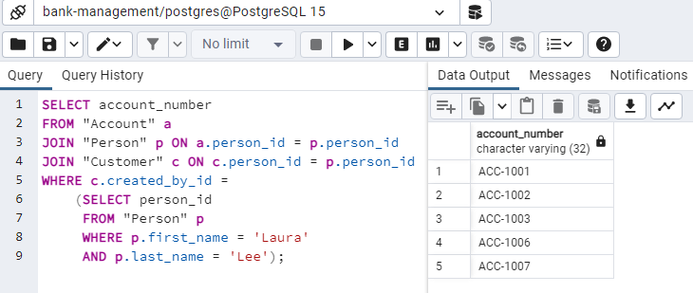
Step Five : Related Queries
Account number of all accounts opened by Laura Lee

Slide 2
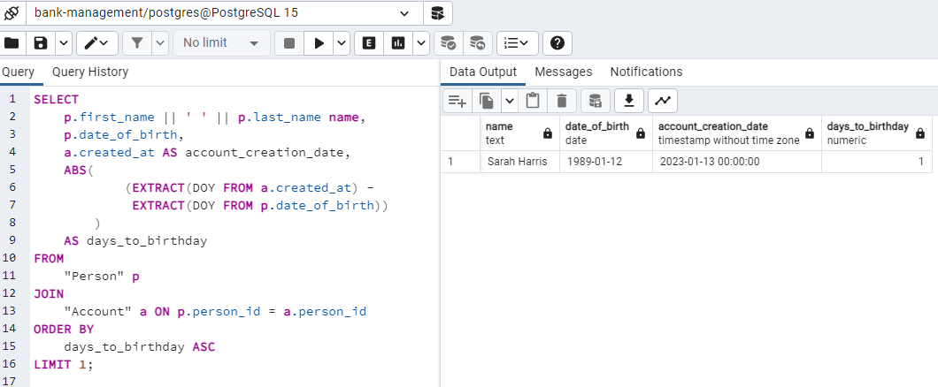
Step Five : Related Queries cont.
Find a person who created an account very close to or on the same day as their birthday

Slide 3
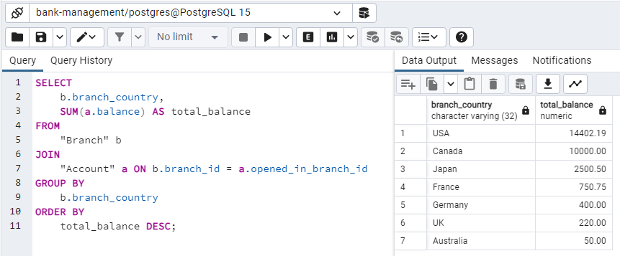
Step Five : Related Queries cont.
Find out which country has the highest total account balance by grouping accounts by countries

Slide 4
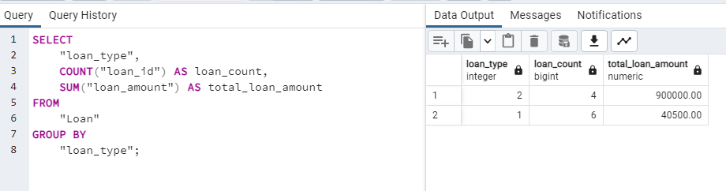
Step Five : Related Queries cont.
Find the number of loans taken and the total loan amount by loan type

Slide 5
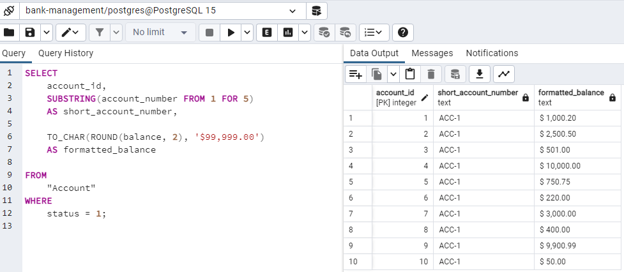
Step Five : Related Queries cont.
List the shortened version of the account number (first 5 characters), and the formatted balance of all active accounts.

