Slide 1







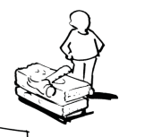
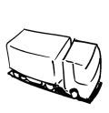


Business Model Canvas
Key Partners | Key Activities | Value Propositions |  | Customer Relationships | Customer Segments
 | Key Resources |  |  | Channels
Cost Structure |  |  | Revenue Streams
http://www.businessmodelgeneration.com
Develop softwer
Marketing
Win bids
Contract partners
Personal meetings
Web
Hotphone
Exibitions
Develop projects
Save energy
Maintenance
Reduction of CO2 emissions
Reduce light pollution
Economical advantageos opportunity to light dark streets
Municipalities
Privates indirect: citizens
Sensor suppliers
Lamps supply
Installation company
Maintenance company
Software
Salesman
HRs
B2B (direct sales)
Software develop/maint
Salesman
Salary
Subcontracts
Project (if not contracted)
Installation
Maintenance
Notes:
(*): COGS: Cost of Good Sold (Includes all manufacturing costs)

Slide 2
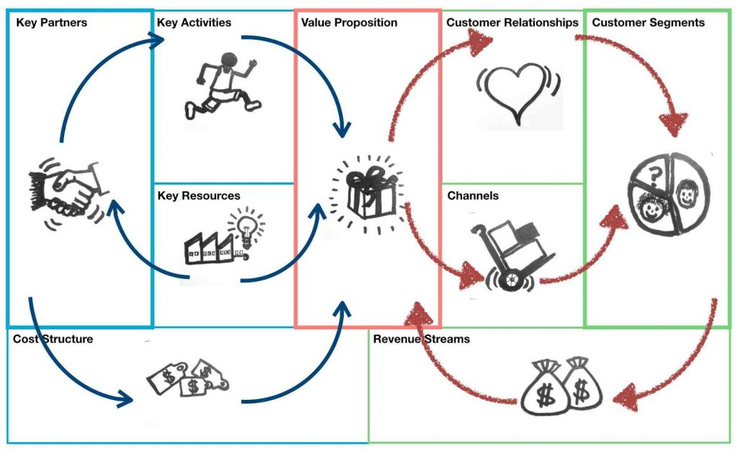
Business Model Canvas
7
2
1
5
4
6
3
9
8

