Slide 1
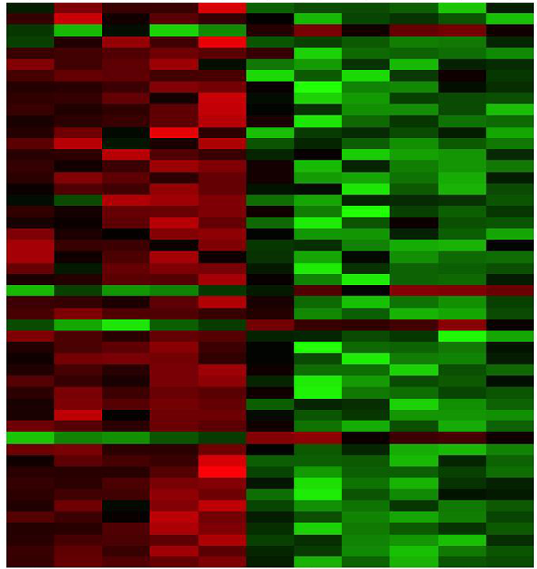

RNA-seq differential expression analysis part 2 Egypt Scholars
Mariam Oweda Kamel
Nile University, Egypt
10/7/2020
“DAR Weekly Webinar”

Slide 2
Outlines
Differential expression general workflow
Sources of variability in RNA-seq data
data normalization
Statistical hypothesis testing
Multiple Hypothesis Testing
Implementation of RNA-seq differential expression using r manually

Slide 3

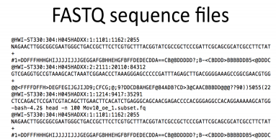
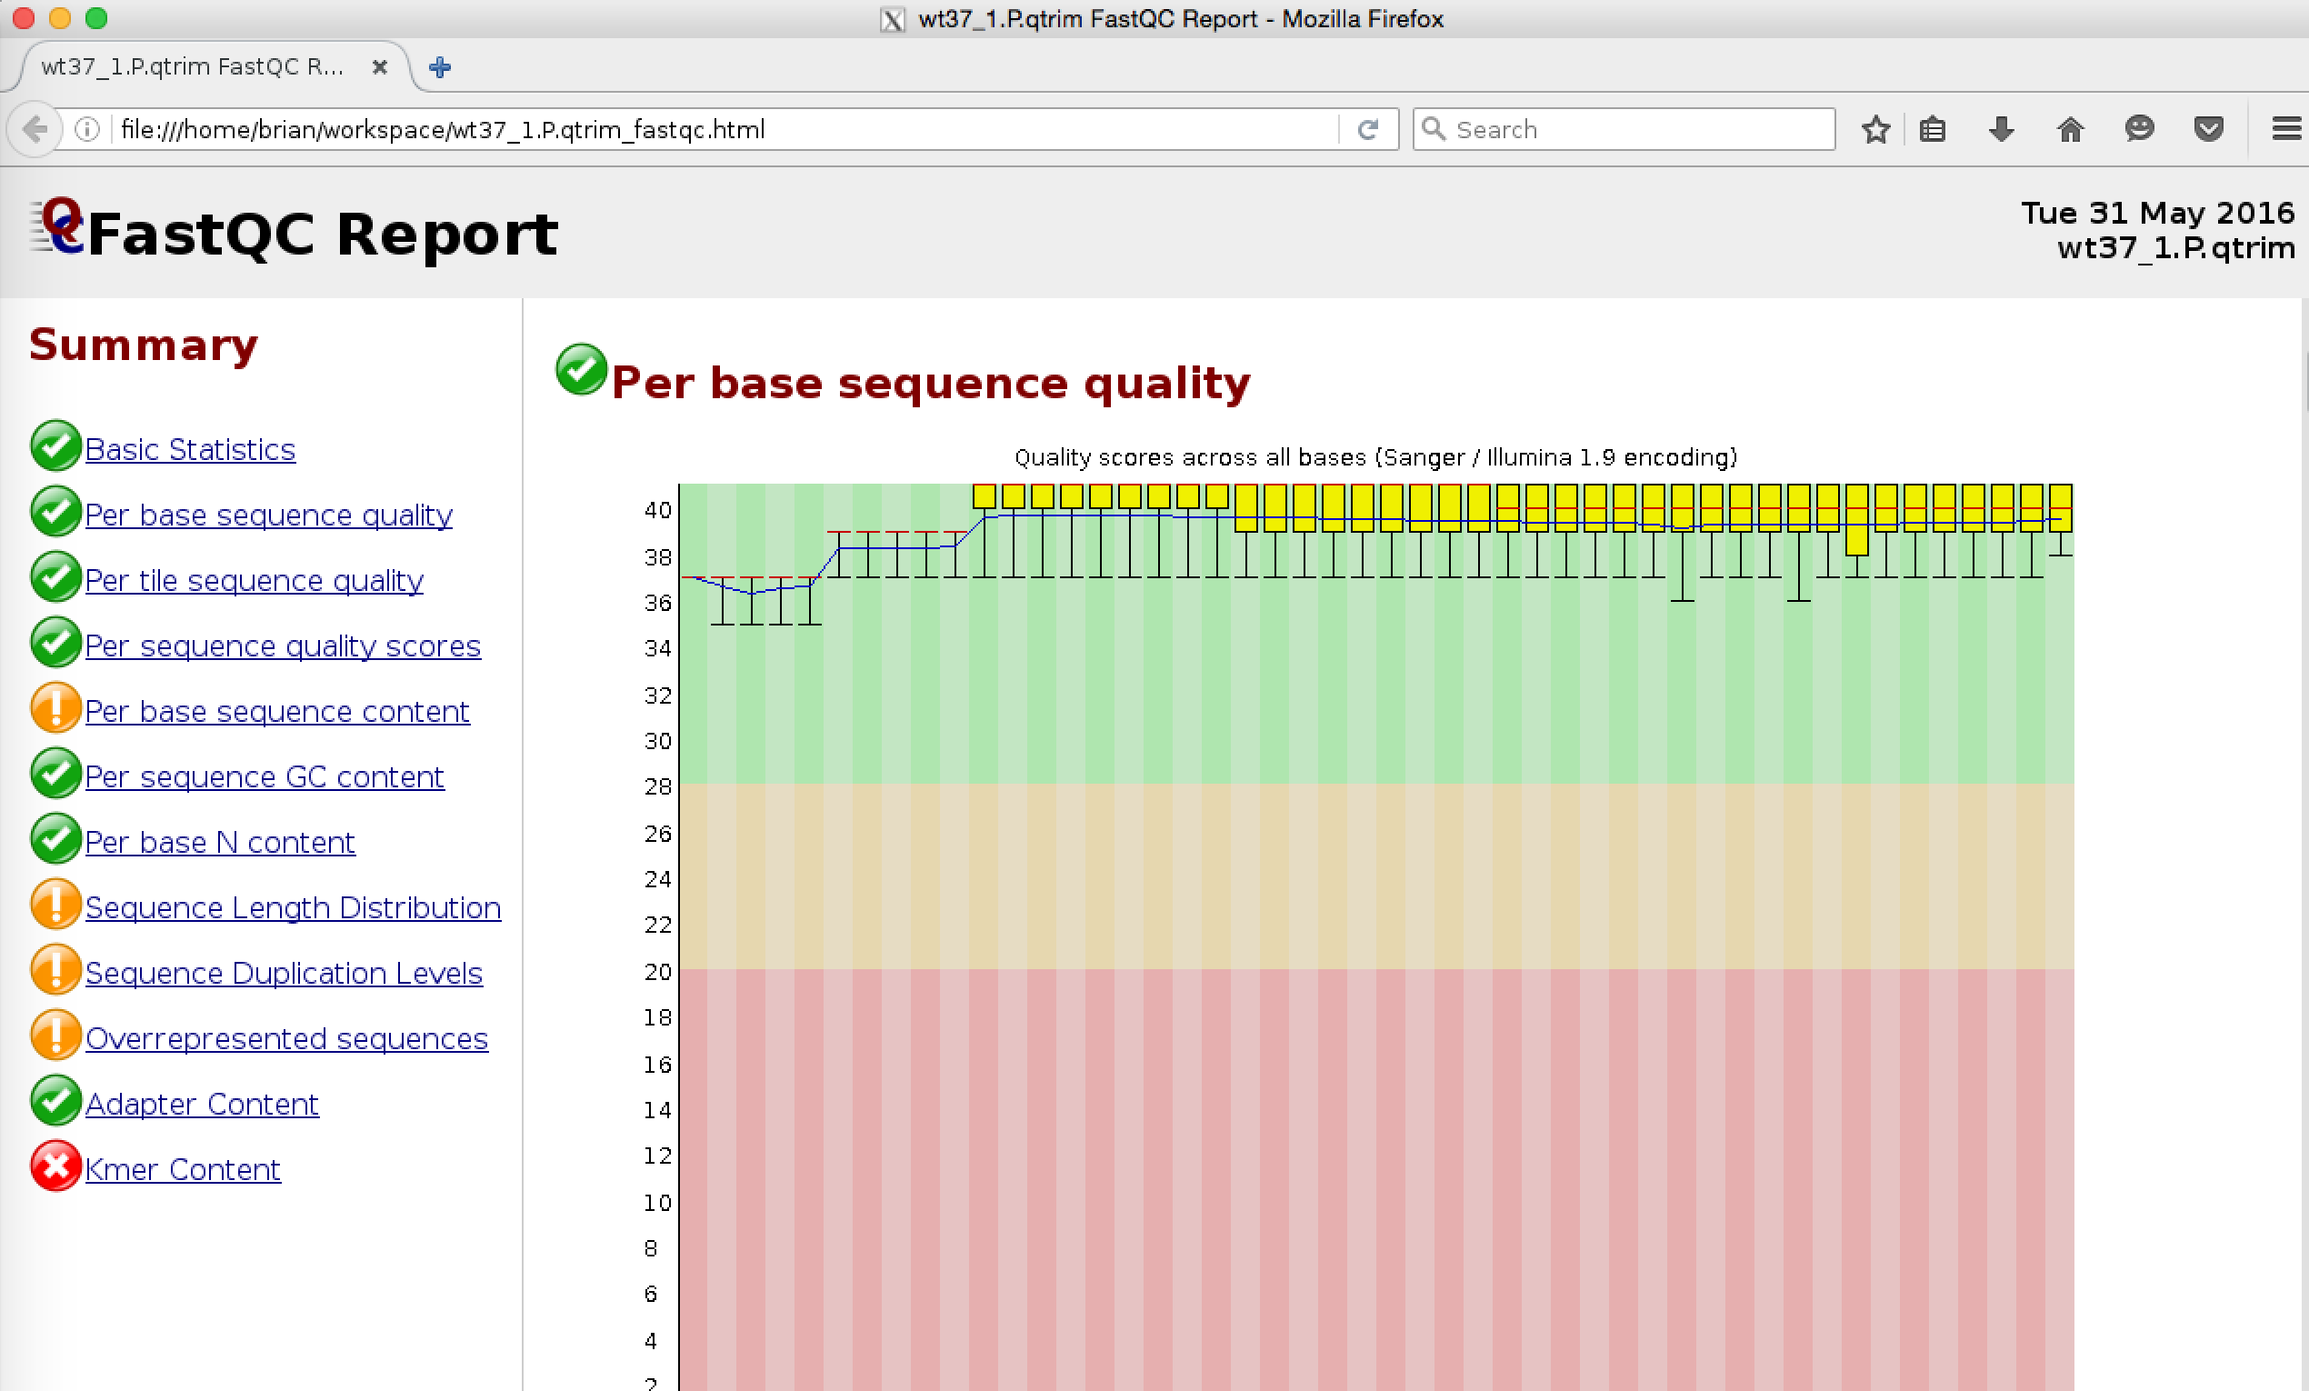
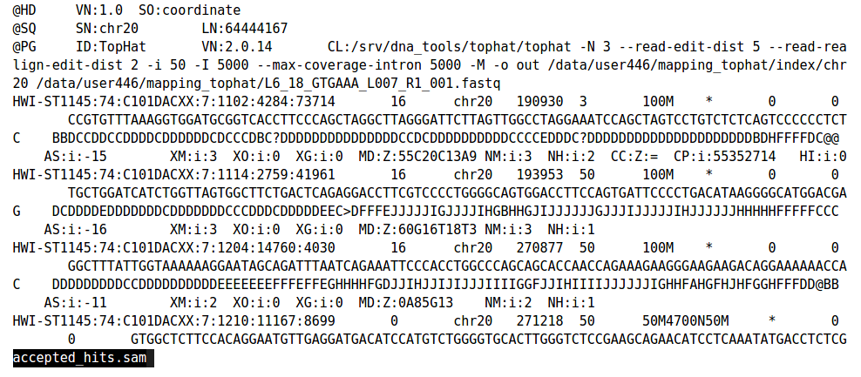
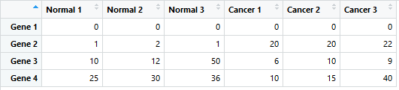
RNA-seq differential expression workflow
RNA-seq short reads
Quality control (FastQC)
reference genome sequences (FASTA files)
Reads mapping to the genome
(STAR, GSNAP, TopHat)
SAM file
annotations (GTF file)
FASTQ sequence reads
DESeq2 is a R/Bioconductor package for differential gene expression analysis on count based expression datasets using the negative binomial distribution.
Counting reads associated with genes (HTSeq, featurecounts)
Statistical analysis to identify the differentially expressed genes (DESeq2, limma, edgeR)

Slide 4
Differential expression analysis
Starting with the count data
We want to identify the difference between the cases? Can we just take the fold change (mean of cancer/mean of healthy)?

Slide 5
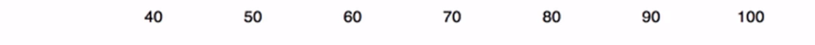
Sources of variability
Phenotypic variability
Measurement error
Nature biological variations
C
H
Notes:
Not comparable

Slide 6
Sources of variability
Phenotypic variability
Measurement error
Nature biological variations
C
H
Notes:
Not comparable

Slide 7
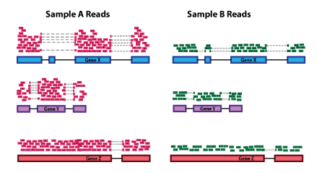
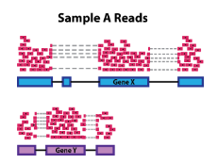
Sources of variability
Sequencing depth (library size) B. Gene length C. RNA composition
D. Sequences bias (GC content)
Notes:
Not comparable RN composition

Slide 8

Normalization
The number of mapped reads for each gene is relative to the expression of RNA ('interesting') in addition to several other factors ('uninteresting'). Normalization is the method of scaling raw count values to take the "uninteresting" variables into account. Through this way the levels of expression between the samples are more comparable.

Slide 9
Methods of normalization
RPKM/FPKM (reads/fragments per kilobase of exon per million reads/fragments mapped)
CPM (counts per million)
TPM (transcripts per kilobase million)
DESeq2’s median of ratios
EdgeR’s trimmed mean of M values (TMM)

Slide 10
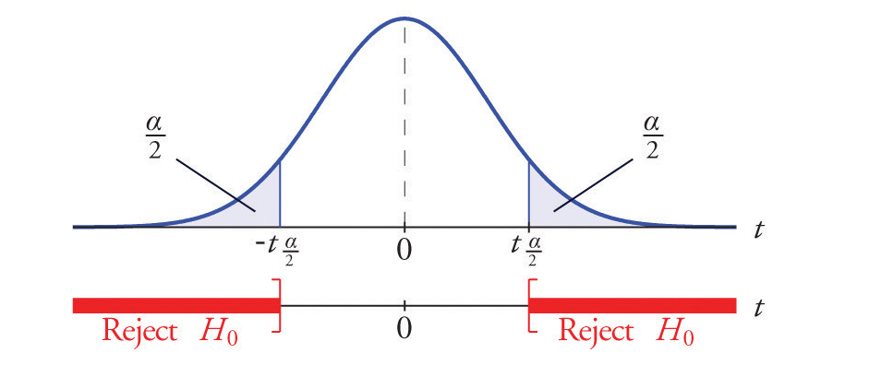
Statistical hypothesis testing
You need to make some assumptions to analyze this data, this assumption is called a hypothesis.
E.g. is there any different between the cases (e.g. control/disease)?
So if there is no difference, we call this the null hypothesis H0:
H0: d = 0
If there is a difference, we call this the alternative hypothesis H1:
H1: d ≠ 0

Slide 11
Types of hypothesis testing
Parametric test
Nonparametric test
If your data, follow the normal distribution
Examples: T test ANOVA test
If your data doesn’t follow the normal distribution
Examples: Wilcoxon test Kruskal-Wallis Test
The output of both tests is a statistic value and a p value which is correspond to the statistic value, A p-value less than 0.05 is statistically significant. It indicates strong evidence against the null hypothesis, as there is less than a 5% probability the null is correct or the error probability in the alternative hypothesis is less than 5%.

Slide 12
Multiple Hypothesis Testing
In RNA-seq differential expression, we usually run hundreds or thousands of comparison tests in a single study, as each gene is tested separately for being differentially expressed that will increase the chance of false positives.
Individual p–values of e.g. 0.5 no longer correspond to significant findings, it’s need to be adjusted for multiple testing using methods like False discovery rate (FDR)
E.g. suppose you have 20,000 genes on RNA-seq experiment. If p value is 0.05 You would expect 20,000∗0.05 = 1,000 of them to have a p-value < 0.05.

Slide 13
Practical work
https://github.com/mariam50411/RNA-Seq-differential-expression

Slide 14
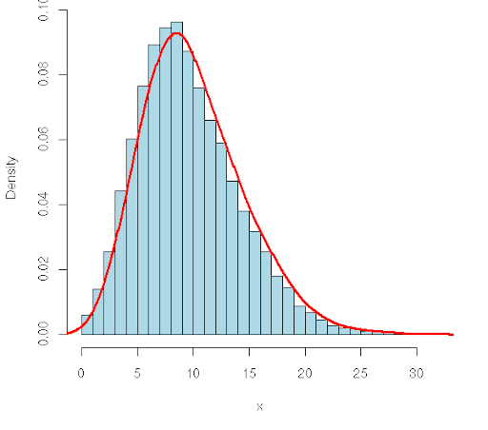
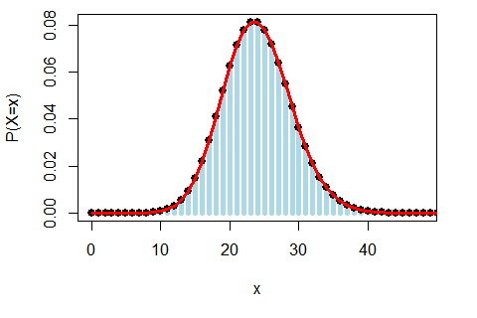
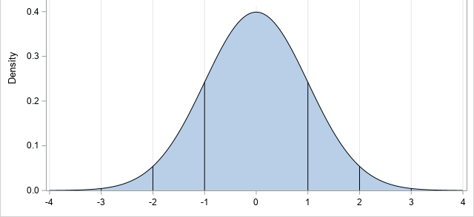
Probability Distributions
normal distribution
Negative binomial distribution
Poisson distribution
Which distribution does the RNA-seq data follow?

Slide 15

hank you

