Slide 1
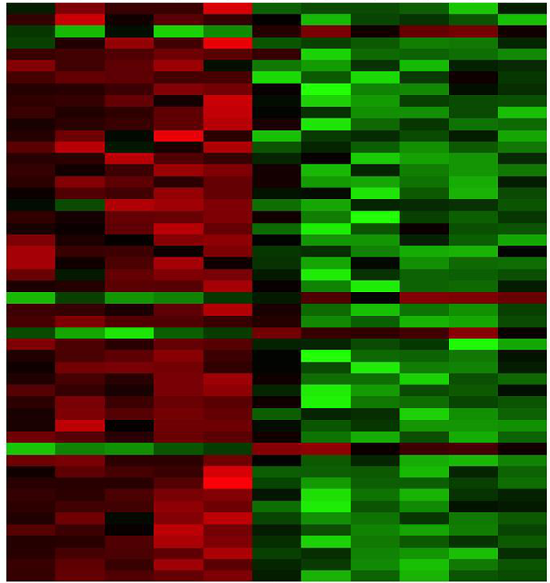

RNA-seq differential expression analysis part 3 Egypt Scholars
Mariam Oweda Kamel
Nile University, Egypt
18/7/2020
“DAR Weekly Webinar”

Slide 2
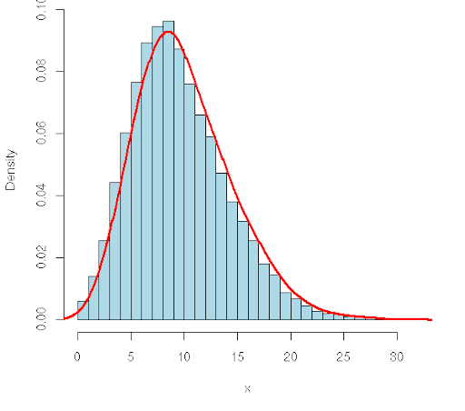
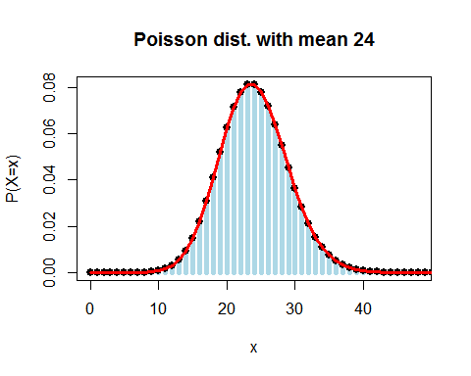
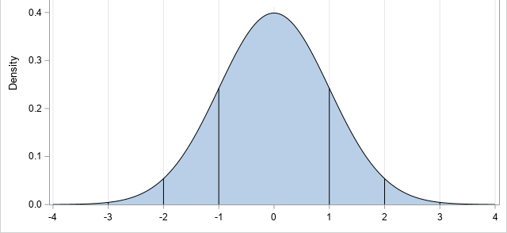

Probability Distributions
normal distribution
Negative binomial distribution
Poisson distribution
Which distribution does the RNA-seq data follow?

Slide 3
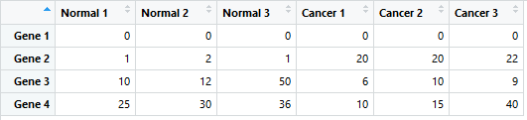
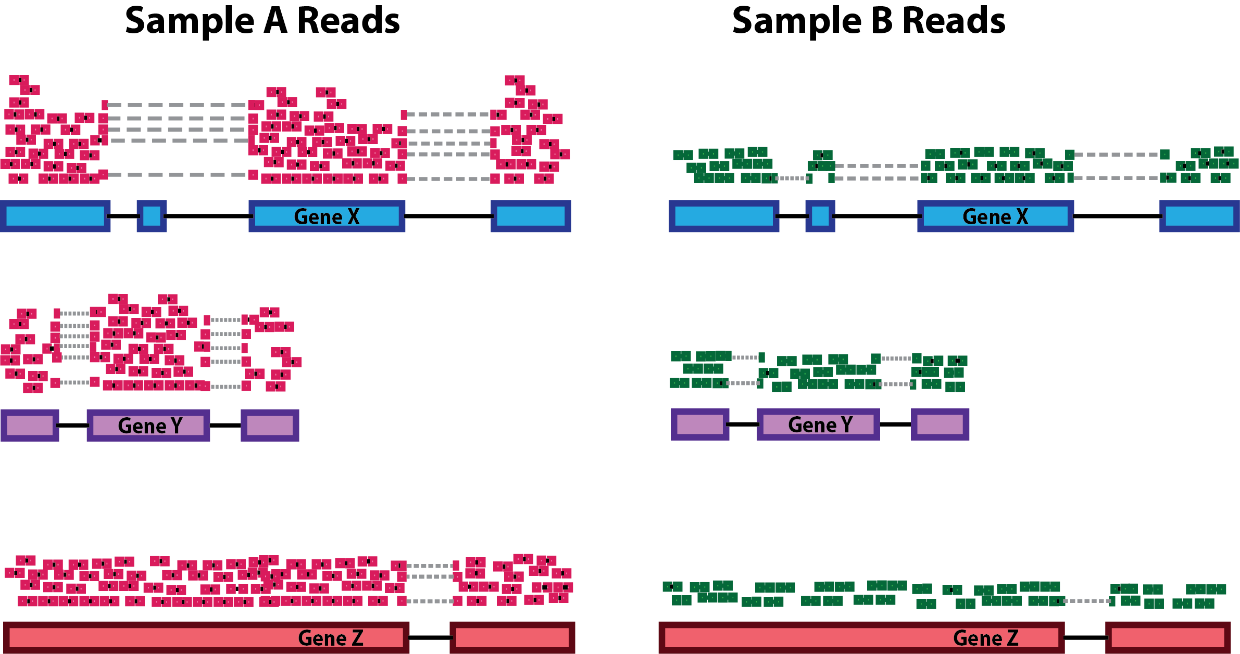
DESeq2 tutorial
Input
1- counts normalization
DESeq2 pipeline

Slide 4
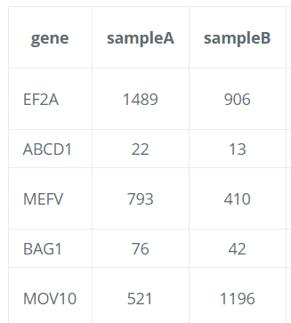
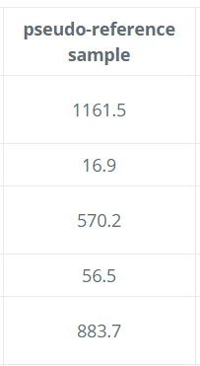
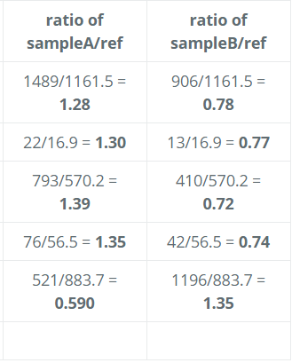
DESeq2 tutorial
1- counts normalization
(median of ratios)
DESeq2 pipeline
sqrt( * )
Median ratio
1.3
0.77
Divide the count by the Median ratio

Slide 5
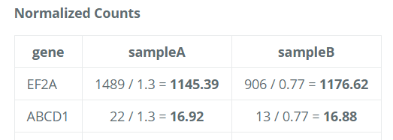
DESeq2 tutorial
1- counts normalization
(median of ratios)
sqrt( * )
DESeq2 pipeline
Median ratio
1.3
0.77
Divide the count by the Median ratio

Slide 6

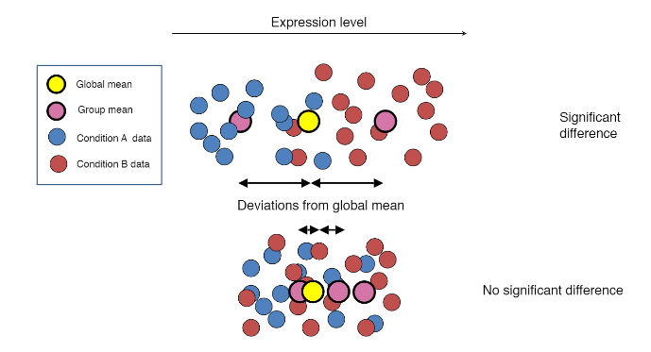
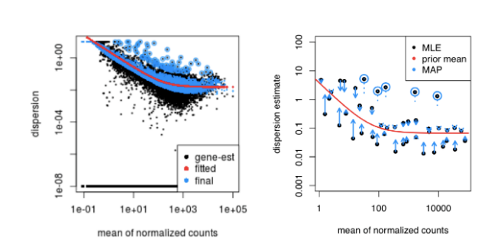
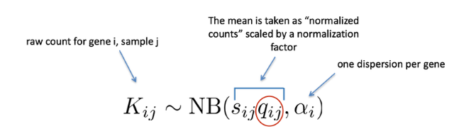
DESeq2 tutorial
Input
1- Counts normalization
2- dispersion estimation
3- Shrink gene-wise dispersion estimates
4- fit the negative binomial model
5- Fold change calculation and Wald test for significance testing
DESeq2 pipeline

Slide 7
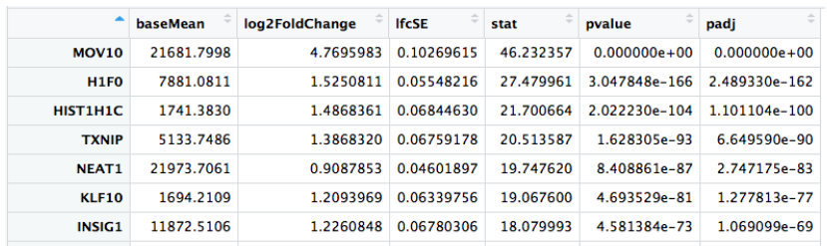
DESeq2 tutorial
The output
1- Counts normalization
2- dispersion estimation
3- Shrink gene-wise dispersion estimates
4- fit the negative binomial model
5- Fold change calculation and Wald test for significance testing
DESeq2 pipeline

Slide 8

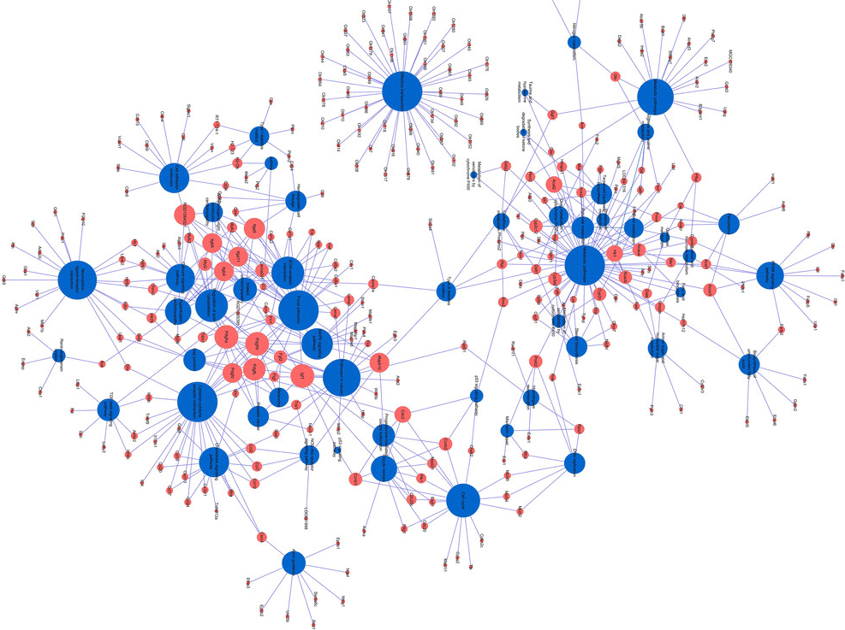
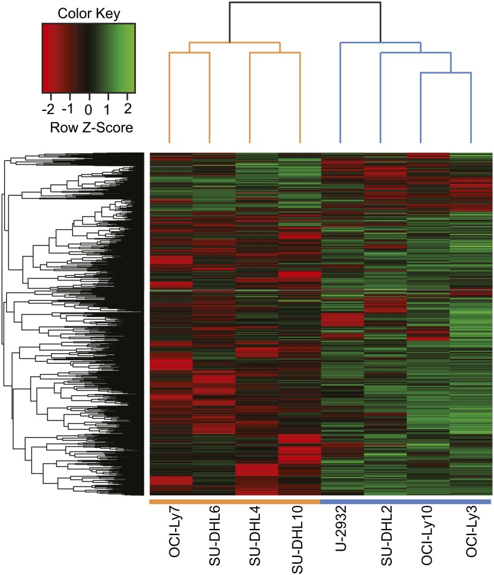

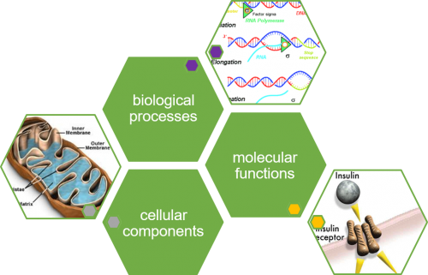
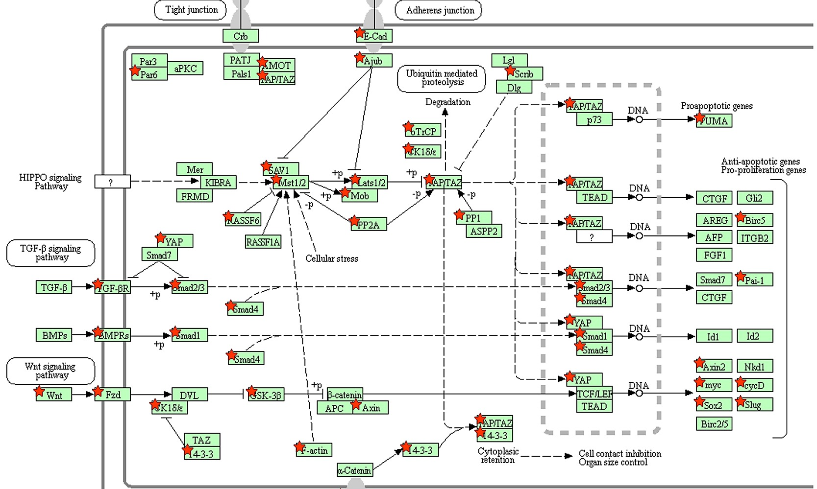
Downstream analysis
Differentially expressed gene list? Now what?
clustering analysis
Functional enrichment analysis
pathway and network analysis

Slide 9
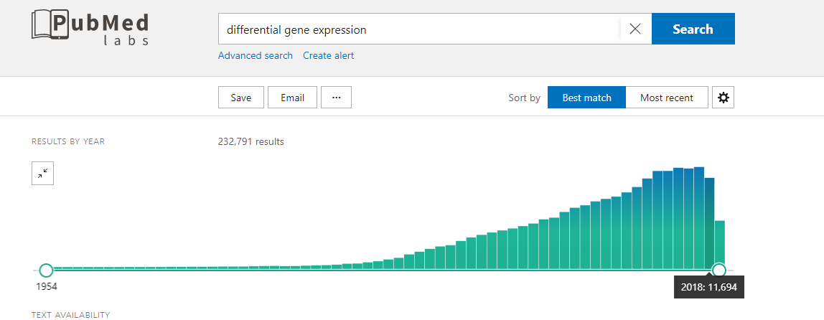
Differential expression analysis publications rate

Slide 10
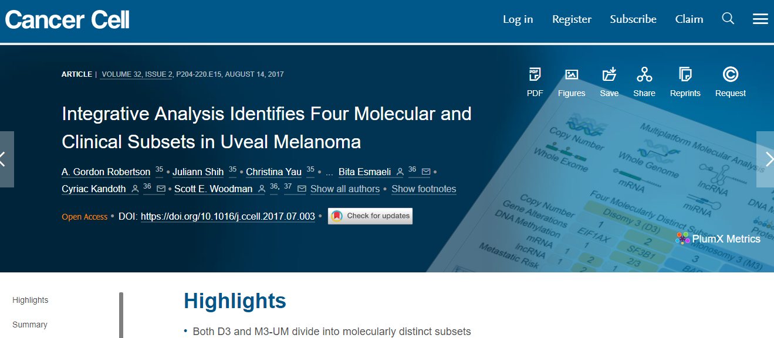
Applications of differential expression analysis
1- Disease classification based on transcriptome profiling

Slide 11
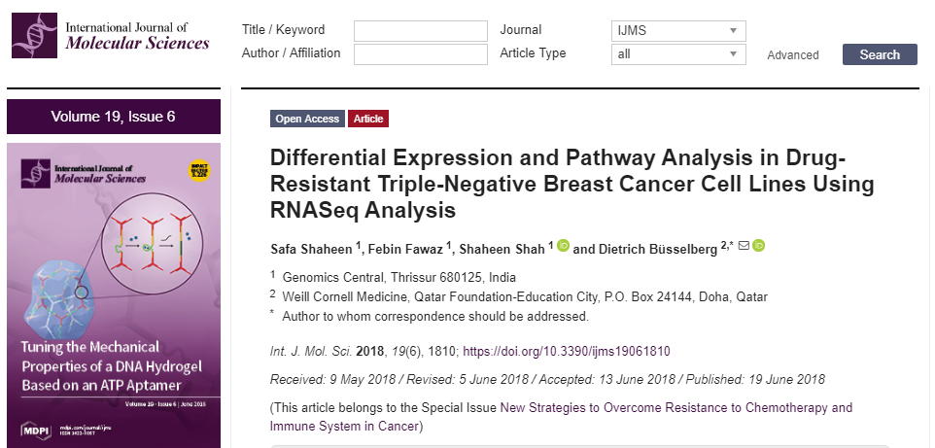
Applications of differential expression analysis
2- understanding the mechanisms of diseases and drug resistance

Slide 12
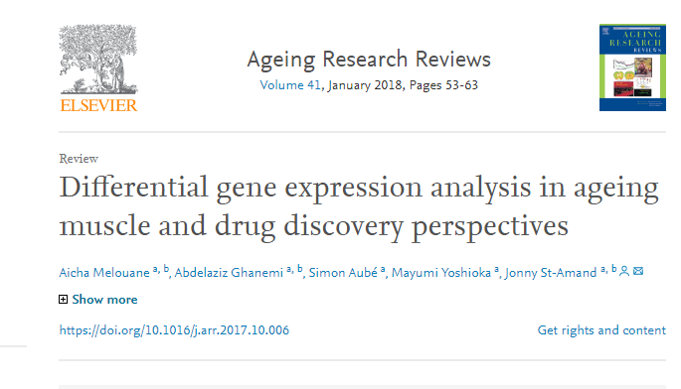

Applications of differential expression analysis
3- Identifying therapeutic target genes

Slide 13
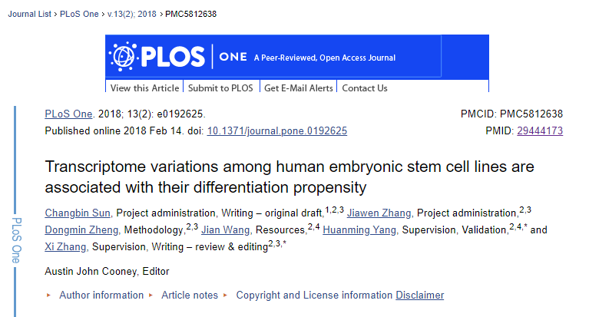
Applications of differential expression analysis
4- understanding the stem cells differentiation abilities

Slide 14


Applications of differential expression analysis
5- Identifying the genes responsible for biotic and abiotic stress resistance
Notes:
-30

Slide 15
Practical work
https://github.com/mariam50411/RNA-Seq-differential-expression

Slide 16
Assignment
Preform a differential expression analysis on a case-control bladder cancer study (attached in the assignment folder on the GitHub) using DEseq2 (part3) and nonparametric test as Wilcoxon test (part2).
Deliverables:
1- Code for both approaches
2- report file contain:
How many DEGs do you had for both approaches? (using the criteria logFC >2, P.adjusted <0.05) (intersect the two list (BOUNS))
How you can interpret this difference in the number of DEGs?
What are the top 5 KEGG pathways enriched by the DEGs obtained from the most accurate approach?
Report if is there any troubleshooting you have done. (BOUNS)

Slide 17
Useful resources
1- A survey of best practices for RNA-seq data analysis
https://genomebiology.biomedcentral.com/articles/10.1186/s13059-016-0881-8
2- RNA-Seq differential expression analysis: An extended review and a software tool
https://journals.plos.org/plosone/article?id=10.1371/journal.pone.0190152
3- Genomic Data Science Specialization johns Hopkins University

Slide 18
My contact
MOweda@nu.edu.eg

Slide 19

hank you

