Slide 1
PISA Data Analysis

Slide 2
PISA is a survey of students' skills and knowledge as they approach the end of compulsory education. It is not a conventional school test. Rather than examining how well students have learned the school curriculum, it looks at how well prepared they are for life beyond school.
Around 510,000 students in 65 economies took part in the PISA 2012 assessment of reading, mathematics and science representing about 28 million 15-year-olds globally. Of those economies, 44 took part in an assessment of creative problem solving and 18 in an assessment of financial literacy.

Slide 3
Univariate Exploration and Analysis

Slide 4
How are scores for each subject distributed?

Slide 5
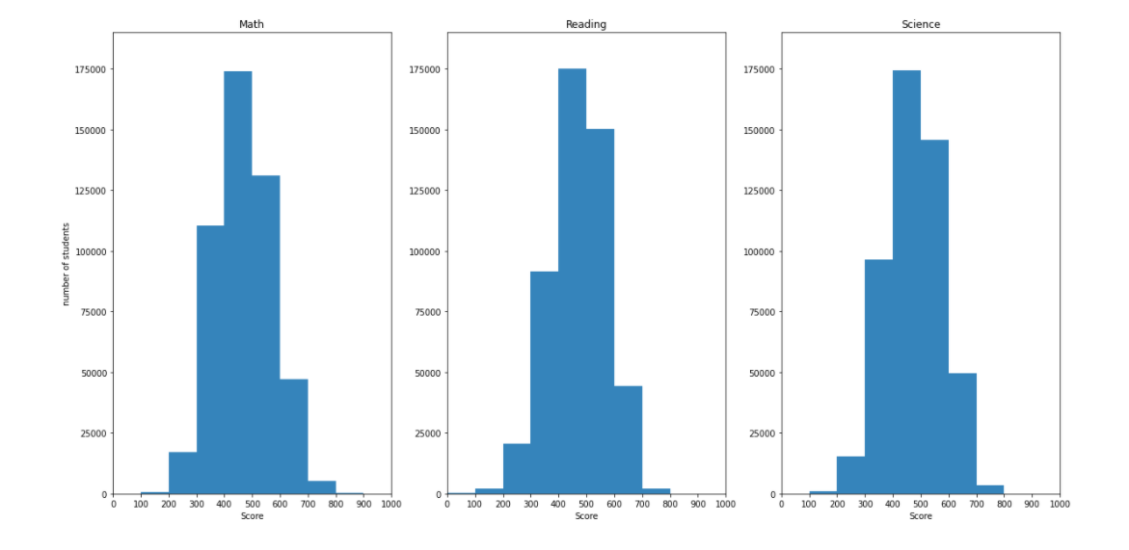

Slide 6
The scores show a normal distribution, with most students having an average score (between 400 to 500) in either Math, Reading or Science. For math, we can see that when compared with reading or science more students are achieving on the lower end of the spectrum, which indicates that math might be considered more "difficult" to students than the other two subjects.

Slide 7
Which countries have the most "brilliant" students (with scores higher than 700) (above average) per subject?

Slide 8
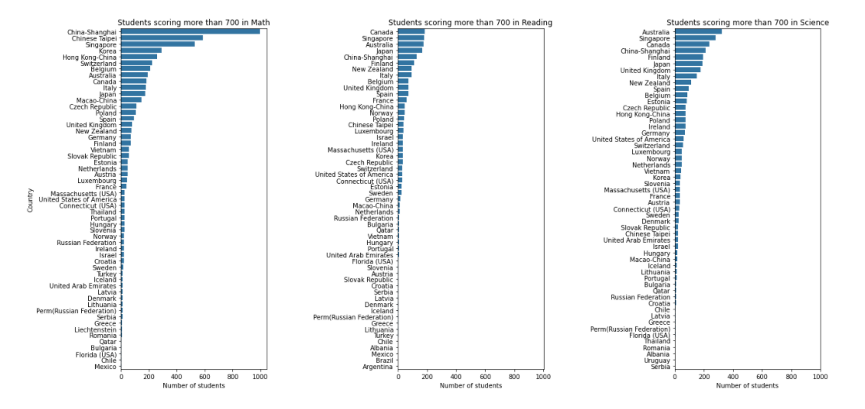

Slide 9
Asian countries china and singapore have dominated top 3 positions in above average math scores, which follows the expected trend of Asians excelling at math.
Singapore has the overall highest number of above average scoring students in all three subjects, which indicates that this country has a strong education system.

Slide 10
What is the proportion of students having parents with same or different country?

Slide 11
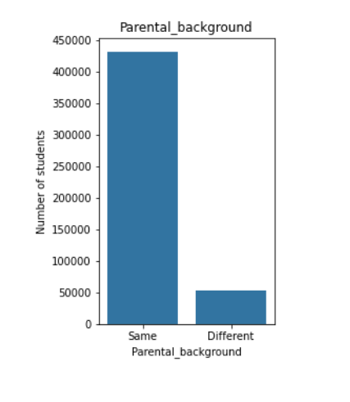

Slide 12
The majority of students have parents from the same country, which makes sense as it is more likely that parents will be from same country.

Slide 13
Bivariate Exploration and Analysis

Slide 14
How does student country affect scores per subject?

Slide 15
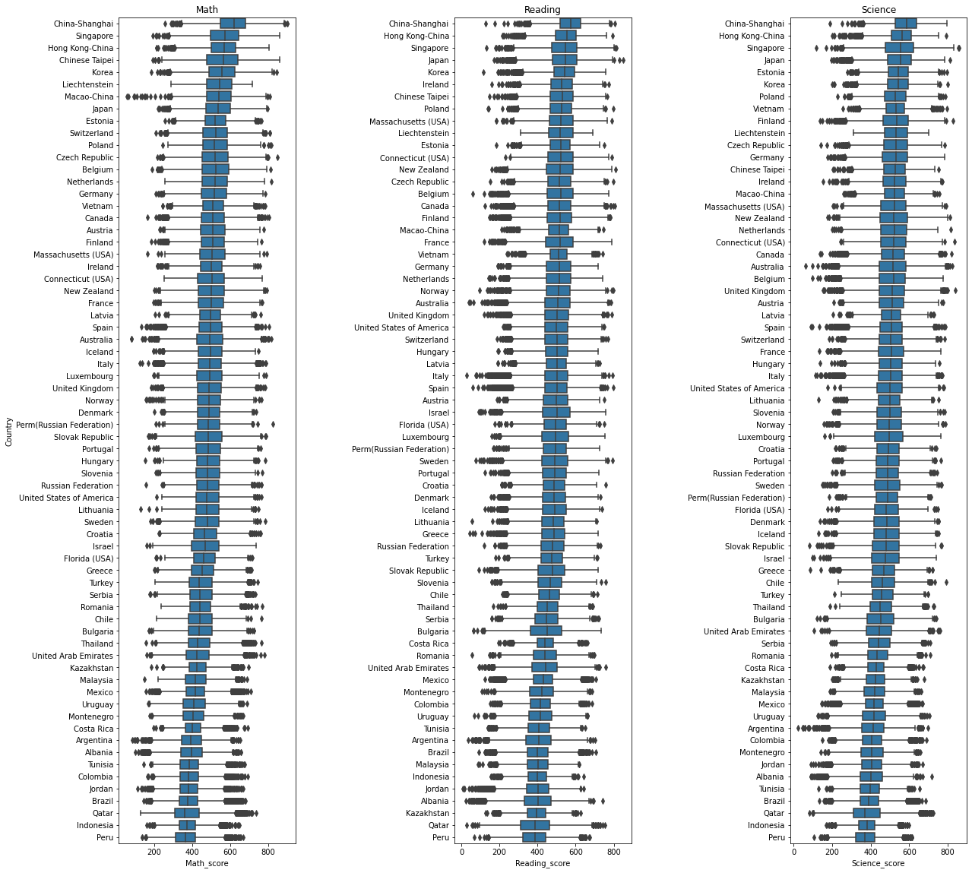

Slide 16
Asian countries such as China, Singapore, and Japan have, on average, the highest scoring students in all three subjects, indicating a strong education system in those countries.
Peru is the country with the lowest average score in all three subjects, which hints at a need of improvement in their education system.
Mid-east countries such as Qatar, Tunisia, and Jordan have the low scoring students in all three subjects, which also hints that the education system needs some optimization in this area.

Slide 17
Which countries have the most "brilliant" students (with scores higher than 700) (above average) in multiple subjects simultaneously?

Slide 18
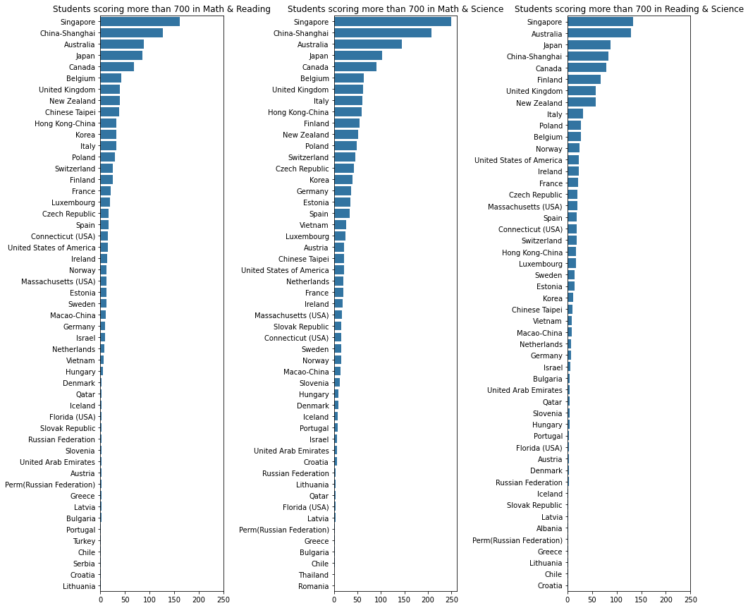

Slide 19
Singapore has the overall highest number of above average scoring students in multiple subjects simultaneously, China, Australia, Canada, and Japan also have multi-talented students.

Slide 20
How does having parents from same and different cultural backgrounds affect student scores?

Slide 21
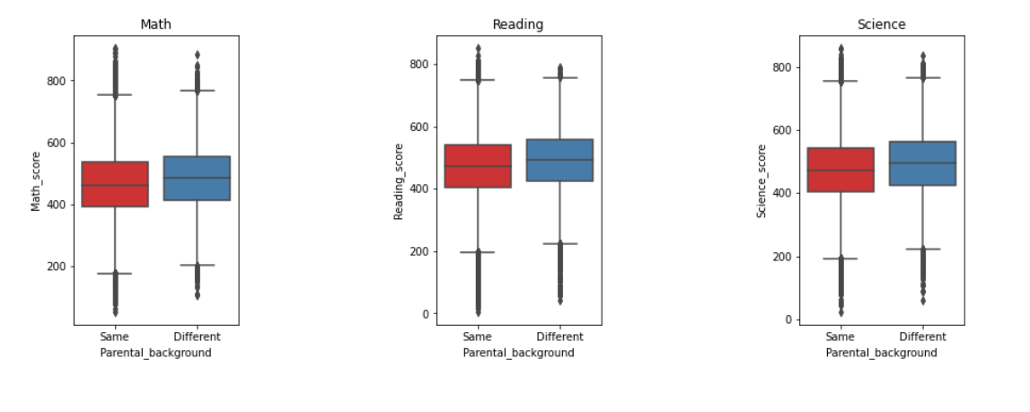

Slide 22
Students with parents having different cultural background have higher scores in all three subjects on average, which may be due to increased versatility in upbringing which stimulates the brain and leads to higher achievement.

Slide 23
Multivariate Exploration and Analysis

Slide 24
How are the scores between each subject correlated?

Slide 25
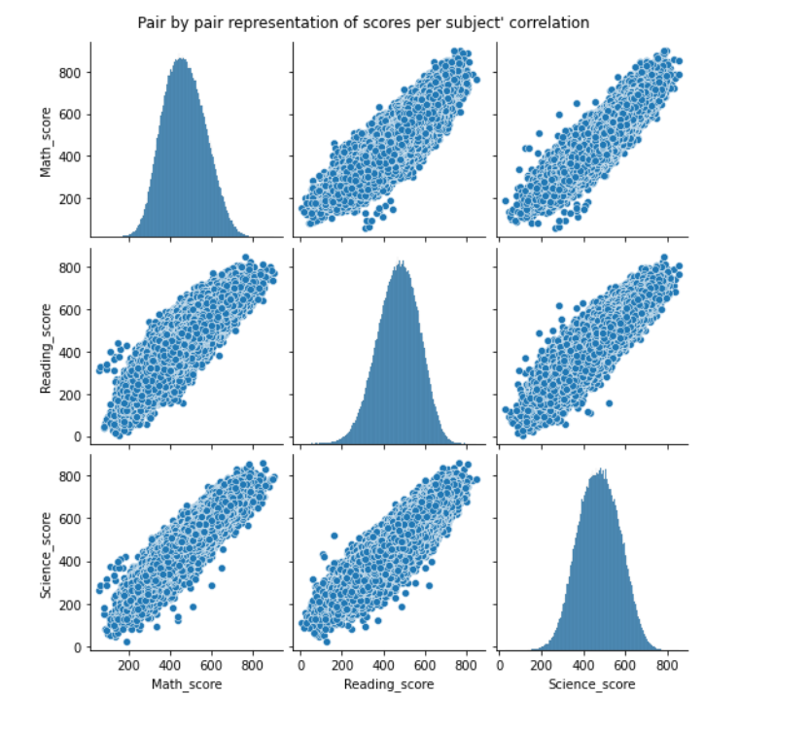

Slide 26
A strong and positive correlation between the score of any two subjects is seen, indicating that students scoring high one subject tend to score high in the other two subjects.
It can be noticed that for a small number of students math performance may be disproportionately weaker than reading or science performance.

Slide 27
What countries have more than a 10 position difference between rankings in each subject are obtained, and what subject(s) is the cause of this anomaly?

Slide 28
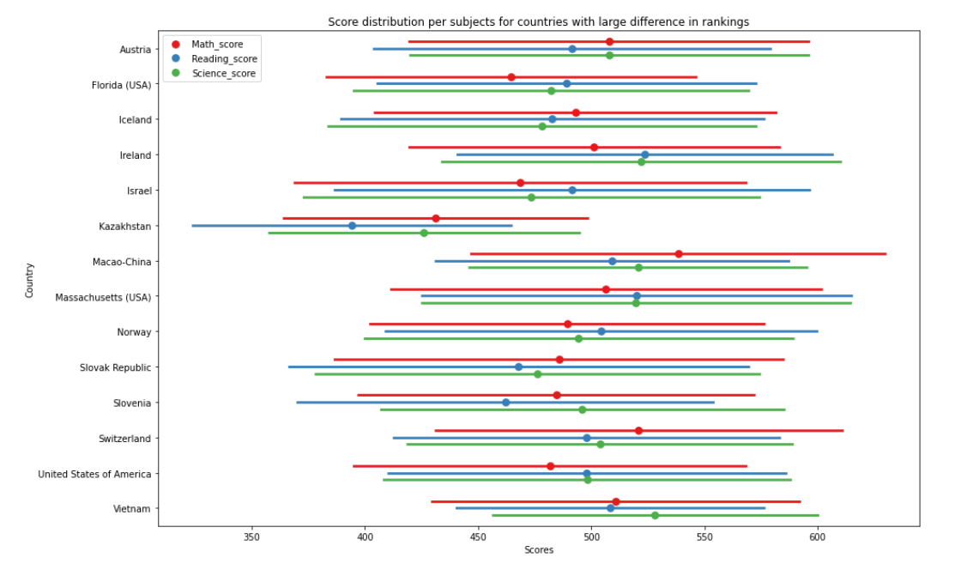

Slide 29
for each country, we can see the subject(s) which is outlying from other scores. For example, in the USA math scores are disproportionately lower than reading/science scores, which inducates that more focus should be given to that subject and that changes should be made to the math syllabus or method of teaching in that country.

Slide 30
Conclusion and Summary of Results

Slide 31
The scores show a normal distribution, with most students having an average score (between 400 to 500) in either Math, Reading or Science. For math, we can see that when compred with reading or science more students are achieving on the lower end of the spectrum, which indicates that math might be considered more "difficult" to students than the other two subjects.
The majority of students have parents from the same country, which makes sense as it is more likely that parents will be from same country.
A strong and positive correlation between the score of any two subjects is seen, indicating that students scoring high one subject tend to score high in the other two subjects. It can be noticed that for a small number of students math performance may be disproportionaely weaker than reading or science performance.

Slide 32
Asian countries such as China, Singapore, and Japan have, on average, the highest scoring students in all three subjects, indicating a strong education system in those countries. Peru is the country with the lowest average score in all three subjects, which hints at a need of improvement in their education system. Mid-east countries such as Qatar, Tunisia, and Jordan have the low scoring students in all three subjects, which also hints that the education system needs some optimization in this area.
For some countries there is a large difference in ranking between the three subjects. For example, in the USA math scores are disproportionately lower than reading/science scores, which indicates that more focus should be given to that subject and that changes should be made to the math syllabus or method of teaching in that country.
Asian countries china and singapore have dominated top 3 positions in above average math scores, which follows the expected trend of Asians excelling at math. Singapore has the overall highest number of above average scoring students in all three subjects, which indicates that this country has a strong education system, moreover, Singapore has the overall highest number of above average scoring students in multiple subjects. China, Australia, Canada, and Japan also have multi-talented students.

