Slide 1
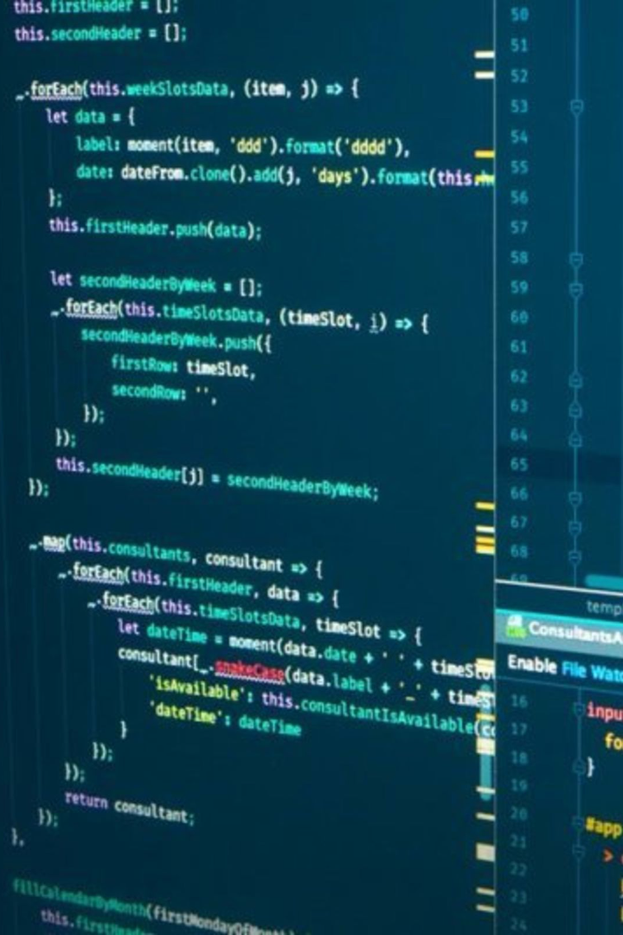
Creating an Information Management System using PyCharm and SQLite3

Slide 2

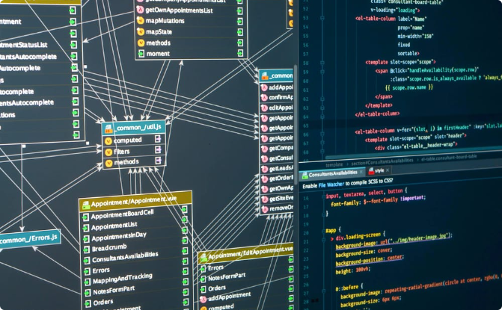
Overview of the Project
Project Management
Database Storage
The project involves creating a solution that will help organizations manage member information easily.
SQLite3 is a lightweight and open-source relational database management system (RDBMS) that is widely used for embedding into applications due to its simplicity and efficiency.

Slide 3
Functionality of the Software
Update Member
Edit and update member information when necessary, all from a single user-friendly interface.
1
2
3
Add Member
Delete Member
Add new members by entering their personal information such as name, gender, and phone number, Age and Address
Delete the member of any previously added member from the database.

Slide 4
Integration with Pycharm and SQLite3
Pycharm IDE
SQLite3 Database
Python Language
Pycharm is an integrated development environment that allows you to write, test, and deploy Python code with ease.
SQLite3 is a built-in module that allows accessing SQLite3 databases without requiring any separate installation.
Python is an interpreted high-level programming language that is best suited for this project due to its simplicity and readability.

Slide 5
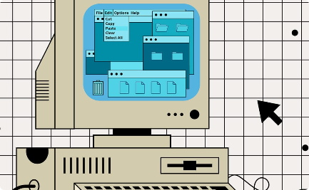
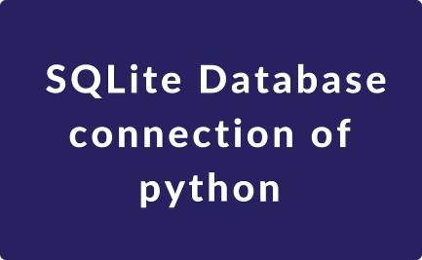
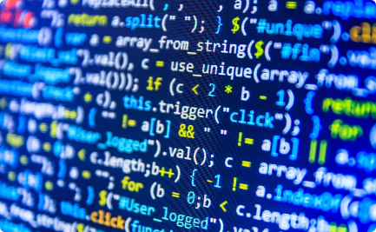
GUI interface and Database Connectivity
Graphical User Interface
Database Connectivity
Code Programming
The GUI interface allows the user to interact with the system and perform various functions by clicking on buttons.
A database connection is established using Pycharm and SQLite3. The database is queried based on the user's request and the results displayed in the GUI
Underlying the GUI interface is a complex code architecture, consisting of various interconnected functions and classes.

Slide 6
Conclusion
1
Benefits
2
Future Development
3
Personal Development
The system is an efficient way to manage member information and improve database storage
Thorough testing and future development might increase the functionality of the system, adding further capabilities to improve performance and usability.
Developing this project is a great way to enhance programming skills using languages like Python and increase knowledge of databases.

Slide 7

Thank you

