Slide 1
Healthcare Data Analytics Case Study
Appointment Trends, No-Show Rates, and Revenue Insights
By: Farahnaz Pierre-Isme
Role/Goal: Aspiring Junior Data Analyst | Healthcare Operations

Slide 2
Project Overview
Stimulate healthcare datasets (Patients, Appointments, Payments)
Focus on key operational KPI’s:
No-Show Rates
Revenue trends by provider
Appointment volume overtime
Tools used: Excel, Tableau, SQL, GitHub

Slide 3
Project Goal
Analyze clinic performance using visual KPI’s
Identify patterns in patient no-show
Understand provider revenue trend
Build a clean Tableau dashboard for stakeholder insights

Slide 4
Mock Dataset Structure
Patient ID | Patient First Name | Patient Last Name | Gender | DOB | Phone | Insurance Provider
Patient Table
Appointment ID | Patient ID | Appointment Date | Department | Appointment Status | DR. Name | Check In | Check Out
Appointment Table
Payment ID | Appointment ID | Payment Date | Amount Billed | Amount Paid | Payment Method | Payment Status
Payments Table

Slide 5
Data Visualization in Tableau
Designed a multi-KPI dashboard Interactive Filters for:
Appointment Date
Department
Provider Name
Used calculated fields to analyze no-show % and total revenue

Slide 6
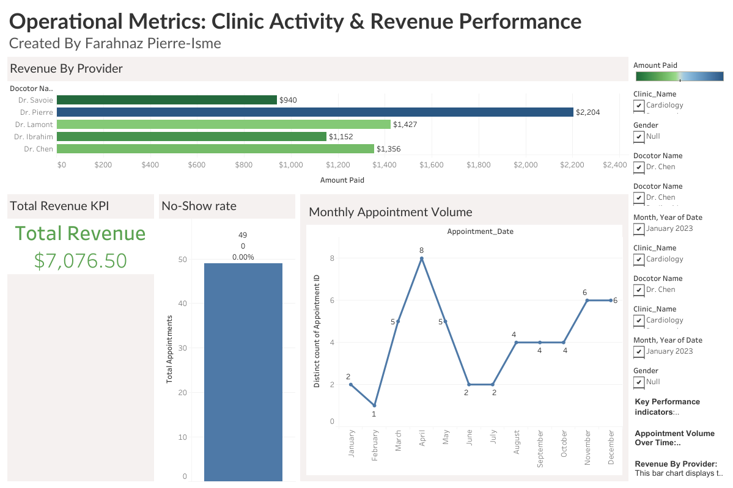
Tableau Dashboard Overview
No-Show KPI with percentage
Line Chart: Appointments over time
Bar Chart: Revenue by provider
Total revenue metric card

Slide 7
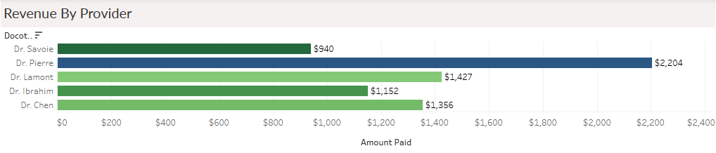
Insight #1: Top Revenue-Generating Providers
Dr. Pierre brought in the highest revenue: $2,204
Total revenue generated across all providers: $7,076.50
Operational Insight: Opportunity to understand high-performer characteristics
Notes:
“Helps management identify top performing providers to replicate best practices or optimize scheduling”

Slide 8
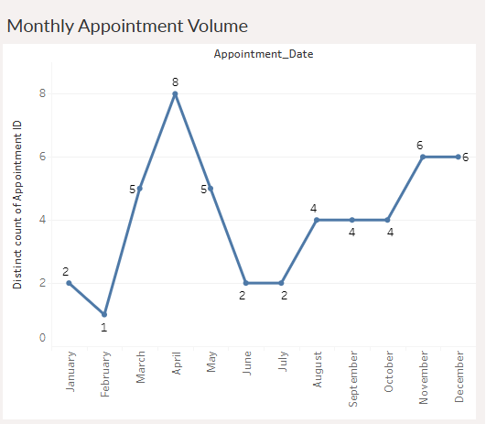
Insight #2: Monthly Appointment Volume
Volume peaked in April (8 appointments)
Seasonal pattern emerge in certain months
Support staffing and planning decisions
Notes:
“Managers can use this trend to forecast patient demand and improve scheduling.”

Slide 9
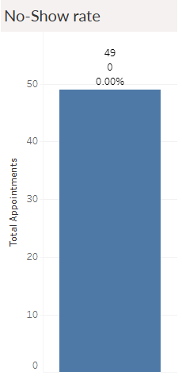
Insight #3: No-Show Trends
No-Show rat: 0.00% for selected filters
Metric calculated using logic across appointment status
Helps identify patient engagement or scheduling issues
Notes:
“This metric allows leadership to target patient

Slide 10
Skills Demonstrated
Tableau (dashboard design, filtering, calculated fields)
Excel (mock data creation)
Data Cleaning
Data Storytelling
GitHub (documentation + file organization)

Slide 11
Access Project Online
🔗 GitHub Repo: github.com/yourusername/healthcare-analytics-case-study
🔗Tableau Dashboard: https://public.tableau.com/views/HealthcareDashboardAppointmentTren

Slide 12
Future Improvements
Add SQL Joins + queries for backend analysis
Predictive modeling for no-show likelihood
Deeper cost/ revenue modeling by provider or diagnosis

Slide 13
About the Analyst
Farahnaz Pierre-Isme – Transitioning into Data Analytics
Background in healthcare ops, recruiting, and customer service
Passionate about using data to improve patient outcomes

Slide 14
Thank You !
Open to feedback or collaborations
Contact: pierrefarahnaz17@gmail.com | LinkedIn Profile

