Slide 1
Machine Learning Course Project
Acne Counting and Grading
Group 17
2050735 Li Hengxin, 2151214 Mi Tiantian,
2152050 Rao Ji, 2152667 Li Ao

Slide 2
Part 1. Background and Motivation
Acne: A common chronic inflammatory skin disease, often found in teenagers.
Effects of acne on daliy life: Acne is often associated with stress, staying up late, irregular diet and other bad habits, seriously affecting the appearance and quality of life of patients.
Treatment method: Doctors need to precisely target acne for topical treatments or laser therapy, both of which require accurate localization of the acne.

Slide 3
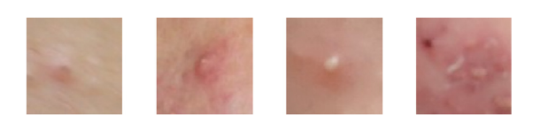
Part 1. Background and Motivation
Why we need acne localization? In clinical practice, it is laborious for dermatologists to diagnose acne grade manually. The purpose of this project is to use the method of object detection in deep neural network to solve it.
Practical significance:
Enhancing doctors' efficiency
Provide services to patients doctors
Offer more effective treatment guidance
Fig. 1. The example of four lesion (acne) images. From left to right: Comedone, Papule, Pustule, Nodule.

Slide 4
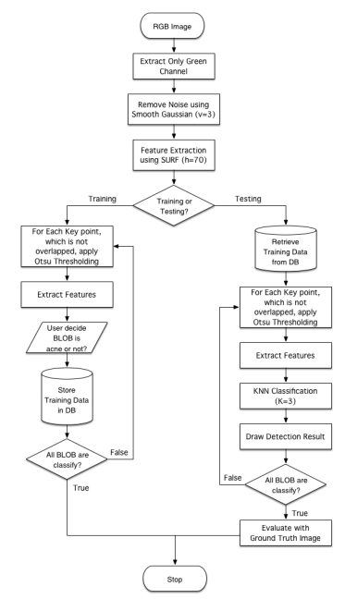
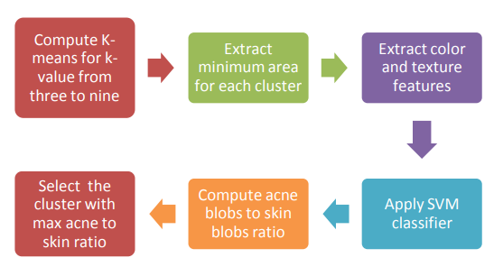
Part 2. Related Works: Acne Detection and Classification
Conventional approaches: suffer from noise and low accuracy
Digital Assessment of Facial Acne Vulgaris
(2014 I2MTC Proceedings)
Acne Detection Using Speeded up Robust Features and
Quantification Using K-Nearest Neighbors Algorithm (2014 ICCBS)
Pipeline: Manual feature + SVM
Pipeline: SURF + KNN

Slide 5
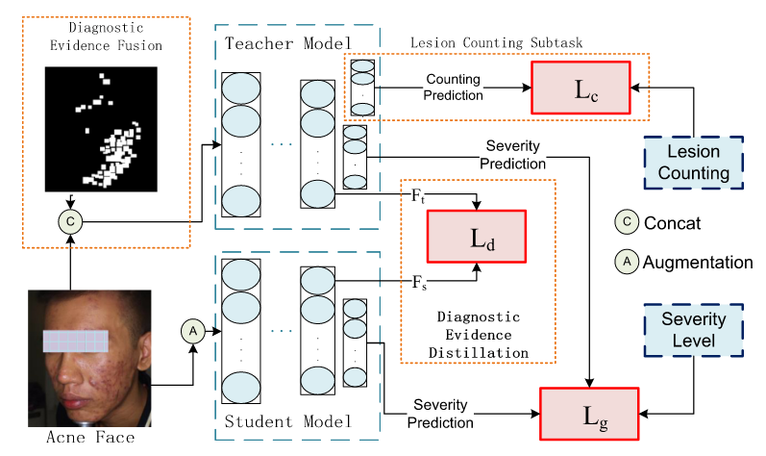
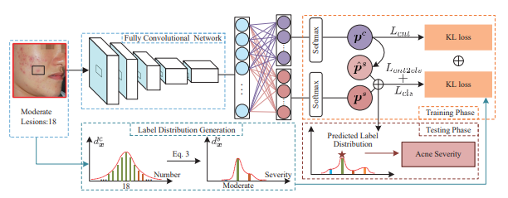
Part 2. Related Works: Acne Detection and Classification
Deep learning-based methods: Regression, classification and segmentation tasks have many applications in medical image analysis.
Joint Acne Image Grading and Counting via Label Distribution Learning
(2019 ICCV)
DED: Diagnostic Evidence Distillation for acne severity grading on face images (2023 Expert Systems With Applications EI)
Pipeline: Counting Distribution Severity Distribution in ResNet Backbone Generating Label Distribution
Pipeline: knowledge distillation framework incorporates with joint learning for the teachernetwork

Slide 6
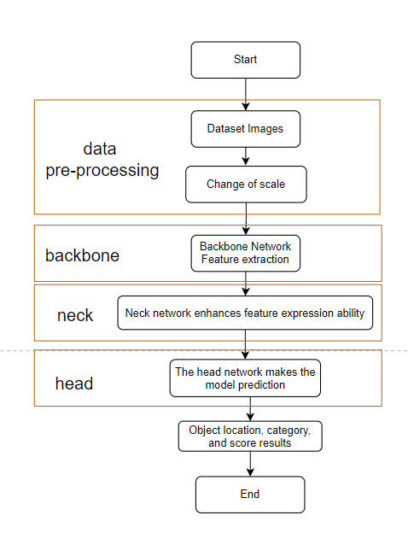
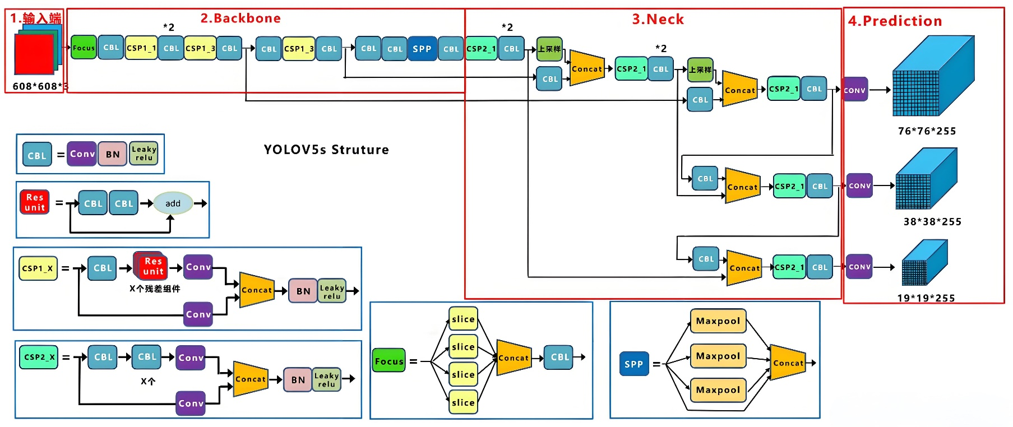
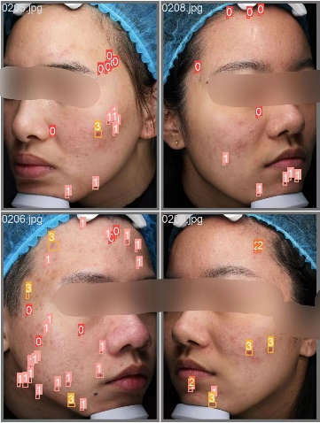
Part 2 Related Works : Object Detection
Why didn't Yolo perform very well?
The target features are not obvious.
Dense distribution leads to confusion.
Complex background.

Slide 7
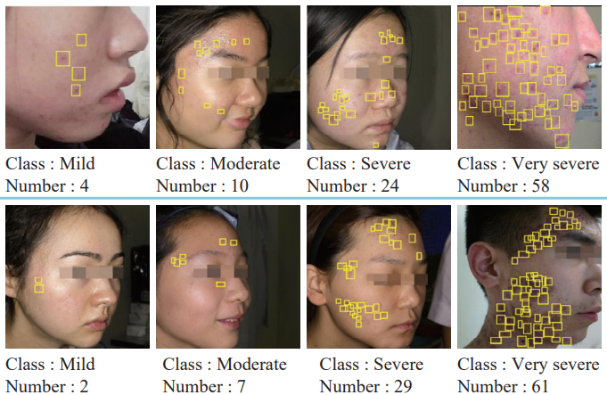
Part 3. Dataset Development
Training and Validation Dataset: ACNE04 (80%)
Test Dataset: ACNE04 (20%)
5-fold Cross-validation
Name | images | size | classes(including background)
ACNE04 | 1457 | 3112×3456 | 5
CelebAMask-HQ | 30000 | 512×512 | 4
Flickr-Faces-HQ | 1572 | 224×224 | -
Nestlé Skin Health | 4700 | 224×224 | 5
ACNE-Shanghai | 322(309 selected) | 3456×5184 | 5
Fig. 4. Examples in the ACNE04 dataset. The numbers undereach image denote the ground-truth severity and lesion number.
Tab.1 information about 5 acne datasets

Slide 8
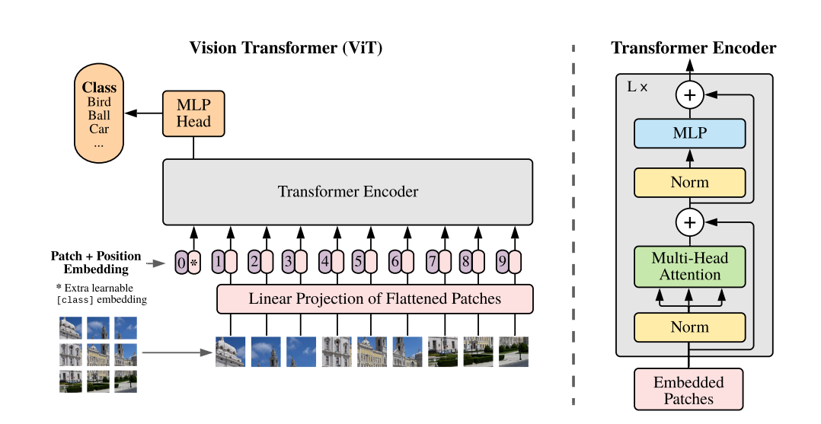
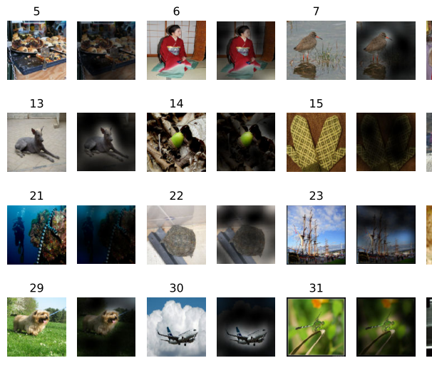
Part 4.1 Model Selection : ViT
Advantages Global relationship modeling can enlarge the receptive field of image and obtain more context information
An Image is Worth 16x16 Words: Transformers for Image Recognition at Scale (ICLR 2021)
Model overview: We split an image into fixed-size patches, linearly embed each of them, add position embeddings, and feed the resulting sequence of vectors to a standard Transformer encoder
Fig.5 Attention maps

Slide 9

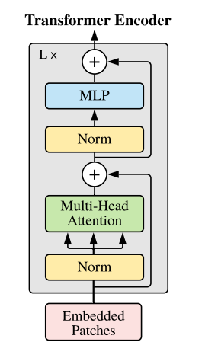
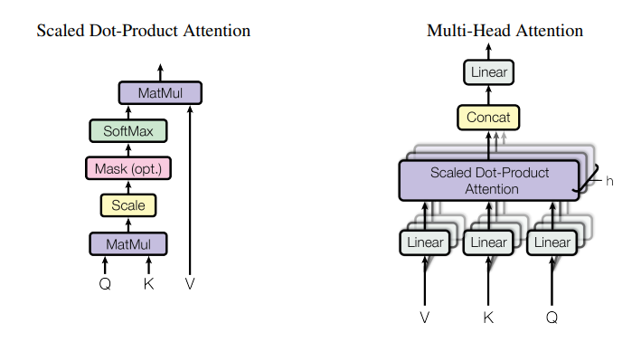
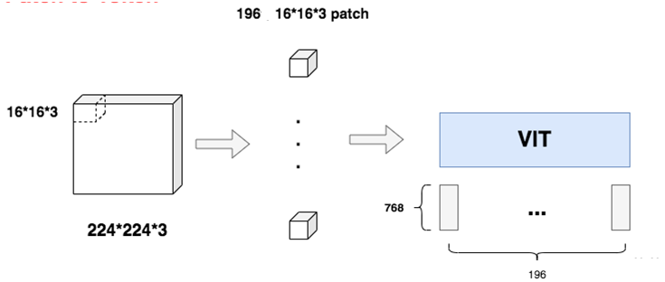

Part 4.1 Model Selection : ViT
Stage 1: Embedding
Stage 2: Transformer Encoder
Patch Embedding
Class Embedding (Learnable Embedding)
Position Embedding
Final Input:
The Transformer encoder consists of alternating multi-head self-attention layers (MSA) and multi-layer perceptron blocks (MLP). Apply Layer Norm before each block and Residual Connection after each block

Slide 10
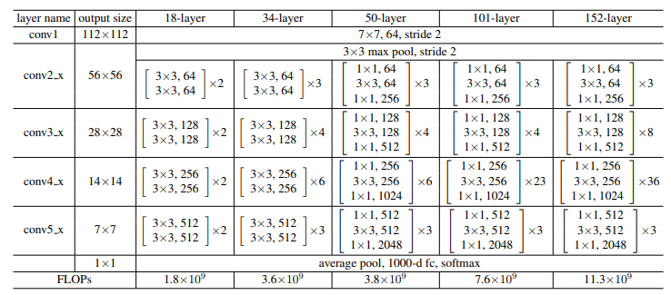
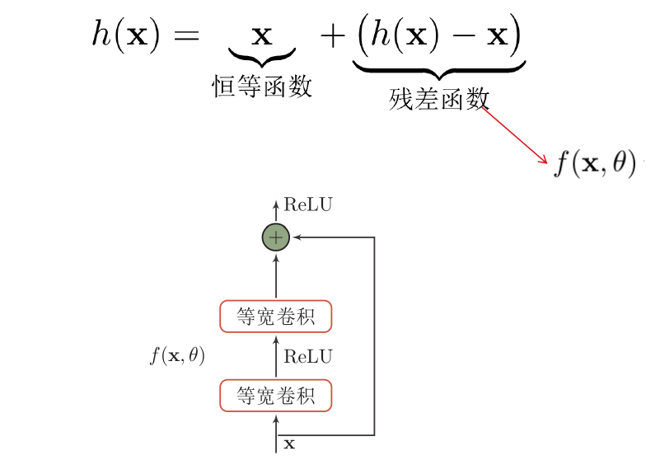
Part 4.2 Model Selection : ResNet
Fig.6 Framework of ResNet layers
Advantages:
avoid loss in information transmission.
transmit the input information to the output to protect the integrity of the information.
simplify the learning goal and difficulty.
Deep Residual Learning for Image Recognition
ILSVRC & COCO 2015 (nndl-book)

Slide 11
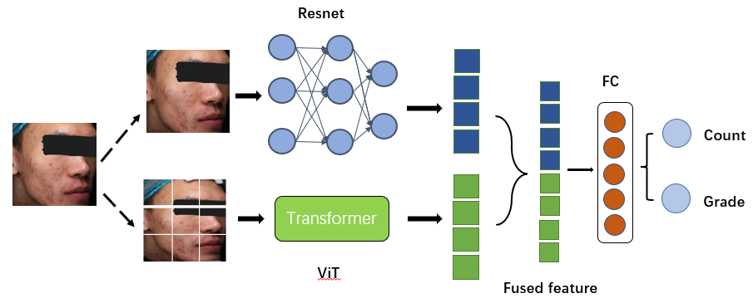
Part 4.3 Our Idea : FusedModel (ViT+Resnet)
Advantages:
Resnet allows the network to train deeper and learn more complex expressions.
ViT is good at processing global information
Some Possible Shortcomings:
The mode and degree of feature fusion is somewhat simple.
The training curve is not very smooth.
Fig. 7 Model proposed by us. Using the idea of feature fusion, the features extracted from Resnet and Vit models are spliced and then passed through the fully connected layer

Slide 12
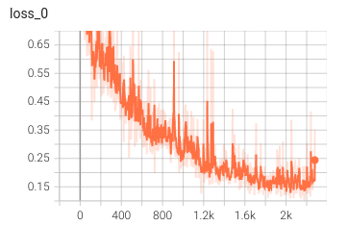
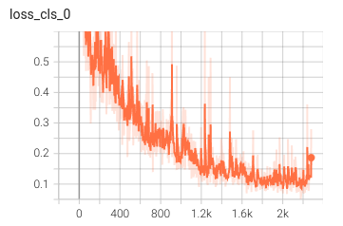
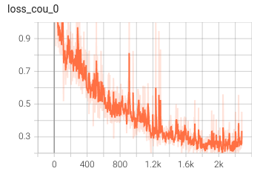

Part 4.4 Loss Function and Optimization
Firstly, we choose L2-norm as loss function: $$L_{cou}=\sum_{i=1}^{n}{{(x_{cou}^{(i)}−y_{cou}^{(i)})}^{2}}$$
Add Kullback-Leibler Divergence: $$D_{KL}(P || Q)=\sum_{x}{P(x) log \frac{P(x)}{Q(x)}} \\ L_{cls}=\sum_{i=1}^{n}{D_{KL}(x_{cou}^{(i)}−y_{cou}^{(i)})} \\ Loss=α{ L}_{cou}+(1−α){ L}_{cls}$$ Optimizer: Adam

Slide 13
Part 5. Experiment Result
SE: Sensitivity (Recall), SP: Specificity, YI=SE+SP−1
 | Precision | SE | SP | YI | MAE | MSE
class0 | 0.7863 | 0.8932 | 0.8677 | 0.7609 | 1.0680 | 1.6010
class1 | 0.8000 | 0.7874 | 0.8485 | 0.6359 | 2.8425 | 3.6121
class2 | 0.7692 | 0.5556 | 0.9766 | 0.5321 | 9.1111 | 13.7477
class3 | 0.8750 | 0.8077 | 0.9887 | 0.7964 | 7.0769 | 12.8333
avg / total | 0.8076 | 0.7610 | 0.9204 | 0.6813 | 3.3664 | 6.6742
Tab.2 Prediction of FusedModel (KL-Loss) on acne counting
 | Precision | SE | SP | YI
class0 | 0.8108 | 0.8738 | 0.8889 | 0.7627
class1 | 0.7923 | 0.8110 | 0.8364 | 0.6474
class2 | 0.7407 | 0.5556 | 0.9727 | 0.5282
class3 | 0.8750 | 0.8077 | 0.9887 | 0.7964
avg / total | 0.8047 | 0.7620 | 0.9217 | 0.6837
Name | Value
learning rate | 1e-4
num of epoch | 120
batch size | 64
sigma | 3
alpha | 0.6
Tab.3 Prediction of FusedModel (KL-Loss) on acne grading
Tab.4 HyperParameter Setting

Slide 14
Part 5. Comparison of Results
 | Counting |  | Grading
 | AVG_ACC | AVG_PRE | AVG_ACC | AVG_PRE
ViT | 0.5342 | 0.5090 | 0.5137 | 0.5342
ResNet | 0.6615 | 0.6678 | 0.6712 | 0.6680
FusedModel (Ours) | 0.7979 | 0.8076 | 0.8014 | 0.8047
Tab.5 Comparison of experimental results of different models
Conclusion:
The experiment proves that our method is effective.
In the future, we will try to integrate more abundant ways to make the advantages of the two models play a greater role

Slide 15
Part 6. References
[CCID Dataset] Quattrini A, Boër C, Leidi T, Paydar R. A Deep Learning-Based Facial Acne Classification System. Clin Cosmet Investig Dermatol. 2022;15:851-857 https://doi.org/10.2147/CCID.S360450
[ACNE04 Dataset] Wu, Xiaoping, Ni, Wen, Jie, Liang, Lai, Yu-Kun, Cheng, Dongyu, She, Ming-Ming, & Yang, Jufeng. (2019). Joint Acne Image Grading and Counting via Label Distribution Learning. In *IEEE International Conference on Computer Vision*.
[Nestlé Skin Health Dataset] https://github.com/microsoft/nestle-acne-assessment
[Flickr-Faces-HQ Dataset] https://github.com/HuynhThanhQuan/skin-detective

Slide 16
Part 6. References
Islam, Md Baharul, Masum Shah Junayed, Arezoo Sadeghzadeh, Nipa Anjum, Afsana Ahsan, A. F. M. Shahen Shah. (2023). Acne Vulgaris Detection and Classification: A Dual Integrated Deep CNN Model.
Lin, Yi, Jingchi Jiang, Dongxin Chen, Zhaoyang Ma, Yi Guan, Xiguang Liu, Haiyan You和Jing Yang. DED: Diagnostic Evidence Distillation for Acne Severity Grading on Face Images. Expert Systems with Applications 228 (2023): 120312.

Slide 17
Thanks

Slide 18
Part 1. Background and Motivation

