Slide 1
SLAM-course-project
stu: 2152050 Rao JI

Slide 2
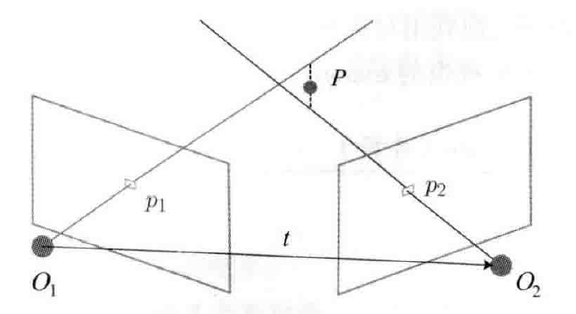
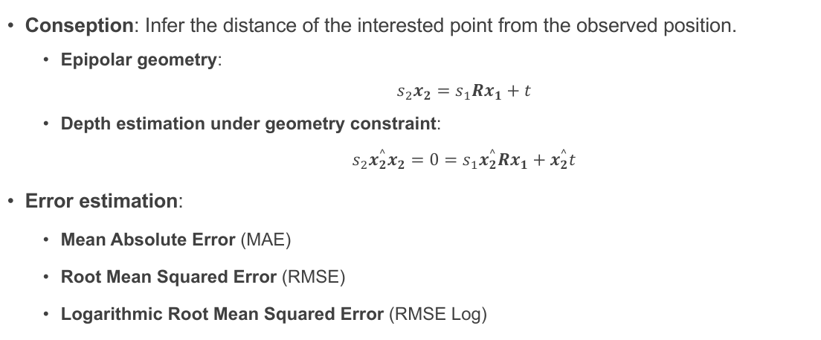
Part 1. Triangulation measurement
Conseption: Infer the distance of the interested point from the observed position.
Epipolar geometry: $$s_{2}x_{2}=s_{1}Rx_{1}+t$$
Depth estimation under geometry constraint: $$s_{2}x_{2}^{^}x_{2}=0=s_{1}x_{2}^{^}Rx_{1}+x_{2}^{^}t$$
Error estimation:
Mean Absolute Error (MAE)
Root Mean Squared Error (RMSE)
Logarithmic Root Mean Squared Error (RMSE Log)
Fig 1. example of triangulation measurement

Slide 3
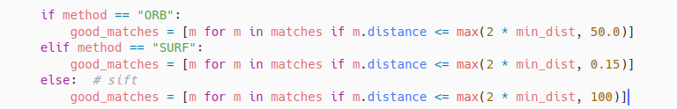
Part 1. Triangulation measurement
 | dim of descriptor
ORB | 32
SURF | 64
SIFT | 128
Feature point detection algorithm:
ORB: Non-maximum suppression direction moment
SIFT: Extreme point detection and calculate the gradient direction
SURF: Determinant detection of feature points to calculate Haar response
Because the calculation of feature descriptors is different between each method, the distance metric is also different.
We adjust the empirical value of screening matching point pairs on the basis of twice the minimum distance to control the number of point pairs obtained by these methods in the same range.
Table 1. dimension of the descriptor in each method

Slide 4

Part 1. Triangulation measurement
Environment construction:
C++ environment construction: The c++ code can only work in opencv with the vision>=4.2, version 4.2.0 is encouraged because of the support of SIFT and SURF detect method.
Python environment construction: The python code also need the avaliability of SIFT and SURF detect method, so opencv-python is needed with the version<=3.4.
tips: If you already have a different version of opencv installed on your computer, please make sure to uninstall the previously installed version.

Slide 5
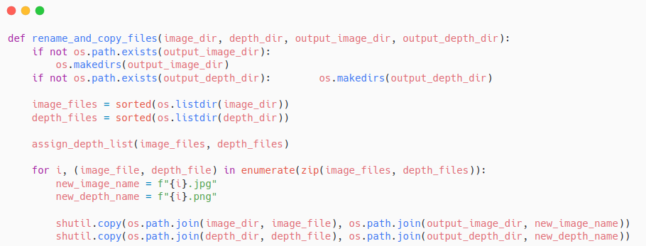
Part 1. Triangulation measurement
Portland_hotel dataset: https://sun3d.cs.princeton.edu/data/Portland_hotel/
Dataset process:
Match depth image and rgb image according to timestamp
Portland_hotel
├── depth
│ ├── 0000001-000000000000.png
│ ├── ...
│ └── 0013323-000446500440.png
├── extrinsics
│ └── 20140808220511.txt
├── image
│ ├── 0000001-000000000000.jpg
│ ├── ...
│ └── 0013323-000446500152.jpg
├── intrinsics.txt
└── thumbnail
└── 20140808220511.jpg

Slide 6
Part 1. Triangulation measurement
 | Avg MAE | Avg RMSE | Avg RMSE log
ORB | 58.997 | 364.173 | 2.092
SIFT | 48.187 | 244.912 | 2.171
SURF | 41.150 | 222.978 | 2.073
Table 2. Triangulation using 3 methods in 200 image-pairs with the interval of 120 frames.
 | Avg MAE | Avg RMSE | Avg RMSE log
ORB | 8.044 | 13.386 | 1.925
SIFT | 9.289 | 21.232 | 1.823
SURF | 7.453 | 15.280 | 1.746
Table 3. Triangulation using 3 methods in 45 image-pairs with the interval of 120 frames.

Slide 7
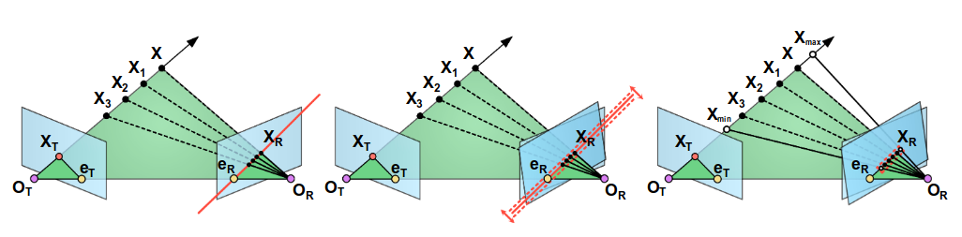
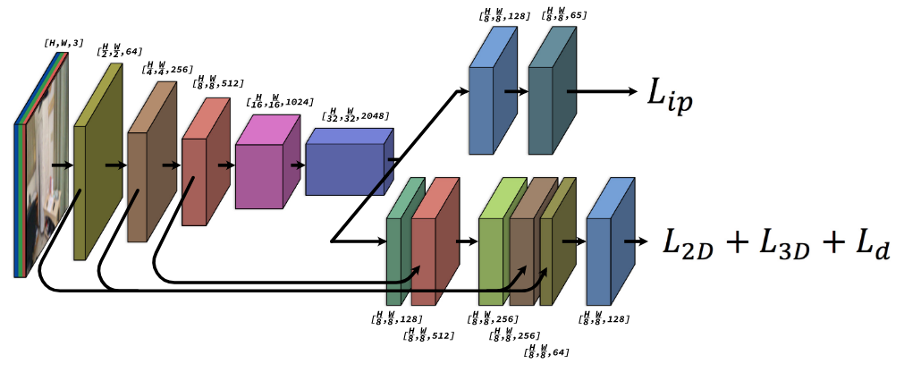
Part 2. DELTAS
Pipeline:
Feature point extraction and descriptor calculation: SuperPoint is used to extract feature points and calculate descriptor of target image
Feature point matching and triangulation: Sample descriptors according to the relation of polar geometry Triangulate the feature points by SVD singular value decomposition method
Densify the sparse depth map: The encode(Resnet 50 based)-decode schema generates the final dense depth map The space pyramid pool module is used to obtain the characteristics of different receptive fields
Fig. 2. Epipolar sampling
Fig. 3. SuperPoint-like network with detector and descriptor heads.

Slide 8
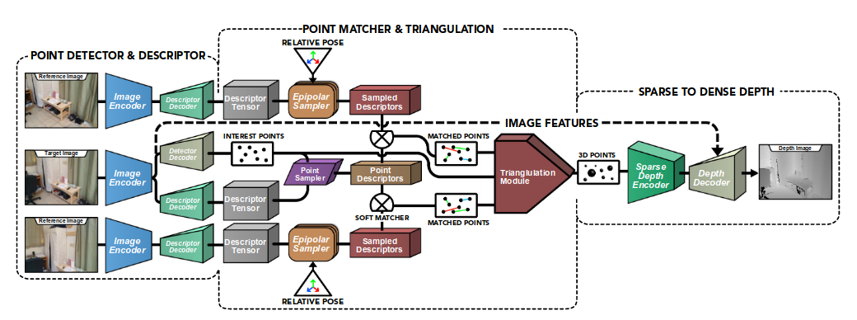
Part 2. DELTAS
Fig. 4. End-to-end network for detection and description of interest points, matching and triangulation of the points and densification of 3D points for depth estimation.

Slide 9
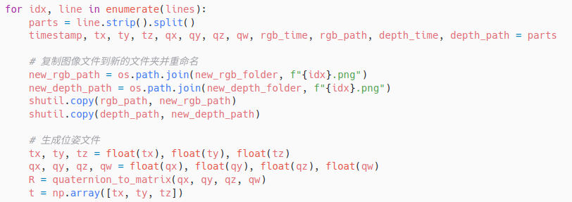
Part 2. DELTAS
Tum dataset: https://cvg.cit.tum.de/rgbd/dataset/freiburg1/rgbd_dataset_freiburg1_xyz.tgz
Dataset process:
translate into ScanNet form
rgbd_dataset_freiburg1_xyz
├── accelerometer.txt
├── associate.txt # offcial tools generated
├── depth
│ ├── 1305031102.160407.png
│ ├── ...
│ └── 1305031128.754646.png
├── depth.txt
├── groundtruth.txt
├── rgb
│ ├── 1305031102.175304.png
│ ├── ...
│ └── 1305031128.747363.png
└── rgb.txt

Slide 10
Part 2. DELTAS
 | AbR | SqR | AbD/MAE | RMSE | RMSE log
1 frame | 0.802 | 3.408 | 4.209 | 4.349 | 1.647
2 frames | 0.802 | 3.390 | 4.199 | 4.325 | 1.643
4 frames | 0.803 | 3.378 | 4.192 | 4.312 | 1.639
5 frames | 0.803 | 3.381 | 4.194 | 4.313 | 1.642
7 frames | 0.803 | 3.379 | 4.193 | 4.311 | 1.640
Table 4. Performance of depth estimation in tum dataset using sequences of length 3.

Slide 11
References
Sinha, A., Murez, Z., Bartolozzi, J., Badrinarayanan, V., & Rabinovich, A. (2020). DELTAS: Depth Estimation by Learning Triangulation And densification of Sparse points. In ECCV. Retrieved from https://arxiv.org/abs/2003.08933
Daniel DeTone, Tomasz Malisiewicz, Andrew Rabinovich. (2018). SuperPoint: Self-Supervised Interest Point Detection and Description. In 2018 IEEE/CVF.
Inference Code for DELTAS: Depth Estimation by Learning Triangulation And densification of Sparse points (ECCV 2020). Retrieved from https://github.com/magicleap/DELTAS

