Slide 1
Employee Attrition Using Machine Learning
Presented by: Faranak Yousefi
Date: October 06, 2025

Slide 2
Question we are solving
What are the primary factors influencing employee attrition in a company, and how do they contribute to predicting turnover?
We're figuring out the main reasons why people quit their jobs, like feeling overworked or underpaid.
Using that knowledge to build a tool that spots who might leave soon, so companies can step in and help them stay.

Slide 3
Why does this matter?
Employee turnover is expensive. It costs a lot to hire and train new people, and teams lose valuable knowledge and productivity when someone leaves.
By understanding why people quit, HR teams can create better plans, like offering more flexible hours, fairer pay, or training programs, to keep everyone happier and boost overall company success.
Current challenges:
Many companies react after someone quits, instead of preventing it.
Without clear insights, it's hard to know who needs support, leading to surprise departures and disrupted teams.

Slide 4
What can we do to achieve this?
Machine learning can help by:
Looking at employee data to spot patterns in why people leave.
Building a smart system that predicts who might quit based on those patterns.
Giving HR easy-to-use tools to act early, like suggesting pay raises or better work schedules.
What Is Currently Missing?
Most companies don't have simple ways to predict quits in advance, so they miss chances to keep good people.
We need straightforward insights from data to make smarter decisions without guesswork.

Slide 5
How did we achieve this?
In this project, we used real employee data, explored it carefully, and built a predictive models step by step to highlight what matters most for keeping people around.
Problems like this are usually solved by:
Gathering information and Collecting data
Cleaning and organizing that info to make sense of it
Using smart programs to find hidden connections and predict behaviors
Testing different approaches to pick the best with reliable predictions

Slide 6
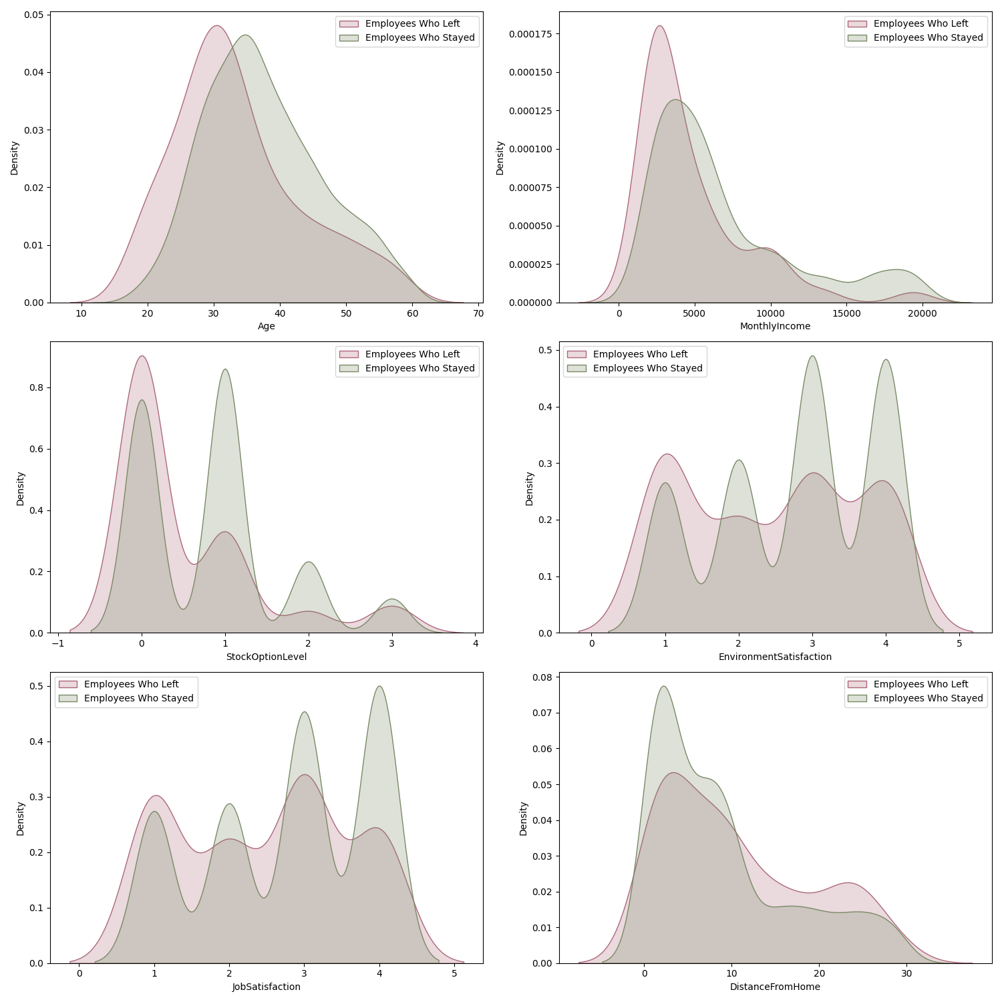
Data Insights
These histograms visualize the probable relations between each factor on attrition:
Age
Monthly Income
Stock Option Level
Environment Satisfaction
Job Satisfaction
Distance From Home

Slide 7
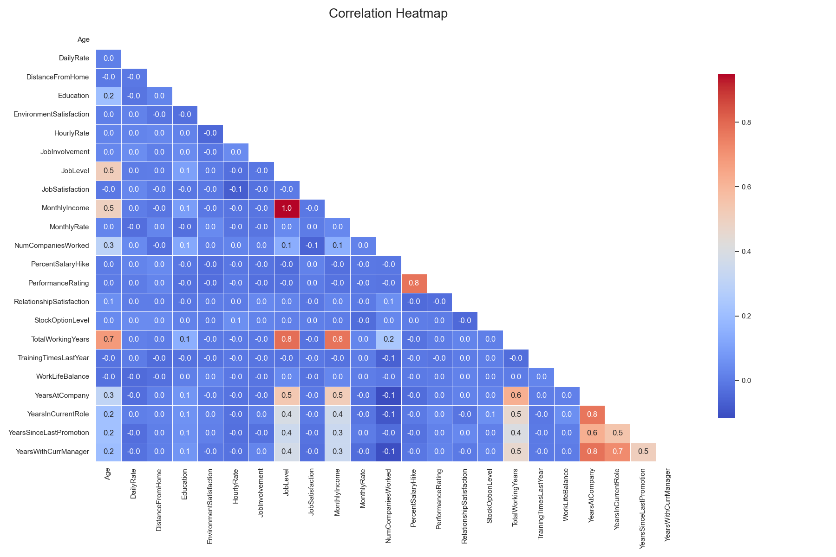
Data Insights
Correlation Heatmap

Slide 8
How we achieved to this conclusion
We started with basic checks on the data to spot important trends.
Then, we created a smart prediction tool using everyday employee info.
We improved it by balancing the data (since fewer people quit than stay) and testing different versions to find the most accurate one.
Finally, we used helpful explanations to understand why the tool makes certain predictions, like how extra work hours matter more when pay is low.
This step-by-step approach ensured our findings are trustworthy and useful.

Slide 9

What was the outcome?
Our best tool, a tuned Gradient Boosting model, achieves a strong overall performance with a weighted F1-score of about 94% and an AUC-ROC of 94%, meaning it's very good at distinguishing between employees who stay and those who might leave. For the rarer cases of actual quits, we improved detection to 42% accuracy after adjusting the model's decision point (threshold tuning) to catch more potential risks.
The model also predicted that factors like working overtime and low monthly pay strongly increase the chance of leaving, especially when combined—our explainability tool (SHAP) showed how these interact, like overtime having a bigger negative effect on lower-paid workers.
We ran into a challenge in: Dealing with uneven data (far more stayers than leavers), but we fixed it using a technique called SMOTE to balance the training and make predictions fairer.
Overall, the tool combines multiple smart methods (like ensembles) to provide reliable, explainable predictions.

Slide 10
What does it mean for HR strategy
Focus on key areas: Use the model's insights to prioritize reducing overtime, especially for roles with lower pay, as our analysis (via SHAP interactions) shows this combo drives quits the most.
Support at-risk groups: Target employees with long commutes or low job happiness with personalized plans, backed by the model's feature importance rankings (e.g., distance and satisfaction as top predictors).
Build a stronger team: Leverage the ensemble approach's accuracy to train managers on early signs and integrate machine learning predictions into HR tools for ongoing monitoring.
Save money and time: By using techniques like threshold tuning to boost detection of potential leavers, companies can act proactively, potentially cutting turnover by 10-20% and avoiding costs from unexpected departures.
This blends data-driven tech with practical steps to create a happier, more stable workplace.

Slide 11

Implementation plan and next step
Short-term: Share model findings with leaders, using simple visualizations from our EDA and SHAP explanations to highlight risks like overtime burdens.
Medium-term: Build an easy dashboard that runs the Gradient Boosting predictions in real time, flagging high-risk employees and suggesting fixes based on feature insights.
Long-term: Refine the model with more data, testing advanced tweaks like adding new factors (e.g., economic trends) or using similar tech like XGBoost for even better accuracy.
Next Steps: Gather team feedback on predictions, pilot the tool in one department, and scale company-wide to potentially reduce quits by 10-20% through smarter, data-backed decisions.

Slide 12
Summary: Our Goal
Understand why employees leave using data exploration
Spot patterns with smart analysis techniques
Build a prediction tool combining multiple models
Provide clear explanations for actionable insights

Slide 13
Summary: The Result
We found overtime, low pay, and unhappiness as top reasons, confirmed by technical rankings.
Our tool predicts well overall (94% scores) and improves on spotting quits with tuning.
The model predicted:
Extra work hurts more when pay is low key for targeted fixes.
Factors like commute distance and short time at the company add to risks.
The model prediction will lead to higher: Retention and team satisfaction through early actions.
The model prediction will avoid any impact to business bottom-line: By minimizing surprise quits with machine learning-driven strategies, saving on hiring and training.

Slide 14
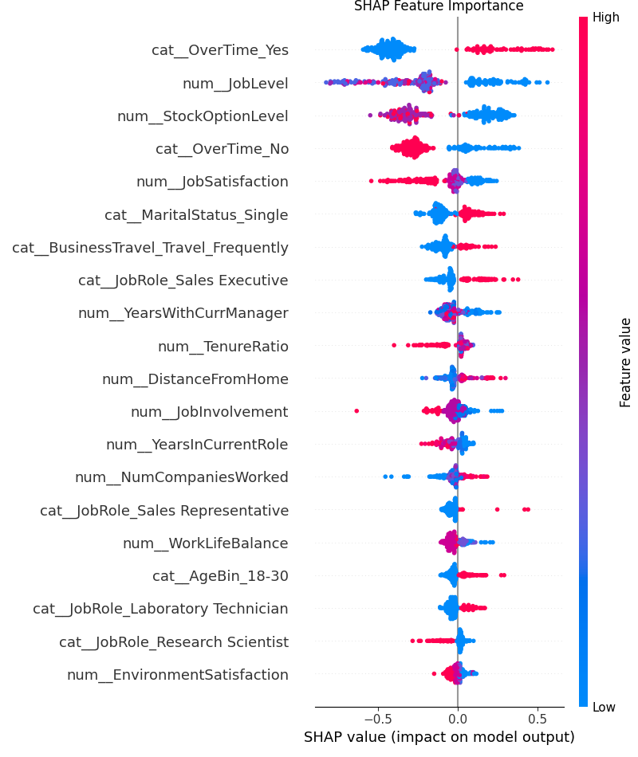
Questions

