Slide 1
HUMANOIDTH / CONNECTING THAI ROBOTICS
THE VISION
Competition moves
Thai robotics
forward.
COMPANIES
01
Bring real challenges
02
LEARNERS
Build and improve
03
PROJECTS
Connect companies. Grow learners.
Build projects. Show progress.
Show measurable progress
A shared home for Thailand’s robotics community.
CONNECT PEOPLE. CREATE CHALLENGES. KEEP IMPROVING.
01 / 06
Notes:
SLIDE 1 — 20 seconds
My goal is to bring Thailand’s robotics companies and learners together. HumanoidTH connects real challenges with people who want to learn and build. Competition gives teams a clear goal, useful feedback, and a reason to turn their ideas into better robotics projects.

Slide 2
HUMANOIDTH / CONNECTING THAI ROBOTICS
01 / CONNECT THE COMMUNITY
Two groups.
One shared opportunity.
Companies
Learners
BRING
BRING
Challenges, technology, mentors
↔
Curiosity, skills, teamwork
GAIN
GAIN
New ideas and visible talent
Practice, feedback, recognition
Universities + labs + service providers support the shared journey.
CONNECT PEOPLE. CREATE CHALLENGES. KEEP IMPROVING.
02 / 06
Notes:
SLIDE 2 — 35 seconds
We are designing the platform around two groups. Companies can bring robots, practical problems, and mentors. In return, they can discover ideas and people with useful skills. Learners bring curiosity and teamwork, but they need a clear starting point and a way to show what they can do. HumanoidTH connects these groups through shared challenges. Universities, labs, and service providers can support the journey. These are the needs and partnerships we want to validate in our first pilot.

Slide 3
HUMANOIDTH / CONNECTING THAI ROBOTICS
02 / COMPETITION DRIVES PROGRESS
Every round should
produce a better solution.
01
Challenge
02
Learn
03
Build
A useful problem
A clear starting point
A working solution
06
Improve
05
Feedback
04
Compete
Try the next version
Evidence and review
Shared rules and tasks
The next round turns feedback into progress.
CONNECT PEOPLE. CREATE CHALLENGES. KEEP IMPROVING.
03 / 06
Notes:
SLIDE 3 — 45 seconds
The central idea is that competition makes progress visible. A company or service provider proposes a challenge. Learners study the skills they need, build a solution, and enter the competition. Evaluation gives them evidence and feedback. They then improve their solution and return for another round. A shared task and clear rules help teams compare their work fairly. We want to reward improvement, clear communication, and useful solutions, so the value of the competition continues after the event ends.

Slide 4
HUMANOIDTH / CONNECTING THAI ROBOTICS
03 / FROM CHALLENGE TO PROJECT
A clear problem.
A project teams can build and improve.
Compare each attempt
EXAMPLE PROJECT
Get from start to goal.
Avoid the obstacles.
Goal reached
Commands used
Write commands, run
Review the replay, improve
Collisions detected
Replay and recorded results
5 x 5 navigation simulation
Start in simulation. Grow into partner-led hardware challenges.
CONNECT PEOPLE. CREATE CHALLENGES. KEEP IMPROVING.
04 / 06
Notes:
SLIDE 4 — 60 seconds
Here is one project that makes the idea concrete: robot navigation. A company could propose a task such as moving from a starting point to a destination while avoiding obstacles. Our current grid simulator gives beginners a simple place to start. Teams write movement commands, save their program, run it, and inspect the replay. They can see whether the goal was reached, how many commands they used, and where a collision happened. After feedback, they change the program and try again. Those attempts make progress visible. This is the project journey we want to support: from a clear problem to a working solution and evidence of improvement. Partner-led hardware challenges would be a later step.

Slide 5
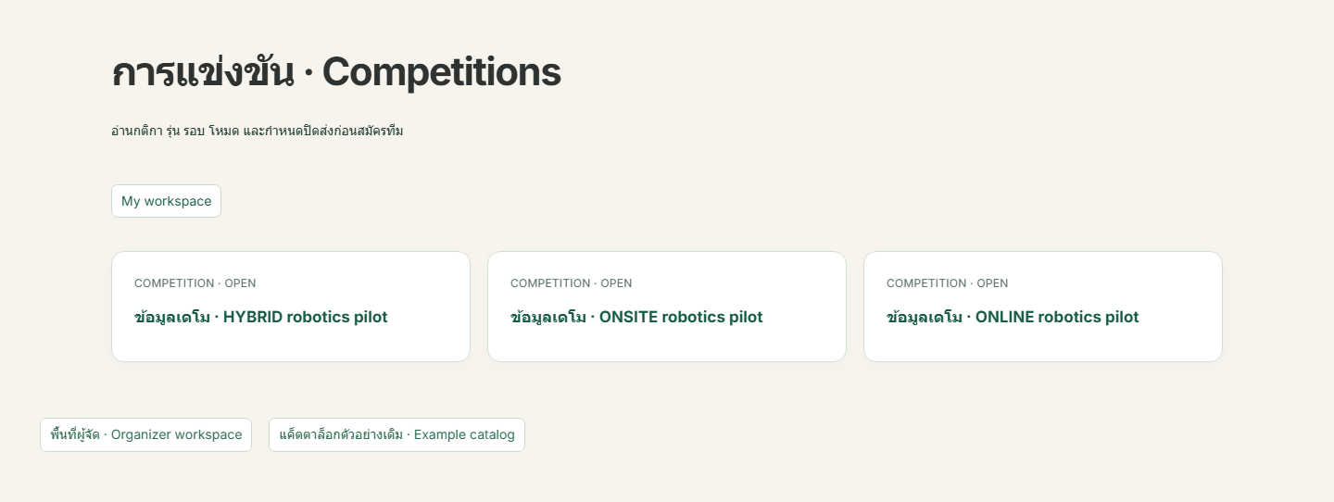
HUMANOIDTH / CONNECTING THAI ROBOTICS
04 / A WORKING SOFTWARE PILOT
One platform supports
the journey from learning to results.
01
Learn
Robot discovery + lessons
02
Practise
Saved programs + run history
03
Compete
Entries + judging + results
Actual competition page • demonstration events in the software pilot
CONNECT PEOPLE. CREATE CHALLENGES. KEEP IMPROVING.
05 / 06
Notes:
SLIDE 5 — 50 seconds
The project already has a working software pilot. Learners can explore robot information, follow lessons, and practise in a saved-program simulator. Their programs and run history give them something concrete to improve and share. Competition workflows support team registration, judging, appeals, and published results. Companies have model profiles, review and versioning workflows, and control over which results become public. This screenshot shows the competition page with demonstration events. Our aim is to bring these features into one shared journey, so a learner can start with a lesson, build a project, and show their progress through a competition.

Slide 6
HUMANOIDTH / CONNECTING THAI ROBOTICS
One challenge.
A community that keeps improving.
1
1
1
Company partner
Learning community
Robotics challenge
Measure: completed solutions • improvement • participant feedback
Help us shape the first pilot challenge.
CONNECT PEOPLE. CREATE CHALLENGES. KEEP IMPROVING.
06 / 06
Notes:
SLIDE 6 — 30 seconds
Our next step is a focused pilot: one company partner, one learning community, and one robotics challenge. We would measure completed solutions, improvement between rounds, and feedback from learners and company mentors. We are looking for partners to shape and test that first challenge with us. Companies bring challenges, learners bring ideas, and competition turns those ideas into working projects and progress for Thai robotics.

