Slide 1
HUMANOIDTH / ROBOTICS FOR BETTER LIVING
THE VISION
Competition moves
Thai robotics
forward.
COMPANIES
01
Bring real challenges
02
LEARNERS
Build and improve
03
PEOPLE
Connect companies. Grow learners.
Build for better living.
Benefit from better solutions
A shared home for Thailand’s robotics community.
CONNECT PEOPLE. CREATE CHALLENGES. KEEP IMPROVING.
01 / 06
Notes:
SLIDE 1 — 20 seconds
My goal is to bring Thailand’s robotics companies and learners together. HumanoidTH connects real challenges with people who want to learn and build. Competition gives them a reason to improve, and wellness gives that progress a human purpose.

Slide 2
HUMANOIDTH / ROBOTICS FOR BETTER LIVING
01 / CONNECT THE COMMUNITY
Two groups.
One shared opportunity.
Companies
Learners
BRING
BRING
Challenges, technology, mentors
↔
Curiosity, skills, teamwork
GAIN
GAIN
New ideas and visible talent
Practice, feedback, recognition
Universities + labs + service providers support the shared journey.
CONNECT PEOPLE. CREATE CHALLENGES. KEEP IMPROVING.
02 / 06
Notes:
SLIDE 2 — 35 seconds
We are designing the platform around two groups. Companies can bring robots, practical problems, and mentors. In return, they can discover ideas and people with useful skills. Learners bring curiosity and teamwork, but they need a clear starting point and a way to show what they can do. HumanoidTH connects these groups through shared challenges. Universities, labs, and service providers can support the journey. These are the needs and partnerships we want to validate in our first pilot.

Slide 3
HUMANOIDTH / ROBOTICS FOR BETTER LIVING
02 / COMPETITION DRIVES PROGRESS
Every round should
produce a better solution.
01
Challenge
02
Learn
03
Build
A useful problem
A clear starting point
A working solution
06
Improve
05
Feedback
04
Compete
Try the next version
Evidence and review
Shared rules and tasks
The next round turns feedback into progress.
CONNECT PEOPLE. CREATE CHALLENGES. KEEP IMPROVING.
03 / 06
Notes:
SLIDE 3 — 45 seconds
The central idea is that competition makes progress visible. A company or service provider proposes a challenge. Learners study the skills they need, build a solution, and enter the competition. Evaluation gives them evidence and feedback. They then improve their solution and return for another round. A shared task and clear rules help teams compare their work fairly. We want to reward improvement, clear communication, and useful solutions, so the value of the competition continues after the event ends.

Slide 4
HUMANOIDTH / ROBOTICS FOR BETTER LIVING
03 / COMPETITION FOR BETTER LIVING
A better welcome.
A visitor who stays in control.
Evaluate the experience
FIRST PROPOSED CHALLENGE
Find an activity room at a wellness centre.
Task completed
Next step understood
“How would you like me to help?”
Staff help / cancel works
Guide me
Call a staff member
Cancel
Comfort reported by users
Simulation today. Real-user trials are needed to establish wellbeing outcomes.
CONNECT PEOPLE. CREATE CHALLENGES. KEEP IMPROVING.
04 / 06
Notes:
SLIDE 4 — 60 seconds
Our first proposed wellness challenge is a better welcome at a wellness centre. Imagine a visitor who needs to find an activity room. The robot explains the options: guide me, call a staff member, or cancel. The visitor stays in control. Teams can compete to make this interaction clearer and more useful. We would evaluate task completion, whether people understand the next step, and whether cancellation or staff handoff works. We also want participants to tell us how comfortable they feel. Our current HRI demo records interaction events and outcomes in simulation. It does not prove a health benefit. The next step is testing with real users and a partner venue.

Slide 5
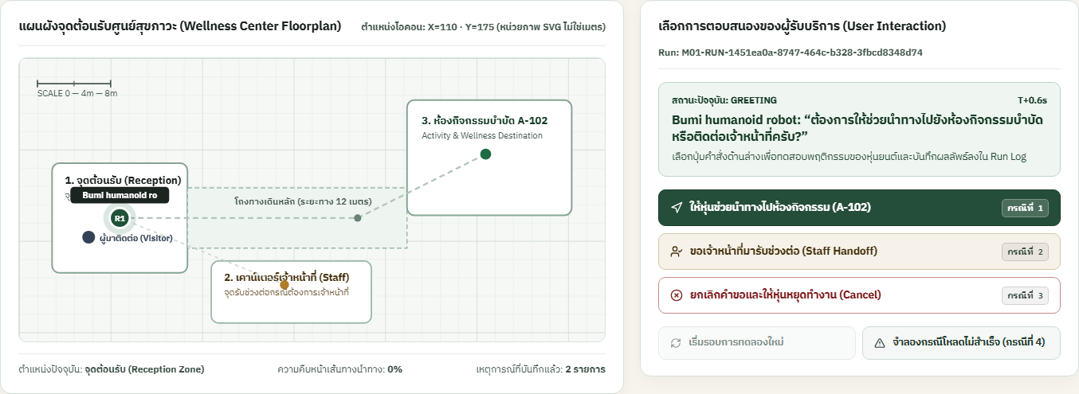
HUMANOIDTH / ROBOTICS FOR BETTER LIVING
04 / A WORKING SOFTWARE PILOT
One platform supports
the journey from learning to results.
01
Learn
Robot discovery + lessons
02
Practise
Saved programs + HRI runs
03
Compete
Entries + judging + results
Actual HRI interface • recorded simulation, not physical robot evidence
CONNECT PEOPLE. CREATE CHALLENGES. KEEP IMPROVING.
05 / 06
Notes:
SLIDE 5 — 50 seconds
We have built a software pilot to support this journey. Learners can explore robot information, follow lessons, and practise in a saved-program simulator. The HRI demonstration lets a visitor choose guidance, staff help, or cancellation and then inspect the recorded run. The platform also supports competition registration, judging, appeals, and results. Companies have review and versioning workflows, with controls over what becomes public. This screenshot is from the actual HRI application. It demonstrates a working software interaction. Physical robot testing and the wellness outcomes remain the next stage of validation.

Slide 6
HUMANOIDTH / ROBOTICS FOR BETTER LIVING
One challenge.
A community that keeps improving.
1
1
1
Company partner
Learning community
Wellness challenge
Measure: completed solutions • improvement • participant feedback
Help us shape the first pilot challenge.
CONNECT PEOPLE. CREATE CHALLENGES. KEEP IMPROVING.
06 / 06
Notes:
SLIDE 6 — 30 seconds
Our next step is a focused pilot: one company partner, one learning community, and one wellness challenge. We would measure completed solutions, improvement between rounds, and feedback from participants and the venue. We are looking for partners to shape and test that first challenge with us. Companies bring challenges, learners bring ideas, and competition turns those ideas into progress for Thai robotics and better everyday living.

