Slide 1
Zebra Crossing
Id:0242310005101237

Slide 2

Introduction
Objective: Ensure pedestrians arrive on red and leave on green using coordinated signals and clear rules.
Design combines signal timing, visible markings, and user cues to reduce conflicts and improve compliance.

Slide 3
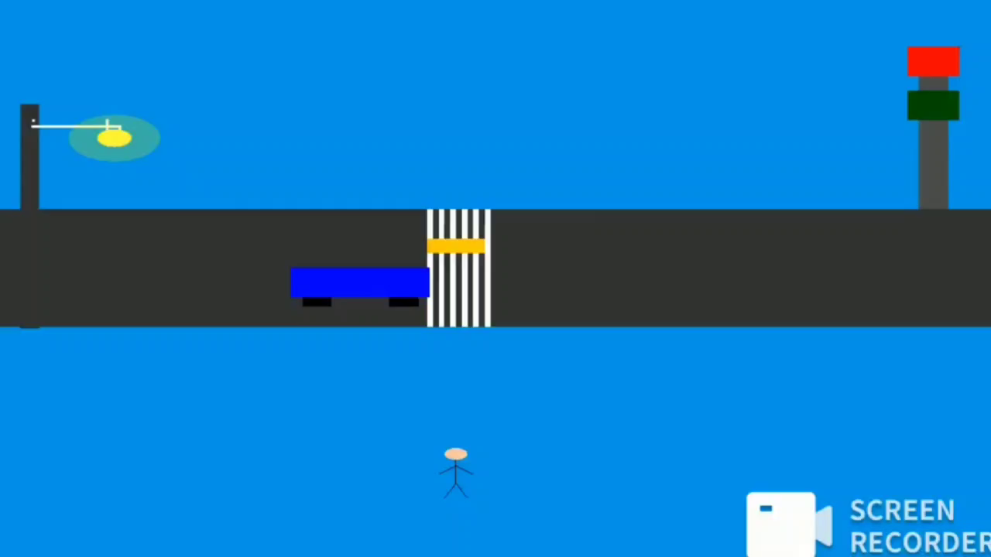

Slide 4

01
Crossing Operation

Slide 5
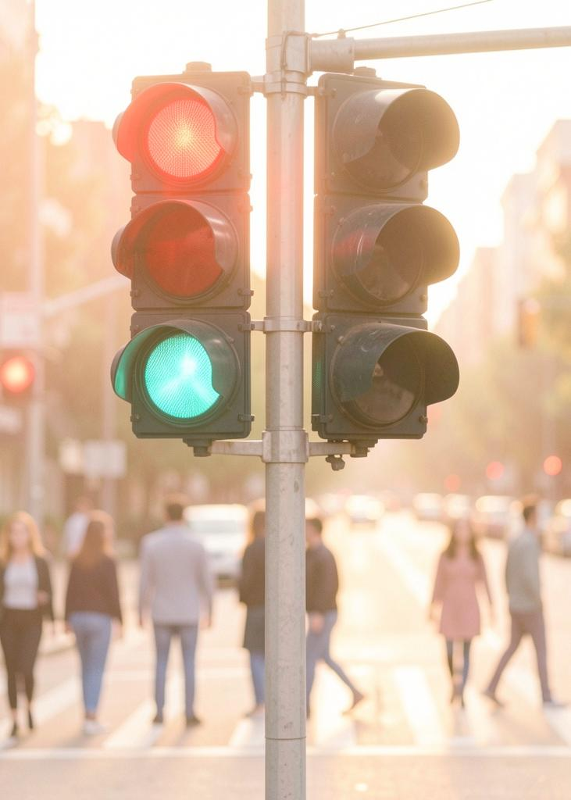
Signal Phases
Red phase: Stops vehicles; allows pedestrian arrival and safe waiting.
Green phase: Allows pedestrian departure and vehicle movement.
Use an all-red buffer to clear crossings between phases.

Slide 6
Smart barriers
Barriers apears whenever traffic signal turns Red
Barriers goes backward whenever traffic signal turns Green
Overall ensures safe and reliable passing:A happy safe passing experience.

Slide 7

01
Safety Measures

Slide 8
Visibility Enhancements
High-contrast zebra markings and LED curb lighting to improve sightlines.
Install countdown displays and audible signals for all users.

Slide 9
Behavioral Rules
Pedestrians start crossing only on red-arrival indication; avoid entering on flashing phases.
Drivers must yield during red and prepare at green transition.

Slide 10

Enforcement & Maintenance
Use cameras and sensors to monitor compliance and detect faults.
Schedule regular inspections and swift repairs to signals and markings.

Slide 11
Conclusions
Design crossings so arrival on red and departure on green are clear and enforced.
Combine timing, visibility, and maintenance to reduce conflicts and improve safety.

