Slide 1
BlackJack Project (BlackJack Game)
BACHELOR OF COMPUTER APPLICATIONS
Presented By: Ahmad Faraz Ansari (B.C.A. 5th Sem)
Batch Year: 2019 - 22

Slide 2
Introduction
BlackJack project is an off-line casino game developed entirely in java.
One of the world’s most renowned off-line casino game.
Simple rules.
Free to play.
Fair decision making algorithm.

Slide 3
objective
To create a simple yet enjoyable cards game.
To create a game which is less time and resource consuming.
Contains simple rules which can be easily understood.
No unfair means can interfere with winner announcement.

Slide 4
Modules used
Java.swing.*; // for GUI
Java.awt.event.*; // for event handling
Java.util.ArrayList; // for storing cards

Slide 5
Methods utilized
Using GUI based game window.
Creating an algorithm for smooth and effective handling of game.
Making platform independent by using Java.

Slide 6
Issues encountered
Choosing a suitable Programming Language.
Program being unable to run under quick response.
Making rules as simple as possible.
Giving more preference to UX and not taking UI design more seriously.
Decision making algorithm being slow and sometimes unresponsive.

Slide 7
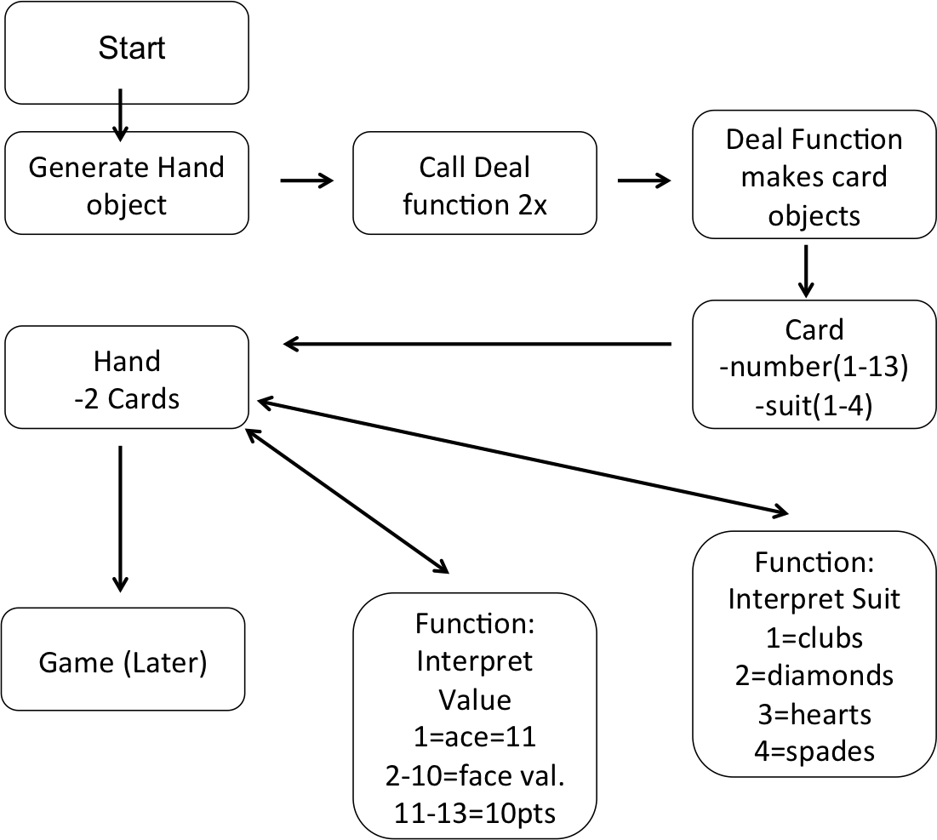
Data flow diagram

Slide 8
Rules of Blackjack project
Player and Dealer (game A.I.) both will have two cards but one dealer card will be kept hidden.
Main goal of Player is to make combination greater than dealer’s combination.
If Player’s combination is less than or equal to 21, then Player wins!
If combination is greater than 21, then Player/Dealer loses.

Slide 9
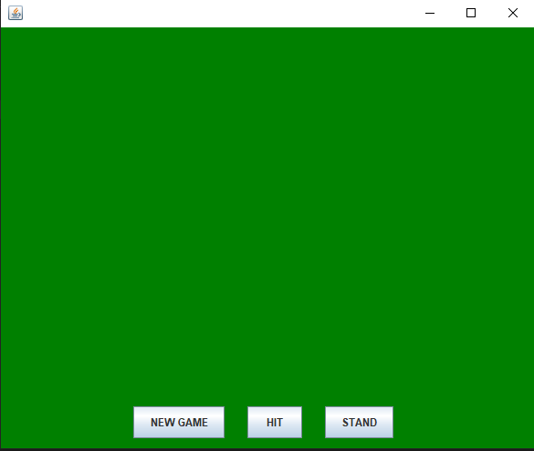
Game screenshots (home screen)

Slide 10
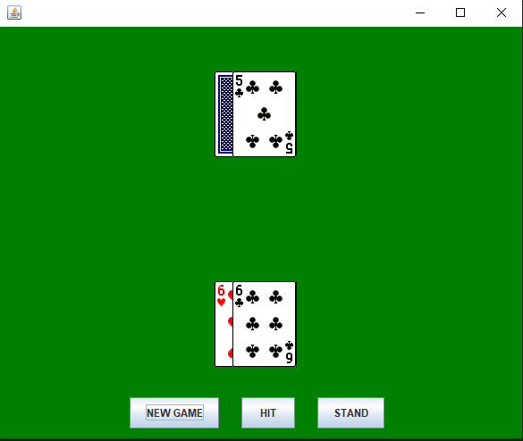
Game screenshots (active game screen)

Slide 11
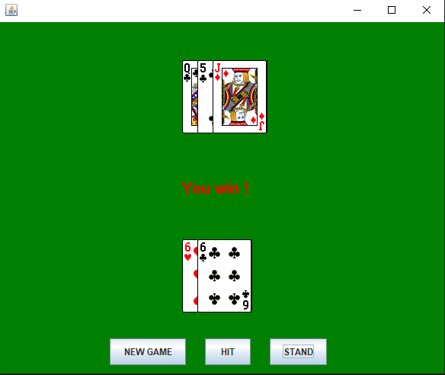
Game screenshots (win screen)

Slide 12
features
BlackJack is played against dealer (Game A.I.) or casino.
It can be used as a replacement to on-line games like Teen Patti etc.
Cost efficient, making it an excellent choice for Player with low hands.
Time and resource saver.
Secured environment that prevents file corruption.
Smooth and faster transitions.

Slide 13
Bibliography & references
https://app.diagrams.net/
https://www.ukessays.com/essays/computer-science/blackjack-playergame-development.php
https://www.123helpme.com/essay/Blackjack-Essay-483801
https://www.wikipedia.com/Blackjack

Slide 14
Thank you!

Slide 15
Any questions? Please feel free to ask them.

