Slide 1
Corona tweet classification
BACHELOR OF COMPUTER APPLICATIONS
Presented By: Ahmad Faraz Ansari (B.C.A. 6th Sem)
Batch Year: 2019 - 22

Slide 2
Introduction
Corona Tweet Classification is a Machine Learning Based Tweet Classification System.
Developed using Python 3.
This System Can Classify Tweets based on the underlying emotion (Positivity or Negativity or Neutrality).

Slide 3
objective
To create a System capable of Classifying Tweets.
Creation of System that has great accuracy and precision.
Classification is done on the basis of severeness of the underlying emotion.

Slide 4
Modules used
Pandas # For Data Analysis
Numpy # For Scientific Computing
Nltk # For Natural Language Processing
Sklearn # For Predictive Data Analysis
Seaborn # For Data Visualization

Slide 5
Methods utilized - 1
Part A). EDA (Explanatory Data Analysis):
Tasks to be achieved are :
Class Distribution.
Number of words in a Tweet.
Average word – length in a Tweet.
Common Stop words (Redundant Words).
Basic Pre-processing.

Slide 6
Methods utilized - 2
Part B). Technique:
Tweet Classification using SVM (Support Vector Machine)
Python Libraries: pandas, numpy, ntlk, sklearn, seaborn

Slide 7
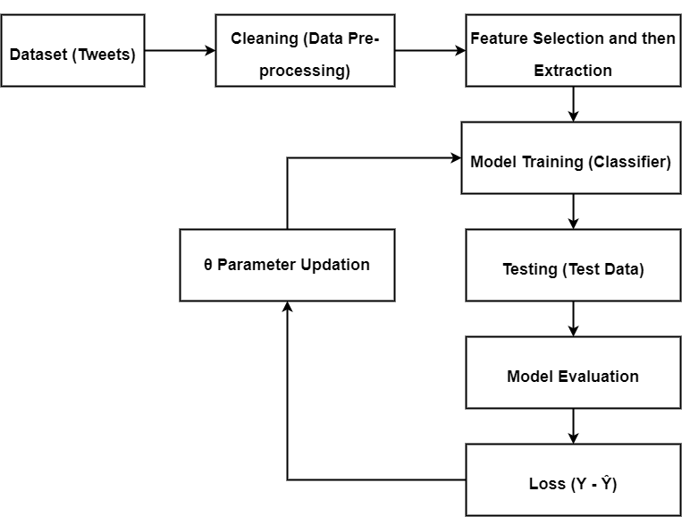
Machine learning pipeline diagram

Slide 8
Tables of Content
Requirements import
Loading Data Set
Pre-processing
Splitting Dataset
Tokenization
Padding Sequences
Modelling using SVM (Support Vector Machine)
Evaluation

Slide 9
Bibliography & references
https://app.diagrams.net/
Kaggle.com/preprocessing-in-NLP
Statistical Analysis using Machine Learning

Slide 10
Thank you!

Slide 11
Any questions? feel free to ask them.

