Slide 1

MADAN MOHAN MALAVIYA UNIVERSITY OF TECHNOLOGY
GORAKHPUR
CORONA TWEET CLASSIFICATION SYSTEM
Presented by:
AHMAD FARAZ ANSARI
Roll no.: 2023073006
M.C.A. 2nd Year (3rd Sem)
Under Supervision By:
MS. PRANJAL MAURYA
ASSISTANT PROFESSOR
DEPT. of ITCA

Slide 2
Contents
Abstract
Problem Statement
Need
Methodology
Corona Tweet Classification System
Performance Metrics
Advantages
Limitations
Future Work
References

Slide 3
Abstract
This report reflects the idea of taking user’s input into consideration and performing classification and establishing conclusion on interested topics using Machine – Learning algorithm.
Corona Tweet Classification System is a tweet classification system based on Machine learning. It takes user input as a tweet and then predicts the sentiment of that tweet i.e., whether the tweet is covid-positive or covid-negative.
After the prediction, the system displays the predicted sentiment i.e., covid-positive or covid-negative.

Slide 4
Problem Statement
The COVID-19 pandemic led to an overwhelming volume of tweets, making it difficult to manually analyze public sentiment toward the crisis. This project aims to develop a machine learning-based system that classifies tweets as COVID-positive or COVID-negative, enabling efficient and accurate sentiment analysis to support researchers, policymakers, and organizations in understanding public opinions during the pandemic.

Slide 5
Need
The COVID-19 pandemic caused a surge in social media activity, making manual analysis of tweets impractical.
Understanding public sentiment helps policymakers and organizations make informed decisions during crises.
Automated sentiment classification saves time and ensures consistency in analyzing large datasets.
Sentiment analysis provides insights into public opinions, concerns, and behaviors related to COVID-19.
A machine learning-based system improves accuracy and scalability compared to manual or traditional methods.

Slide 6
Methodology
Data collection and preprocessing.
Feature extraction (tweet length, polarity scores).
Model selection: Support Vector Machine (SVM).
Model training using labeled datasets.
Model testing and evaluation (F1 Score, Jaccard Index).
Prediction of sentiment for user-input tweets.

Slide 7
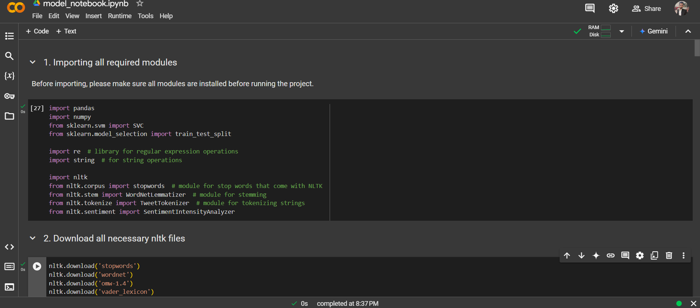
Corona Tweet Classification System

Slide 8
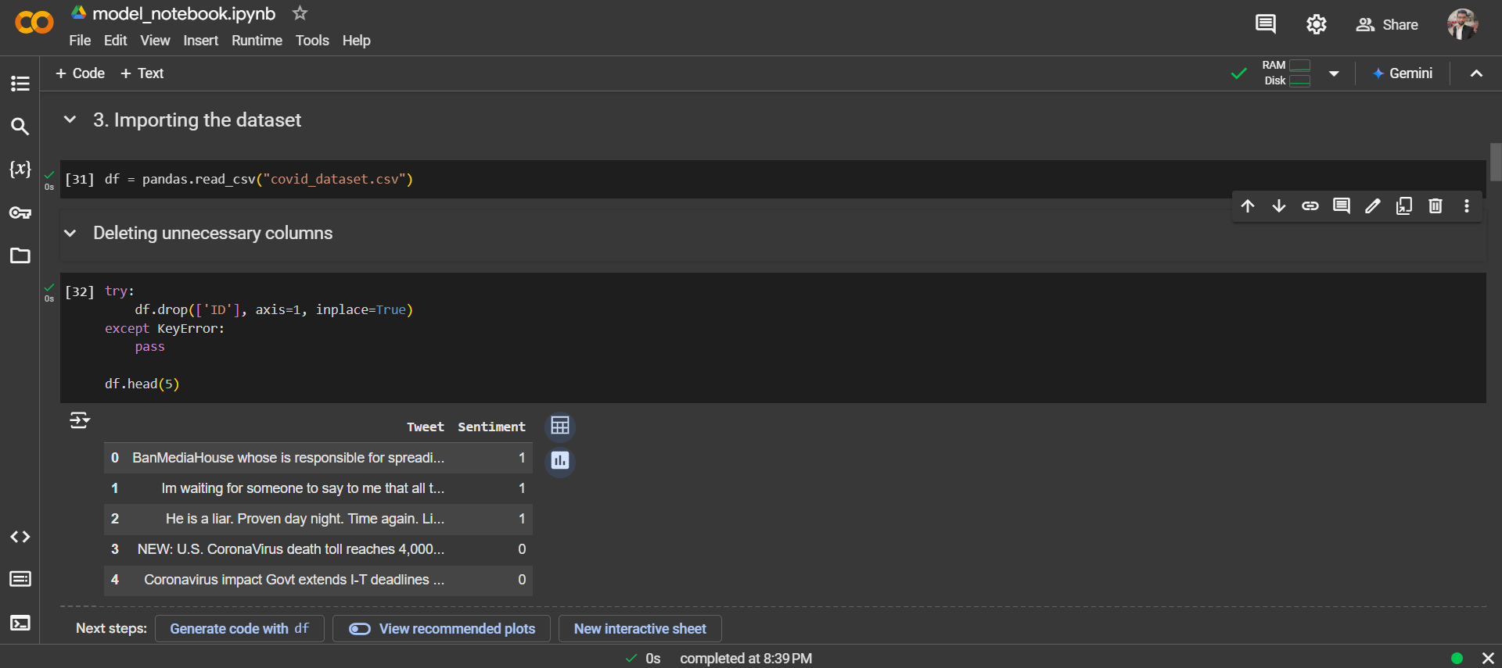

Slide 9
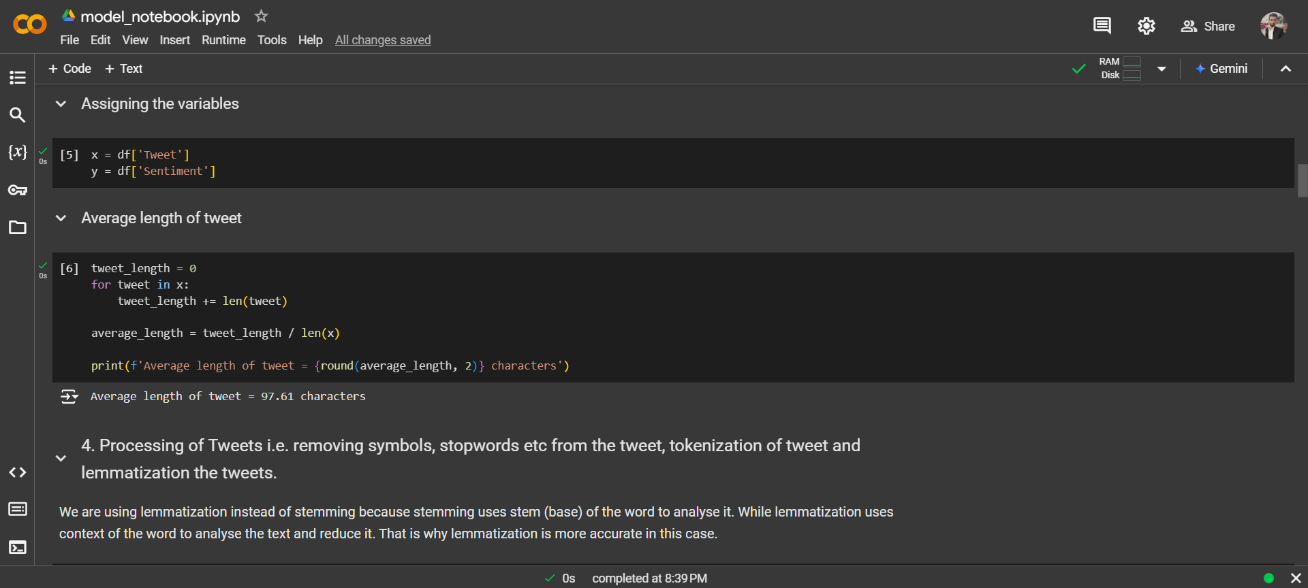

Slide 10
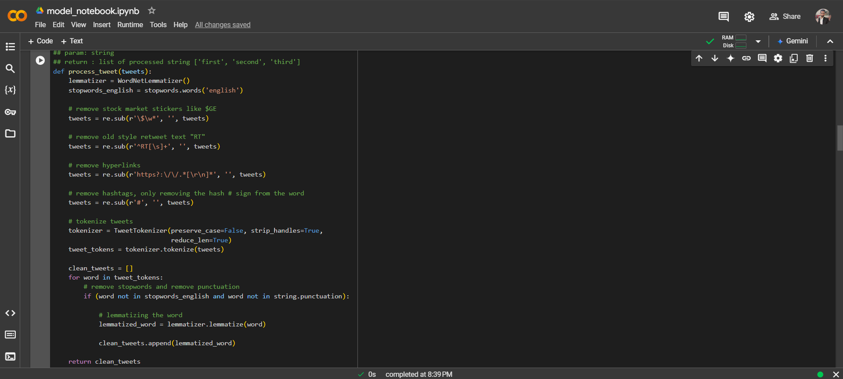

Slide 11
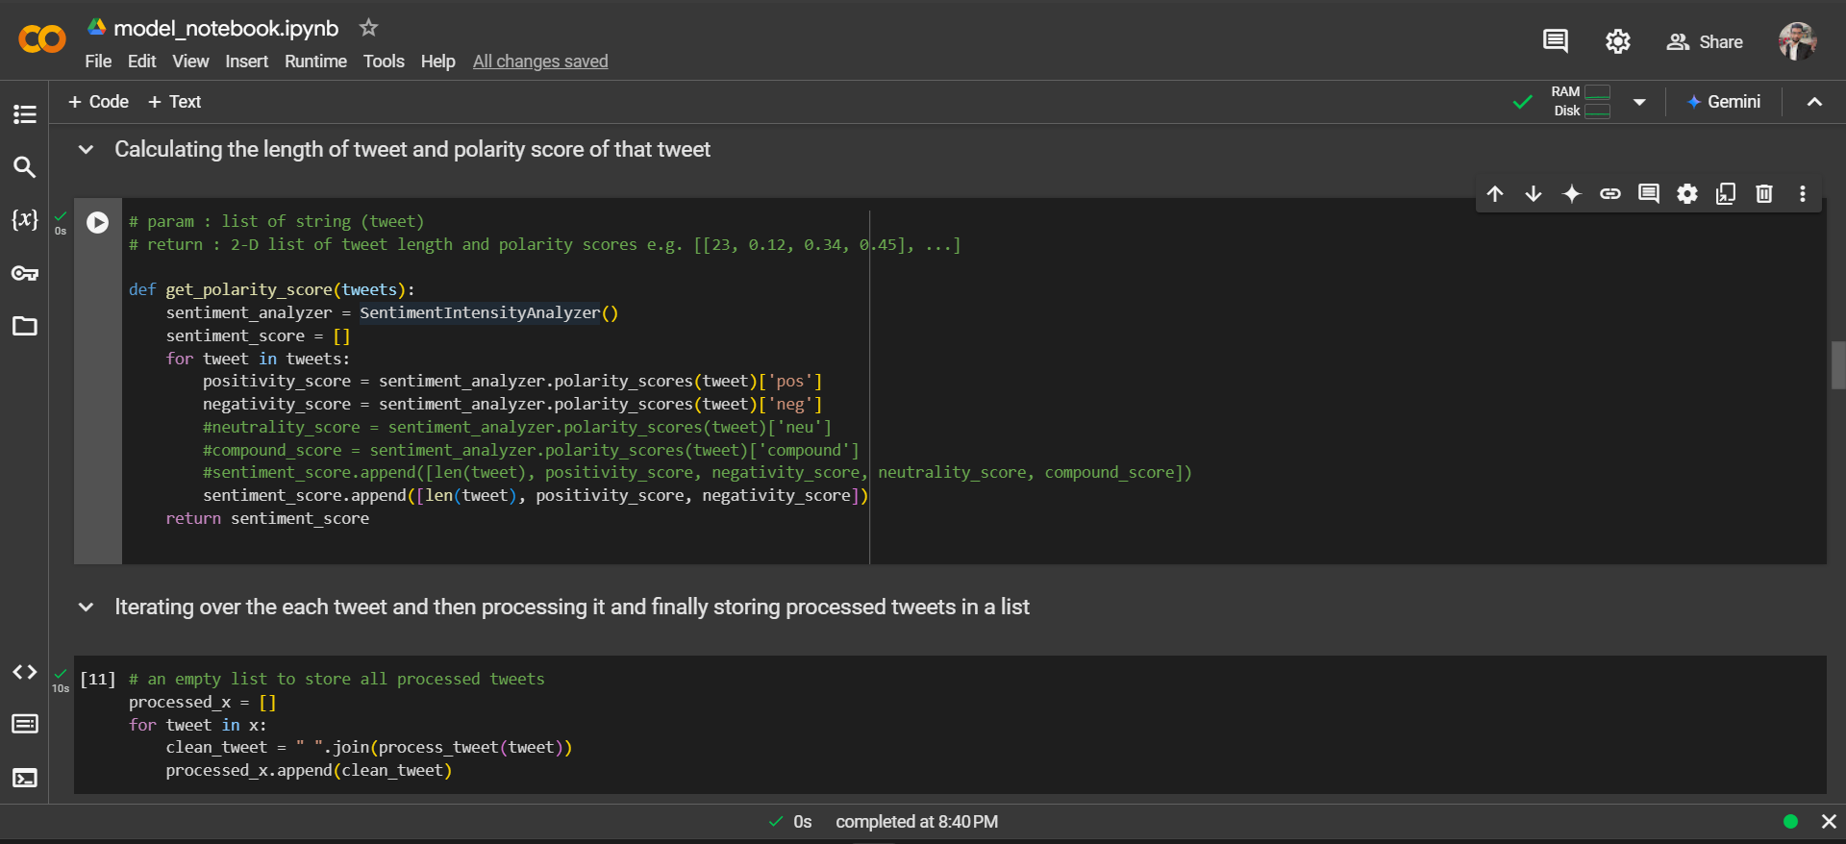

Slide 12
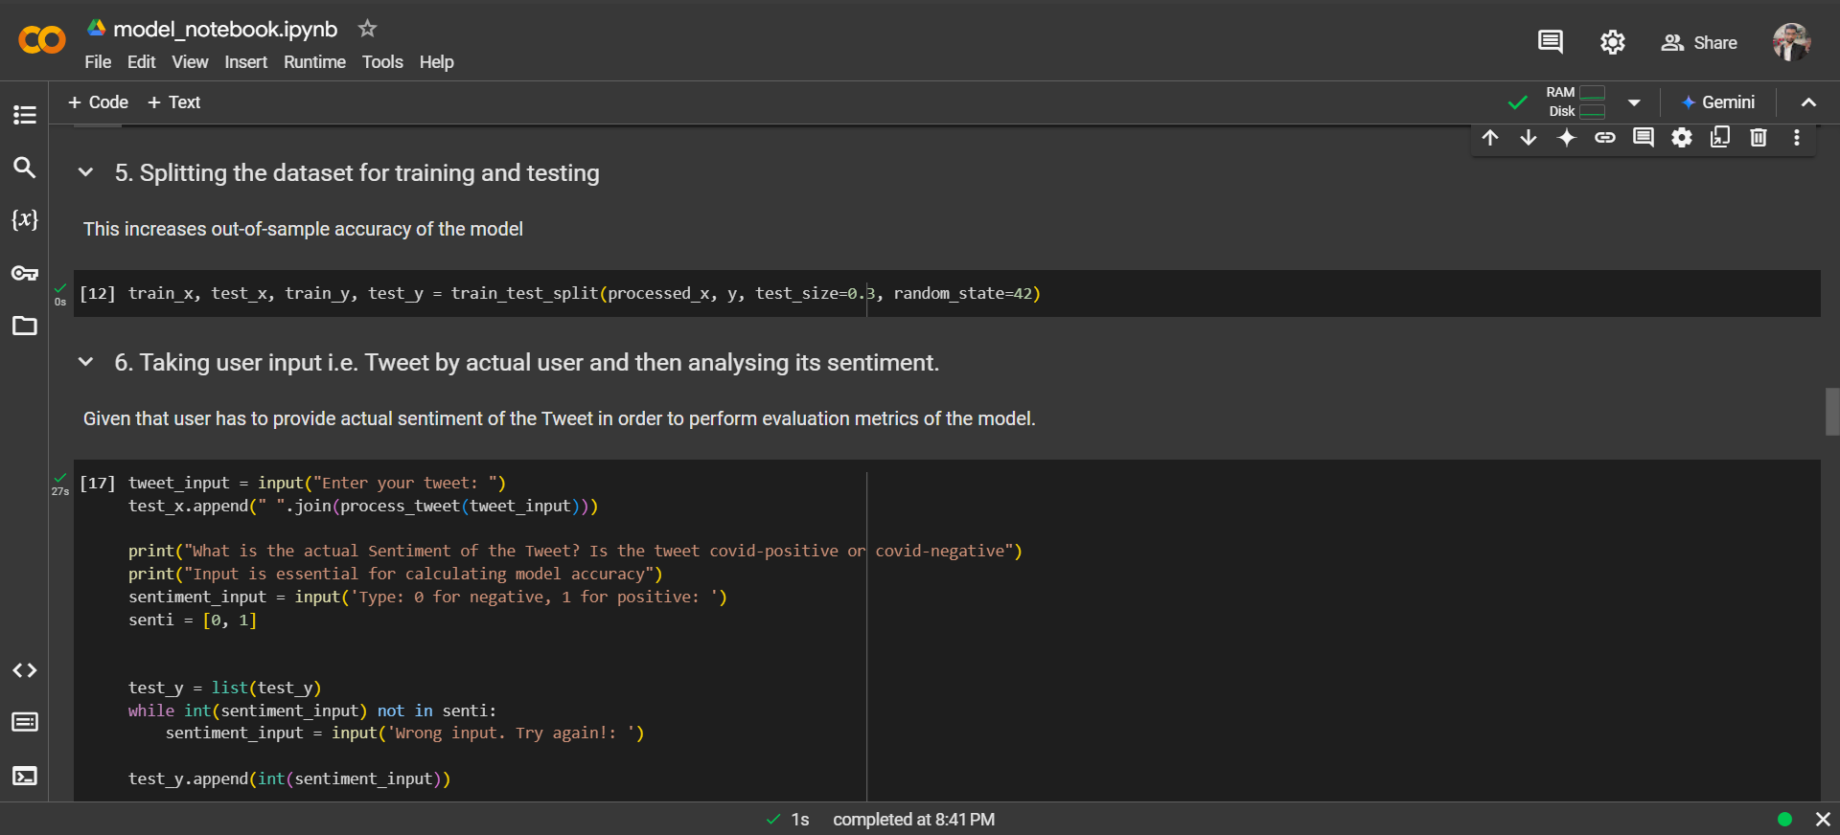

Slide 13
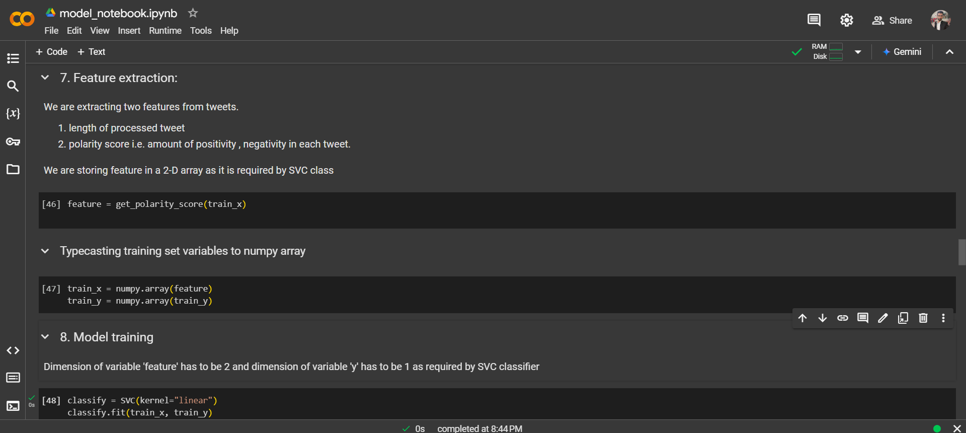

Slide 14
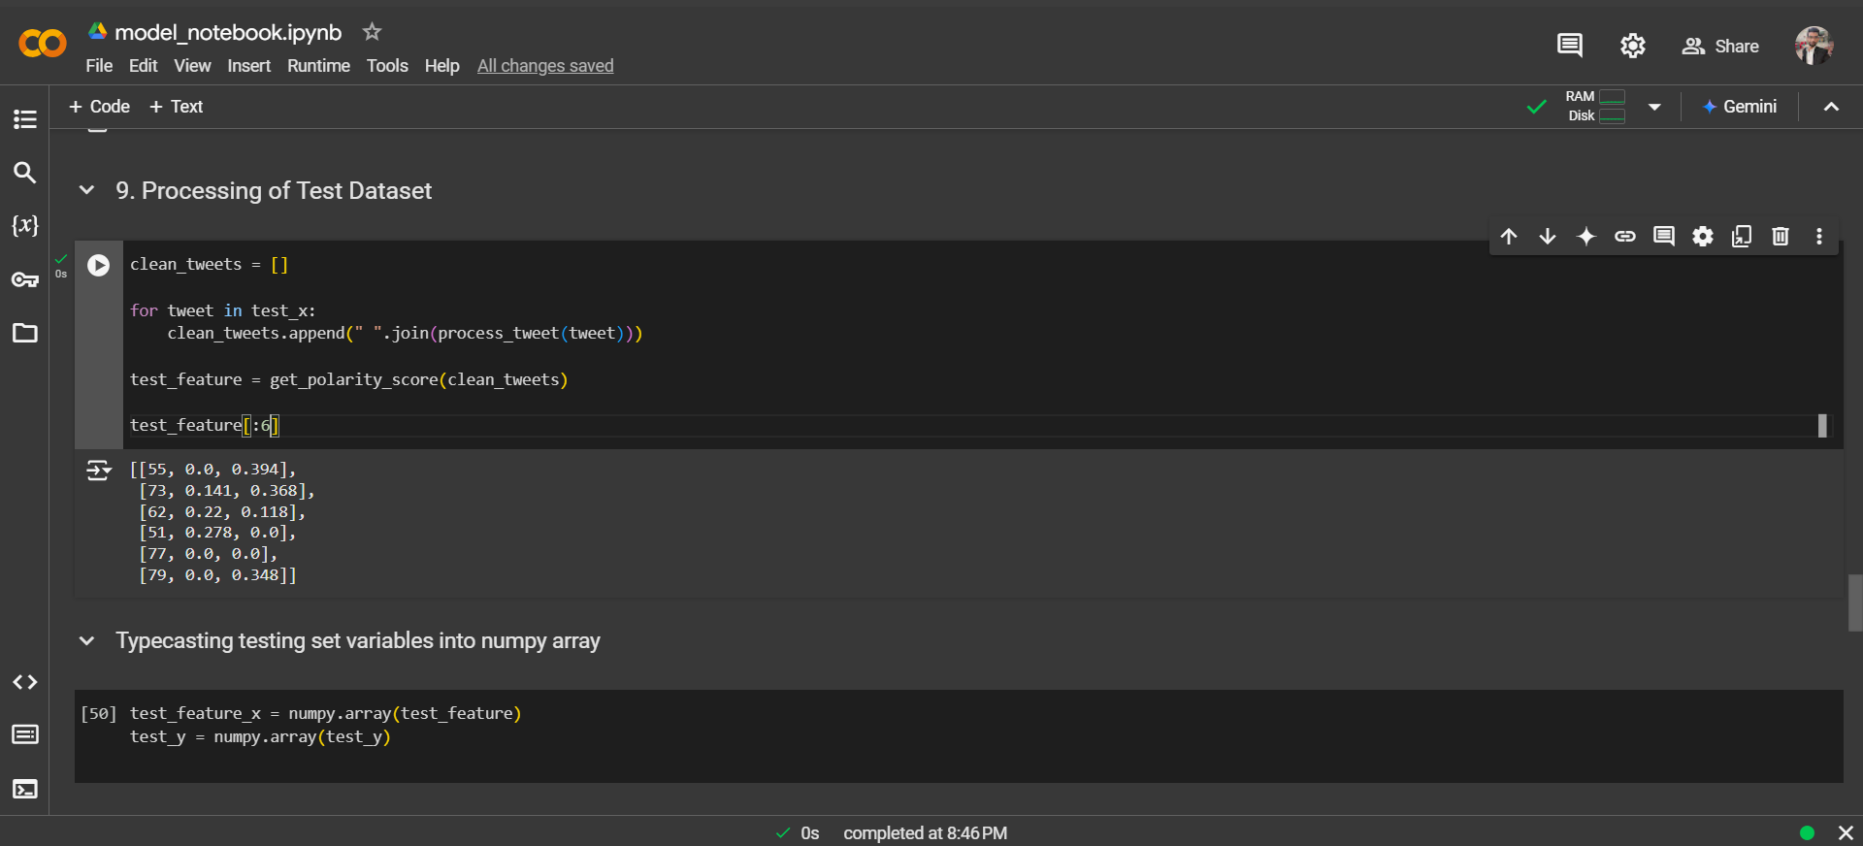

Slide 15
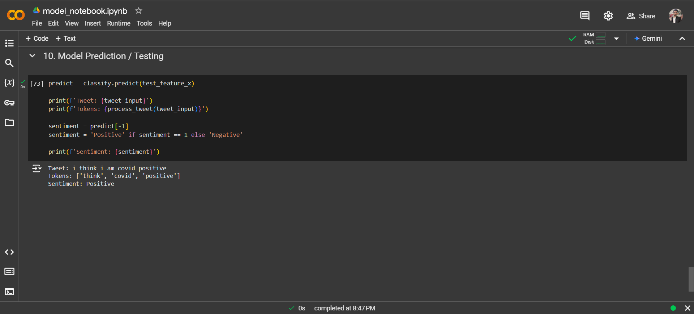

Slide 16
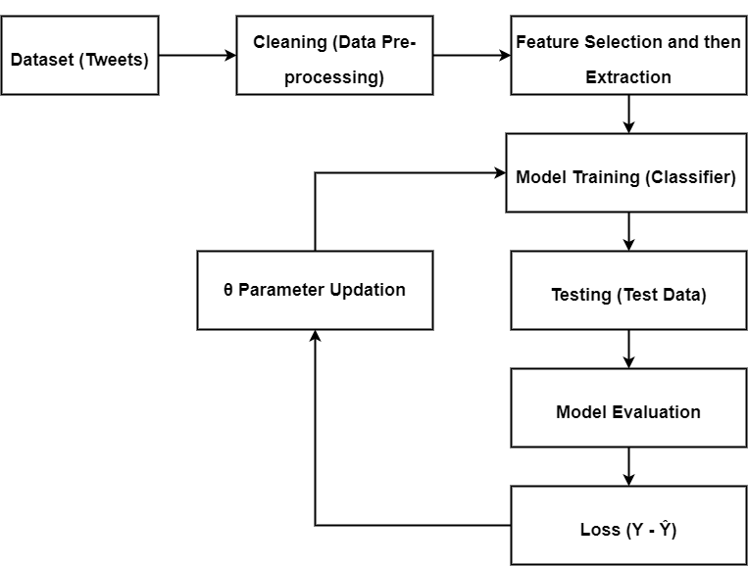
Machine Learning Pipeline Diagram

Slide 17
Performance Metrics
Following are the performance metrics:
F1 Score: Measures the accuracy of the model by considering both precision and recall.
Jaccard Index: Evaluates the similarity between predicted and actual sentiment sets.
Accuracy: Determines the percentage of correctly classified tweets out of the total.
Precision: Measures the proportion of correctly predicted positive observations to total predicted positives. Precision: Measures the proportion of correctly predicted positive observations to total predicted positives.
Recall (Sensitivity): Measures the proportion of correctly predicted positive observations to all actual positives.

Slide 18
Advantages
Automates sentiment analysis, saving time and effort compared to manual methods.
Provides accurate and consistent tweet classification using machine learning.
Enables real-time analysis of public sentiment during critical events like pandemics.
Scalable to handle large datasets with minimal resource requirements.
Helps researchers and organizations gain valuable insights into public sentiment trends.

Slide 19
Limitations
System relies heavily on the quality and size of the training dataset.
Struggles to classify tweets in multiple languages without additional preprocessing.
May misinterpret sarcasm, humor, or ambiguous statements.
Performance depends on the effectiveness of the preprocessing and feature extraction steps.
Requires periodic retraining to adapt to evolving language trends and contexts.

Slide 20
Future Work
Implement a user-friendly interface for easier interaction and analysis.
Expand the system to support multiple languages for broader applicability.
Integrate real-time data processing for live tweet sentiment classification.
Enhance the model’s accuracy by incorporating more advanced machine learning techniques.
Develop an executable version to eliminate the need for users to install Python or other dependencies.

Slide 21
References
Géron, A. Hands-On Machine Learning with Scikit-Learn, Keras, and TensorFlow. O'Reilly Media, 2019.
Ng, A. Machine Learning Yearning. DeepLearning.ai, 2018.
Deitel, P., & Deitel, H. Intro to Python for Computer Science and Data Science. Pearson, 2020.
Kaggle.com: Datasets and Resources for Machine Learning and Natural Language Processing

Slide 22
Thank You.

Slide 23
Any Question? Please feel free to ask them

