Slide 1

MADAN MOHAN MALAVIYA UNIVERSITY OF TECHNOLOGY
GORAKHPUR
FALL DETECTION SYSTEM USING WEARABLE SENSORS
Presented by:
BRIJKANT YADAV(2021071014)
AWANTIKA KRISHNA(2021071057)
DEVANSH PRAKASH(2021071061)
B.Tech I.T. 3rd Year (6th Sem)
Under Supervision By:
DR. R K DWIVEDI
ASSISTANT PROFESSOR
DEPT. of ITCA

Slide 2
CONTENTS
Abstract
Problem Statement
Need
Methodology
IoT-based fall monitoring system
Performance Metrics
Advantages
Limitations
Future Work
References

Slide 3
Abstract
This presentation explores the application of wearable sensors in the existing fall detection systems for elderly people to prevent false alarms that occur due to the lack of accuracy in the systems.
A fall detection system is a technological solution designed to detect and respond to falls, particularly among vulnerable populations such as the elderly or individuals with medical conditions by sending an alert to the emergency monitoring center, a loved one or 102.
IoT technology offers numerous benefits for fall detection systems which can provide more accurate, reliable, and responsive support for individuals at risk of falls, improving their safety, well-being, and quality of life.

Slide 4
Problem Statement
Existing fall detection systems for elderly monitoring lack accuracy, leading to false alarms and delayed responses. This compromises the safety of the elderly population. To address this, there's a need for an intelligent fall detection algorithm leveraging IoT technology. This algorithm should enhance accuracy through advanced techniques while seamlessly integrating with IoT infrastructure for real-time monitoring and timely notifications to caregivers and healthcare providers.

Slide 5
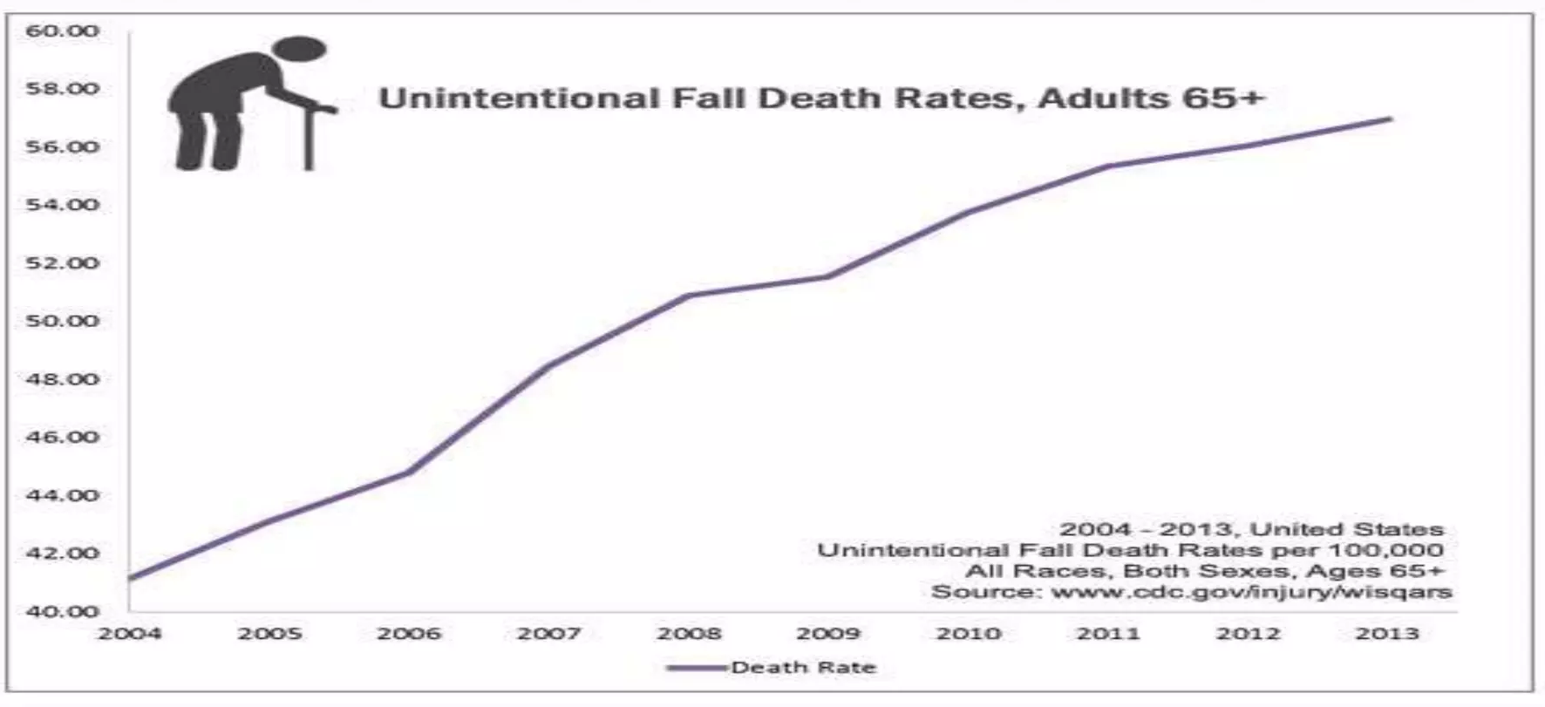
Need
Early detection and rapid response
Independence and quality of life
Peace of mind for caregivers
Reduced healthcare cost
Prevention of secondary complications
Support for aging population

Slide 6
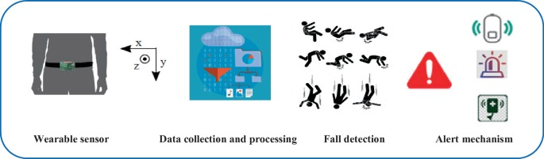
Methodology
Problem Analysis
Sensor Selection and placement
Data Collection
Data Preprocessing
Algorithm Development
Real-time Monitoring and Alerting
User Evaluation
Performance Evaluation
Deployment and Long-term Evaluation

Slide 7
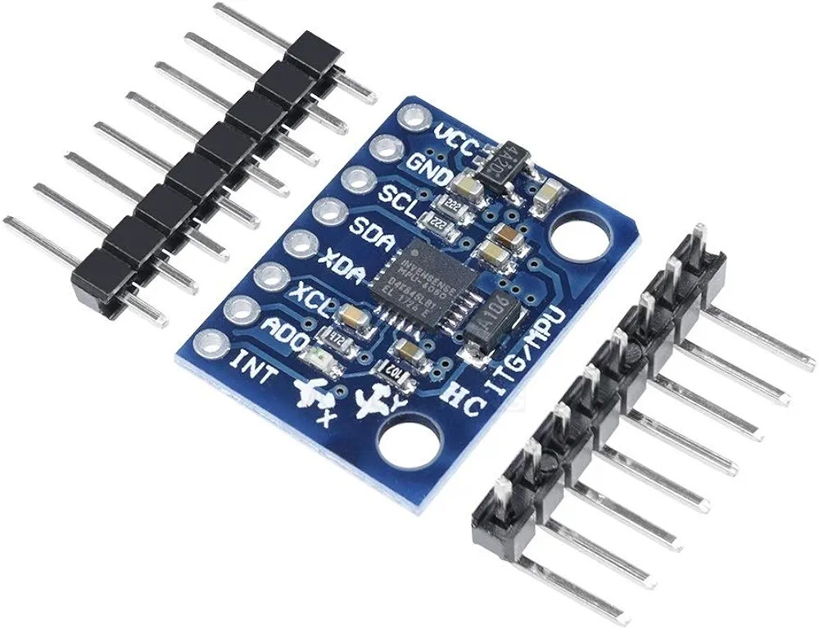
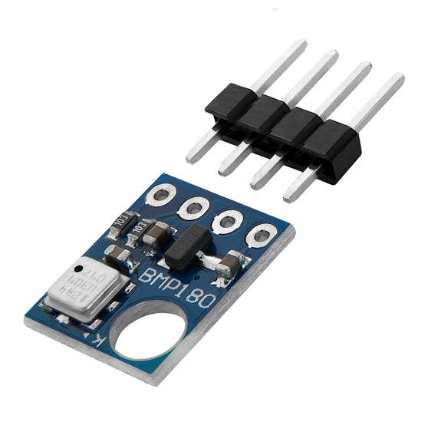
IoT-based Fall Monitoring system
SENSOR SELECTION AND PLACEMENT:
Sensor selection:
Tri-axial accelerometer
Gyroscope
Barometer (optional)
MPU-6050 Tri-axial gyroscope accelerometer CentIoT- BMP180 Barometric sensors

Slide 8
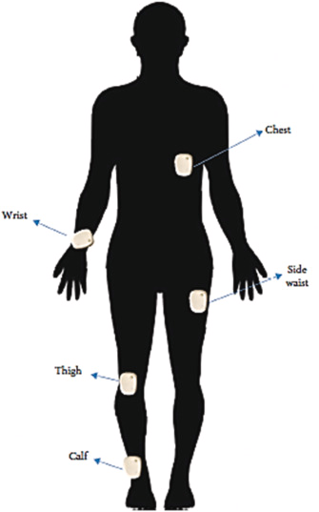
IoT-based Fall Monitoring system
Sensor Placement Strategy:
Primary Location (choose one or two):
Waist
Wrist
2. Secondary Location (optional):
Ankle
Rationale for Multi-Sensor Placement:
Redundancy
Comprehensive Data Collection

Slide 9
IoT-based Fall Monitoring system
DATA ACQUISITION AND PREPROCESSING:
Collect diverse data (Activities of daily living)
Data segmentation
Data cleaning
MACHINE LEARNING ALGORITHM DEVELOPMENT:
Extract relevant features from the sensor data like:
Acceleration magnitude and peak values
Orientation changes
Impact duration
Explore and select a suitable machine learning algorithm (e.g., Random Forests, SVM, LSTM networks) for fall detection.

Slide 10
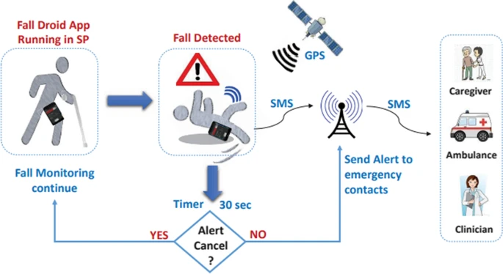
IoT-based Fall Monitoring system

Slide 11
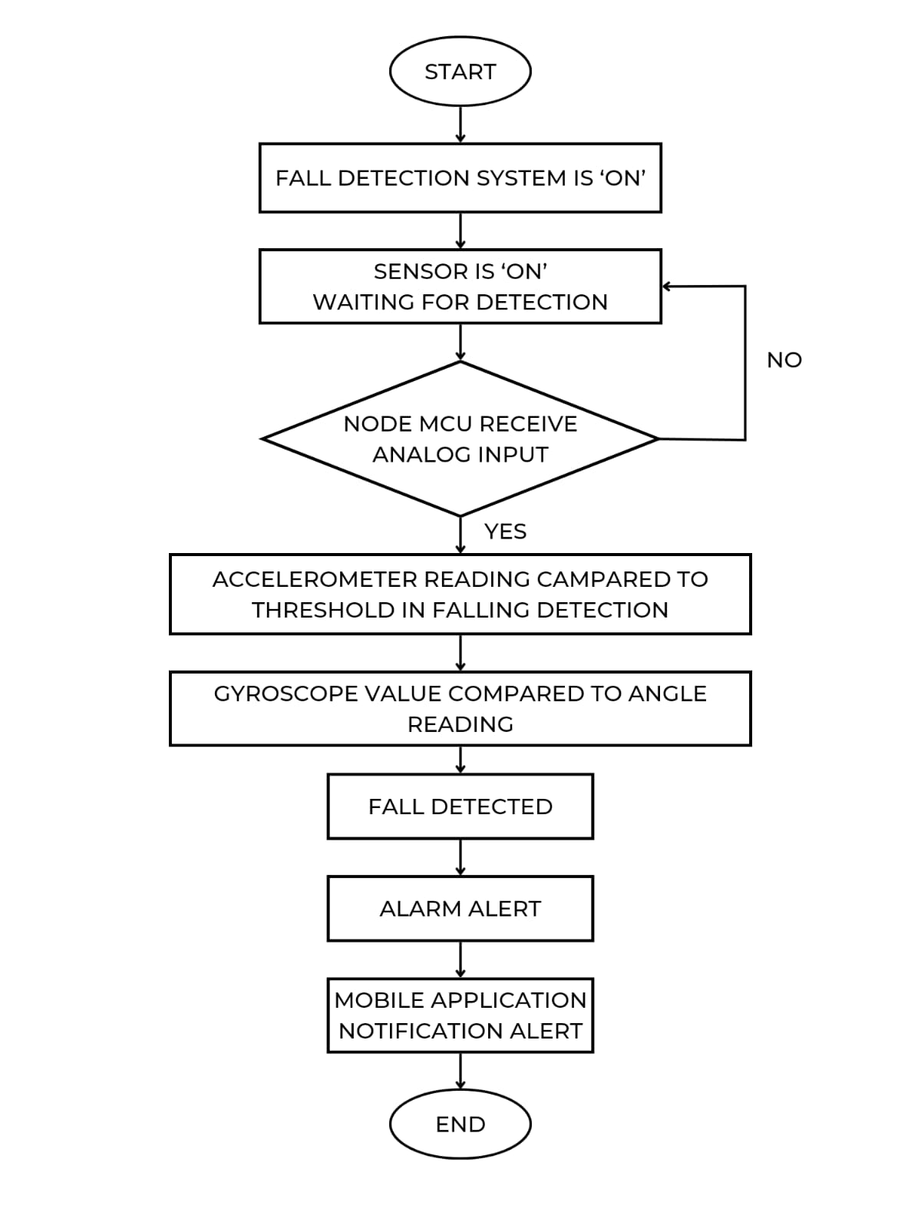
Flow Chart

Slide 12



Performance Metrics
Following are the performance metrics for the fall detection system:
True positive (TP)
False positive (FP)
True negative (TN)
False negative (FN)
Sensitivity: Sensitivity is the ability to determine cases correctly with respect to falling.
6. Specificity: Specificity is the ability to determine non-faller cases correctly.
7. Accuracy: Accuracy is the ability to correctly differentiate non-faller and faller cases.

Slide 13
Advantages
Early detection of falls
Rapid Response
24/7 monitoring
Improved independence
Reduced caregiver burden
Privacy and dignity
Customizable alerts
Prevention care
Cost-effective

Slide 14
Limitations
Fall detection systems using wearable sensors for the elderly is a well-researched area, but there are still limitations to address. Here are some of the challenges:
Accuracy
False positives
False negatives
Sensor limitations
Sensor placement
Sensor sensitivity
Other limitations
Cost
Comfort
Privacy concerns

Slide 15
Future Work
Integration of additional sensors(like - Heart rate monitors, Pulse oximeters)
Advance Machine learning Techniques
Multimodal sensor fusion
User interface and interaction design
Validation in diverse populations and environments
Collaborations with Healthcare provider
Adaptive and personalized Algorithms

Slide 16
References
https://link.springer.com/article/10.1007/s11042-023-15820-0#article-info
https://www.sciencedirect.com/science/article/pii/S2665917422002483
http://publisher.uthm.edu.my/periodicals/index.php/eeee
https://www.mdpi.com/1424-8220/23/15/6977/pdf?version=1691319008

Slide 17
Thank You.

