Slide 1
Corona tweet classification system
MASTER OF COMPUTER APPLICATIONS
Presented By: Ahmad Faraz Ansari
(Roll No: 2023073006)
(M.C.A. – 3rd Sem)
Batch: 2024 - 25

Slide 2
Table of contents
Introduction
Methods Utilized
Machine Learning Pipeline Diagram
Data flow
Code Snippets
References

Slide 3
Introduction
Corona Tweet Classification System is a machine - learning based tweet classification system.
Developed entirely using Python 3 for platform-independence and vast support of ML libraries.
Classification is done using SVM algorithm.
Proposed System can classify tweets based on the underlying emotion i.e., whether tweet is covid-positive or covid-negative.

Slide 4
Methods utilized - 1
1. EDA (Explanatory Data Analysis):
Calculating the length of the tweet to get average length of tweet.
Basic pre-processing (dataset cleaning).
Removing common stop-words (redundant words).

Slide 5
Methods utilized - 2
2. Technique:
Tweet Classification using Support Vector Machine (SVM)
Python Libraries: pandas, numpy, ntlk, sklearn, re, string

Slide 6
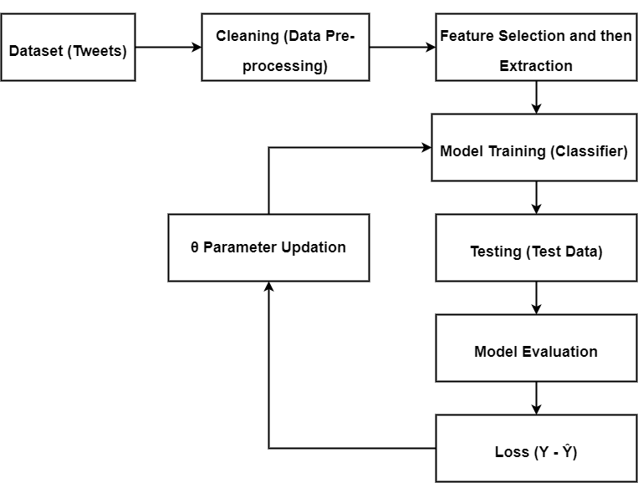
Machine learning pipeline diagram

Slide 7
Data flow
Requirements import
Loading dataset
Pre-processing (cleaning of dataset)
Splitting of the dataset
Tokenization
Lamentization
Features extraction
Modelling using SVM (Support Vector Machine)

Slide 8
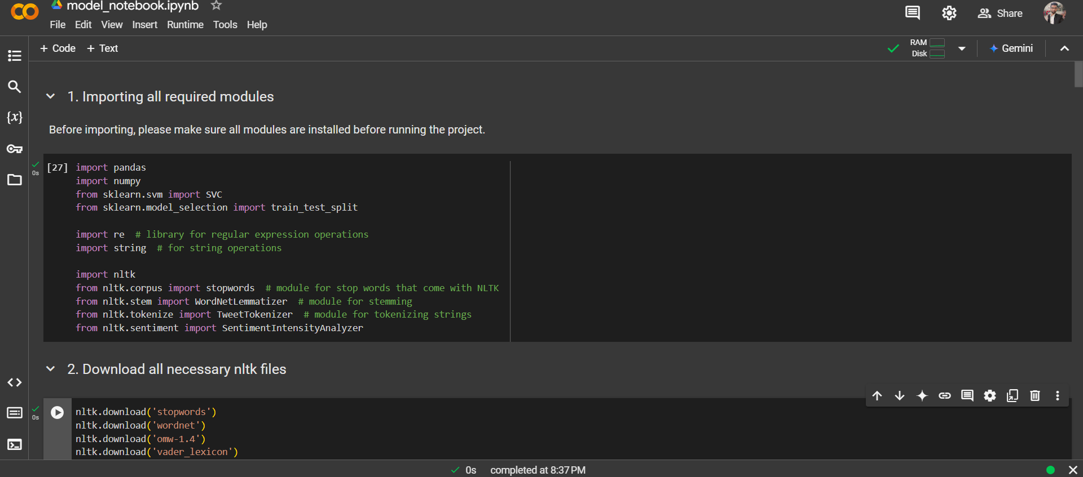
Code snippets

Slide 9
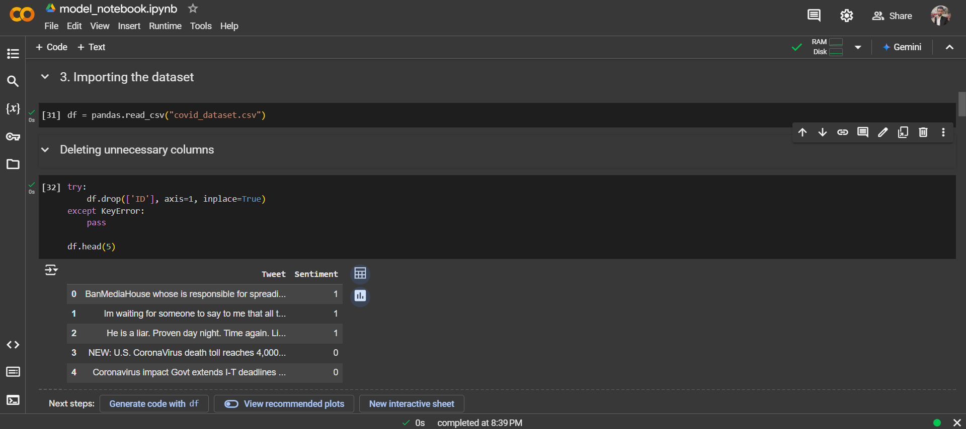

Slide 10
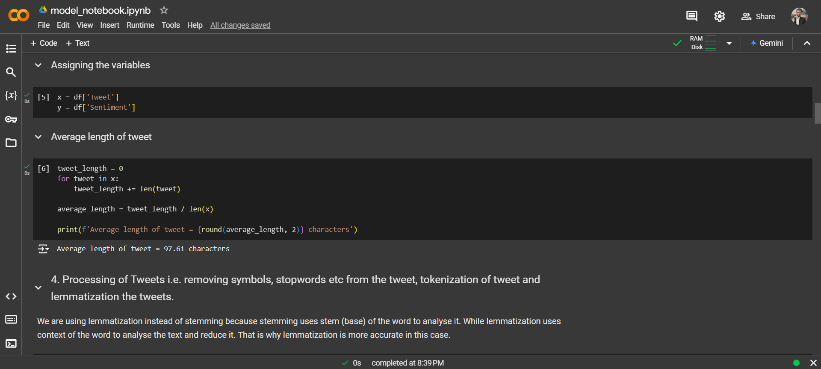

Slide 11
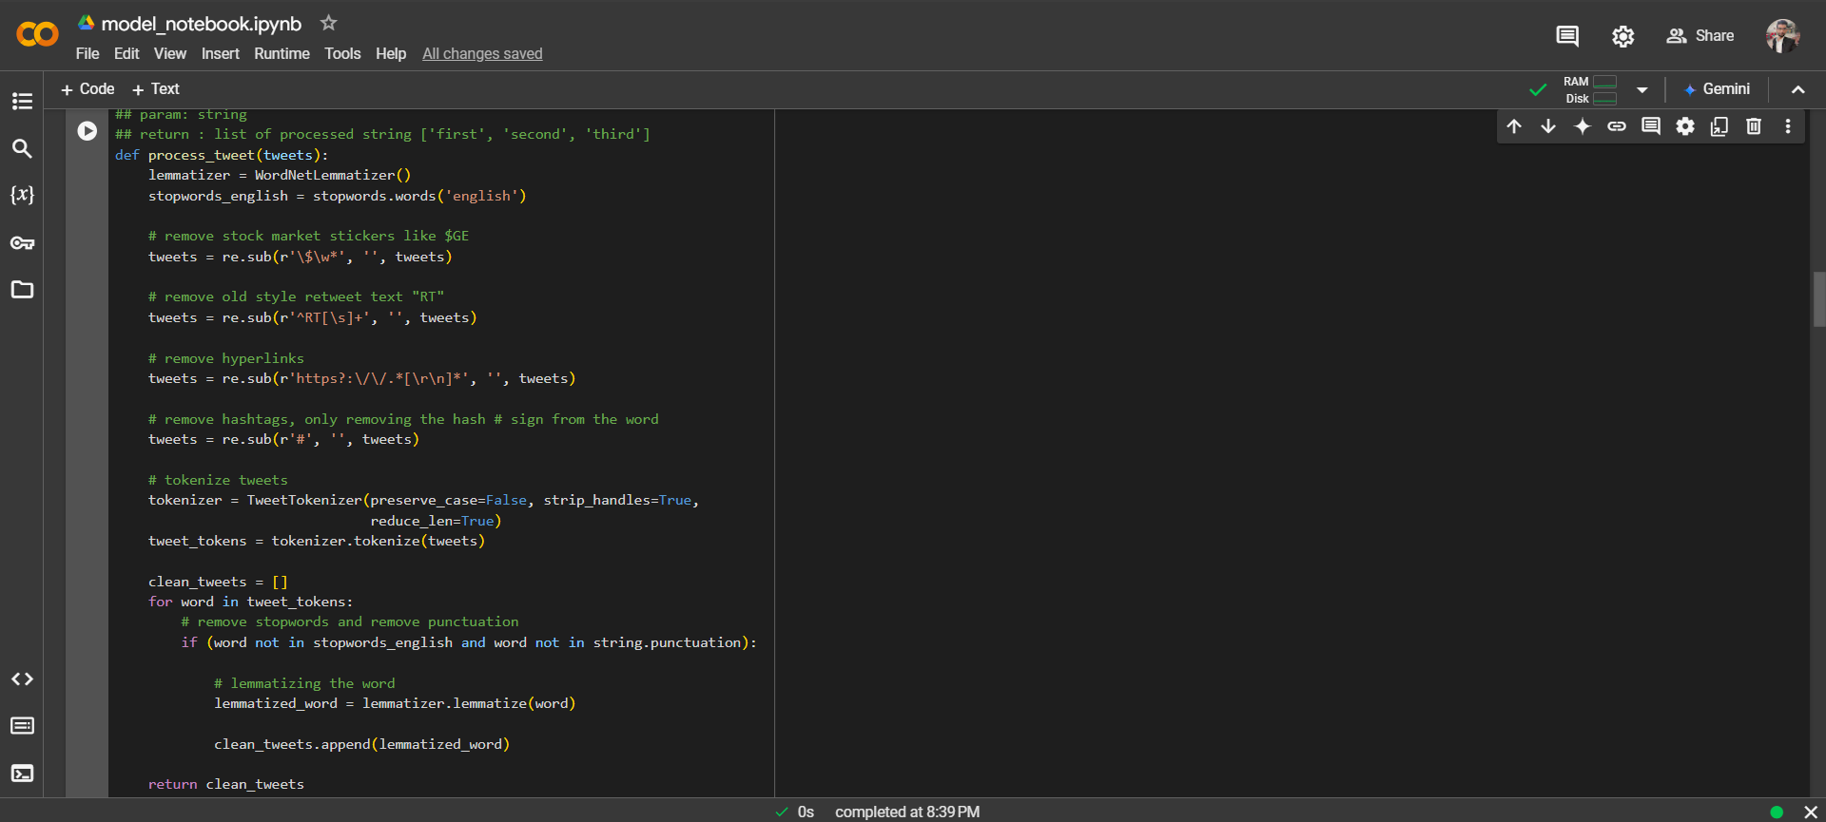

Slide 12
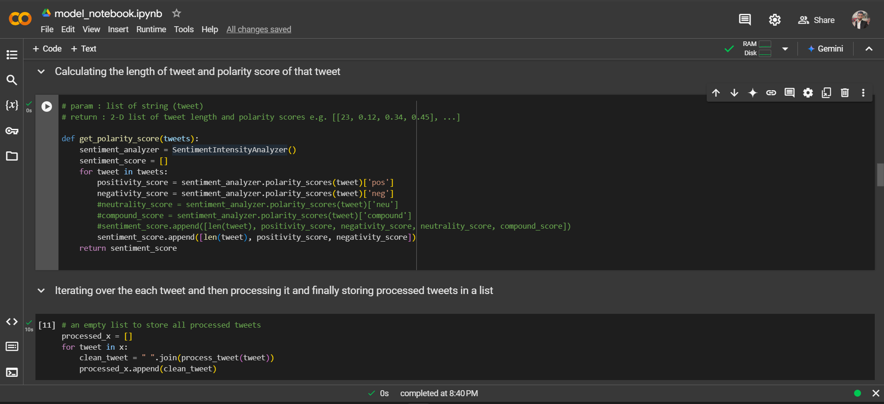

Slide 13
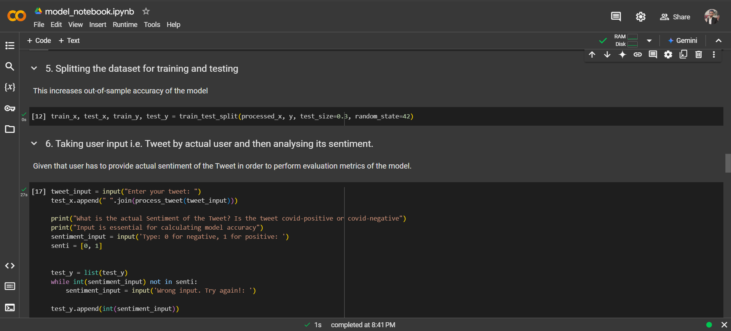

Slide 14
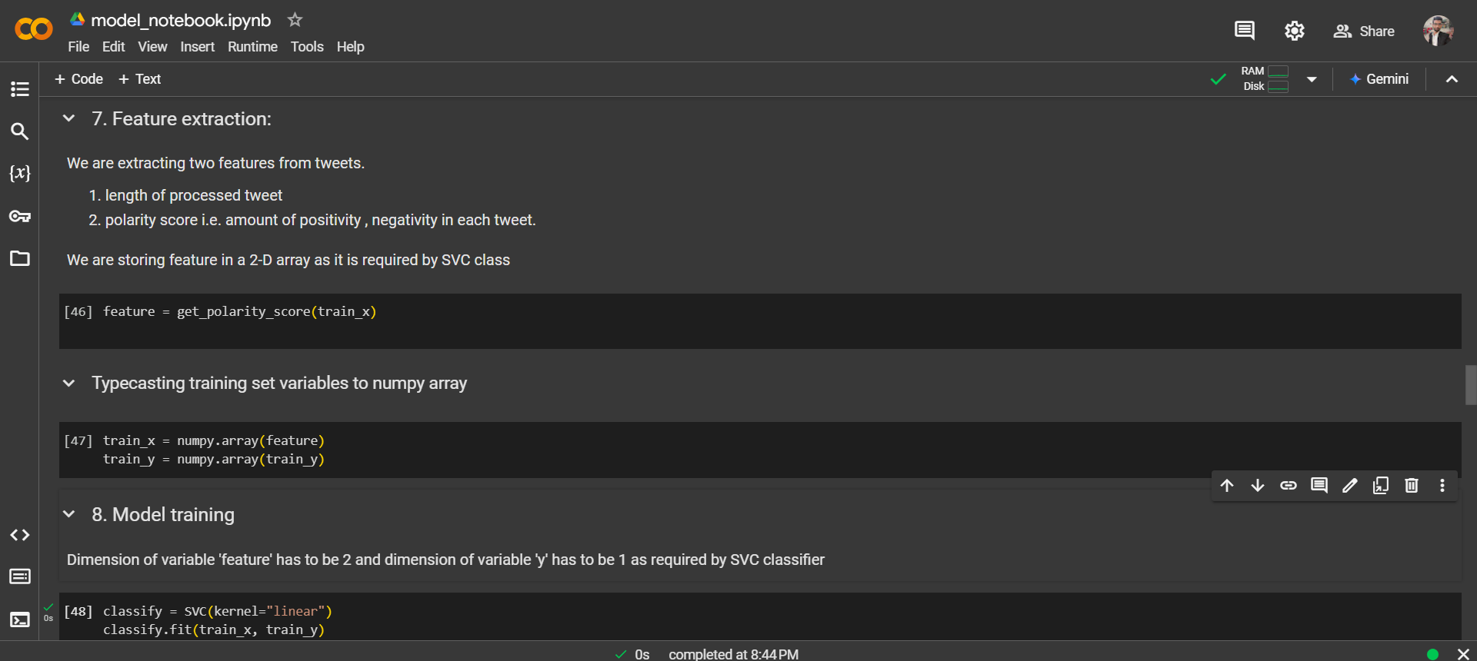

Slide 15
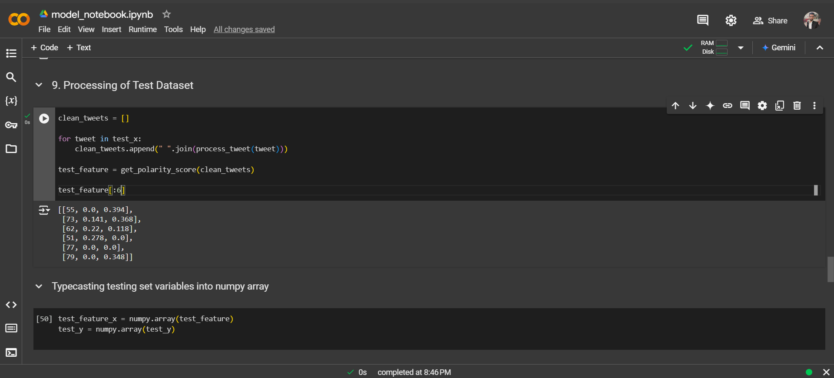

Slide 16
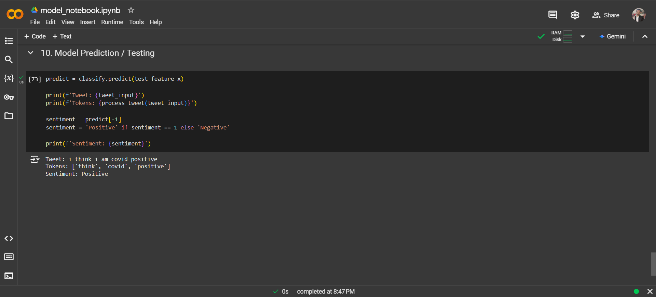

Slide 17
references
https://app.diagrams.net/
Kaggle.com/pre-processing-in-NLP
Kaggle.com/sentiment-analysis-using-logistic-regression
Documentation of all python libraries used

Slide 18

Thank you!

Slide 19

Any questions? feel free to ask them.

