Slide 1
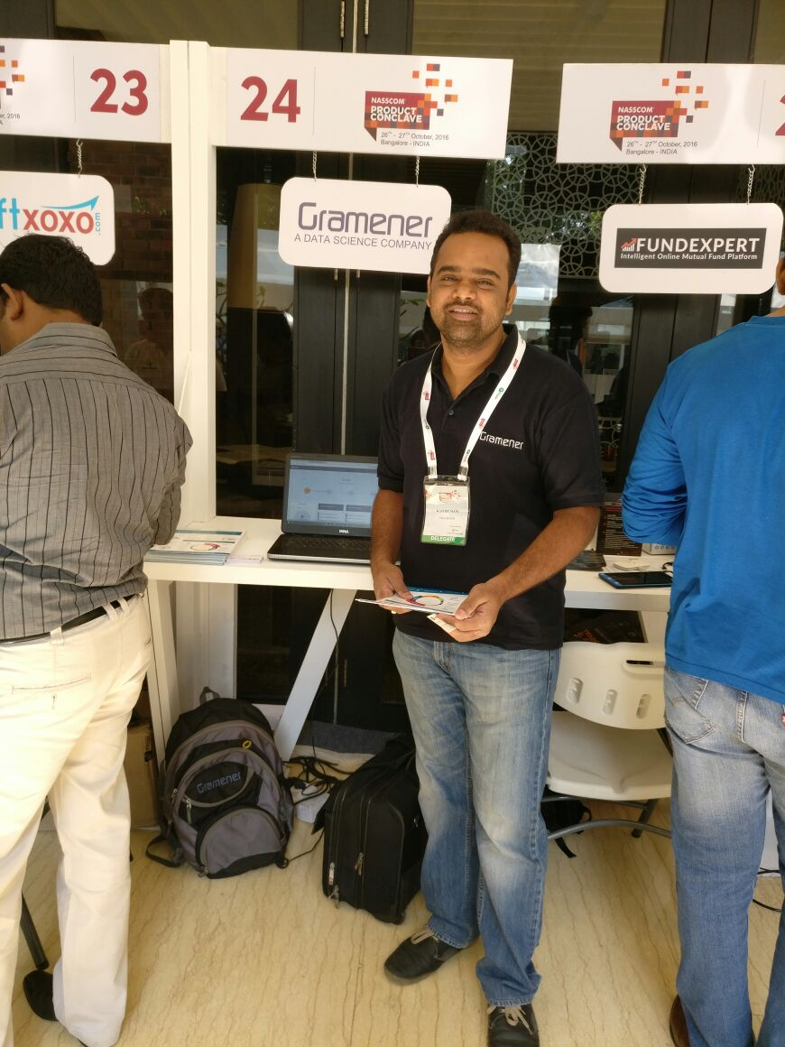
About Myself…
Name | Kathirmani Sukumar
Currently | Data Scientist @Gramener (4.5 years)
Previously | Project Associate @IIT Madras (3 years)
Total Experience | 7.5 years
Areas of Expertise | Data Visualization, Data Science, Exploratory Data Analysis, Web development, Python, R
Also involved in | Corporate / Academic trainings , workshops, talks
Current location | Bangalore

Slide 2





Social Media Profiles
http://skathirmani.com
https://twitter.com/skathirmani
https://github.com/skathirmani
http://stackoverflow.com/users/1645853/kathirmani-sukumar
https://in.linkedin.com/in/skathirmani

Slide 3
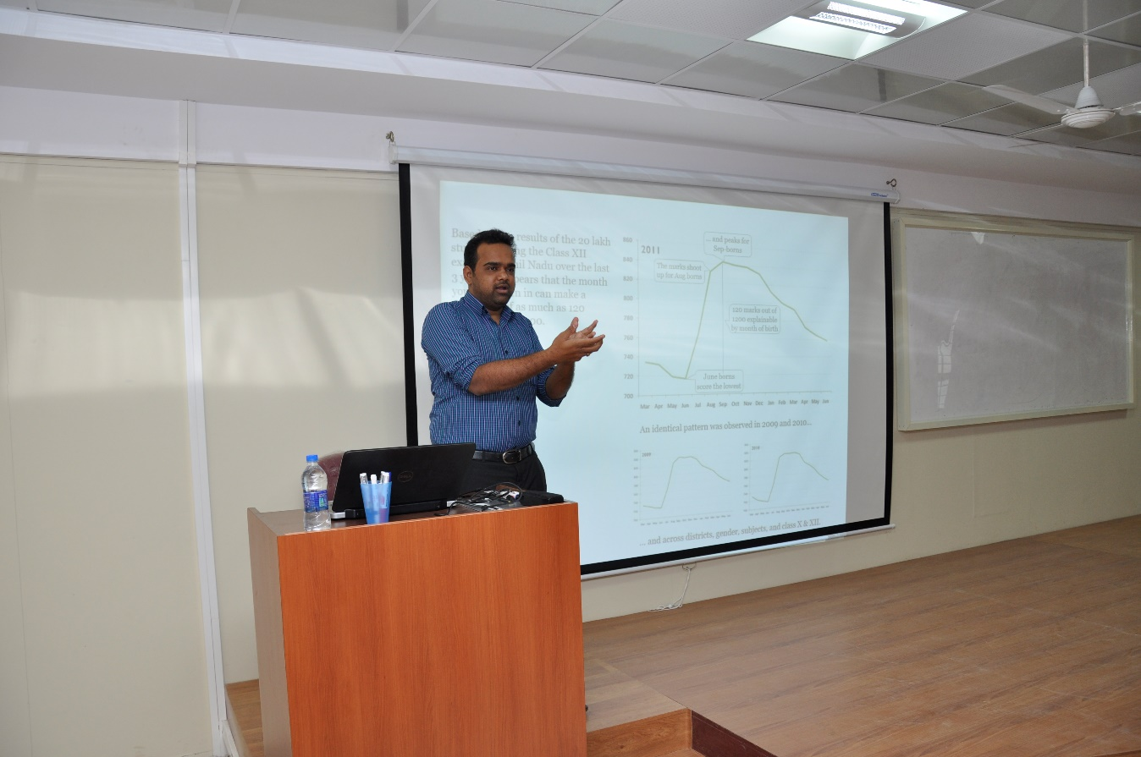
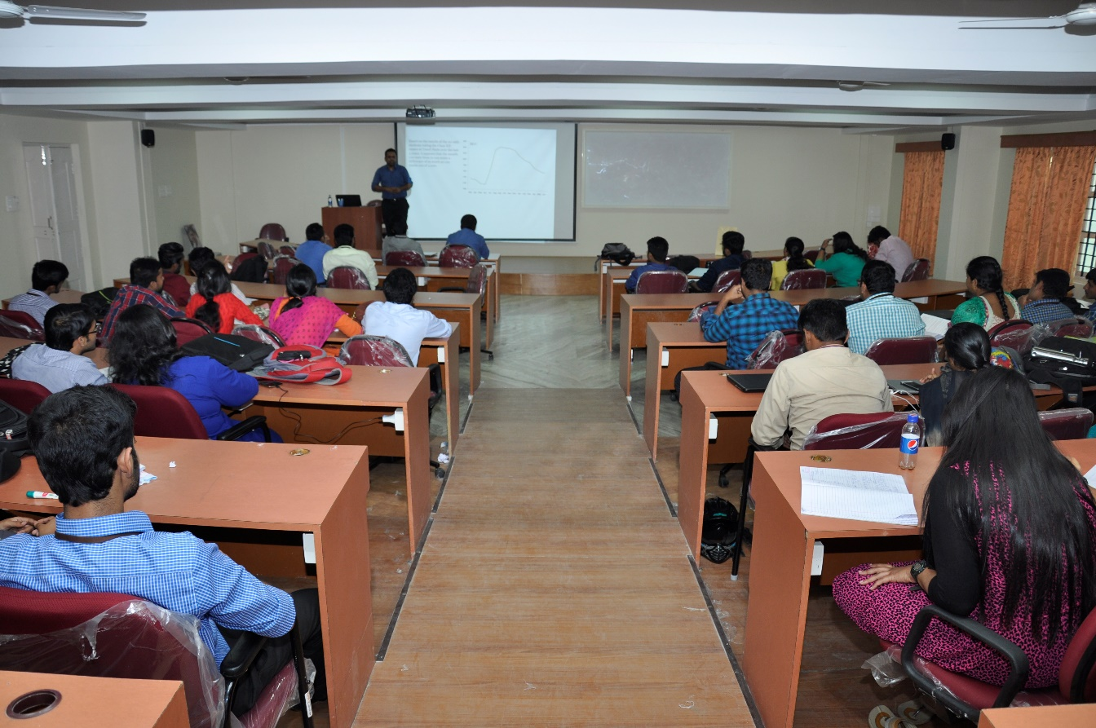
Talk at Amrita University on Exploratory Data Analysis

Slide 4
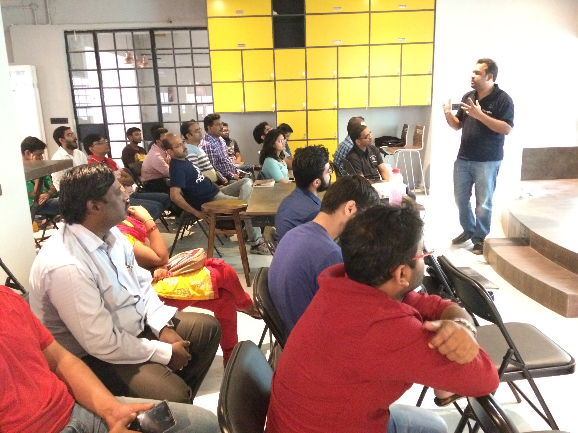
Talk at UpGrad on Data Science

Slide 5
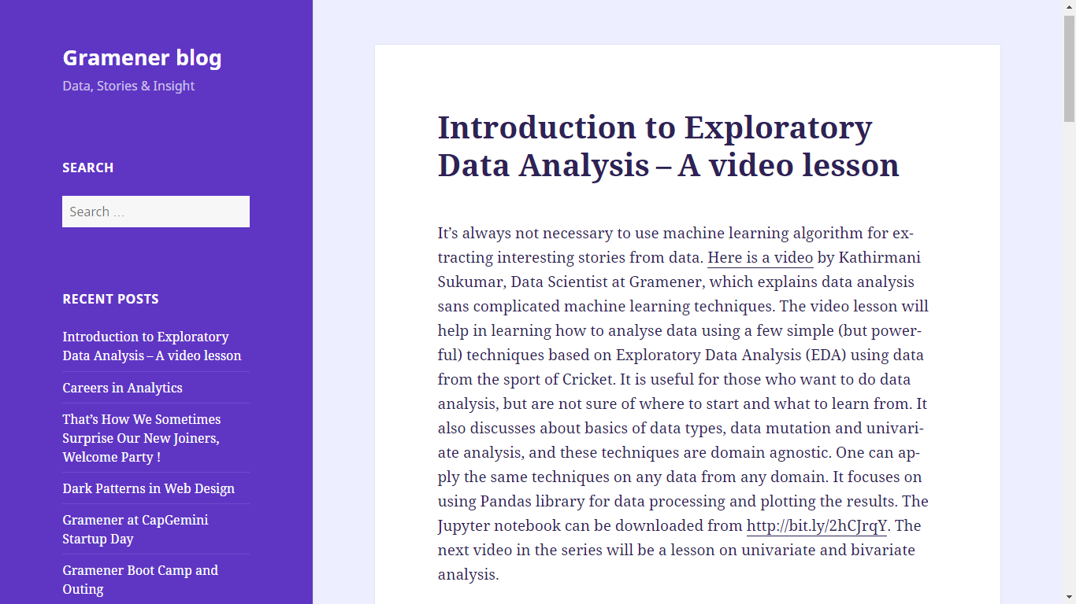
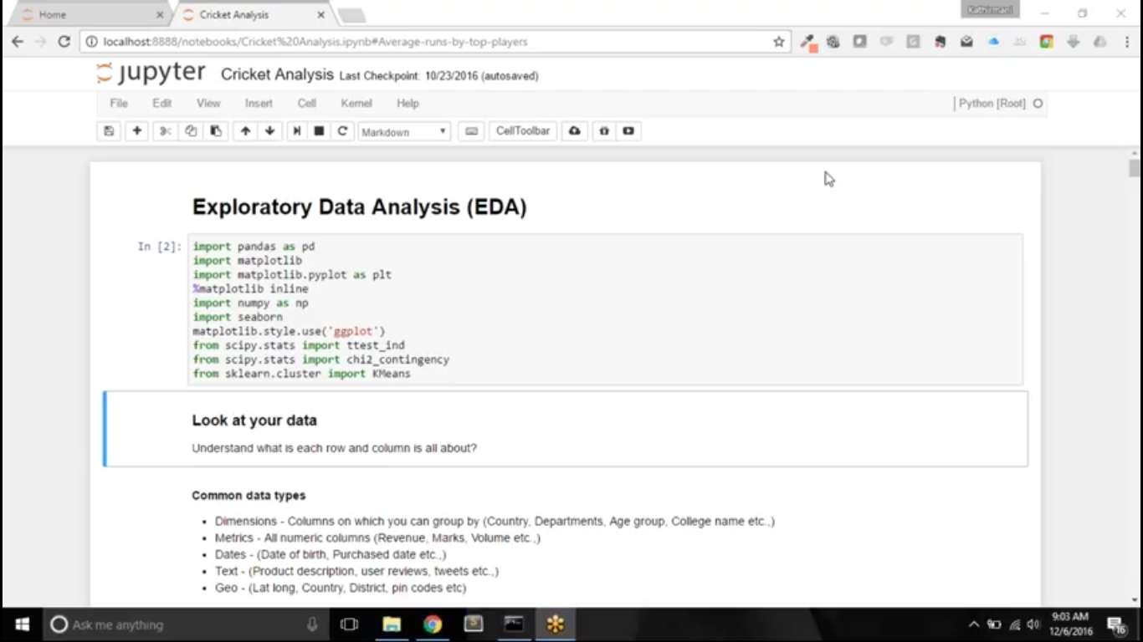
Telling stories from data
Link: http://blog.gramener.com/2514/introduction-to-exploratory-data-analysis-a-video-lesson

Slide 6
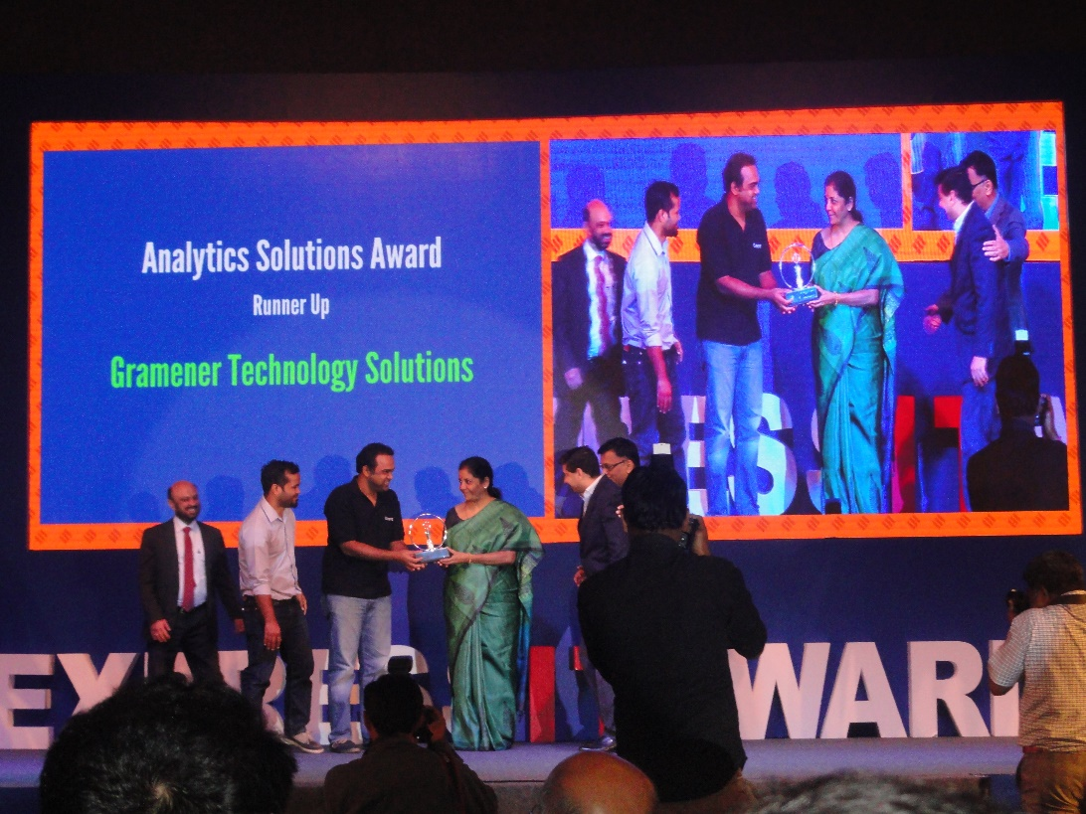
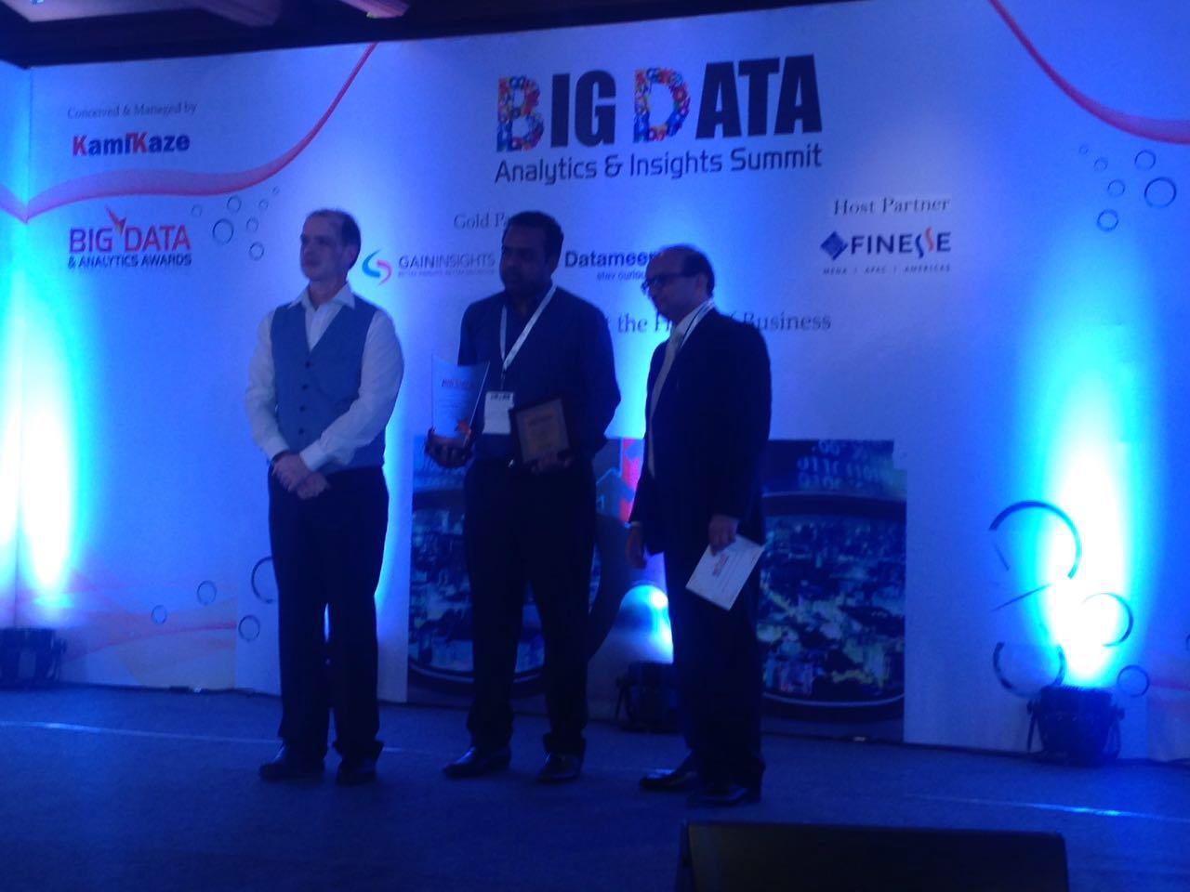
Awards for the product that I am currently leading at Gramener
Received award from India’s commerce minister Nirmal Sitharaman during Express IT Awards organized by Financial Express for the product that I am currently leading.
Received "Best Practices in Data Analysis & Strategy“ in Big Data Analytics & Insights Summit

Slide 7
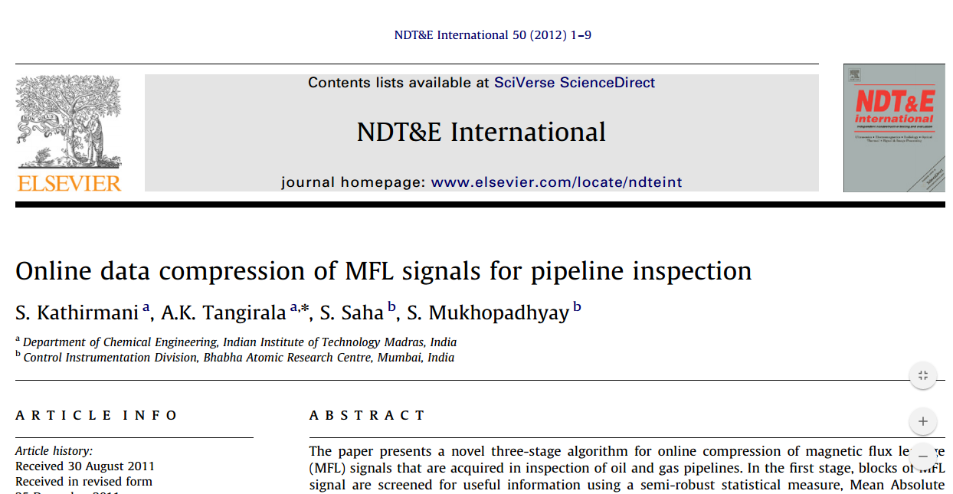
International Journal Publication

