Slide 1
PAMAT501 · PROBABILITY AND STATISTICS · COURSE-BASED PROJECT
Statistical Estimation of Canteen Arrival Overload Probability Using Poisson Distribution
Predicting when the lunch peak happens and how likely it is to overwhelm the counters
Faraz Akhtar Khan
Mayur Krishna
Malhar Bhosale
26MCA0197 · Team in-charge
26MCA0191 · Team member
26MCA0199 · Team member
Faculty: Dr. Manimaran A, School of Advanced Sciences, VIT Vellore
Notes:
Introduce the team and the title. Faraz Akhtar Khan is the team in-charge. The project estimates the probability that canteen arrivals exceed capacity in each 15-minute slot and predicts when the peak happens.

Slide 2
Lunch arrivals pile into a few minutes
Every day the canteen sees a short, sharp rush. When more students arrive in 15 minutes than the counters can serve, queues form and food runs out.
Today, decisions about when to eat or how many counters to open are made by guesswork.
Our question
What is the probability that arrivals exceed capacity in a given slot, and when will today's peak occur?
8 slots
15-minute slots from 12:30 to 14:30
C = 30
students per slot the counters can serve (capacity)
P(X > C)
the overload probability we estimate for every slot
Notes:
Explain the motivation: short intervals, sudden rushes. Capacity C is a project decision (30 per 15-minute slot) and can be changed in the dashboard.

Slide 3






Aim and objectives
Aim: estimate, for each short slot of the lunch period, the probability that arrivals exceed serving capacity, and predict when the day's peak will occur, using Poisson models that are tested against the data.
1. Collect and clean
2. Estimate rates
3. Overload probability
Arrival counts in fixed 15-minute slots across working days
Mean rate λ per slot with an exact confidence interval; test the Poisson fit
P(X > C) per slot, labelled low, medium or high risk
4. Useful time windows
5. Predict the peak
6. Validate
The quietest slot, tested, and the capacity needed at the peak
Day-specific risk, P(slot is the peak), same-day Bayesian update
Forecast unseen days and test the forecasts with hypothesis tests
Notes:
Objectives 1 to 4 are the original review-1 scope. Objectives 5 and 6 are the extension: predicting the peak time and validating the forecasts on unseen days.

Slide 4




What earlier work leaves open
Canteen studies
Tang et al. model pedestrian flow; queueing studies assume Poisson arrivals at one fixed rate.
Arrival-forecasting studies
Call centres and ambulance services forecast rates and update them during the day.
Tests of Poisson arrivals
Kim and Whitt; Brown et al. show the assumption must be checked, not assumed.
Gap 1: No slot-level overload probability
Studies report averages or queue lengths, not P(X > C) per slot
Gap 2: Poisson assumed, not tested
Arrival rate is an input; its fit is never checked
Gap 3: No day-specific peak forecast
No prediction of a given day's peak time, or update from early counts
Gap 4: No test on unseen days
Canteen forecasts are not validated against held-out data
Notes:
Eighteen papers were reviewed. These four gaps are gaps of focus and application, not a claim that Poisson modelling of arrivals is new.

Slide 5
Data and data reference
90
8
Collection protocol (field data)
Count students entering the canteen in fixed 15-minute slots, 12:30–14:30, on working days (manual or permitted video), following Tang et al. (2019).
Prototype dataset used now
Synthetic semester from data_generator.py (seed 42): lunch rush near 13:15, weekday and exam-week effects, day-to-day variation. Not observed results.
Cleaning
Missing or invalid counts are dropped, not imputed, so the variance is not shrunk.
working days (one 18-week semester)
15-minute slots per day
717
3
slot observations used
missing counts dropped (of 720)
2
52
exam weeks (weeks 9 and 18)
largest count in one slot
Notes:
Field collection is in progress. All methods re-estimate everything from the counts, so they apply unchanged when the real counts replace the synthetic file.

Slide 6

Method: six steps, each mapped to the syllabus
Estimate
Test
Overload
Forecast
Update
Validate
Rate λ per slot, exact CI
χ² GOF, dispersion test
P(X > C), risk label
Regression, Poisson–Gamma
Bayes' theorem in the day
Unseen days, z/t/KS tests
M2, M4
M5
M2
M1, M3
M1
M4, M5
Syllabus modules: M1 probability and Bayes' theorem · M2 discrete distributions (Poisson, binomial, negative binomial) · M3 correlation and regression · M4 sampling and estimation, large-sample tests · M5 small-sample tests (t, χ², F, ANOVA, non-parametric)
Notes:
Walk through the pipeline left to right. Every step uses a technique from the PAMAT501 syllabus; 24 components are mapped in the report.

Slide 7
Preliminaries: the key formulas
Poisson model
Overload probability
P(X = x) = e^{−λ} λ^{x} / x!
P(X > C) = 1 − Σ_{x=0..C} e^{−λ} λ^{x} / x!
Mean = variance = λ; estimate λ by the sample mean Σxᵢ / m
Low < 20%, High > 50%, otherwise Medium
Exact (Garwood) CI
Poisson–Gamma and Bayes
[ χ²_{α/2}(2S) / 2m , χ²_{1−α/2}(2S+2) / 2m ]
W ~ Gamma(1/v, 1/v) ⇒ X ~ NegBin(λ, v)
S = total count over m days
After early counts: W | x ~ Gamma(a + Σx, a + Σλ)
Notes:
Poisson for counts in a short interval; maximum-likelihood estimate is the sample mean. The Poisson–Gamma mixture comes from the theorem of total probability and allows busier or quieter whole days. The Bayesian update uses the Gamma prior's conjugacy.

Slide 8
Arrivals peak at 13:15–13:30, above capacity
34.4
peak rate at 13:15–13:30; 95% CI [33.2, 35.6]
16.3
lowest rate at 14:15–14:30
2
slots where the mean itself is above C
Notes:
Each bar is the sample mean of 90 days for that slot. The exact confidence intervals are narrow (about ±1.2), so the peak is well determined.

Slide 9
The Poisson model fits every slot
Slot | Mean λ | Var / mean | χ² GOF p | Decision
12:30-12:45 | 24.47 | 1.09 | 0.450 | Fit OK
12:45-13:00 | 29.42 | 1.34 | 0.552 | Fit OK
13:00-13:15 | 33.37 | 1.26 | 0.309 | Fit OK
13:15-13:30 | 34.36 | 1.10 | 0.701 | Fit OK
13:30-13:45 | 29.04 | 1.03 | 0.218 | Fit OK
13:45-14:00 | 24.72 | 1.25 | 0.310 | Fit OK
14:00-14:15 | 19.12 | 1.34 | 0.148 | Fit OK
14:15-14:30 | 16.33 | 1.24 | 0.257 | Fit OK
0 of 8
slots reject Poisson at α = 0.05 (0.4 expected by chance)
≈ 1
variance-to-mean ratio, as Poisson requires
Categories merged until expected count ≥ 5 (Cochran); df = k − 2 because λ is estimated.
Notes:
Chi-square goodness-of-fit test per slot, plus the index-of-dispersion test. A binomial check guards against multiple testing: with 8 tests, about 0.4 rejections are expected by chance.

Slide 10
Overload risk: two slots are high risk
73.9%
chance of overload at 13:15–13:30
39
capacity per slot needed to keep every slot below 20%
High 2 Medium 2 Low 4
Notes:
P(X > C) = 1 − P(X ≤ C) with λ̂ from each slot. Across the confidence interval for λ, the peak slot's risk ranges from about 67% to 80%.

Slide 11
The quietest time is genuinely quieter
16.3
19.1
p = 5.2 × 10⁻⁶
students on average at 14:15–14:30 (quietest)
at 14:00–14:15 (next quietest)
exact conditional test: significantly quieter
How the test works. Under H₀: λ₁ = λ₂, the count in the quietest slot given the combined count is binomial: S₁ | (S₁ + S₂) ~ Bin(S₁ + S₂, m₁ / (m₁ + m₂)). A tiny p-value means the difference is not chance.
Notes:
Students who can choose should eat after 14:15: only about 0.08% chance of overload, against 74% at the peak.

Slide 12
Weekday and exam weeks shift the whole day
R² = 0.58
ln(x + 0.5) ~ slot + weekday + day type, smearing back-transform
−11.3%
exam weeks (Welch t-test p = 0.0005)
Dark bars: p < 0.05. Weekday differences in daily totals: ANOVA p = 0.091.
Notes:
Multiple linear regression with dummy variables. Friday is about 9% quieter and exam weeks about 11% quieter. These effects drive the day-specific forecasts.

Slide 13
Whole days vary a little more than Poisson allows
p = 0.003
Pearson χ² = 812 on 704 df: day-to-day variation exists
v̂ = 0.006
variance of the busyness factor W (about 7.6% CV)
Small in practice: overload probabilities change by at most about 2 points.
Notes:
Per-slot tests pass, but pooling across slots reveals mild overdispersion. The negative binomial (Poisson–Gamma) model handles it and is used for forecasts.

Slide 14
Predicting today's peak: Monday example
42%
peak at 13:15–13:30 (most likely slot)
75%
peak falls in 13:00–13:30
98%
chance at least one slot exceeds C
Notes:
20,000 simulated Mondays: draw the busyness factor W from the Gamma distribution, then Poisson counts for each slot, and record which slot is largest.

Slide 15
Updating the forecast from the first counts
Bayes' theorem
Prior W ~ Gamma(a, a). After the first two slots the posterior is Gamma(a + Σx, a + Σλ).
A busy morning (30 and 36 vs 26 and 31 forecast) lifts the 13:15 risk from 81% to 87%.
On unseen days the update improved the Brier score of later slots: 0.124 → 0.119.
Notes:
This is the practical use: by 13:00 the canteen manager can see whether today is running hot and open an extra counter before the peak.

Slide 16
Testing the forecasts on 60 unseen days
93.7%
40%
4.57 vs 4.62
r = 0.73
95% intervals covered the actual count (z-test p = 0.20: consistent with 95%)
busiest slot named correctly, vs 13% by chance (p < 0.001)
mean absolute error, model vs per-slot average (paired t p = 0.29)
correlation between predicted and actual counts (p < 0.001)
Supports model: Yes
Supports model: Yes
Supports model: Not significant
Supports model: Yes
Honest reading. Every day is forecast only from earlier days (477 slot forecasts). Intervals and peak-slot prediction work; the gain in point accuracy over a simple average is small and not significant, which is expected when day effects are mild. Exam days benefit most (MAE 4.53 vs 4.78).
Notes:
Rolling-origin backtest with an expanding window. Tests used: z-test of a proportion, paired t-test, sign test, Kolmogorov–Smirnov and chi-square on PIT values, Pearson and Spearman correlation.

Slide 17
Comparison with existing studies
Study | Approach | Slot overload P | Tests Poisson | Peak time | Unseen days
Tang et al. (2019) | Pedestrian flow in a canteen | No | No | No | No
Jiao et al. (2022) | M/M/C simulation, one rate | No | No | No | No
Kim & Whitt (2014) | Tests of Poisson arrivals | No | Yes | No | —
Weinberg et al. (2007) | Bayesian rate forecasts | No | Partly | No | Yes
Shah et al. (2025) | ML daily dining totals | No | No | No | Yes
This project | Per-slot Poisson + regression + Bayes | Yes | Yes | Yes | Yes
Within the project: the regression + Poisson–Gamma forecast versus the per-slot average gives better-calibrated intervals and a big gain in peak-slot hits, but similar point error.
Notes:
The contribution is the combination: a tested per-slot Poisson model, a day-specific peak forecast with an intraday update, and validation on unseen days.

Slide 18
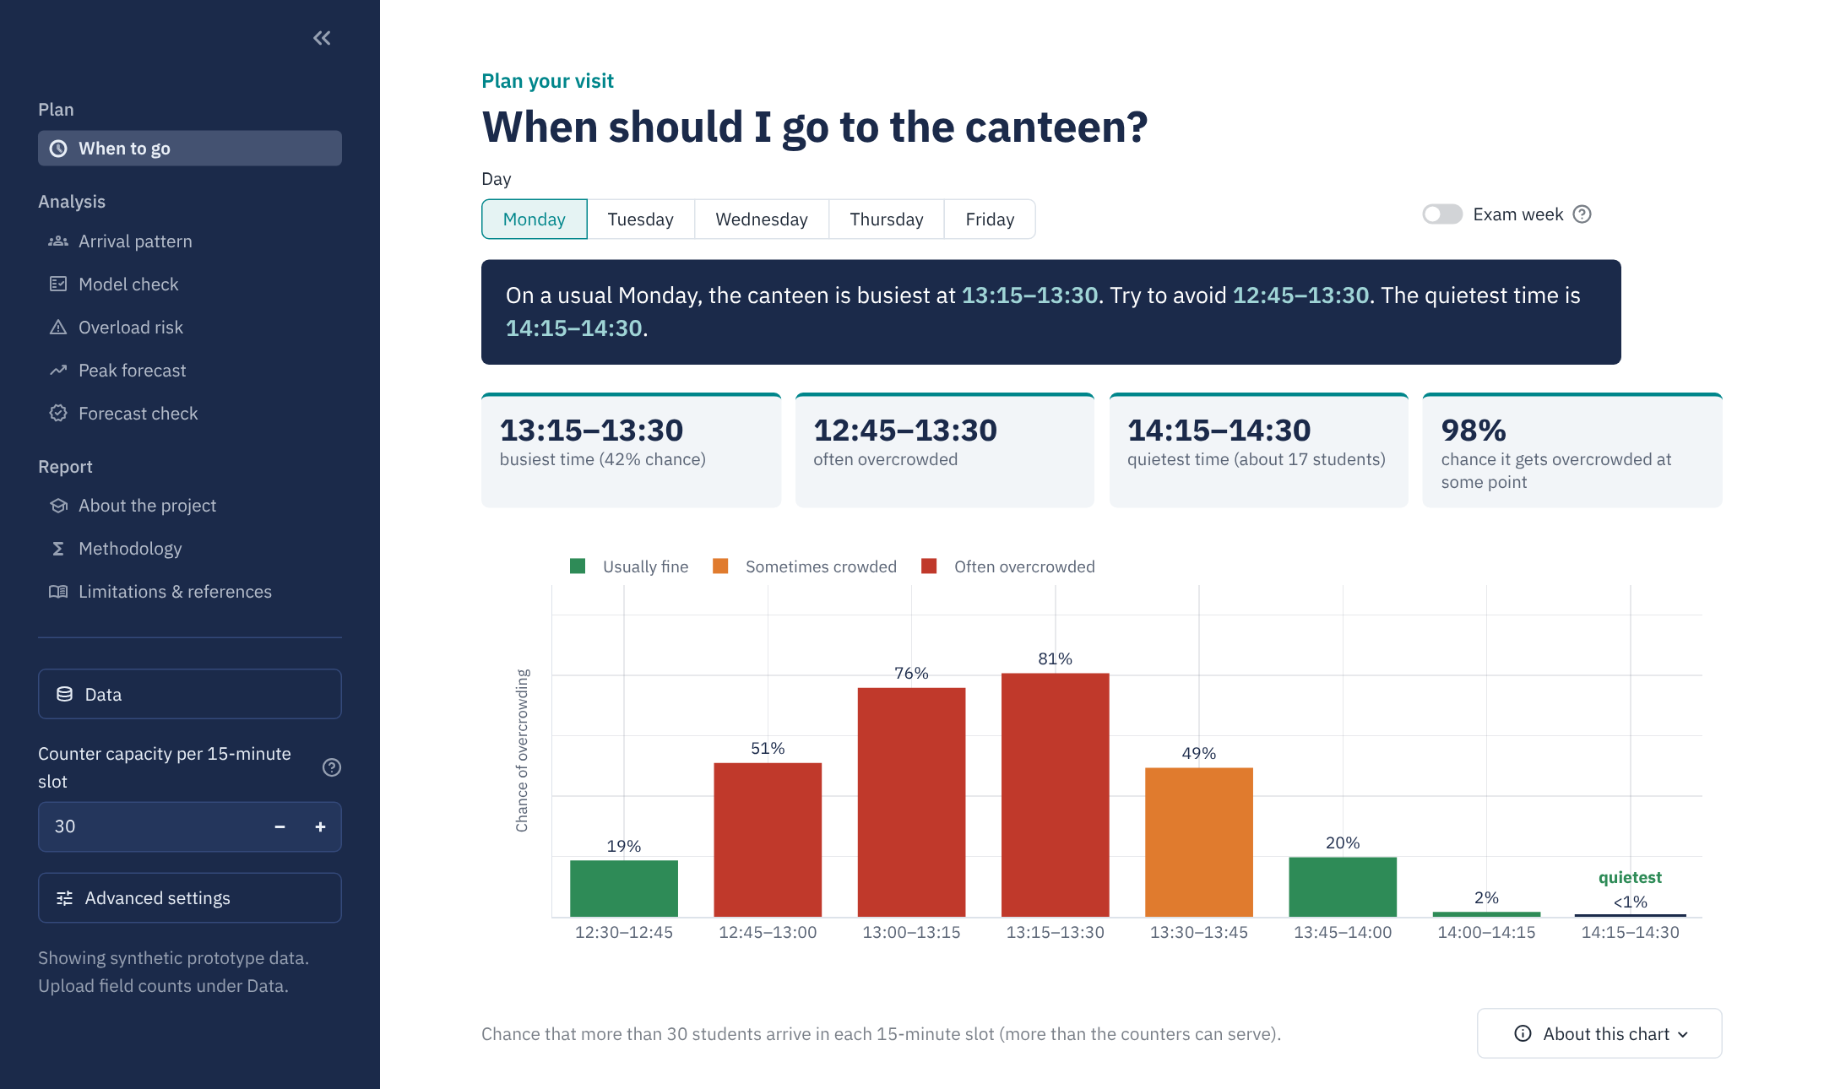
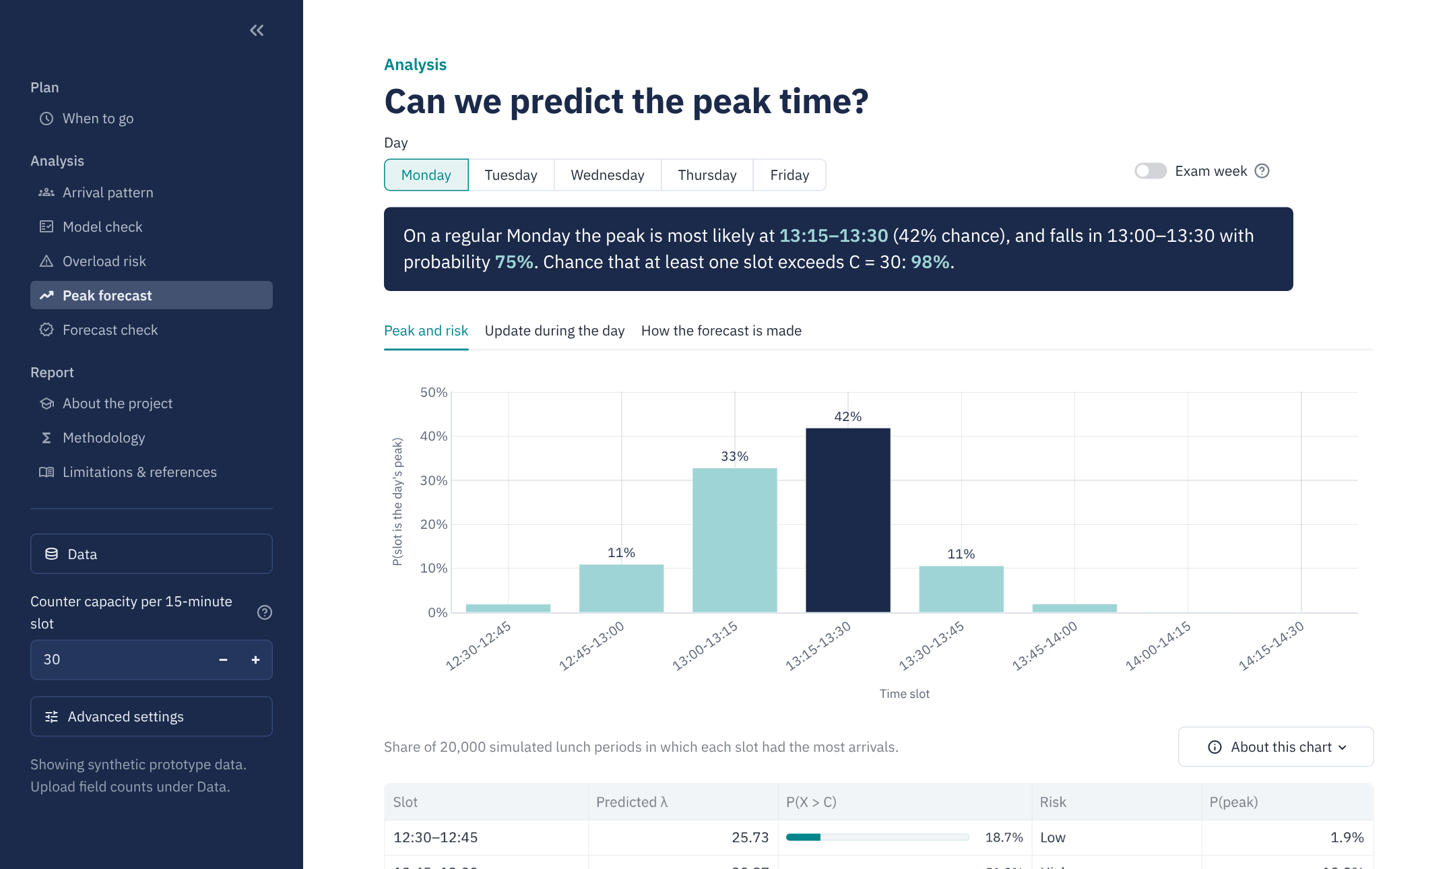
CanteenFlow: the interactive dashboard
When to go: plain-language advice for any weekday or exam week
Peak forecast: P(peak), same-day update, 3D views
Python · Streamlit · Plotly 3D · SciPy · 83 automated tests. Upload real counts and every result updates.
Notes:
Live demo if time permits: change the day, toggle exam week, change capacity, and show the same-day update.

Slide 19
Conclusion and future work
Limitations
Synthetic data for now; arrival risk, not waiting time; group arrivals ignored.
Next steps
Replace with field counts
Add service times for an M/M/c queue
Automatic same-day update from turnstile or camera counts
What we found
The Poisson model fits each slot; it was tested, not assumed.
Highest risk at 13:15–13:30 (74%); 13:00–13:30 is the danger window.
14:15–14:30 is significantly quieter (p = 5.2 × 10⁻⁶).
39 per slot keeps every slot below 20% risk.
The peak time is predictable (40% hits vs 13% chance) and early counts sharpen it.
Notes:
Close with the practical message: avoid 13:00–13:30, open an extra counter when the early counts run high, and collect real counts to confirm.

Slide 20
Key references
T.-Q. Tang, B.-T. Zhang, J. Zhang, T. Wang, "Statistical analysis and modeling of pedestrian flow in university canteen during peak period," Physica A, vol. 521, pp. 29–40, 2019.
S.-H. Kim and W. Whitt, "Are call center and hospital arrivals well modeled by nonhomogeneous Poisson processes?" MSOM, vol. 16, no. 3, pp. 464–480, 2014.
L. Brown et al., "Statistical analysis of a telephone call center: a queueing-science perspective," JASA, vol. 100, pp. 36–50, 2005.
J. Weinberg, L. D. Brown, J. R. Stroud, "Bayesian forecasting of an inhomogeneous Poisson process with applications to call center data," JASA, vol. 102, pp. 1185–1199, 2007.
R. Ibrahim, H. Ye, P. L'Ecuyer, H. Shen, "Modeling and forecasting call center arrivals: a literature survey and a case study," IJF, vol. 32, pp. 865–874, 2016.
S. Jiao et al., "Simulation and optimization of university canteen service ... based on queuing theory," ITM Web of Conf., vol. 47, 02052, 2022.
W. G. Cochran, "Some methods for strengthening the common χ² tests," Biometrics, vol. 10, pp. 417–451, 1954.
F. Garwood, "Fiducial limits for the Poisson distribution," Biometrika, vol. 28, pp. 437–442, 1936.
R. A. Johnson, Miller & Freund's Probability and Statistics for Engineers, 9th ed., Pearson, 2018.
Notes:
The full list of 25 references is in the R Markdown report and the IEEE paper.

Slide 21
Thank you
Questions and discussion
Faraz Akhtar Khan (26MCA0197, team in-charge) · Mayur Krishna (26MCA0191) · Malhar Bhosale (26MCA0199)
Faculty: Dr. Manimaran A · PAMAT501 Probability and Statistics

