Slide 1
Superstore Sales Performance and Insights
Presenter's Name: Farah Essam Eldeen Sayed
Digital Egypt Pioneers Initiative – DEPI
Instructor : Jackie Abualeam

Slide 2
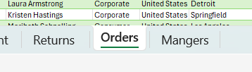
Overview Of The Superstore Dataset
Orders Table: Includes details about each order such as order ID, customer name, category, sub-category, sales, profit , discount and etc..
Returns Table: Contains information about returned orders .
Managers Table: Lists managers and their regions. There are four managers, each responsible for one region.

Slide 3
Purpose Of The Analysis
We conducted an in-depth analysis of our sales data to gain valuable insights and identify strategies for enhancing our sales performance. This analysis focused on understanding current sales trends, customer behavior, and market dynamics within a specific scope.

Slide 4
The scope of this analysis
Evaluating the impact of region, city, and state on sales .
Assessing the influence of product categories and subcategories . Identifying the highest-selling product names in each region .
Analyzing sales trends over the years .
Determining the highest-performing customer segments .
Recognizing the managers who achieved the highest sales .

Slide 5
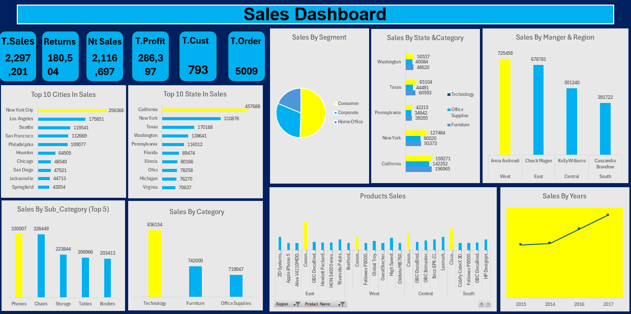

Slide 6
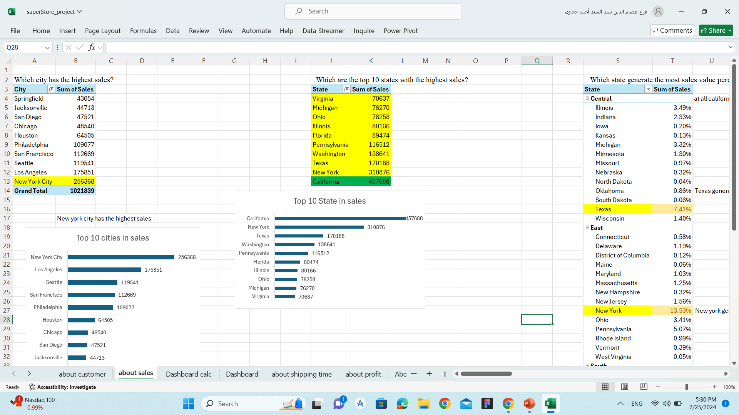
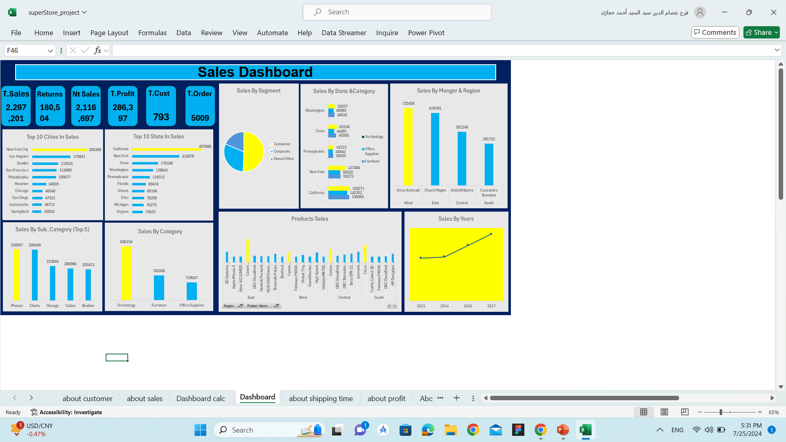
We found that California state has the highest sales overall, followed by New York. Among cities, New York City have the highest sales

Slide 7

We found that Technology Category has the highest sales overall, Phone Sub Category have the highest sales

Slide 8

Sales By State & Category

Slide 9
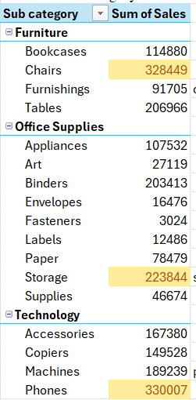
Chairs have the highest sales in Furniture , Storage have the highest sale in Office Supplies , Phones have the highest sale in Technology

Slide 10

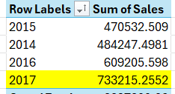
We found that sales have increased consistently over the years

Slide 11

Anna Andreadi achieved the highest sales in the West region !

Slide 12
THANK YOU!

