Slide 1
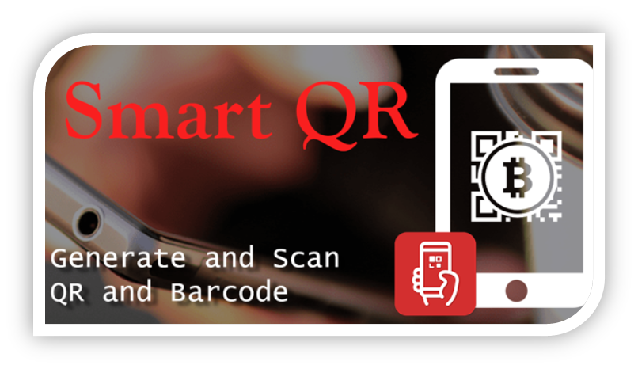
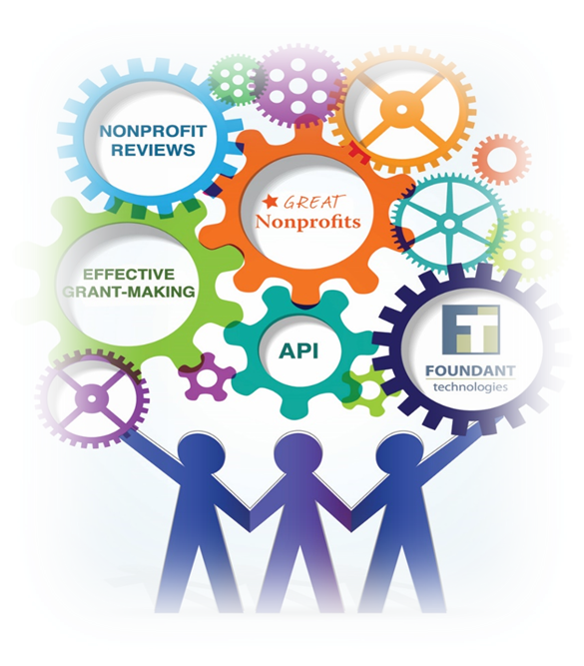
By:
Muhammad Faizan Riaz
Farbod Aprin
Hasan Mhd Amin
Mhd Yazan Al Zaeem

Slide 2

About Project
Students face a lot of problems while preparing for exams and always looking for some helping material at the later stages , so we came up with this idea to provide the student a common platform by just scanning our QR code app and get easy access to the learning material of there need

Slide 3
Searching For Data
Basically once the QR-Code is scanned all the relevant data according to that QR-Code will be showned in the different cards, And we also have plan to implement some ranking or rating funcationality for the students. So that they can get best relevant data.

Slide 4
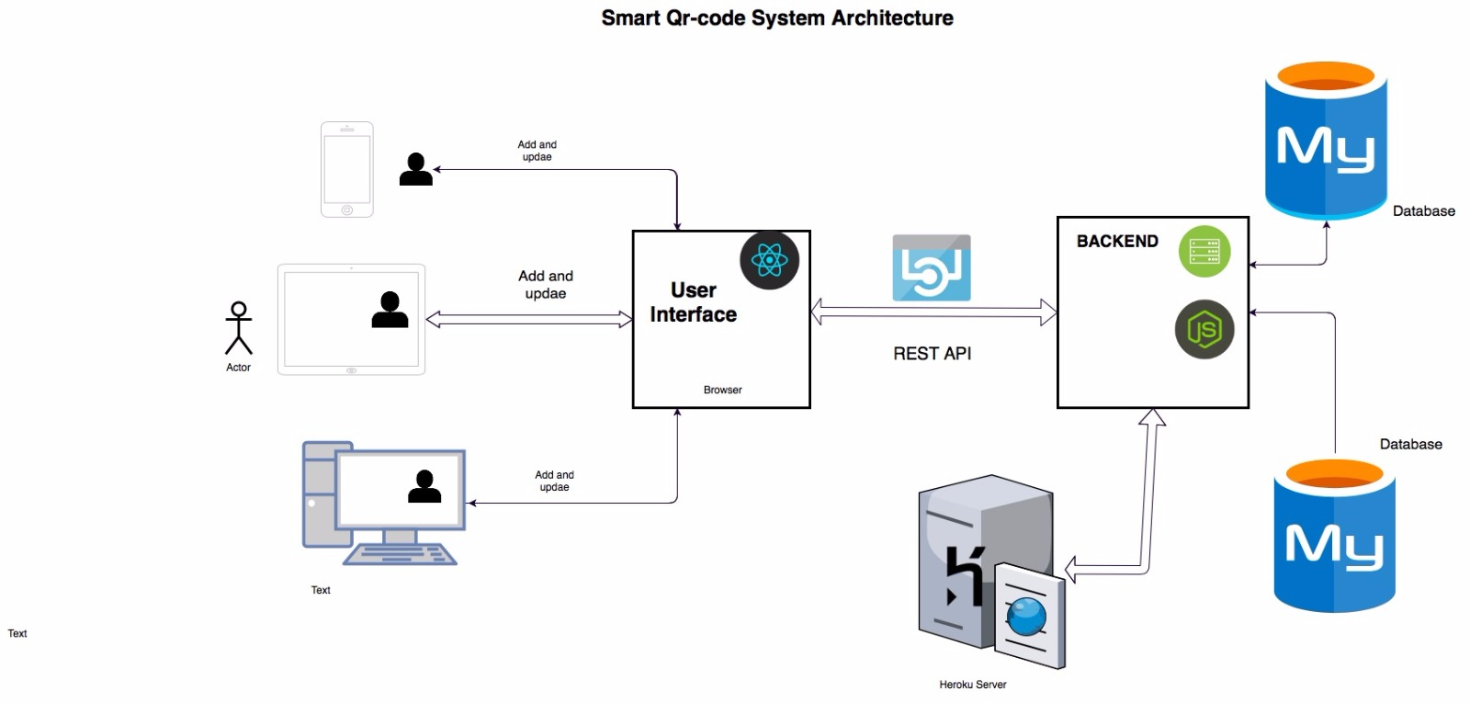
Project Architecture

Slide 5
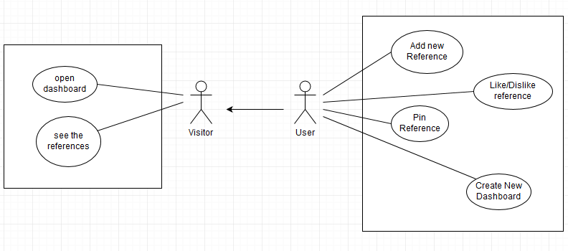
Use Cases

Slide 6
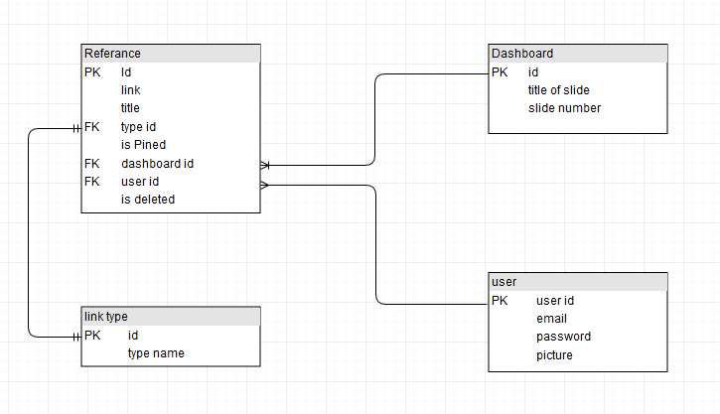

Slide 7
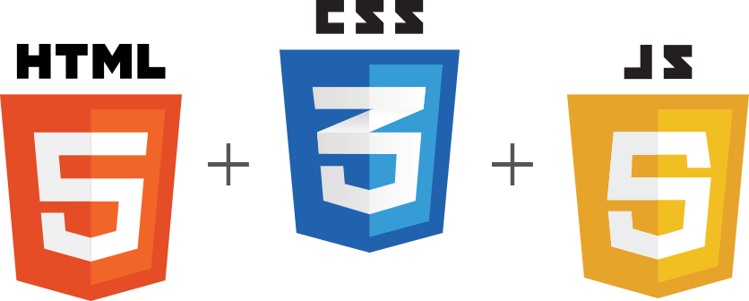
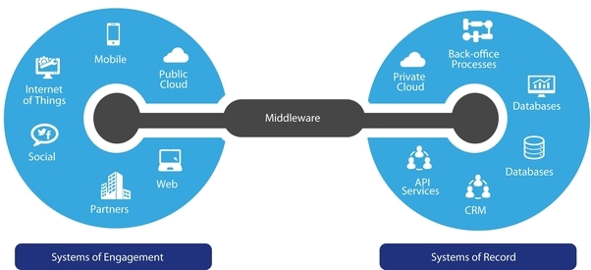
Frontend and Middleware
In Frontend
  We are using HTML, CSS and JavaScript:
  For Views
In Middleware
  We are using React:
  for Controller and Routing

Slide 8

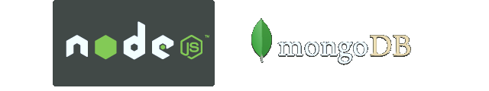
Backend
In Backend:
  As a database we are using Mongo db.
  for the connection setup and API´s we are using Nodes.js

