Slide 1



Design and Analysis of Algorithm(CS2271)
Semester 04
Assignment 01:-
Group Members:-
Anish Banerjee (2021CSB001)
Joyabrata Acharya(2021CSB011)
Sk Fardeen Hossain(2021CSB023)
Source Codes and Documentations are available at Github
Indian Institute of Engineering Science and Technology, Shibpur

Slide 2
Index
SL. NO.​ | TOPIC​ | SUBTOPICS​
1​ | DATASET GENERATION​ | ​Uniform Distribution Normal Distribution
2​ | IMPLEMENTATION OF VARIOUS SORTING ALGORITHMS​ | ​Merge Sort Quick Sort Randomised Quick Sort Normalisation of Dataset, Bucket Sort
3​ | MASTER PROGRAM : GRAPHICAL ANALYSIS​ | ​Average Number of Comparisons Time Complexity
4​ | WORST CASE LINEAR MEDIAN SELECTION​ | ​Median of Medians Divide Size Analysis Partition Size Analysis

Slide 3
Introduction
Sorting is a fundamental operation in Computer Science, and its extensive use is found in various applications such as database systems, search engines and scientific computing.
In this study, several sorting algorithms and distributions were explored to analyse their performance and complexity.
Large datasets were generated using two different distributions-uniform and normal, and then merge and quick sort were applied to them. Further quick sort was modified to make it randomised and datasets were normalised so as to apply bucket sort to them analysing the performance and correctness. The worst case linear median selection algorithm was implemented using median of medians approach and further partition size analysis was done taking median of medians as the pivotal element. A master program was also implemented to have an overview of all the sorting algorithms done in this study.

Slide 4
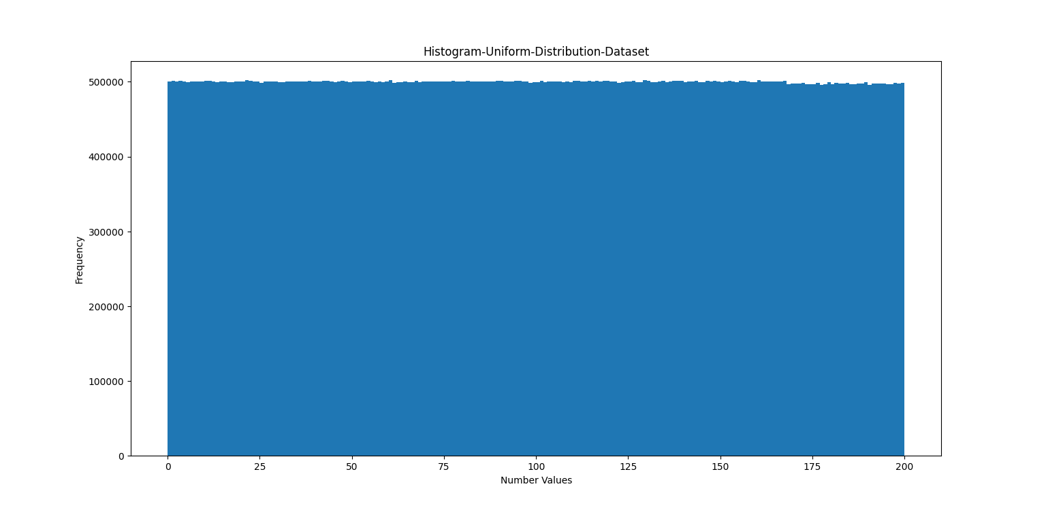
1-A: Construct large datasets taking random numbers from uniform distribution (UD)
Uniform Distribution of 10e7 numbers in the range of 0 to 200

Slide 5
Procedures to Generate the Dataset:-
We will use the inbuilt C rand() function to generate random numbers uniformly. We setup the random seed using <time.h> module and print the random numbers obtained in "uniform_distribution.csv" file.
The numbers can be generated via the formula:
Number=rand()%MAX;// MAX is 200 in our case
We then plotted the histogram of the numbers generated and observe.

Slide 6
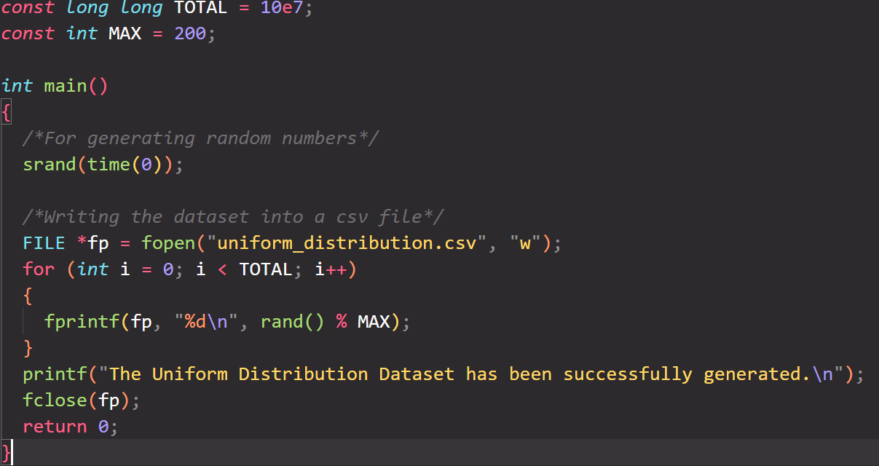
Code Snippet:

Slide 7
Observation:
We can see that the dataset has been generated successfully and every number in the range 0 to 200 has almost same number of occurrences(frequency) which was to be observed in a uniform dataset.

Slide 8
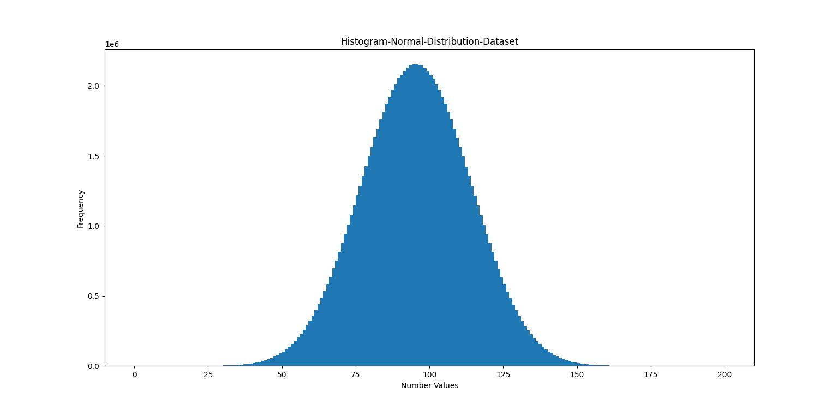
1-B: Construct large datasets taking random numbers from normal distribution (ND)
Normal Distribution of 10e7 numbers in the range of 0 to 200

Slide 9
Procedures to Generate the Dataset:
• The intuition to generate a normal distribution dataset is to know that the frequency of values at the extremes of the range must be low and those near the mean must be high.
• Now we just take the sum of 10 uniformly distributed each numbers between 0 and 10 for 20 rounds and print it onto the dataset such that the min. sum will be 0 and the max sum will be 200 but the frequency of sums near 100 will be appreciably higher.
• We did the same procedure 10^8 times to generate a dataset normal_distribution.csv consisting of 10^8 normally distributed numbers.
• Then we plot the values in the histogram and check for correctness of the generated dataset.

Slide 10
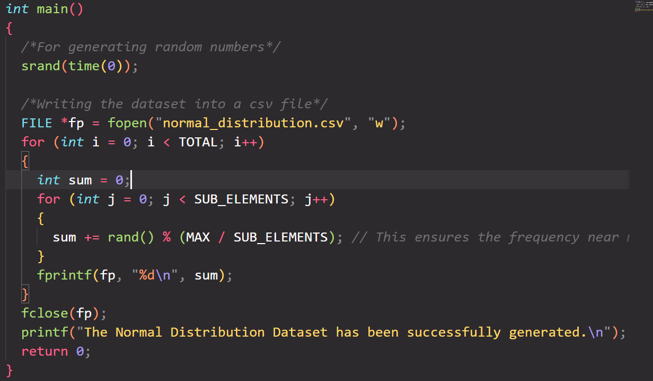
Code Snippet:

Slide 11
Observation
We can see that the plot shows the natural bell curve a characteristic of normalised data thus ensuring that the dataset generated gives normal distribution.

Slide 12
2-A: Implement Merge Sort (MS) and check for correctness
Merge Sort is a comparison-based sorting algorithm that works on the divide and conquer paradigm. There are 3 stages in a merge sort:
Divide: n-element sequence into n/2 elements into 2 subsequences and this will take O(1) time
Conquer: We sort the two subsequences recursively.
Combine: We then combine the sorted subsequence into a sorted sequence; takes O(N) time
The method gives the following recurrence relation:
T(N)=2*T(N/2)+O(N); T(N) is the time taken to sort an array of size N.
The Time complexity obtained after solving the relation is O(NlogN) which is both the best case and average case time complexity.

Slide 13
Merge Sort Algorithm:
MergeSort(arr[ ], l, r){
If (r > l) {
// Find the middle point to divide the array into two halves
middle m = (l+r)/2 ;
// Call Merge Sort for first half
MergeSort(arr, l, m) ;
// Call merge Sort for second half
MergeSort(arr, m+1, r) ;
// Merge the two halves sorted
Merge(arr, l, m, r) ;
}
}
You can check for correctness of code at :- MergeSort

Slide 14
2-B: Implement Quick Sort (QS) and check for correctness
Quick Sort is also a Divide and Conquer algorithm but unlike merge sort in quick sort the conquer time is constant while the divide time is almost linear. Unlike Merge Sort which has a deterministic time complexity, quick sort algorithm has probabilistic time-complexity that is the choice of pivot element at each step in quick sort drives the time complexity.
The pivot element can be chosen randomly, first element, last element or median of three and many more and each of the approach gives different tweaking in the time complexity of O(N*logN).
The method in each step divides the array into 3 parts: 1st part contains all those elements less than pivot value, 2nd part contains only the pivot value and the last part contains all those elements more than pivot value. The pivot value in each step gets its position fixed as that will be its position in the sorted array

Slide 15
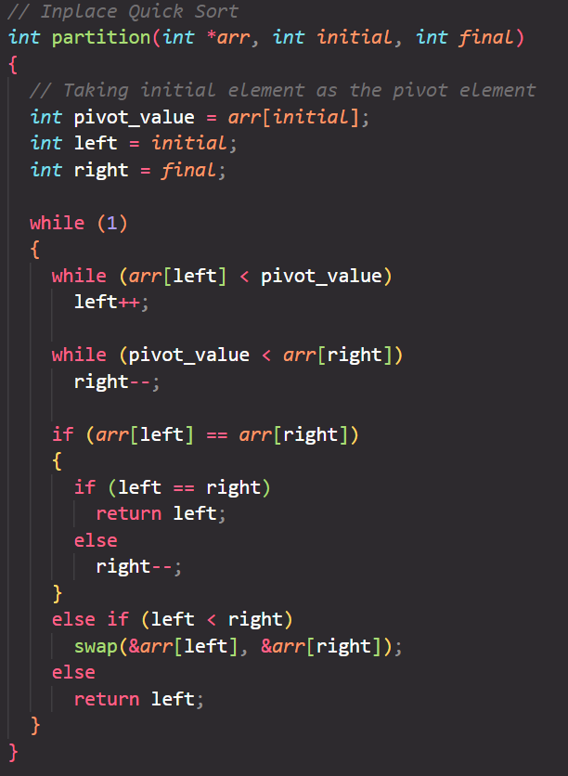
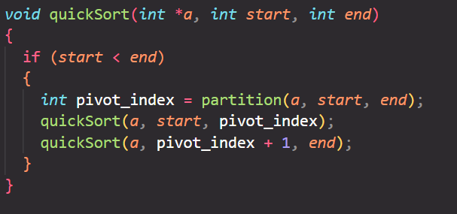
Quick Sort Algorithm:
You can check for correctness of code at :- QuickSort

Slide 16
3. Count the operations performed, like comparisons and swaps with problem size increasing in powers of 2, for both MS and QS with both UD and ND as input data
For each of the sorting algorithms we analyse two min areas:
1. Average Number of Comparisons
2. Average Time Taken
The range of the size of the array was kept between 2 and 2^18 and are incremented in increasing powers of 2
For each array size we take 50 rounds of the same array size and calculate the average time taken and the average number of comparisons taken
We then plot the comparison and time ratio by dividing the average comparisons and time taken by N*logN N being the size of the array.

Slide 17

A. Merge Sort and Quick Sort
$$Code Snippets$$
/*---Merge Sort---*/
void merge(double *merge, double *arr1, double *arr2, ui n1, ui n2)
{
ui i=0,j=0,k=0;
while (i < n1 && j < n2)
{
merge[k++] = ((arr1[i]<arr2[j]) ? arr1[i++] : arr2[j++]);
(*comp)++;
}
while(i < n1)
merge[k++] = arr1[i++];
while (j < n2)
merge[k++] = arr2[j++];
}
void mergeSort(double * arr,ui n,ui *comp)
{
if(n < 2) return;
ui mid = n >> 1; double larr[mid],rarr[n-mid]; for (ui i = 0; i < mid; i++)
larr[i] = arr[i];
for (ui i = 0; i < n-mid; i++)
rarr[i] = arr[i+mid];
mergeSort(larr,mid,comp);
mergeSort(rarr,n-mid,comp);
merge(arr,larr,rarr,mid,n-mid,comp);
}
/*---Normal QS---*/
int partitionQS(double * arr, int low, int high,ui *comp,ui *swaps)
{
double pivot = arr[high];
int i = low;
for (int j = low; j < high; j++)
{
if (arr[j] < pivot)
{
swap(&arr[i], &arr[j]);
(*swaps)++;
i++;
}
(*comp)++;
}
swap(&arr[i], &arr[high]);
(*swaps)++;
return i;
}
void quickSort(double * arr, int low, int high,ui *comp)
{
if(low < high)
{
int pi = partitionQS(arr,low,high,comp,swaps);
quickSort(arr,low,pi-1,comp,swaps);
quickSort(arr,pi+1,high,comp,swaps);
}
}

Slide 18
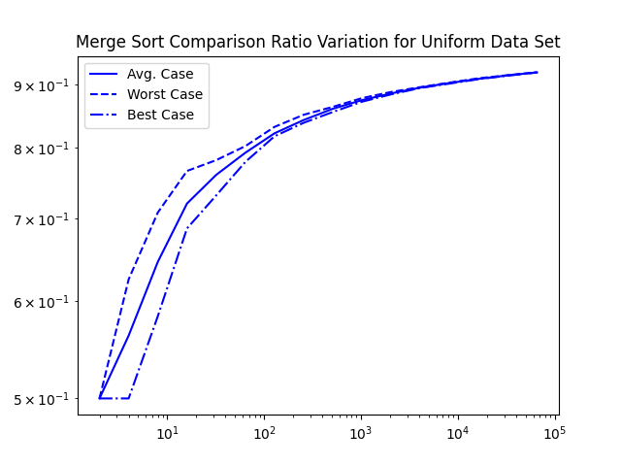
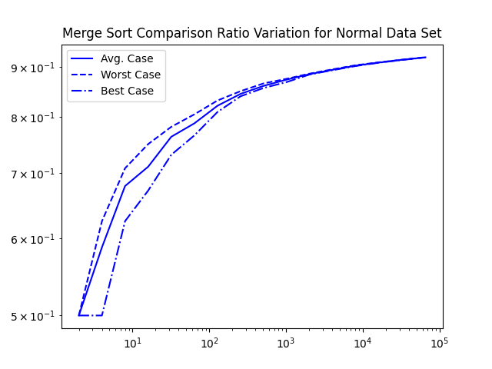
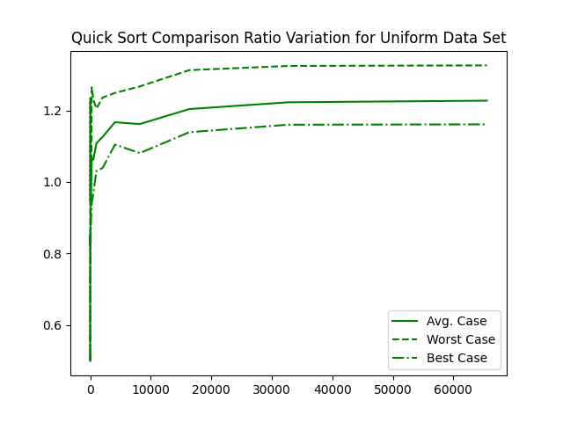
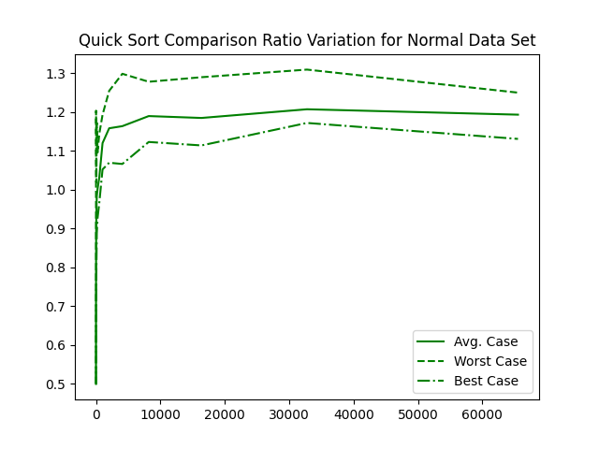





$$i. Merge Sort and Quick Sort Comparison Ratio Observations:$$
$${Comparisons}/{Nlog\left(N\right)}→$$
$${Comparisons}/{Nlog\left(N\right)}→$$
$$DataSet Size\left(N\right)→$$
$$DataSet Size\left(N\right)→$$
$${Comparisons}/{Nlog\left(N\right)}→$$
$${Comparisons}/{Nlog\left(N\right)}→$$
$$DataSet Size\left(N\right)→$$
$$DataSet Size\left(N\right)→$$

Slide 19
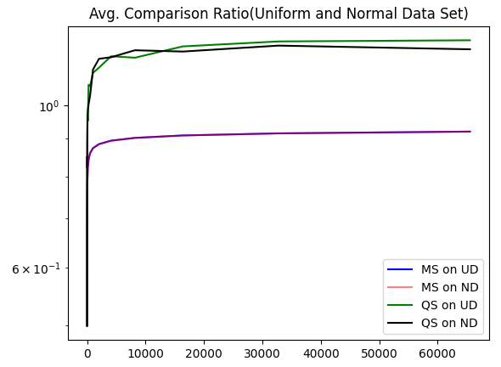


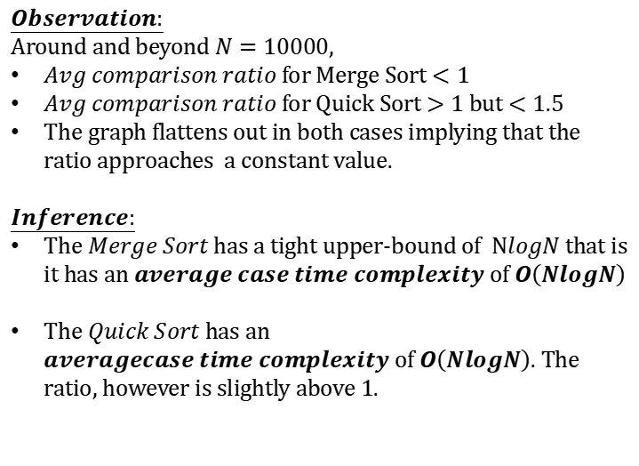
$$ii.Merge Sort vs Normal Quick Sort$$
$$Observation:$$
Around and beyond $N=10000,$
$Avg comparison ratio$ for Merge Sort $<1$
$Avg comparison ratio$ for Quick Sort $>1$ but $<1.5$
The graph flattens out in both cases implying that the ratio approaches a constant value.
$$Inference:$$
The $Merge Sort$ has a tight upper-bound of $NlogN$ that is it has an $average case time complexity$of $O\left(NlogN\right)$
The $Quick Sort$ has an $averagecase time complexity$of $O\left(NlogN\right)$. The ratio, however is slightly above 1.
$${Comparisons}/{Nlog\left(N\right)}→$$
$$DataSet Size\left(N\right)→$$

Slide 20
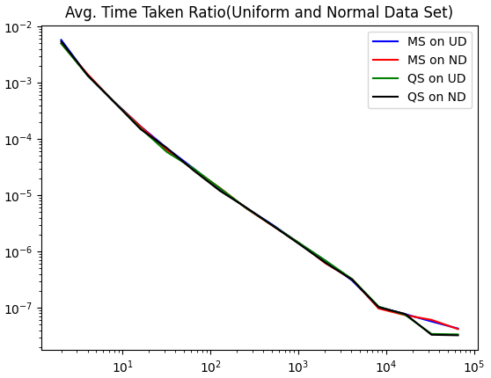
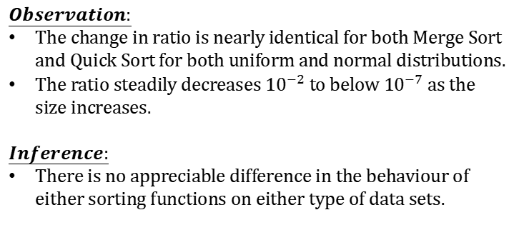

$$iii.Time Taken Ratio Analysis$$
$$Observation:$$
The change in ratio is nearly identical for both Merge Sort and Quick Sort for both uniform and normal distributions.
The ratio steadily decreases ${10}^{−2}$ to below${10}^{−7}$ as the size increases.
$$Inference:$$
There is no appreciable difference in the behaviour of either sorting functions on either type of data sets.
$${Time taken}/{Nlog\left(N\right)}→$$
$$DataSet Size\left(N\right)→$$

Slide 21
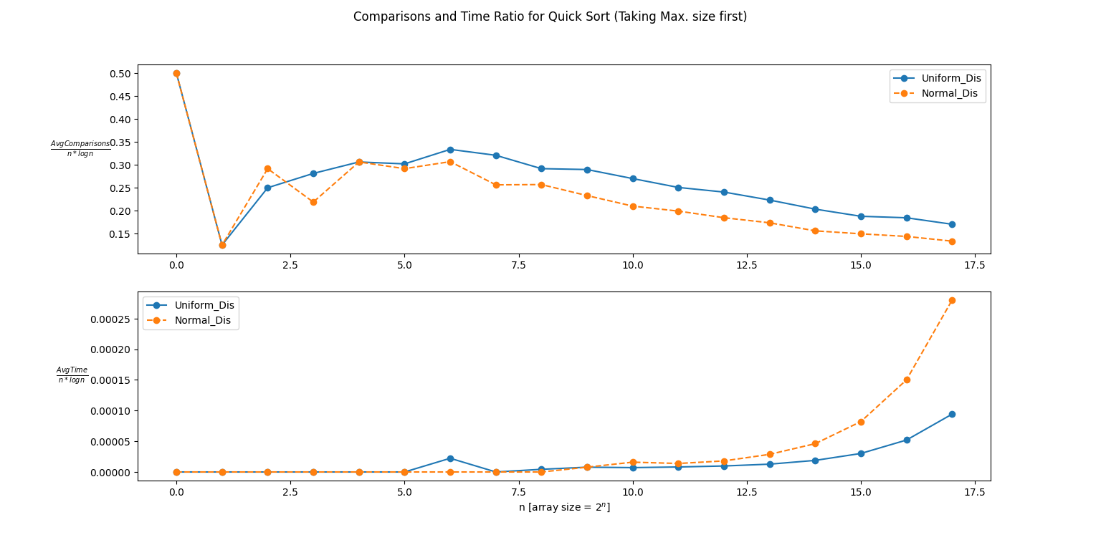
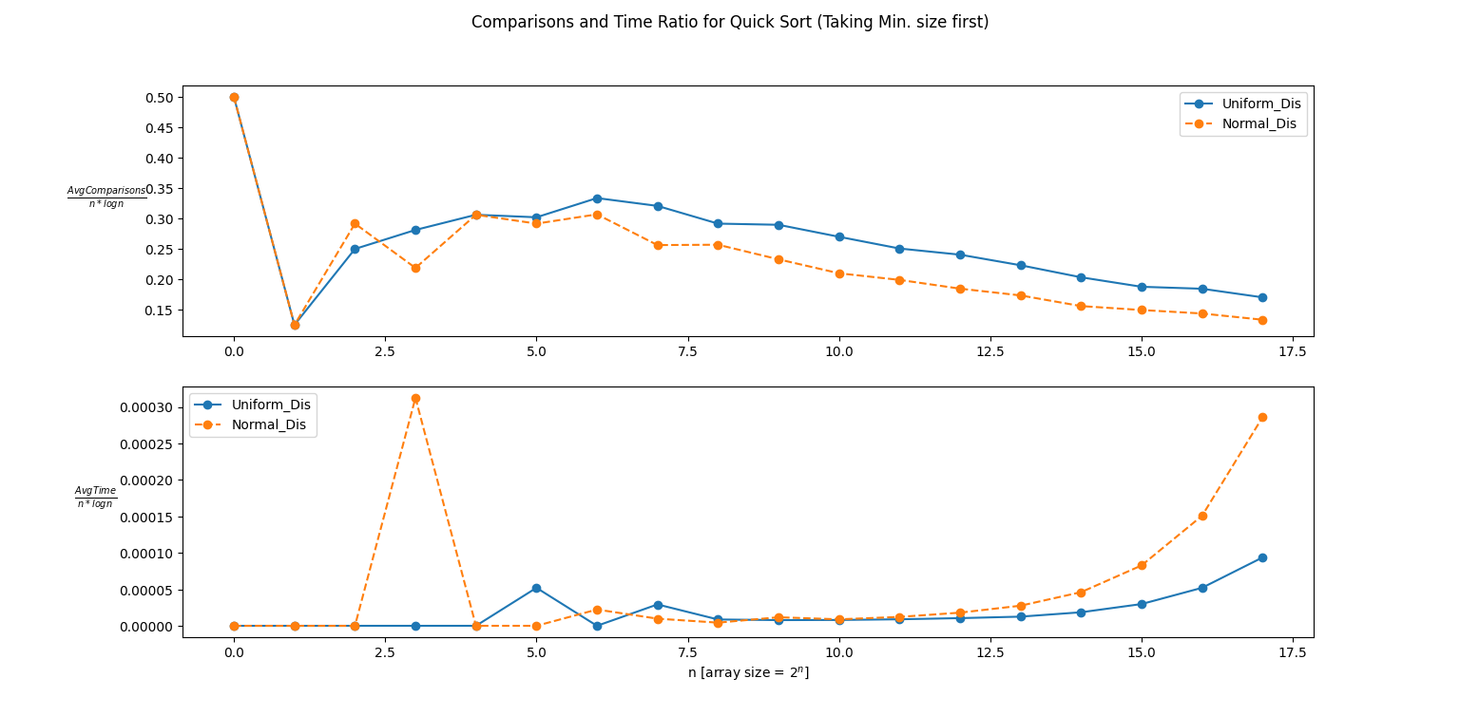
Analysis for Quick Sort preferrential sorting
Here we analyse the case when we sort the min or max size part first after partitioning the array in each turn. So what we do is to just tweak the quickSort part and quickSort the max or min size first depending on the choice.
As we can observe that sorting min size or max size first does not change the trend of the quick sort algorithm and it can be inferred that preferrentially sorting in this manner will give same average number of comparisons.

Slide 22
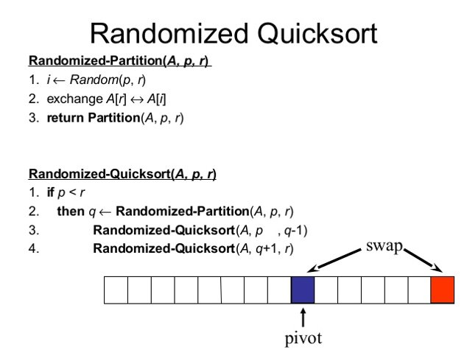
4. Experiment with randomized QS (RQS) with both UD and ND as input data to arrive at the average complexity (count of operations performed) with both input datasets.
The idea of a randomised algorithm is the use of random numbers to decide what to do anywhere it's next logic. In a randomised Quick Sort Algorithm we use a random number in a given range as the pivot value.

Slide 23
Time Complexity
Being a randomised algorithm, the randomised quick sort algorithm has expected time complexity of O(nlogn) whereas the worst case time complexity is also same. In the worst case domain the pivot element to be picked is always the extreme points.

Slide 24
Procedure:
We perform RQS for different size array starting from size 2 to 2^18 with size increasing in powers of 2 in each turn.
For each size we perform 50 rounds of RQS and check for correctness keeping track of the average time taken and the number of comparisons.
We then plotted the avg time taken and the number of comparisons by taking a ration with nlogn, n being the size of the array.

Slide 25
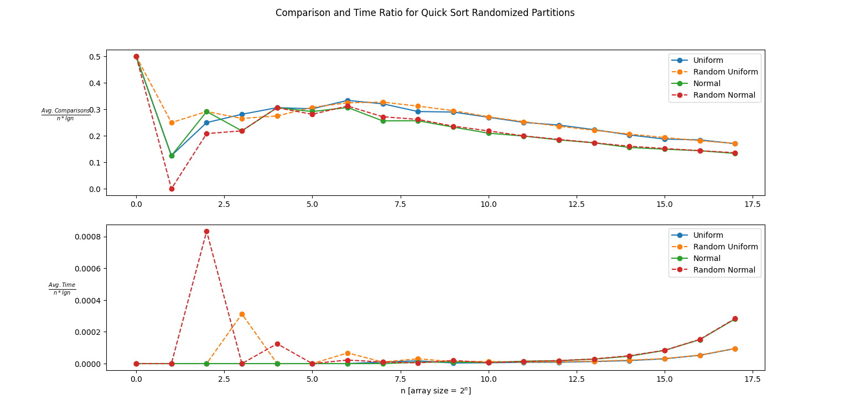
Observation
As the array size keeps on increasing the comparison and time ratio settles to a stable value, thus making the average and worst case time complexity to be same in this case.
The near same semblance to the normal quick sort may be due to the fact that the random pivot goes for a 1:1 partition. To get a perspective on the randomness we can do deliberate partitions and compare it with randomised partitions.

Slide 26
$$ii.Deliberate Parition Quick Sort$$
int partition(double *arr, int low, int high, int *comp)
{
double pivot_value = arr[low]; int i = low;
int j = high;
while (1)
{
while (arr[i] < pivot_value)
i++;
while (pivot_value < arr[j])
j--;
if (arr[i] == arr[j])
if (i == j) return i;
else j--;
else if (i < j)
{
swap(&arr[i], &arr[j]);
(*comp)++;
}
else return i;
}
}
int randomized_partition(double *arr, int low, int high, int *comp)
{
int i = rand() % (high - low) + low;
swap(&arr[low], &arr[i]);
return partition(arr, low, high, comp);
}
int randomized_select(double *arr,int low,int high,int find_pos, int *comp)
{
if (low == high) return low;
if (find_pos < low || find_pos > high)
{
printf("Error: Less\n");
exit(0);
}
int q = randomized_partition(arr, low, high, comp);
int k = q + 1;
if (find_pos < k)
return randomized_select(arr, low, q, find_pos, comp);
else
return randomized_select(arr, k, high, find_pos, comp);
}
void quick_sort_ratio(double *arr, int low, int high, int *comp, int ratio)
{
if (low < high)
{
int pivot_pos = randomized_select(arr,low,high,low+(high-low)/ratio, comp);
quick_sort_ratio(arr, low, pivot_pos, comp, ratio);
quick_sort_ratio(arr, pivot_pos + 1, high, comp, ratio);
}
}

Slide 27
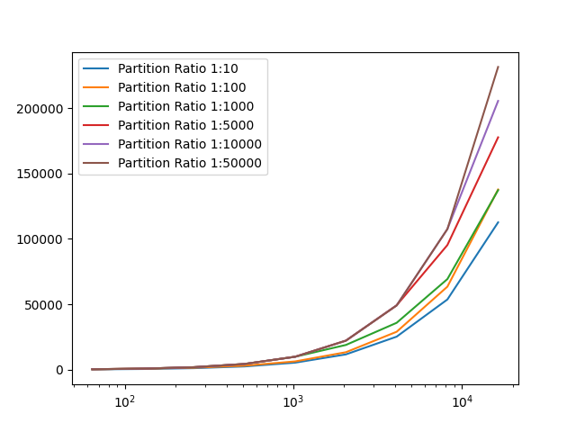


$$i. Effect of Growth in Comparison Quick Sort Comparison Ratio Observations$$
$$Comparisons$$
$$Comparisons$$
$$DataSet Size\left(N\right)→$$
$$DataSet Size\left(N\right)→$$

Slide 28
5. Now normalize both the datasets in the range from 0 to 1 and implement bucket sort (BS) algorithm and check for correctness.
To normalise a dataset between 0 and 1 we just need to divide all the elements in the corresponding dataset by the max value of the range(200).
We then save the normalised dataset into another .csv file and then plot the histograms of the dataset to check for correctness.

Slide 29
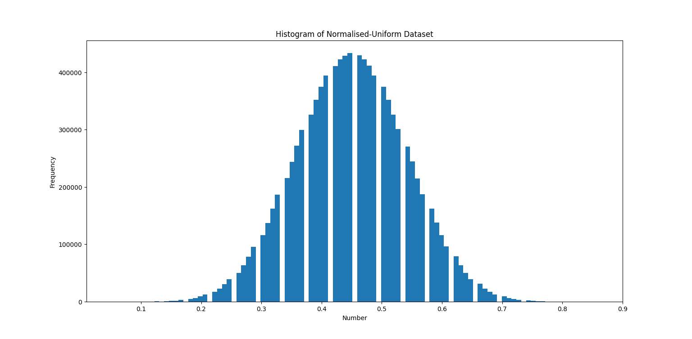
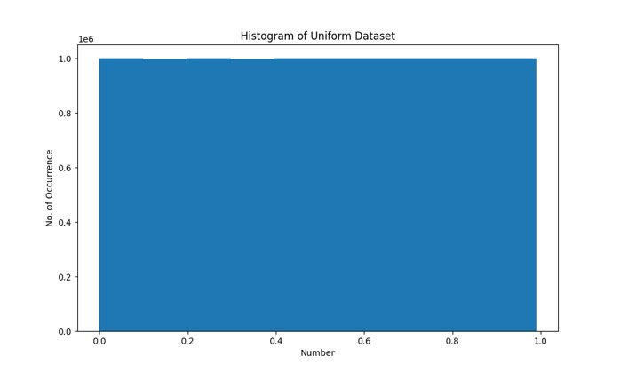
Observation

Slide 30
6. Experiment with BS to arrive at its average complexity for both UD and ND data sets and infer.
Bucket sort, or bin sort, is a sorting algorithm that works by distributing the elements of an array into several buckets. Each bucket is then sorted individually, either using a different sorting algorithm, or by recursively applying the bucket sorting algorithm. It is a distribution sort, a generalization of pigeonhole sort, and is a cousin of radix sort in the most-to-least significant digit flavor. Bucket sort can be implemented with comparisons and therefore can also be considered a comparison sort algorithm. The computational complexity depends on the algorithm used to sort each bucket, the number of buckets to use, and whether the input is uniformly distributed.
It is not a comparison based sort unlike QS or MS.

Slide 31
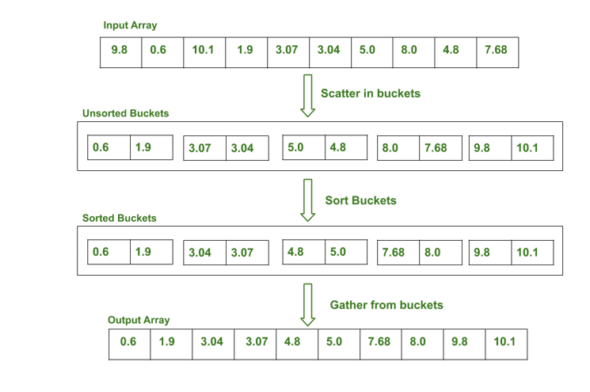
Bucket Sort in Action
The time complexity of bucket sort is O(n+k) for best case and average case while O(n^2) for worst case
K being the average size of the bucket.
The space complexity of bucket sort is O(nk) k being the average size of bucket

Slide 32
Procedure
We implement the bucket sort algorithm using a array based linked list implementation where each element of the array is a bucket manifested in the form of a linked list.
We apply the algorithm for the normalised dataset with the size of array increasing in powers of 2 and each size takes 15 rounds.
We then compare the average time taken and average number of comparisons with n, n being the size of the array.

Slide 33
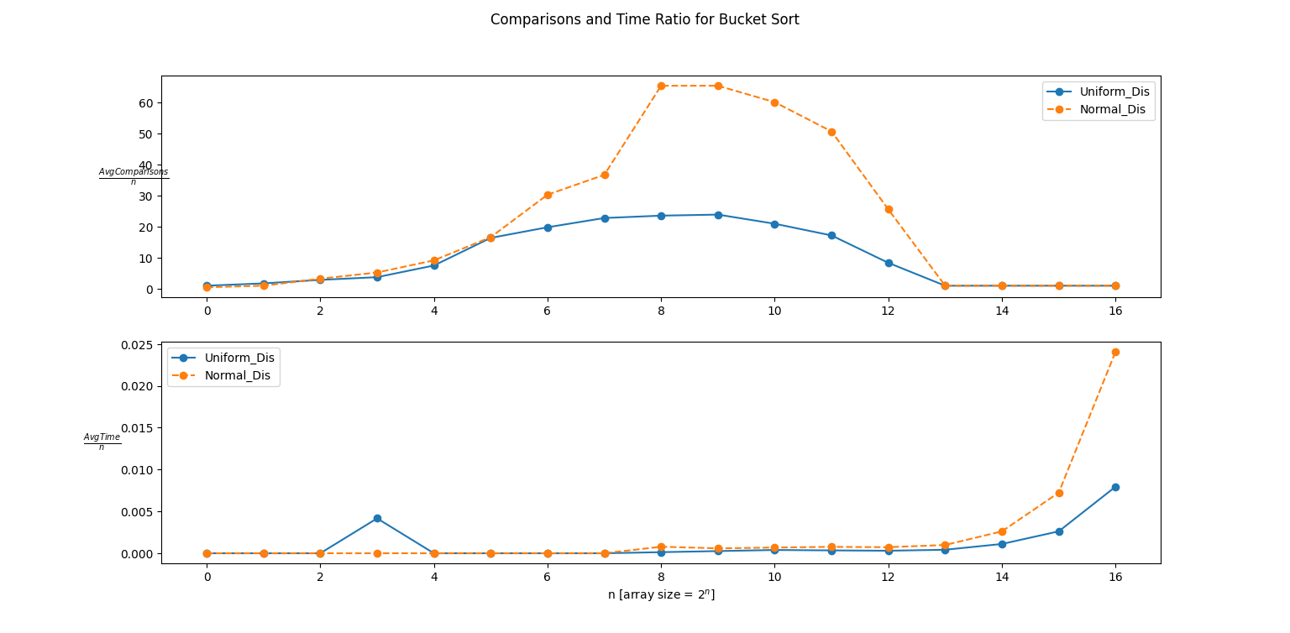
Observation

Slide 34
7. Master Program
TO STUDY THE COMPARISON BETWEEN MERGE SORT, QUICK SORT, RANDOMISED QUICK SORT AND BUCKET SORT ON THE BASIS OF AVERAGE TIME TAKEN AND AVERAGE NUMBER OF COMPARISONS INVOLVED. GRAPHICAL INTERPRETATION HAS BEEN DEMONSTRATED

Slide 35
Procedure
The previously mentioned implementations have been utilised to generate a master comparison program in C-language. Both Uniform and Normal Datasets of sizes varying 2 1 to 2 16 have been subjected to the 4 sorting algorithms separately. For the randomised Quick Sort, the same dataset was iterated 10 times while for the others, it was 10 various combinations of the datasets. Ultimately, the average time taken and number of comparisons have been plotted with respect the theoretically known complexities, i.e. ’n log2 n’ for Merge, Quick and Randomised Quick Sort, and ’n’ for Bucket Sort.
The results have been generated in Master Text Files (both in detailed and easy viewable format). Respective graphs have been plotted.

Slide 36
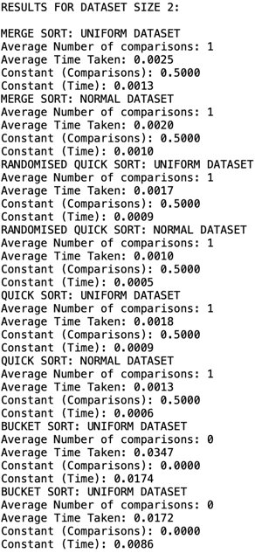
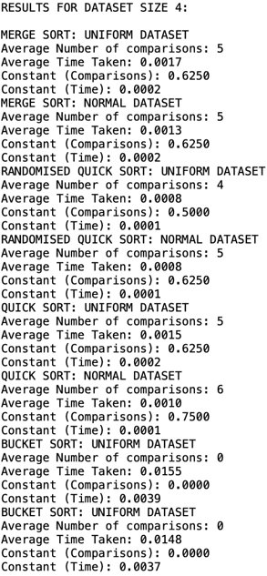
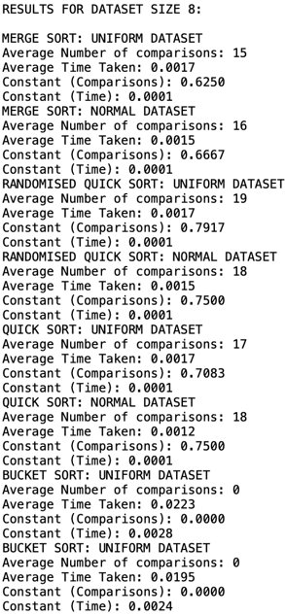
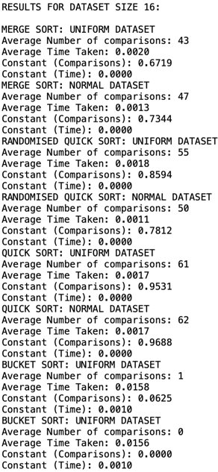
Master File results
Time in mlliseconds

Slide 37
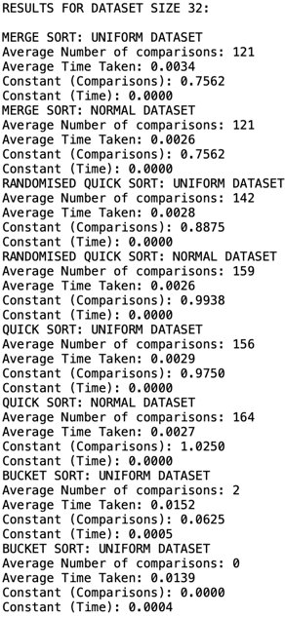
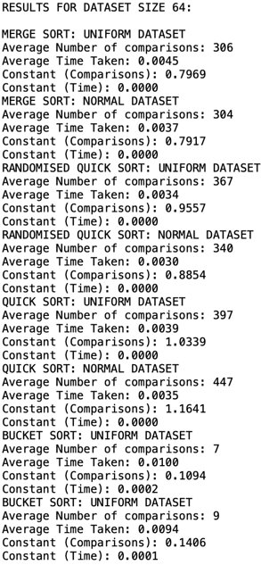
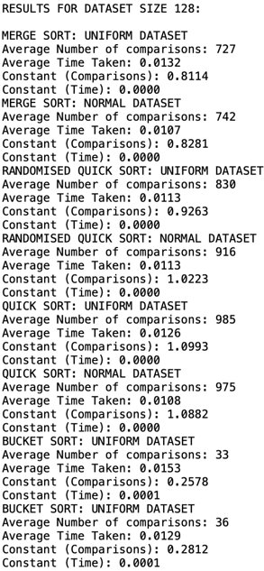
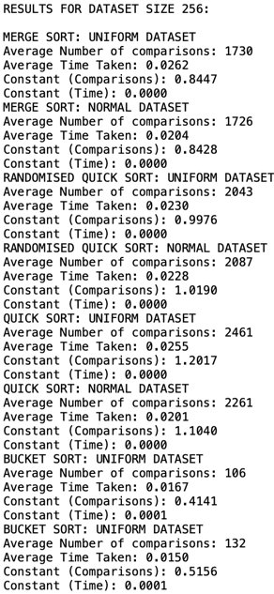
Master File results
Time in mlliseconds

Slide 38
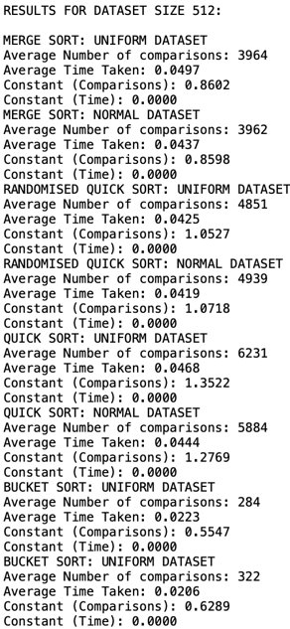
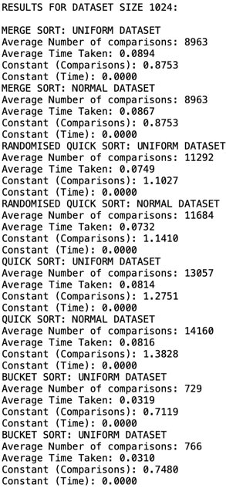
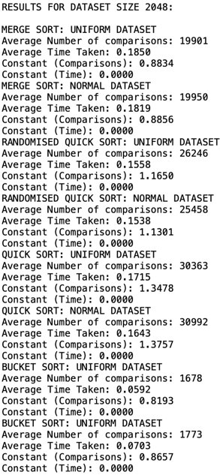
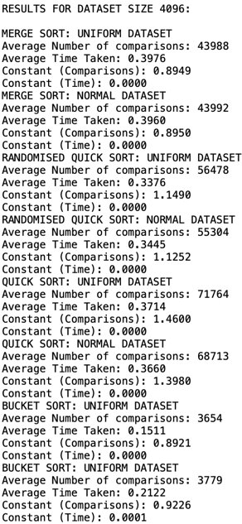
Master File results
Time in mlliseconds

Slide 39
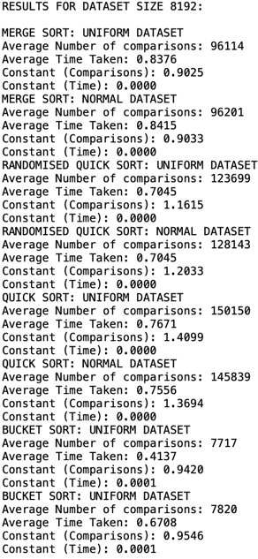
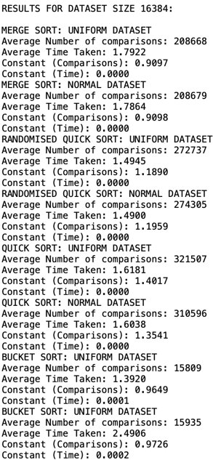
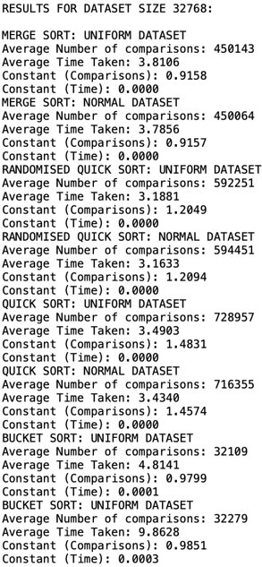
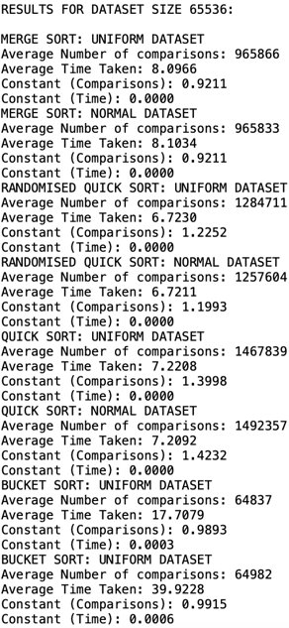
Master File results
Time in mlliseconds

Slide 40
Summarised Results (Constant Ratio)
DATASET SIZE​ | MS_UD​ | MS_ND​ | RQS_UD​ | RQS_ND​ | QS_UD​ | QS_ND​ | BS_UD​ | BS_ND​
2​ | 0.500000​ | 0.500000​ | 0.500000​ | 0.500000​ | 0.500000​ | 0.500000​ | 0.000000​ | 0.000000​
4​ | 0.625000​ | 0.625000​ | 0.500000​ | 0.625000​ | 0.625000​ | 0.750000​ | 0.000000​ | 0.000000​
8​ | 0.625000​ | 0.666667​ | 0.791667​ | 0.750000​ | 0.708333​ | 0.750000​ | 0.000000​ | 0.000000​
16​ | 0.671875​ | 0.734375​ | 0.859375​ | 0.781250​ | 0.953125​ | 0.968750​ | 0.062500​ | 0.000000​
32​ | 0.756250​ | 0.756250​ | 0.887500​ | 0.993750​ | 0.975000​ | 1.025000​ | 0.062500​ | 0.000000​
64​ | 0.796875​ | 0.791667​ | 0.955729​ | 0.885417​ | 1.033854​ | 1.164062​ | 0.109375​ | 0.140625​
128​ | 0.811384​ | 0.828125​ | 1.052734​ | 1.022321​ | 1.099330​ | 1.088170​ | 0.257812​ | 0.281250​
256​ | 0.844727​ | 0.842773​ | 1.102734​ | 1.019043​ | 1.201660​ | 1.04004​ | 0.414062​ | 0.515625​
512​ | 0.860243​ | 0.859809​ | 1.165039​ | 1.071832​ | 1.352214​ | 1.276910​ | 0.554688​ | 0.628906​
1024​ | 0.875293​ | 0.875293​ | 1.149048​ | 1.141016​ | 1.275098​ | 1.382812​ | 0.711914​ | 0.748047​
2048​ | 0.883390​ | 0.885565​ | 1.165039​ | 1.130060​ | 1.347789​ | 1.375710​ | 0.819336​ | 0.865723​
4096​ | 0.894938​ | 0.895020​ | 1.149048​ | 1.125163​ | 1.460042​ | 1.397970​ | 0.892090​ | 0.922607​
8192​ | 0.902513​ | 0.903330​ | 1.161537​ | 1.203266​ | 1.409912​ | 1.369432​ | 0.942017​ | 0.954590​
16384​ | 0.909720​ | 0.909768​ | 1.189039​ | 1.195875​ | 1.401659​ | 1.354091​ | 0.964905​ | 0.972595​
32768​ | 0.915818​ | 0.915658​ | 1.204938​ | 1.209414​ | 1.483067​ | 1.457428​ | 0.979889​ | 0.985077​
65536​ | 0.921122​ | 0.921090​ | 1.225196​ | 1.199345​ | 1.399840​ | 1.423223​ | 0.989334​ | 0.991547​

Slide 41
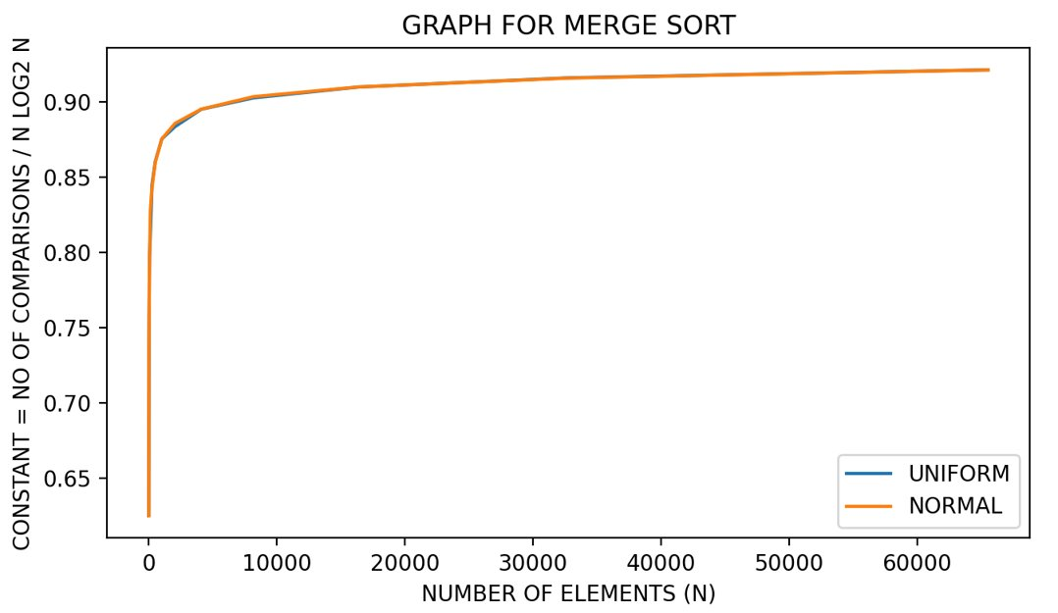
Comparative Graphs (Average number of Comparisons)

Slide 42
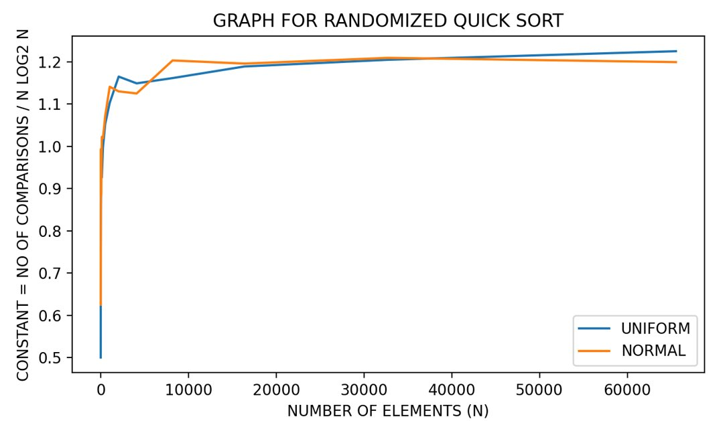
Comparative Graphs (Average number of Comparisons)

Slide 43
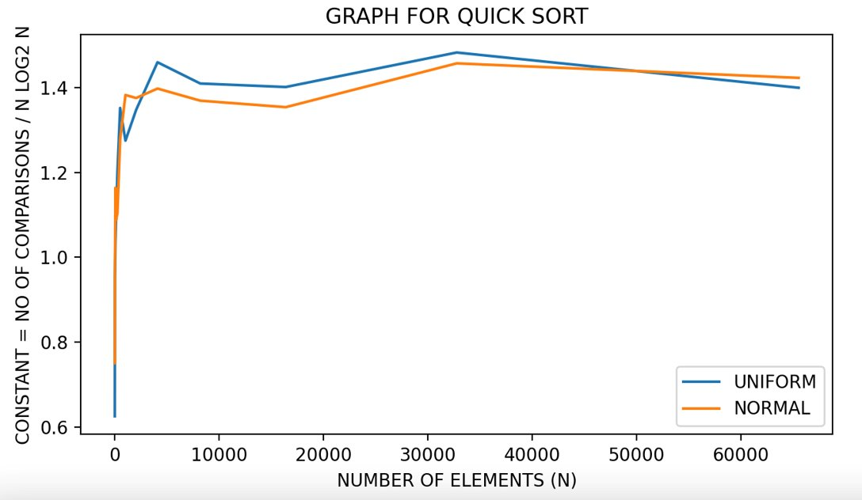
Comparative Graphs (Average number of Comparisons)

Slide 44
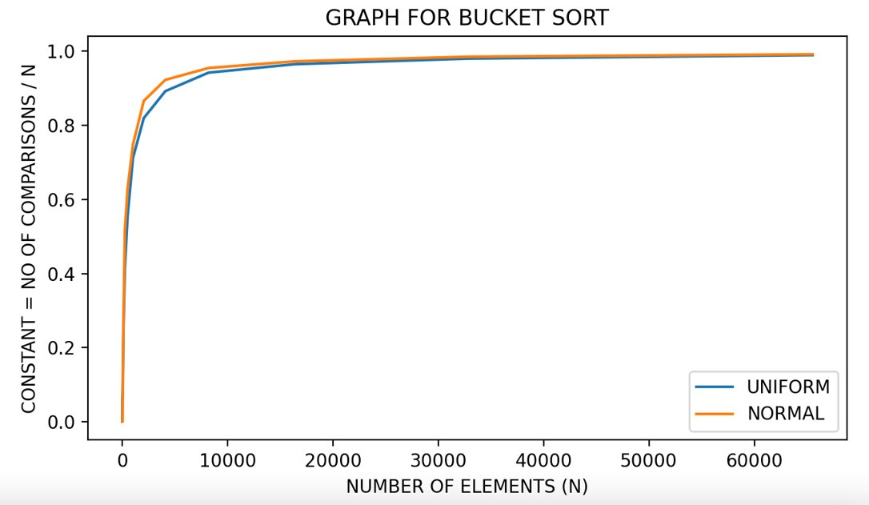
Comparative Graphs (Average number of Comparisons)

Slide 45
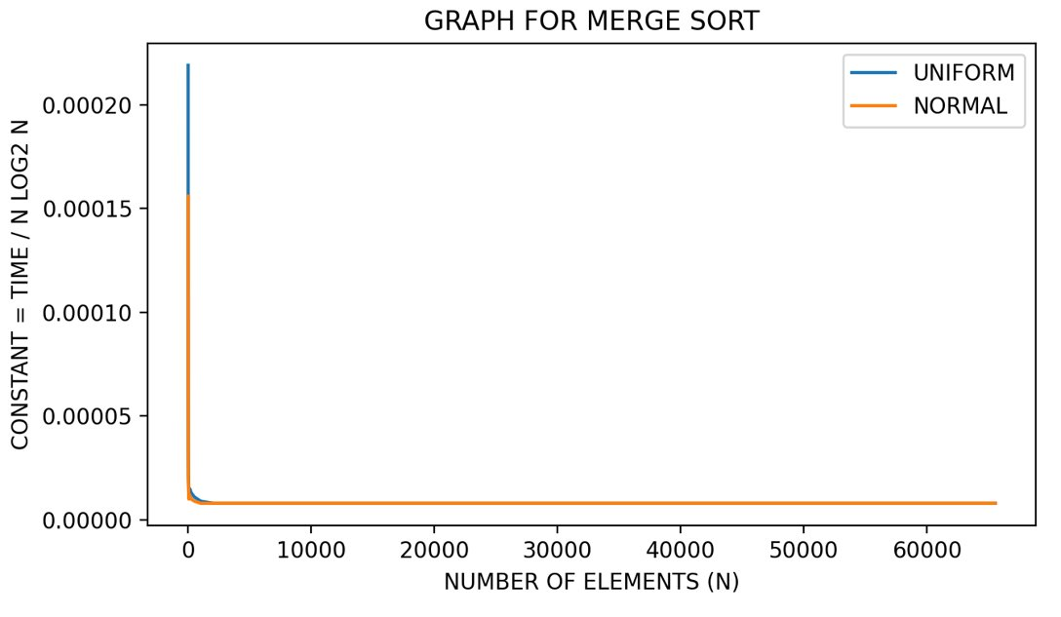
Comparative Graphs (Average Time Taken)

Slide 46
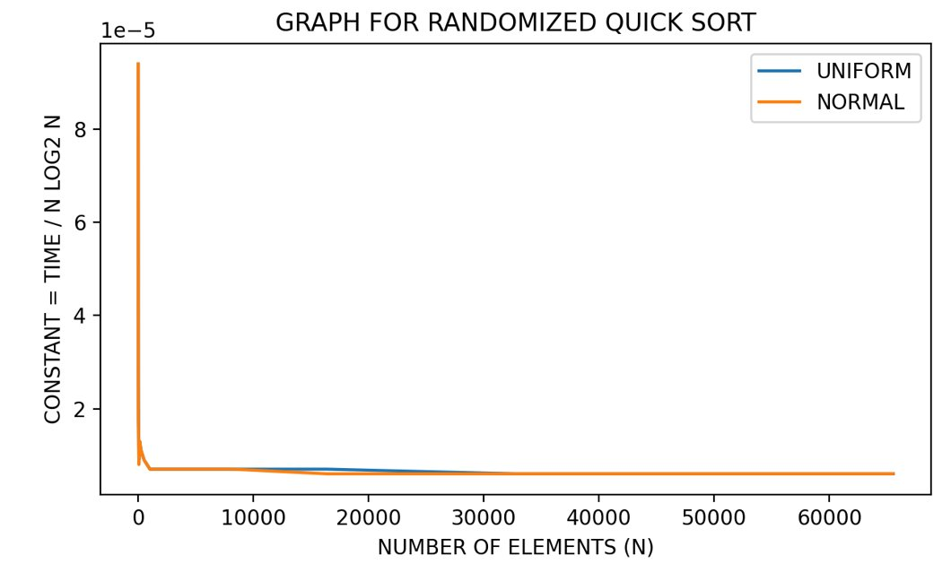
Comparative Graphs (Average Time Taken)

Slide 47
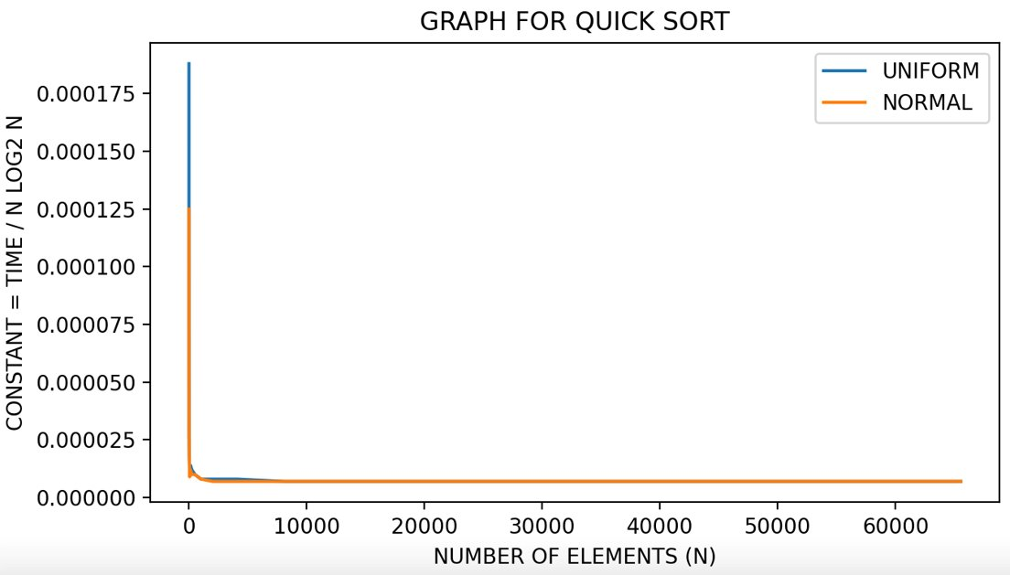
Comparative Graphs (Average Time Taken)

Slide 48
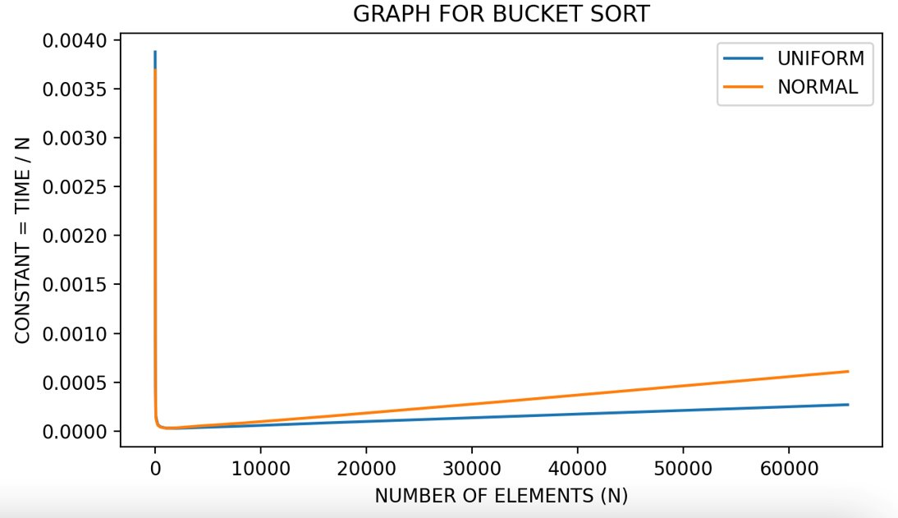
Comparative Graphs (Average Time Taken)

Slide 49
Inference
The graphs certainly give us an insight into the complexities of the various sorting algorithms. The results obtain indeed go hand-in-hand with our expected theoretical complexities.
SORTING ALGORITHM​ | AVERAGE COMPLEXITY​
MERGE​ | n log2 n​
QUICK​ | n log2 n​
RANDOMISED QUICK​ | n log2 n​
BUCKET​ | n ​

Slide 50
8. Implement the worst case linear median selection algorithm by taking the median of medians (MoM) as the pivotal element and check for correctness.
In computer science, the median of medians is an approximate median selection algorithm, frequently used to supply a good pivot for an exact selection algorithm, most commonly quickselect, that selects the kth smallest element of an initially unsorted array. Median of medians finds an approximate median in linear time. Using this approximate median as an improved pivot, the worst-case complexity of quick-select reduces from quadratic to linear, which is also the asymptotically optimal worst-case complexity of any selection algorithm. In other words, the median of medians is an approximate median-selection algorithm that helps building an asymptotically optimal, exact general selection algorithm (especially in the sense of worst-case complexity), by producing good pivot elements.
Median of medians can also be used as a pivot strategy in quicksort, yielding an optimal algorithm, with worst-case complexity O(Nlog⁡N). Although this approach optimizes the asymptotic worst-case complexity quite well, it is typically outperformed in practice by instead choosing random pivots for its average O(N) complexity for selection and average O(Nlog⁡N) complexity for sorting, without any overhead of computing the pivot.

Slide 51
Procedure
We n elements into n/divide_size groups of size same as divide_size and n%divide_size elements in the last group
We then find the direct median of each group and group them into an array of size n/divide_size(+1 if extra group exists)
We then repeat steps 1 and 2 till a single value is reached.

Slide 52
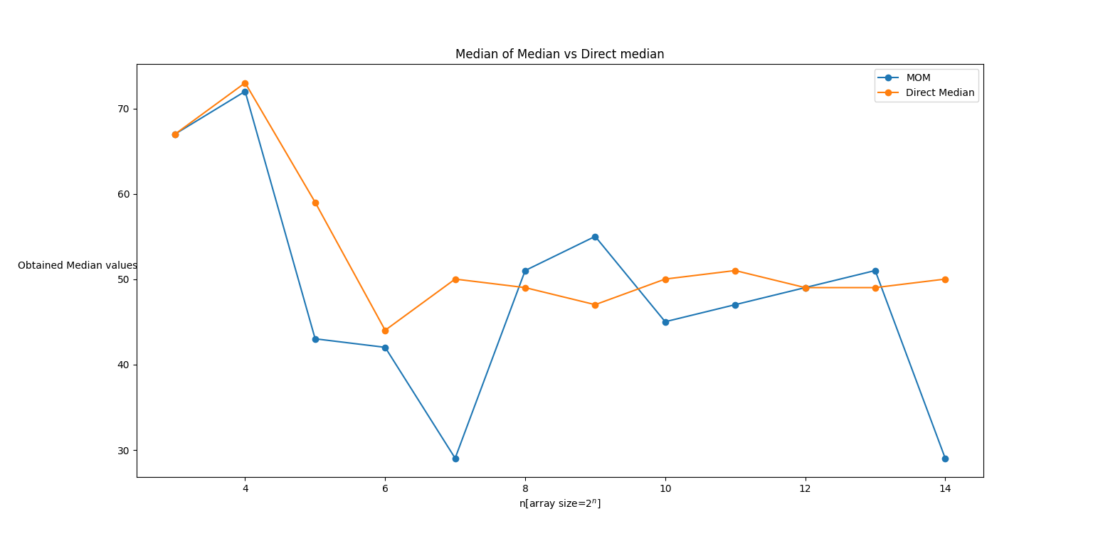
Observation

Slide 53
9. Take different sizes for each trivial partition (3/5/7 ...) and see how the time taken is changing.
We performed Median of Medians algorithm on array of fixed size of 10^5 keeping the divide_size changing from 3 to 2001 consisting of odd numbers only.
For each divide size we took 15 rounds and computed the average time taken to perform the median selection and then plotted it against the divide_size.

Slide 54
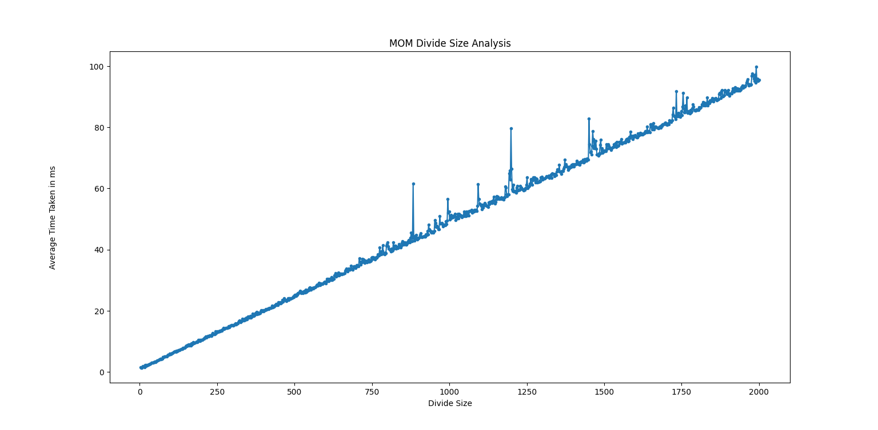
Observation:
From the graph it can be inferred that the average system time taken is almost linear with the divide size.

Slide 55
10. Perform experiments by rearranging the elements of the datasets (both UD and ND) and comment on the partition or split obtained using the pivotal element chosen as MoM.
We perform the partitions on an array taken median of medians as the pivot element with the divide size being a constant in each observation.
We increase the array size from 100 to 10^5 by incrementing the size by 100 in each turn. Each turn has 10 rounds, and we take the average partition size of each size and print it in a .csv file and observe.

Slide 56
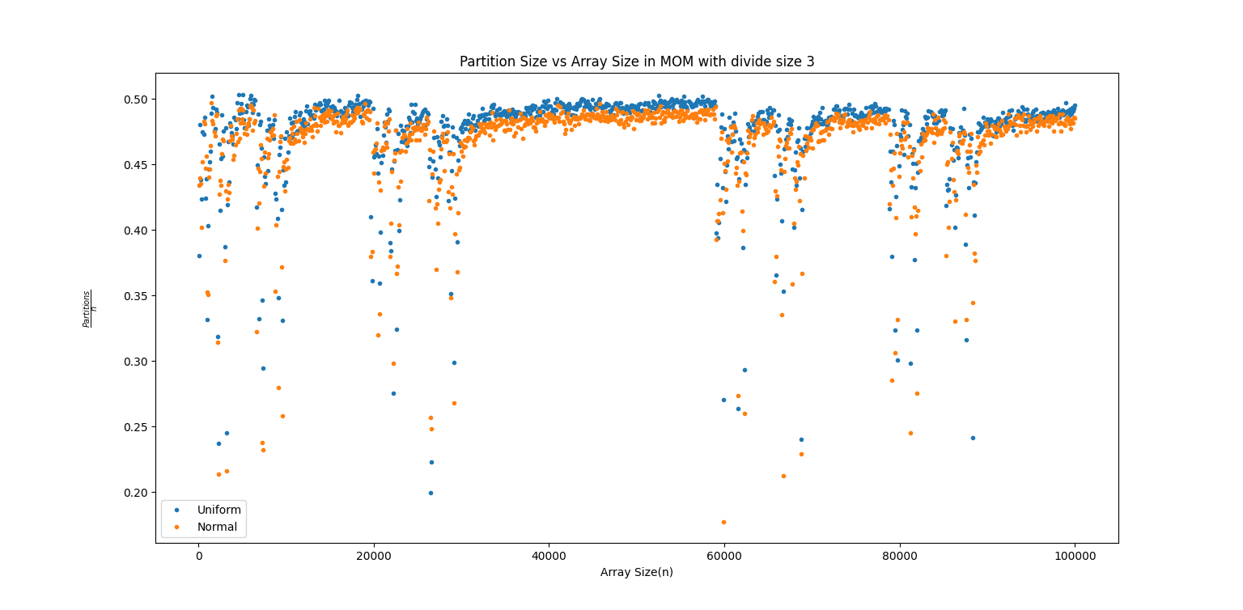


Observation

Slide 57
Inferences
There are some stark outliers at some regions in the graph for both the distributions and for all the divide sizes
Another fact is the accuracy of MOM in case of normal distribution deprecates as compared to uniform which may be hinted due to its high density near the mean
Divide Size 3 as compared to others gives a better accuracy for normal distribution as opposed to divide size 5 and 7.

