Slide 1

Character Segmentation of Bengali Letters
Group –6 Members:
Arnab Nath(2021CSB054)
Sk Fardeen Hossain(2021CSB023)
Avishek Rana(2021CSB056)
Ankita Das(2021CSB055)
Sujit Pradipkumar Jaiswal(2021CSB086)
Project Advisor:
Prof. Dr. Sekhar mandal
All the necessary codes and results can be found here
Project is live here

Slide 2
Index
Algorithm regarding the removal the letter-heads (shirorekha) of Bengali letters.
Program Snippet
Observations
Algorithm regarding Bengali Character Segmentation
Program Snippet
Observations
References

Slide 3
Algorithm regarding the removal the letter-heads (shirorekha) of Bengali letters.
For removing the letter-heads, the algorithm we employed used the fact that any kernel having height and width almost same as the letter heads will easily remove the letter-heads from the image after an opening operation with that kernel is employed on the image.
We set the height of kernel element as 2 pixels.
The main objective was to find the stroke-width of the letter-head which was found by finding the special-sequence-length(special sequence is a transition of pixels from white to black and back to white –in the same row ; the intermediate region constitutes the special sequence). We then find the lengths of all such special-sequences and find the max-length special sequence which will be our stroke width.
After finding the dimensions of the kernel, we then perform opening operation on the image(erosion followed by dilation) which will yield our resulting image.

Slide 4
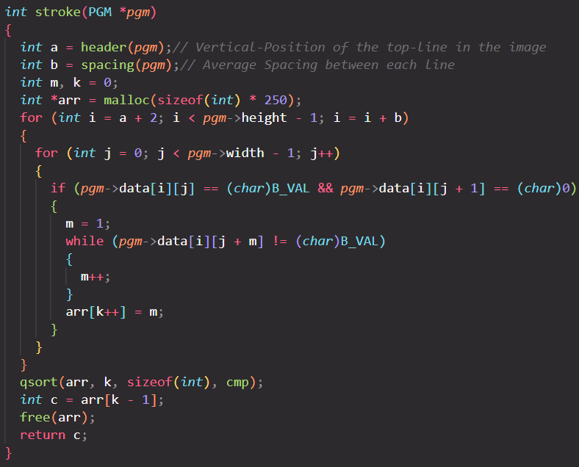
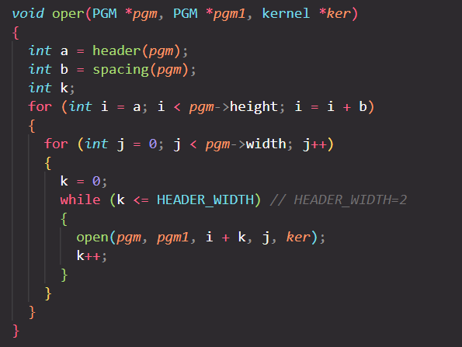
Program Snippet
Stroke-Width
Main Operation

Slide 5
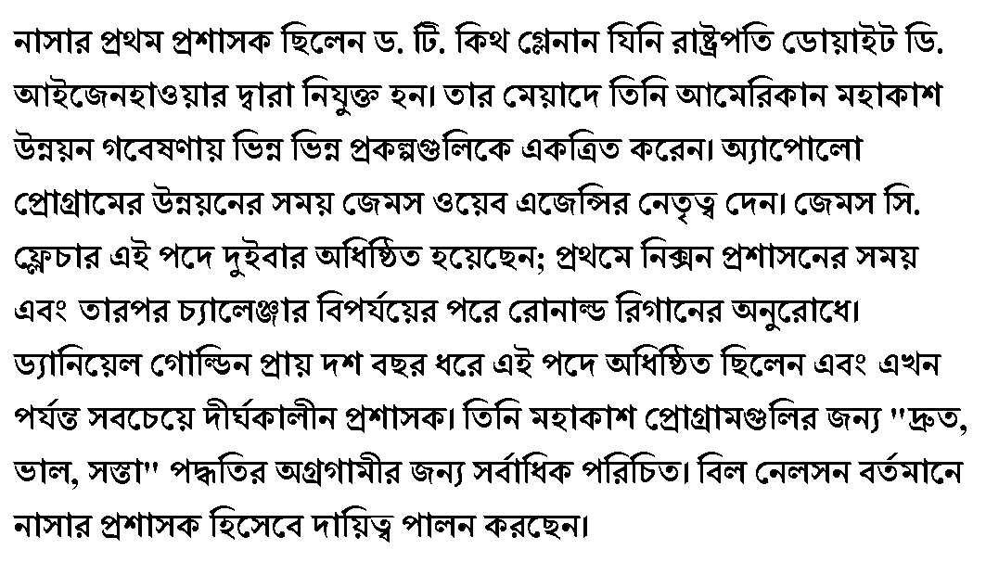
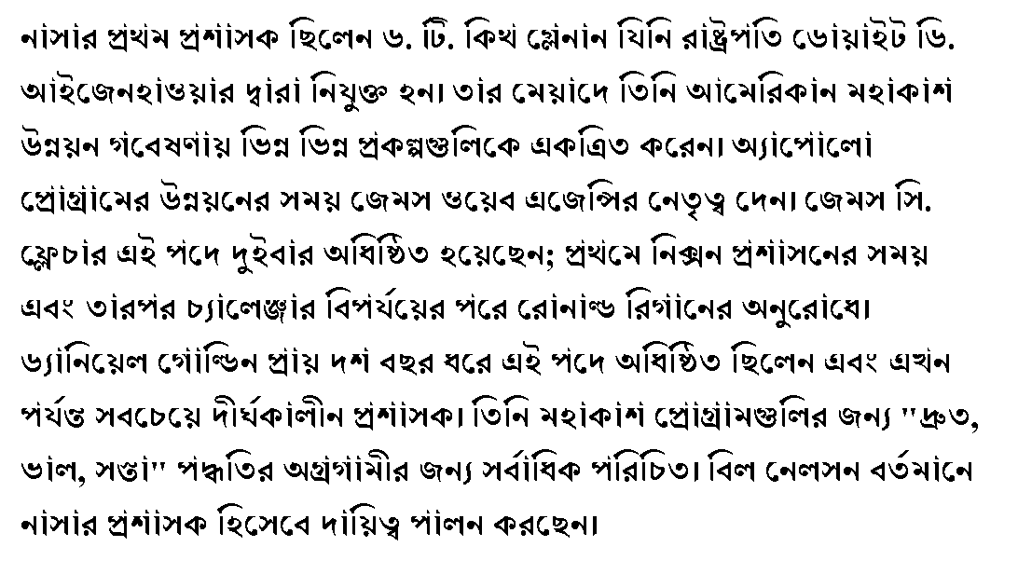
Observations
Original Image
Result Image

Slide 6
Algorithm regarding Bengali Character Segmentation
The main idea to segment an image file containing Bengali characters is to first segment it line by line and then by characters.
For segmenting line by line we need to find the base-line for each line-row of the image file which can help us determine the lines by their base-line. This can be done easily by finding the letter-height and spacing between the lines which we have done earlier, and storing the base-line positions for all the lines in an array as we will use them to in character segmentation.
We will also calculate the median height of all the lines in the above process of finding the base-line.
For segmenting characters in a given line, the idea to start the traversal of our pointer from the base-line to the top column-wise, and if the pointer encounters any black pixel it should look left and if it sees a black pixel it should again move to the base-line otherwise it will move left and again try to go up following the above procedure. When the height traversed by the pointer is greater than equal to the median height, we will mark the next 2 columns blank(for the line-height only), thus segmenting the characters. However for some characters like (গ) for which the segmentation appears earlier; to prevent this we safely shift the blank creation some pixels right for such characters, by checking whether there is a sudden shrink on height of the pointer after reaching median height, which is a sign that the character is not totally scanned yet.
Thus by employing the above strategies we can safely segment the Bengali characters in an image file.

Slide 7
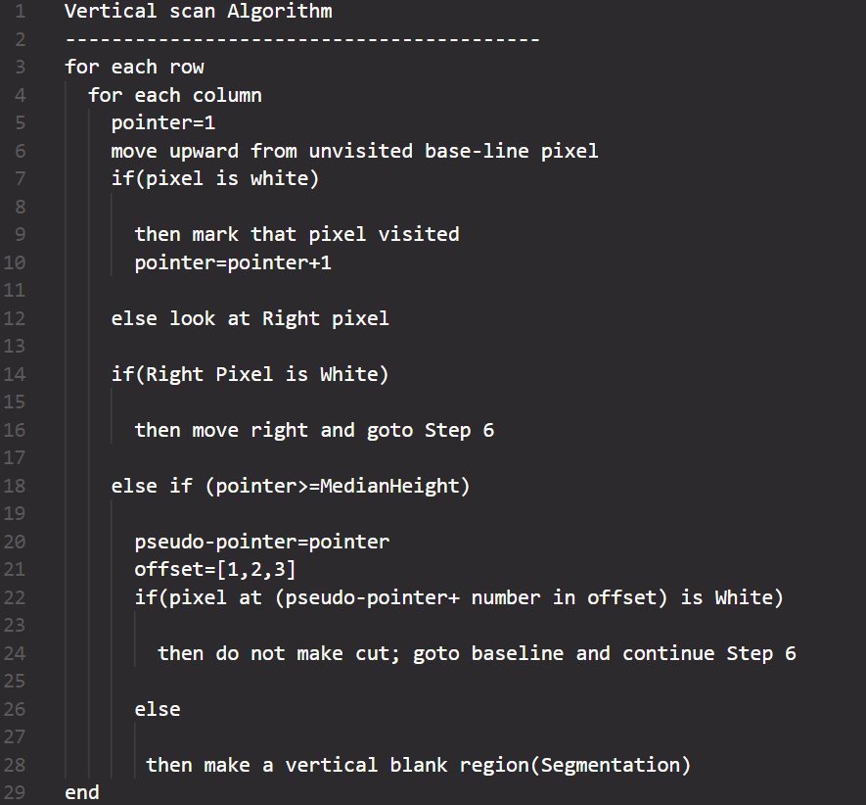
Program Snippet
Pseudo-Code
Dry Run

Slide 8
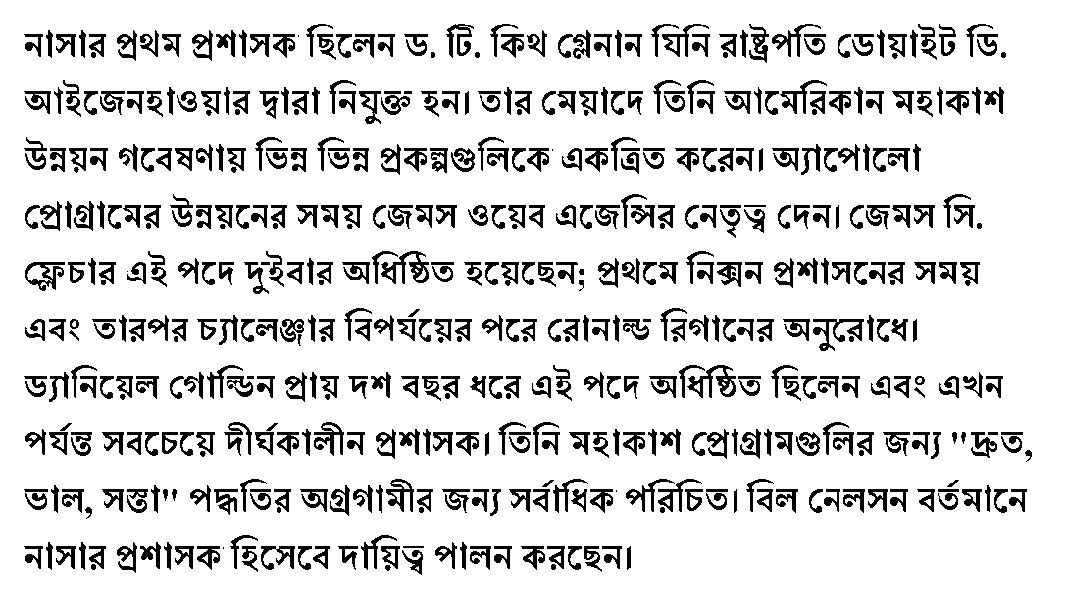
Observations
Original Image
Result Image

Slide 9
References
Image Processing in C by Dwayne Phillips
Image Morphology
Medium Article on character segmentation

