Slide 1
CSE431
Task - 2
RNN LSTM-based Deep Hybrid Learning Model for Text Classification
using Machine Learning Variant XGBoost
Sandhya Alagarsamya, and Visumathi James
Presented by, Md Fardin Rahman Ami (20101549)
From Team #12
RA: Md Humaion Kabir Mehedi
ST: Ehsanur Rahman Rhythm

Slide 2
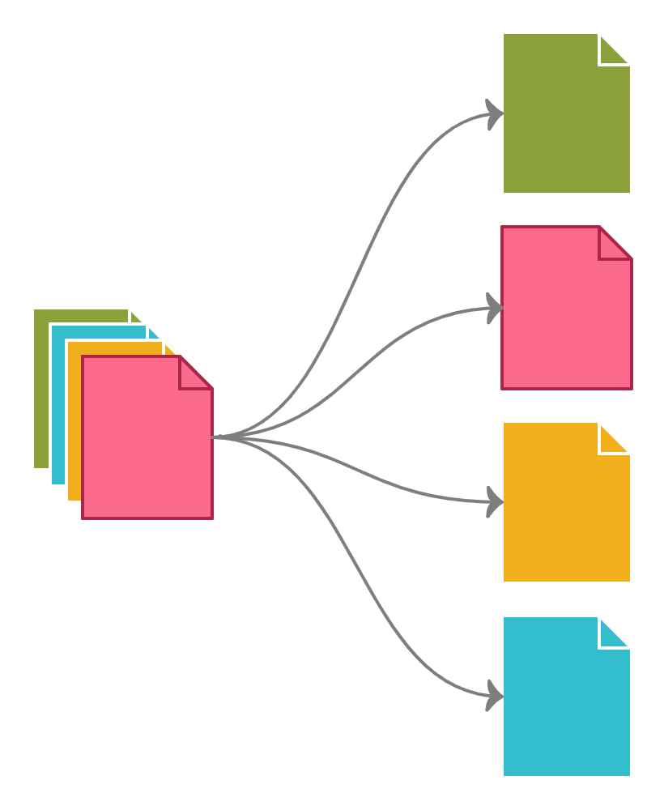
Introduction
Text classification performs the classification of input text document.
Source of data can be social medias (i.e. Twitter database, Facebook or any website reviews)
Sentiment analysis or classification (Positive vs Negative)
Sentiment analysis helps to get human behavior and trend
Multiple approaches and drawbacks
Usage of Deep neural network (DNN) in classification
Typical CNN model fails in dealing with the long-time series

Slide 3

Research objectives:
To classify slang words, spams, depression texts
Plays important role in target marketing
To understand experiences (Review analysis)
Identifying frauds

Slide 4
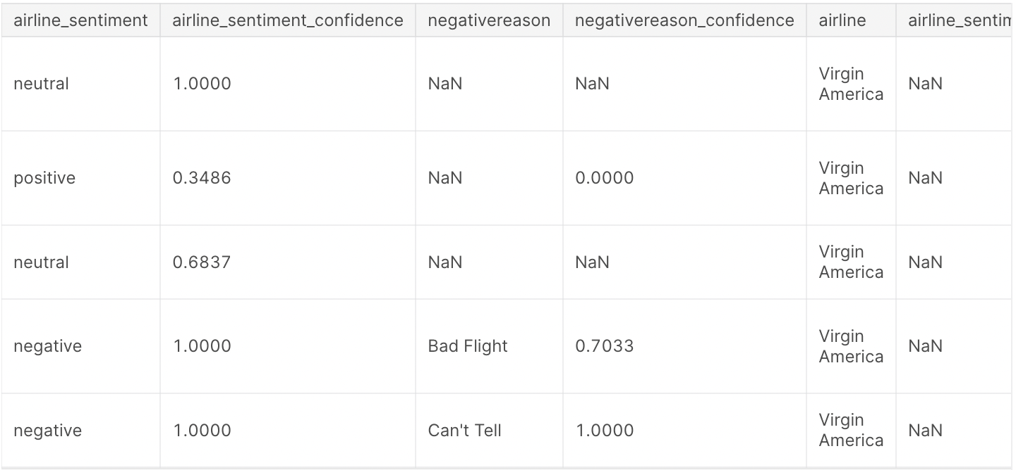
Dataset overview:
Contains all English values
Dataset has the customer tweets of particular airline
Input text document has two fields namely tweet_text and sentiment_value
Dataset dimension is (14,579, 15)
Used Word2Vec for word embedding
Columns that contains
Tweet_id
Tweet_text
Sentiment_value
Airline_id

Slide 5
Basic Pre-processings:
Symbol/Character removal
& , * ! & > < /
Stop words remove
am, is, are, was, were
Lemmatization/
Stemming
goes-> go, doing->do
Tokenization
[“go”, “do”, “Jack”]

Slide 6
Model Describe:
RNN
LSTM
XGBoost
RNN stands for Recurrent Neural Network, a type of artificial neural network designed to process sequential data by utilizing feedback connections to maintain memory of previous inputs.
Long Short-Term Memory, a type of recurrent neural network architecture that addresses the vanishing gradient problem by incorporating specialized memory cells capable of capturing long-term dependencies in sequential data.
XGBoost is an optimized gradient boosting algorithm that combines the power of multiple weak predictive models to deliver accurate predictions and handle various data types.

Slide 7
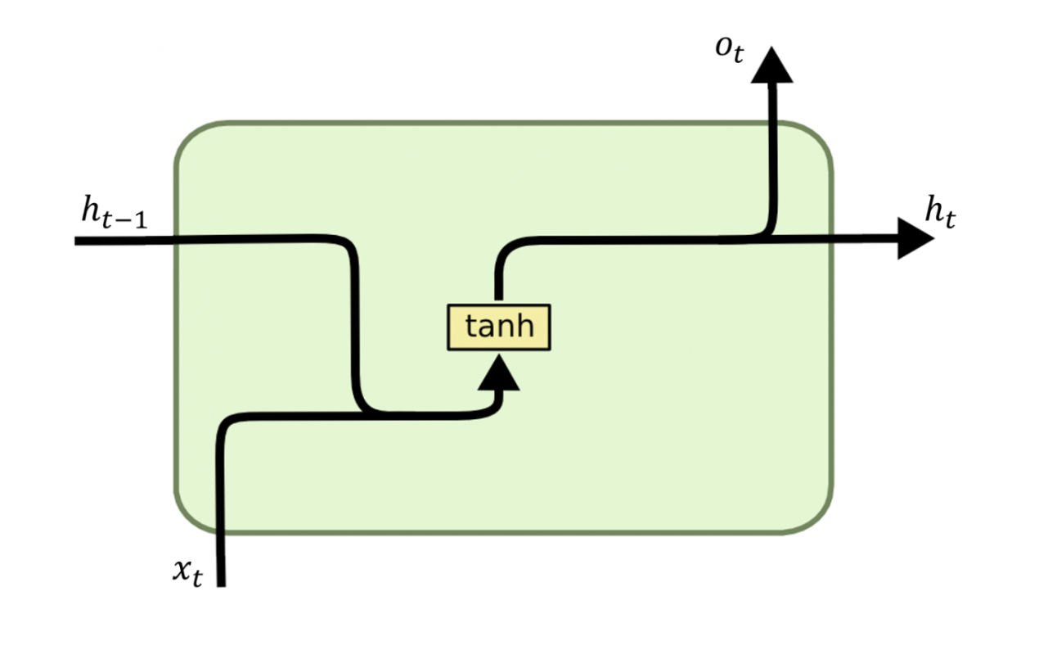
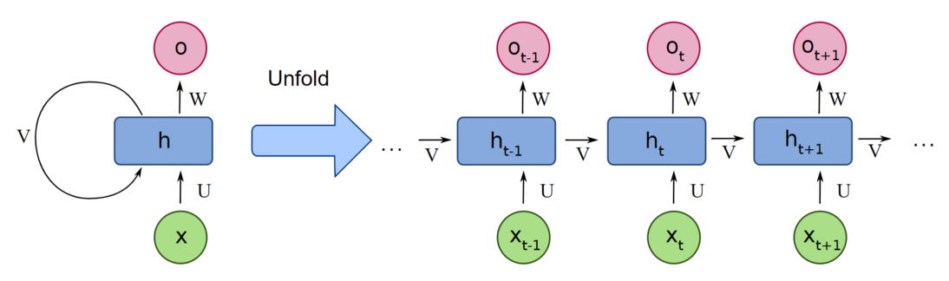
Recurrent Neural Network
- Sequential data processing
- Feedback connections
- Memory of previous inputs
- Time series analysis
- Variable-length input sequences
- Hidden states and memory cells

Slide 8
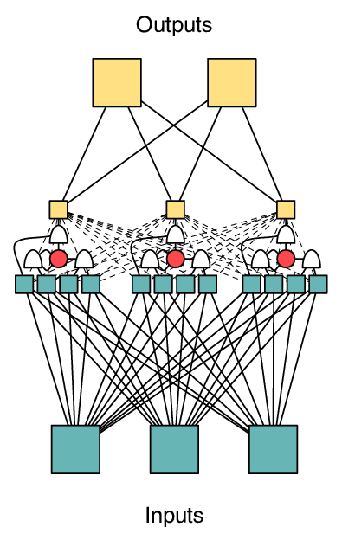
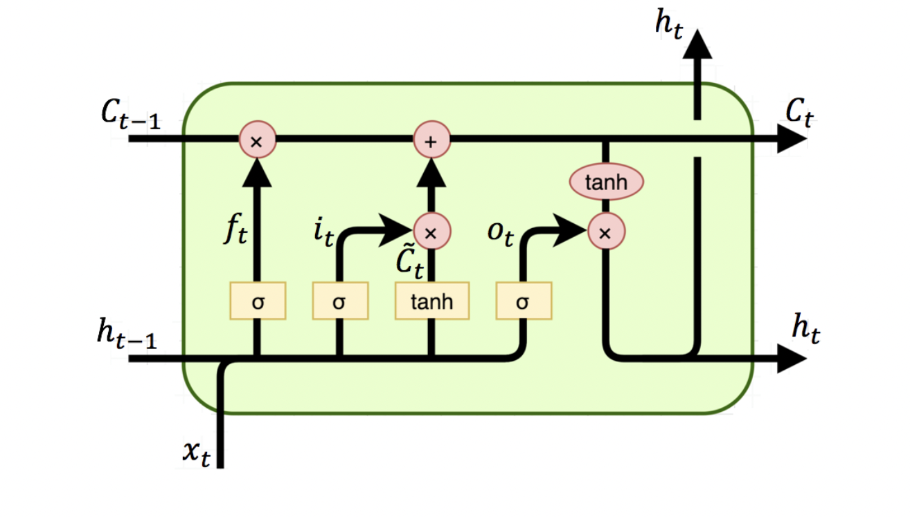
Long Short-Term Memory
RNN variant
Addressing vanishing/exploding gradient problem
Capturing long-term dependencies
Input, forget, and output gates
Improved information retention

Slide 9
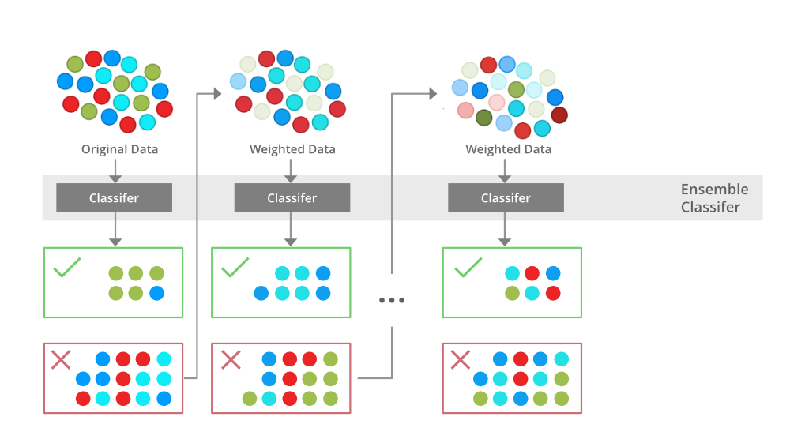
Optimized gradient boosting
Gradient boosting algorithm
Ensemble method
Handling diverse data types
XGBoost to map the extracted features
XGBoost Machine Learning Variant for final prediction

Slide 10
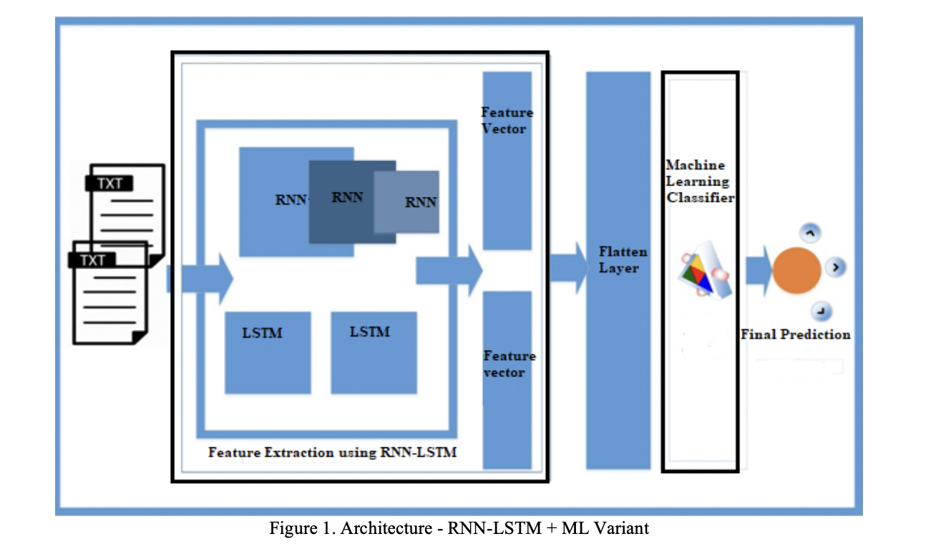
Overlook of the proposed model

Slide 11
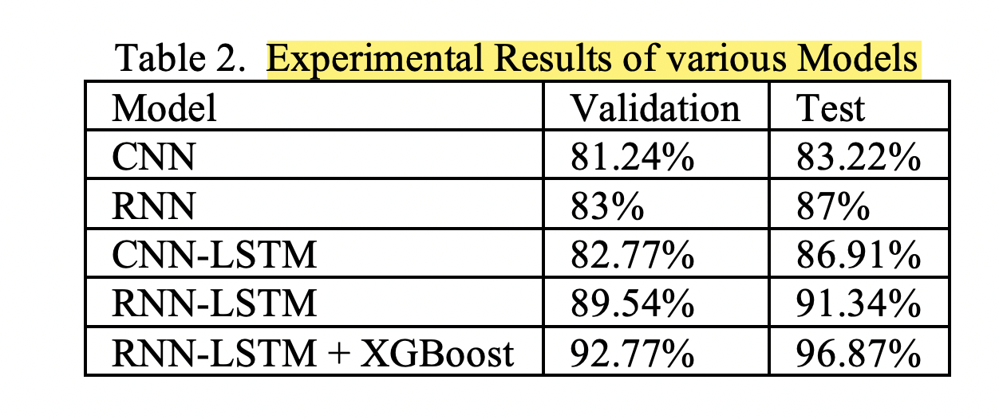
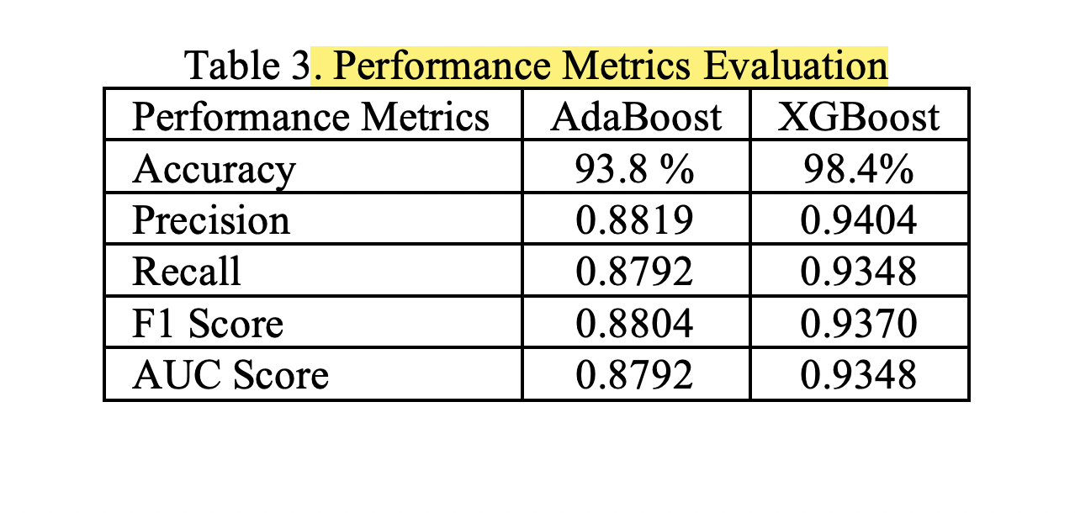
Result Analysis

Slide 12
Conclusion
This paper proposed a RNN-LSMT based hybrid model with a ML variant for text classification.
The model uses Machine Learning variant XGBoost to process the extracted features and makes the final prediction
Proposed model works with less cost and effectively improved the text classification accuracy
Length and complexity of text documents increase complexity in text classification
In future work, they will incorporate the Wikipedia and Wordnet databases
They will try a large and dynamic text corpus with minimum epoch value.

