Slide 1
C++ Project

Slide 2
Team Members:
Md. Mumtahin Habib Ullah Mazumder – 160041066
A. H. M. Rezaul Karim – 160041022
Fardin Ahsan Sakib – 160041059
Ahmad Imam – 160041054
Mohammad Sabik Irbaz - 160041004

Slide 3
Student Information System

Slide 4
Motivation

Slide 5

Student Information System
To develop a lowcost, user friendly student information system using c++.

Slide 6
Features

Slide 7
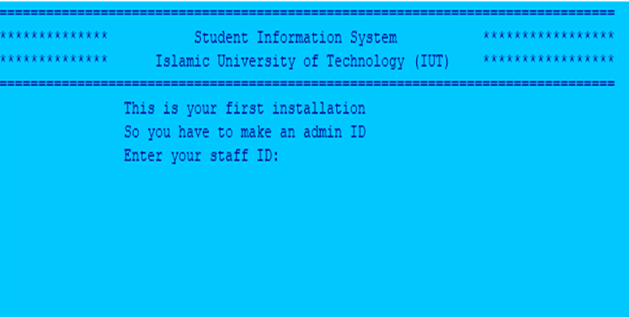
1.Start
First installation requires admin ID and password.

Slide 8
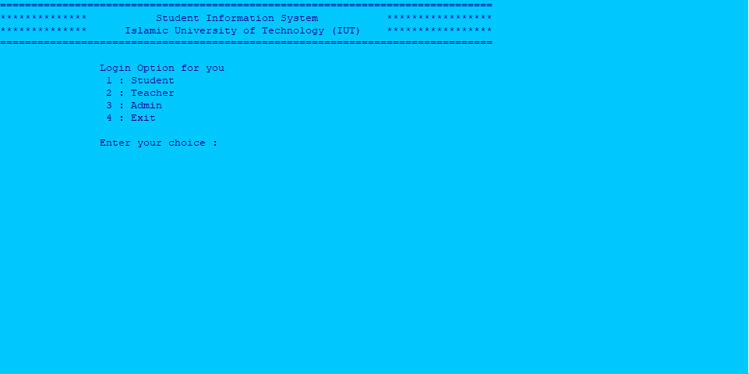
2. Login Option
Lets the user choose between different login options (e.g. Student, teacher, admin)

Slide 9

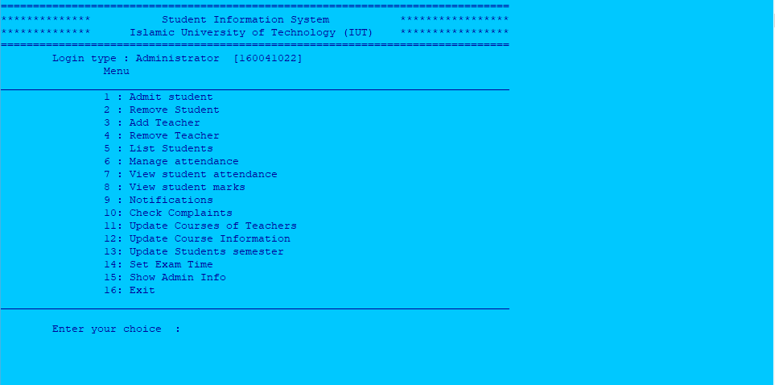
3. Admin options
Lets the admin conduct different administrative functions (e.g. admit student, add teachers, select courses for teachers etc.)

Slide 10
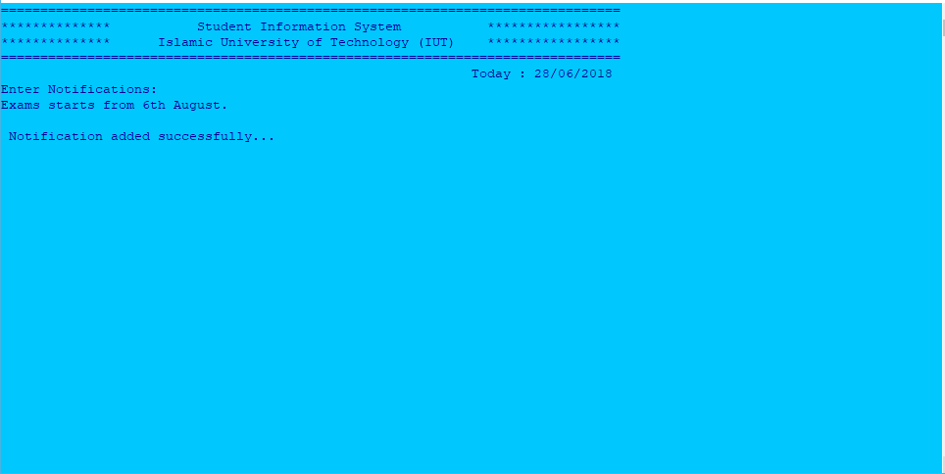
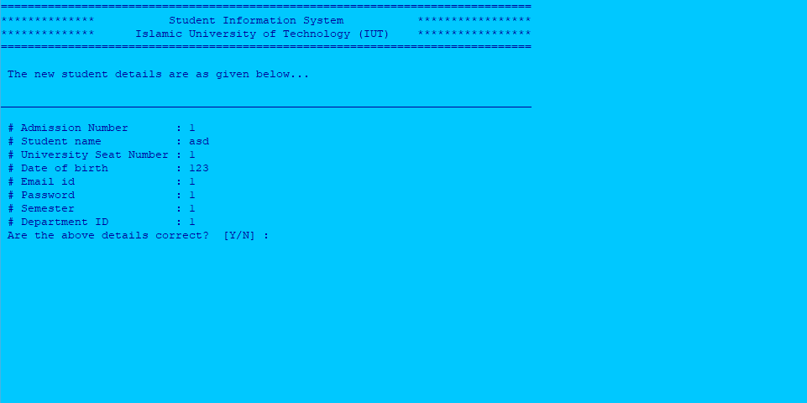
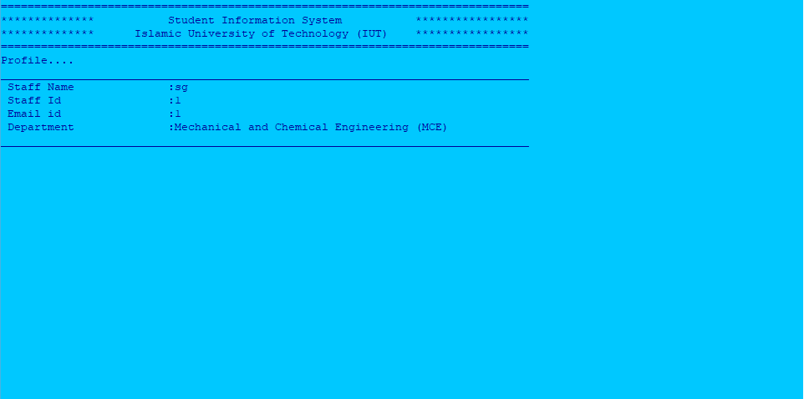
Examples
Add Notification
Add Student
Add Teacher

Slide 11
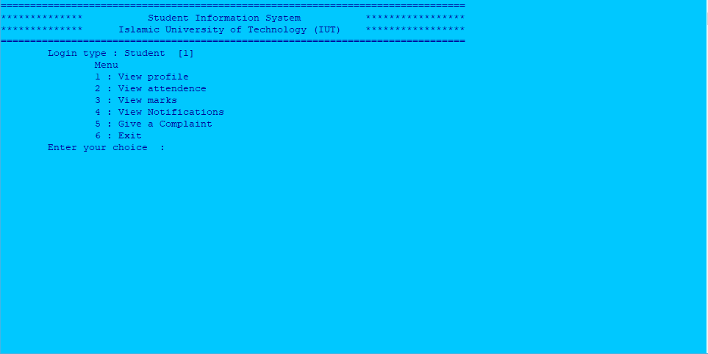
4. Student options
Allows students to view student information and academic performance.

Slide 12
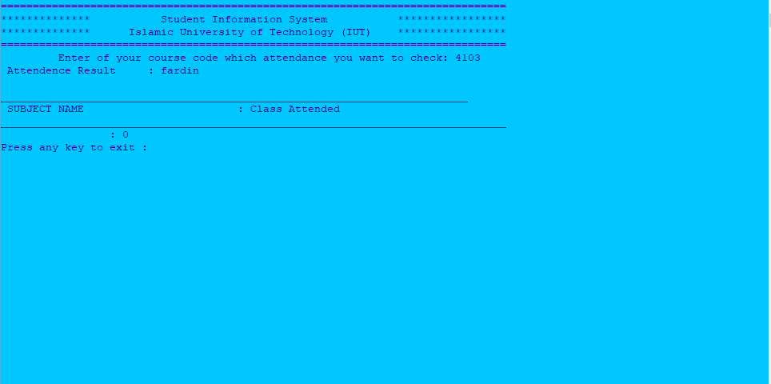
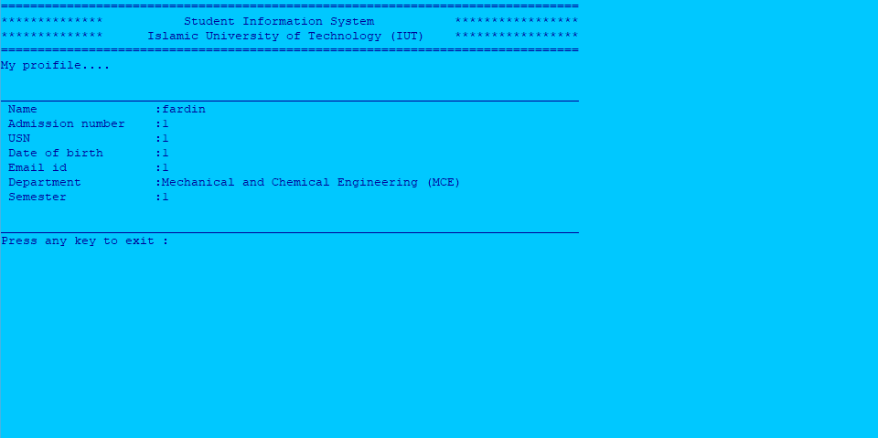
Example
Class Attendance
Student Profile

Slide 13
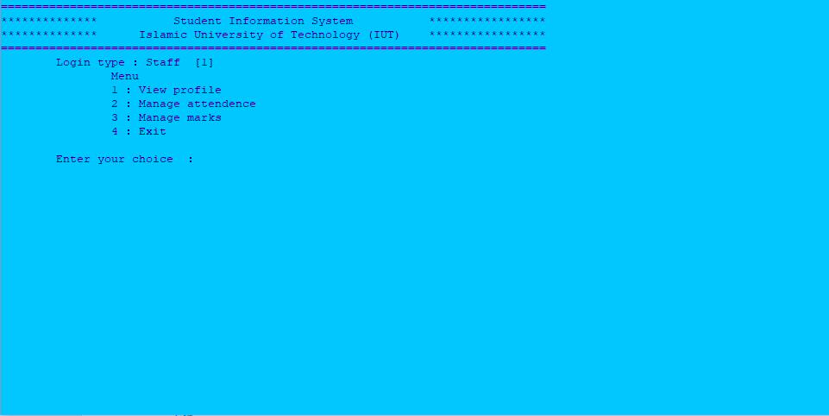
5. Teacher options
Allows teachers to view profile and manage academic records.

Slide 14
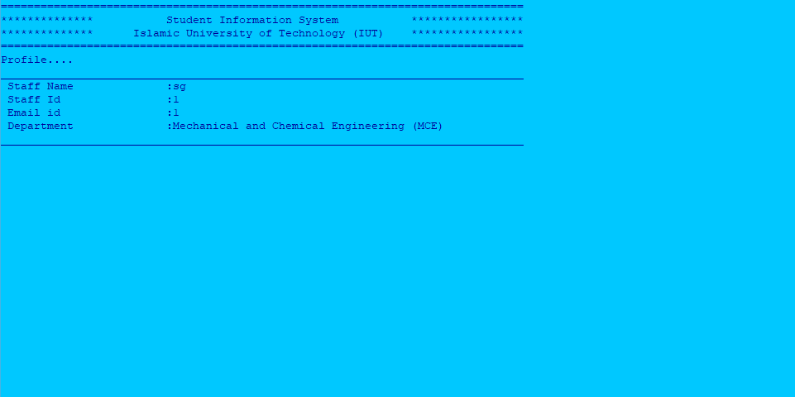
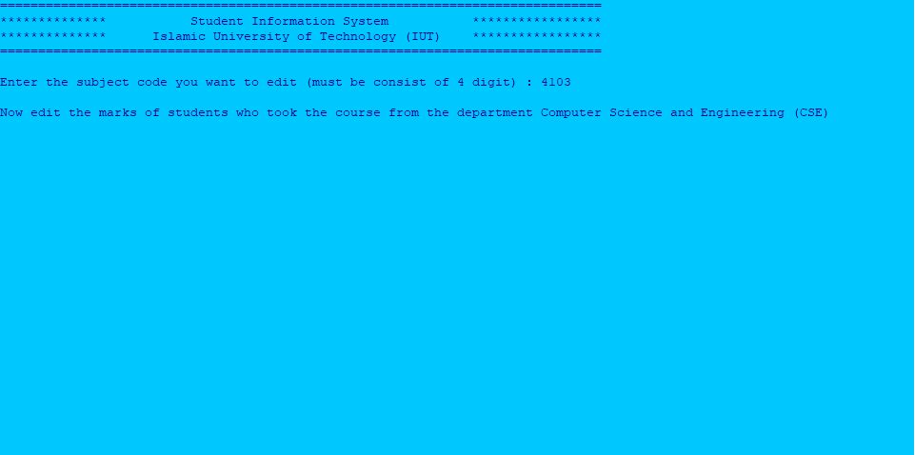
Example
Attendance
Teacher Profile

Slide 15
Implementation

Slide 16
C++:
C++ language was used to develop the software.
Database Connection:
Oracle database system was used to store data.
File System:
Alternatively data can also be stored in binary files.

Slide 17



The Making

Slide 18
Thanks!

