Slide 1


Green University of Bangladesh
Dept. of CSE
Submitted to:
MD.Mamunur Rahman
Lecturer, dept. of CSE
Structure Lab
Course Code: CSE 106
Course Title: Data

Slide 2

Shop Management System
Submitted by:
1. Shahid hasan (ID:191002065)
2. Fardin Amin Arpon (ID: 201002243)
3. Nurjahan Akther (ID:201002073)
4. Sagor Sarkar (ID:201002014)

Slide 3

Introduction
Information of product
Used of program
Shop design
Some code & Result
Final Out put
Reference

Slide 4

Introduction
The Shop Management System is developed for desktop systems to facilitate shop owners management of customer details and inventory data, which will include product details.

Slide 5

This software will provide in a simple and easy to operate user interface yet that is not graphical interface, which can be managed by shop manager.

Slide 6

Information of product
This system is provided to the reader that how much product we have stored and which model. And how much product we sold. And we can find that which product we have stored.

Slide 7

Information of product
While some products will be empty then this system can remove this product information. By this system, easy to calculate how much product we sold and memorize this information.

Slide 8

Using of program
Linear Search
Bubble sort.
Insertion
Deletion

Slide 9
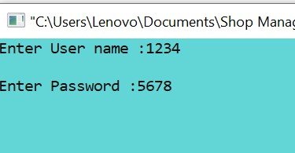
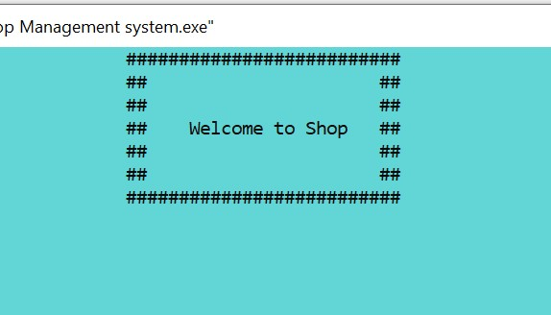
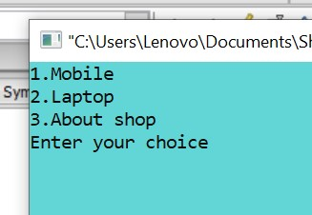
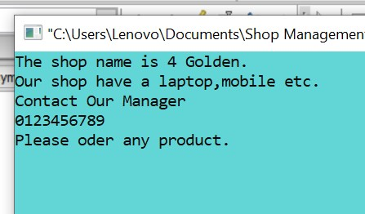
Shop design :

Slide 10
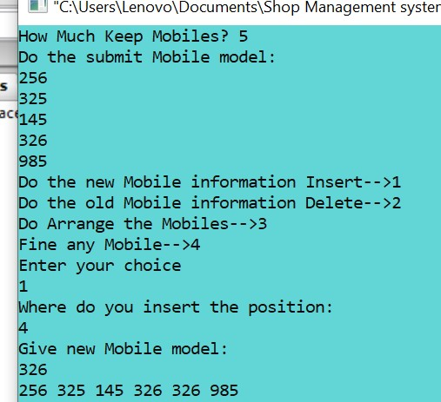
Some code :
Result:
size = size+1;
for (i=size-1; i>=0; i--)
{
if (i==p)
{
arr[i]=nv;
break;
}

Slide 11
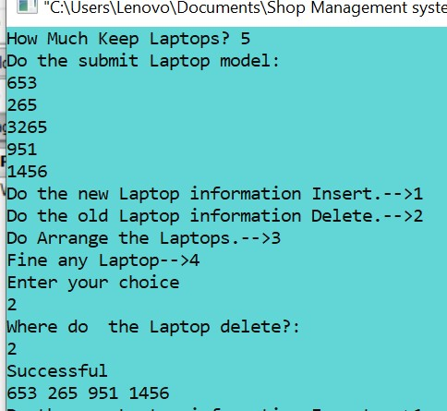
Some code :
Result:
size = size-1;
for (i=p; i<size; i++)
{
arr[i]=arr[i+1];
}

Slide 12
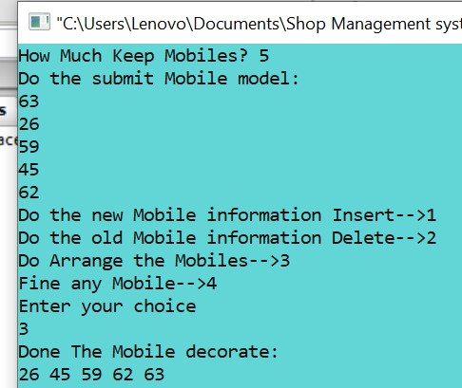
Some code :
Result:
for(i=0; i<size; i++)
{
for(j=0; j<size; j++)
if(arr[j]>arr[j+1])
{
temp=arr[j];
arr[j]=arr[j+1];
arr[j+1]=temp;
}
}

Slide 13
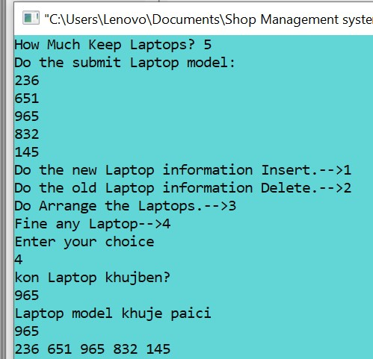
Some code :
Result:
for(i=0; i<size; i++)
{
if(arr[i]==num)
{
printf("Laptop model khuje paici\n%d\n",num);
flag=1;
}
}

Slide 14
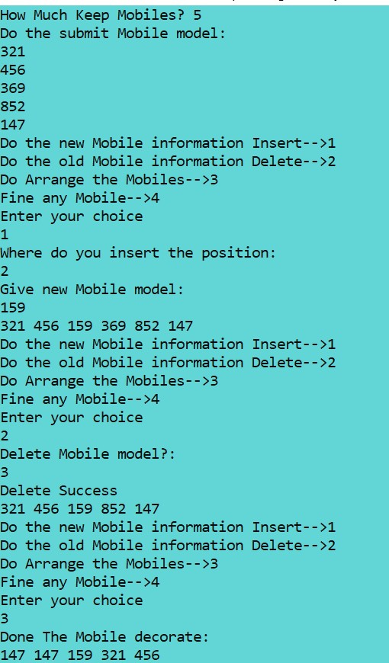
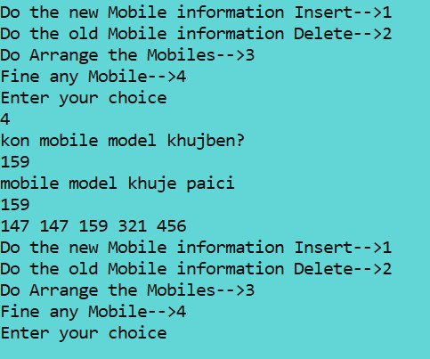
Final output :

Slide 15

Reference :
www.google.com

Slide 16


