Slide 1
Automated Door Locking System using Arduino

Slide 2
01
Introduction
Secuirity is paramount
Traditional locks inadequate
Continuous, authorized access
Arduino-powered innovation

Slide 3
Automated Door Locking Service
02
Components
Key Functions
Enhanced Secuirity
Simplified Circuit

Slide 4
Objectives
03
Low power consumption
Simple and easy to implement
Economical

Slide 5
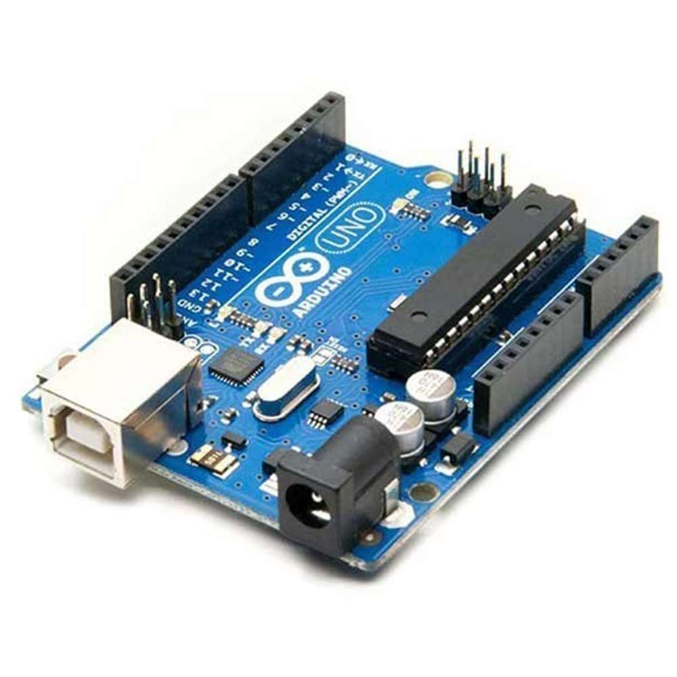
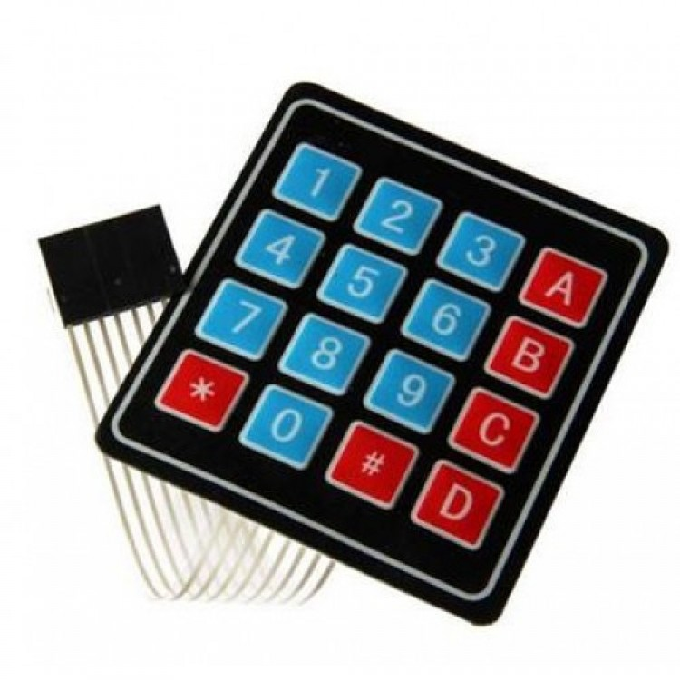
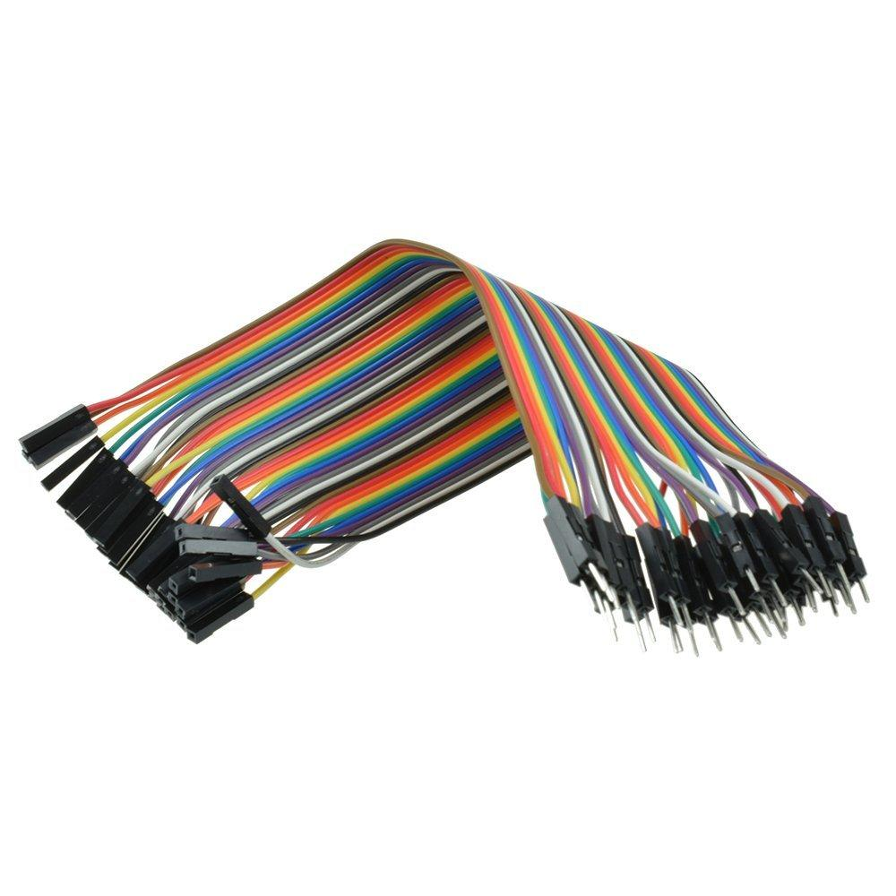
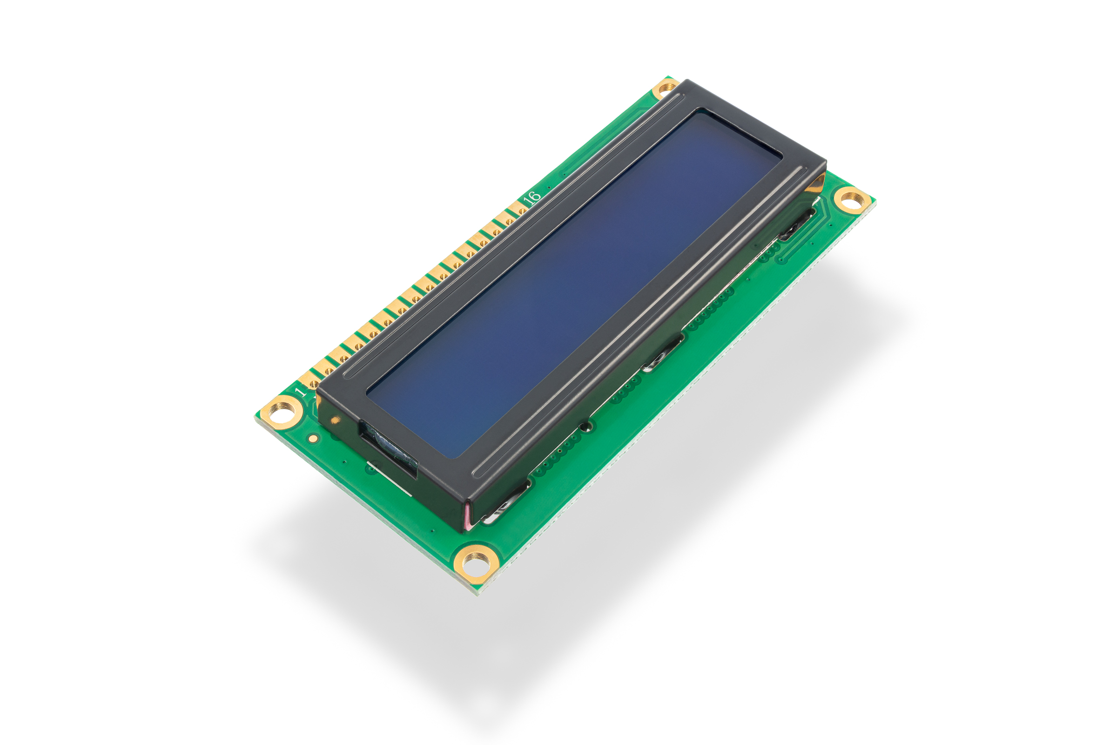
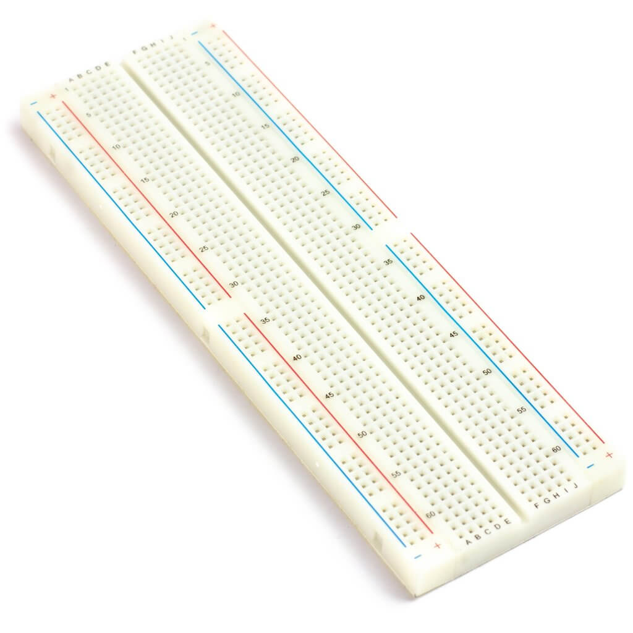
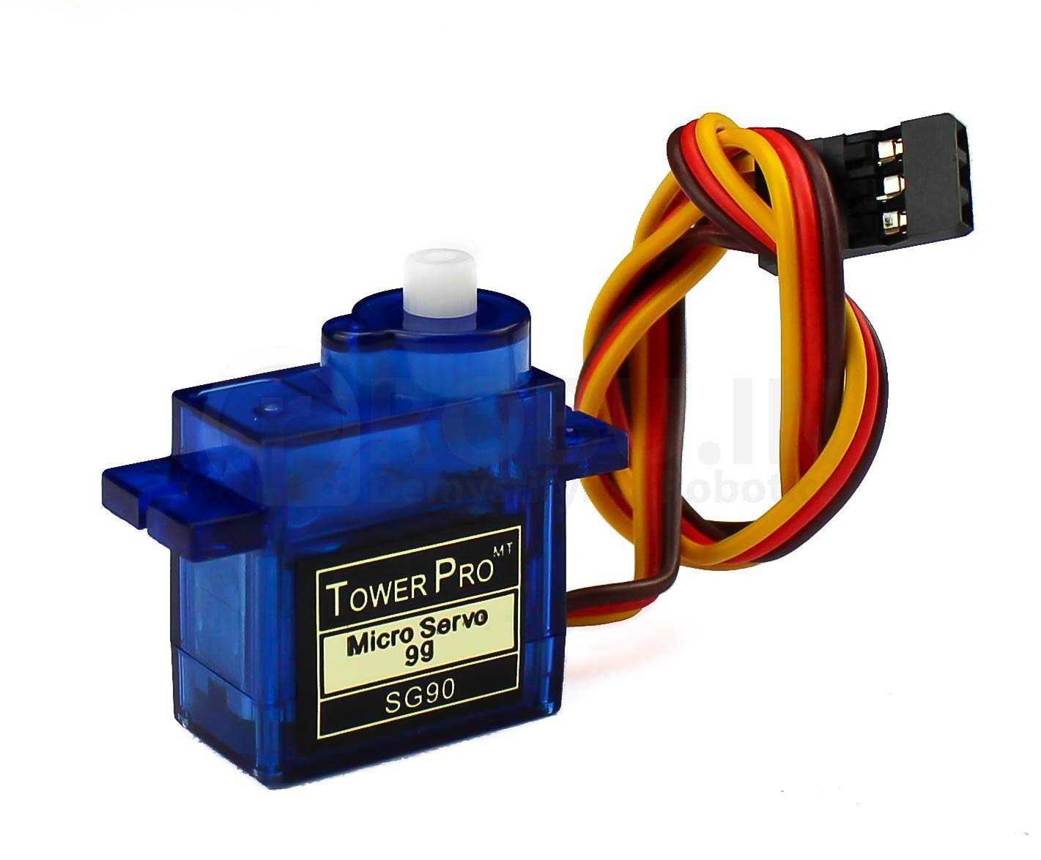
Components
04
Arduino Uno
Keypad (16x4)
Jumper Wires
LCD Display (16x2)
Breadboard
DC Motor – Micro Servo

Slide 6
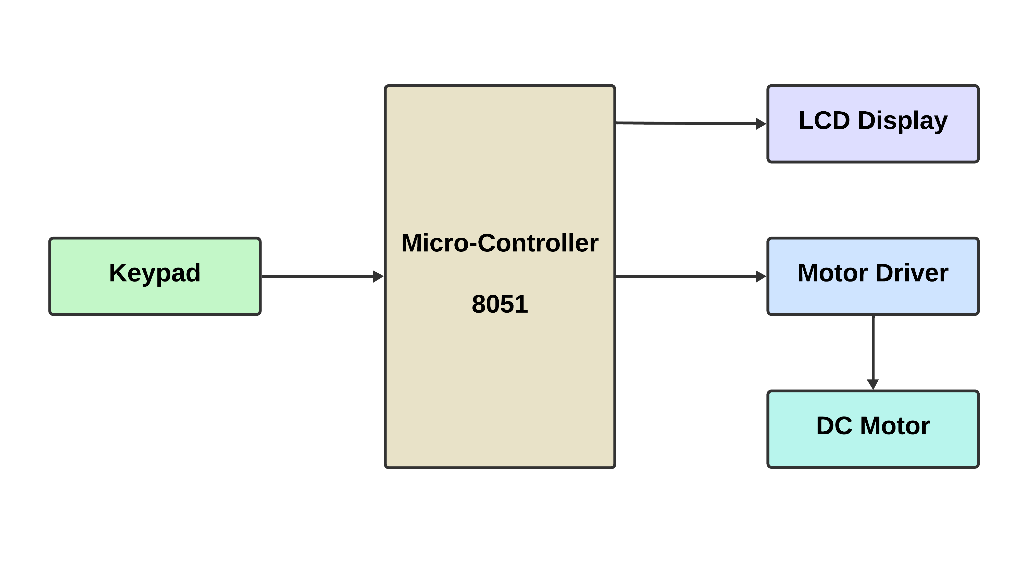
Block Diagram
05
Block Diagram

Slide 7
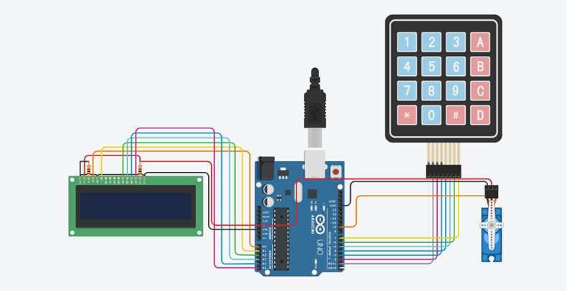
Image of Schematic Circuit
06
Schematic Circuit Diagram using Tinkercad

Slide 8
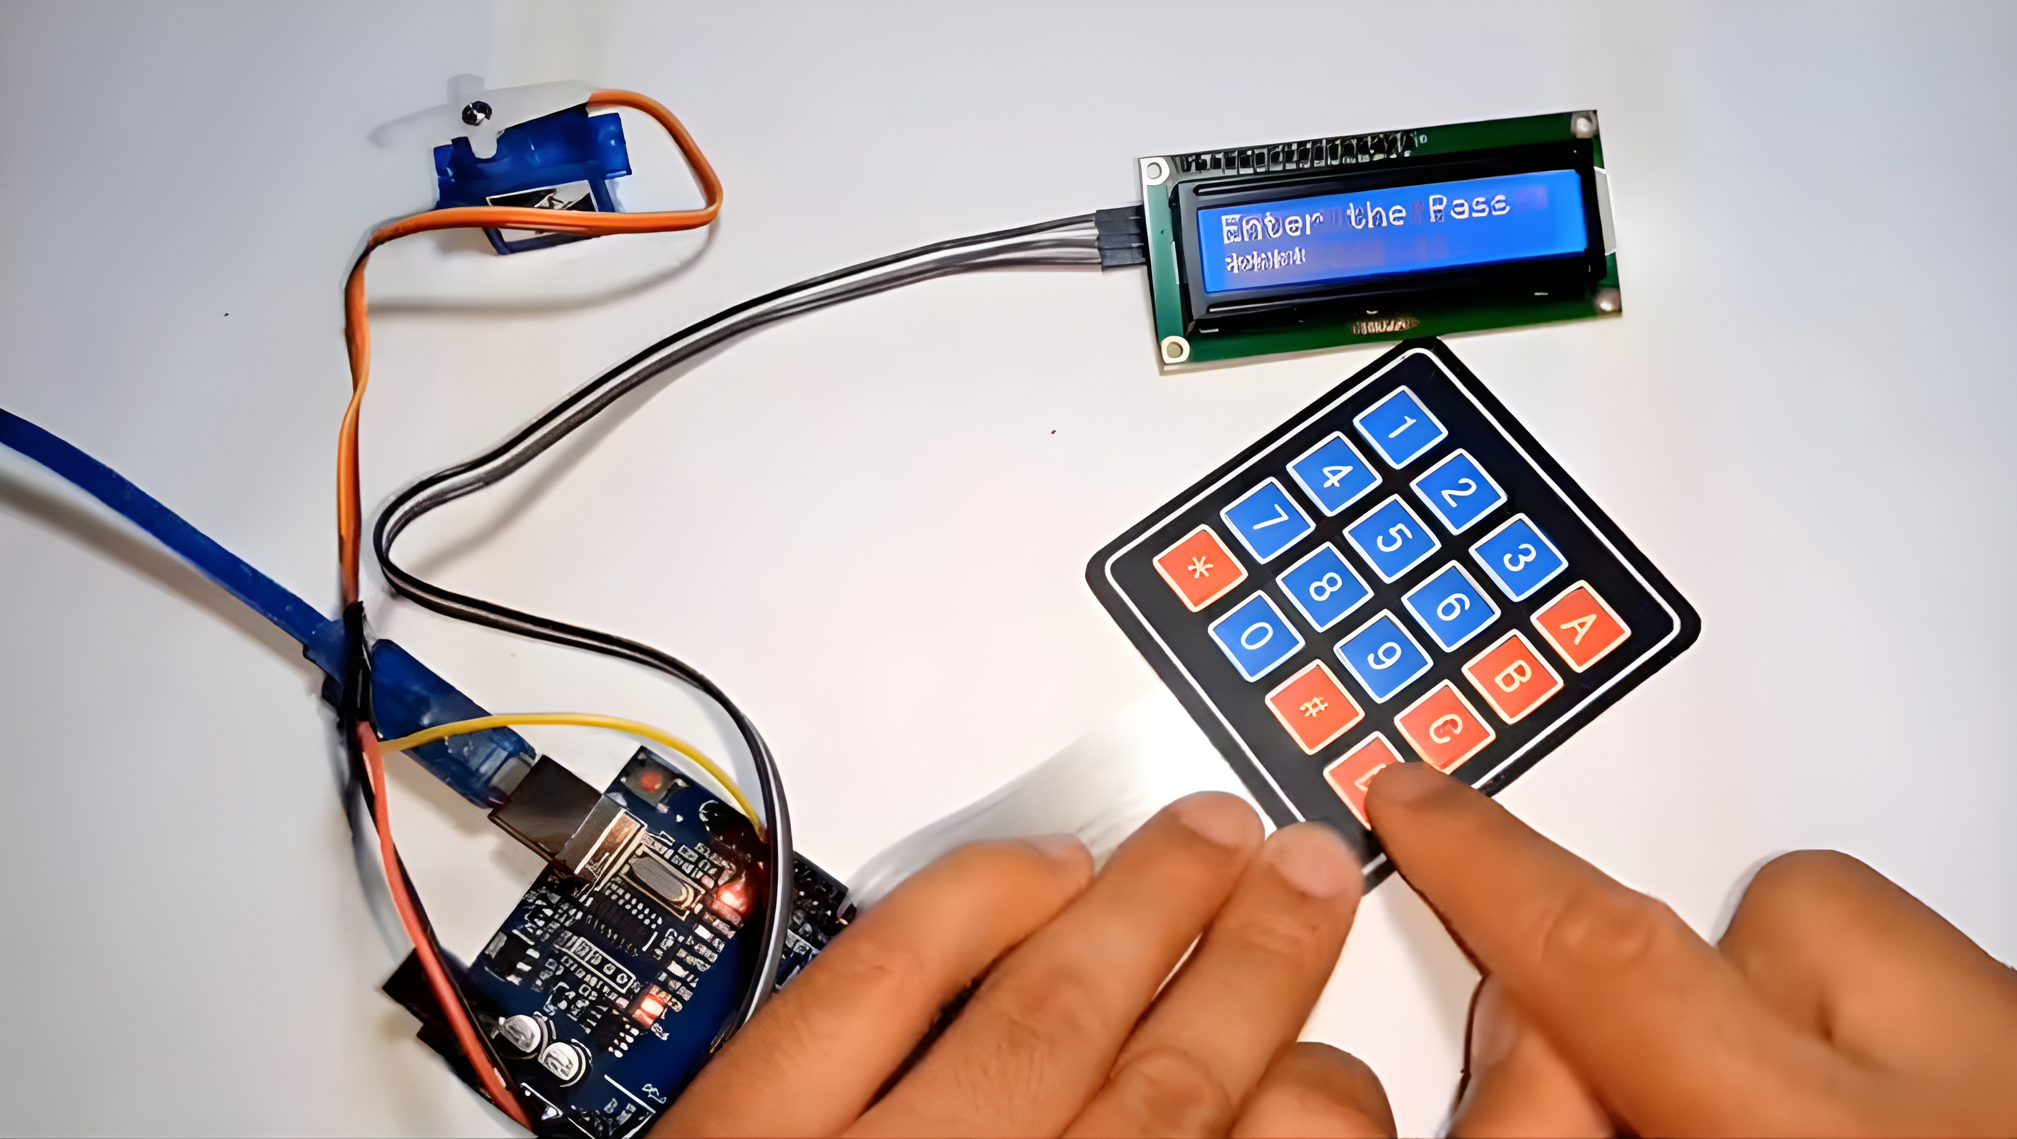
Hardware Tool
07
Hardware Tool of Smart Door Locking System

Slide 9
Conclusion
08
Enhancing security with Arduino
Crime mitigation
Keyless convenience

Slide 10
Thanks!
Do you have any questions?

