Slide 1

Khulna University of Engineering & Technology BECM 4000 Project and Thesis
MACHINE LEARNING ALGORITHMS FOR PREDECTING CONSTRUCTION DELAY
Supervised By:
Md. Jewel Rana
Assistant Professor
Department of BECM, KUET
Presented By:
Sayed Arafat
Roll: 1823027
Department of BECM, KUET

Slide 2
TABLE OF CONTENTS
INTRODUCTION
OBJECTIVES
METHODOLOGY
RESULT AND DISCUSSION
CONCLUSION
REFERENCES

Slide 3
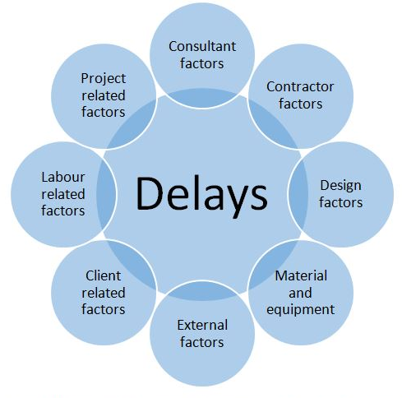
INTRODUCTION
The construction industry is underperforming due to project delays, leading to low profitability, capital expenditure, and research and development, causing client dissatisfaction and cost overruns [1].
Machine learning algorithms are underutilized in the construction industry, despite their potential for detecting delays in early project planning stages [2].
Figure01. Factors of Delays in Construction Projects [3]

Slide 4
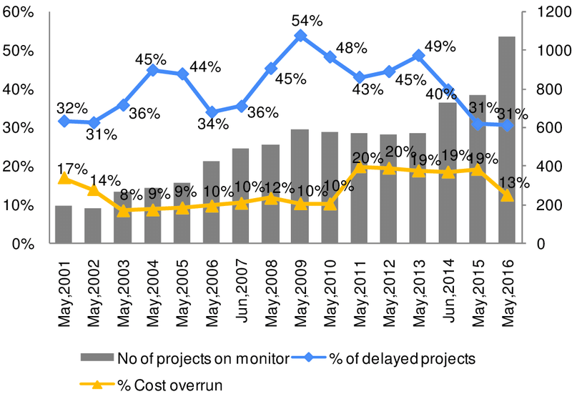
INTRODUCTION
Effects due to these delay factors include bad reputation, time overrun, cost overrun, low quality of work, dispute, litigation, and arbitration [4].
Delays can be mitigated by utilizing strategies prescribed in studies by technical professionals and experts in the construction industry [5].
Figure02: Cost Overruns Due to Delays in Construction Projects in India [6]

Slide 5
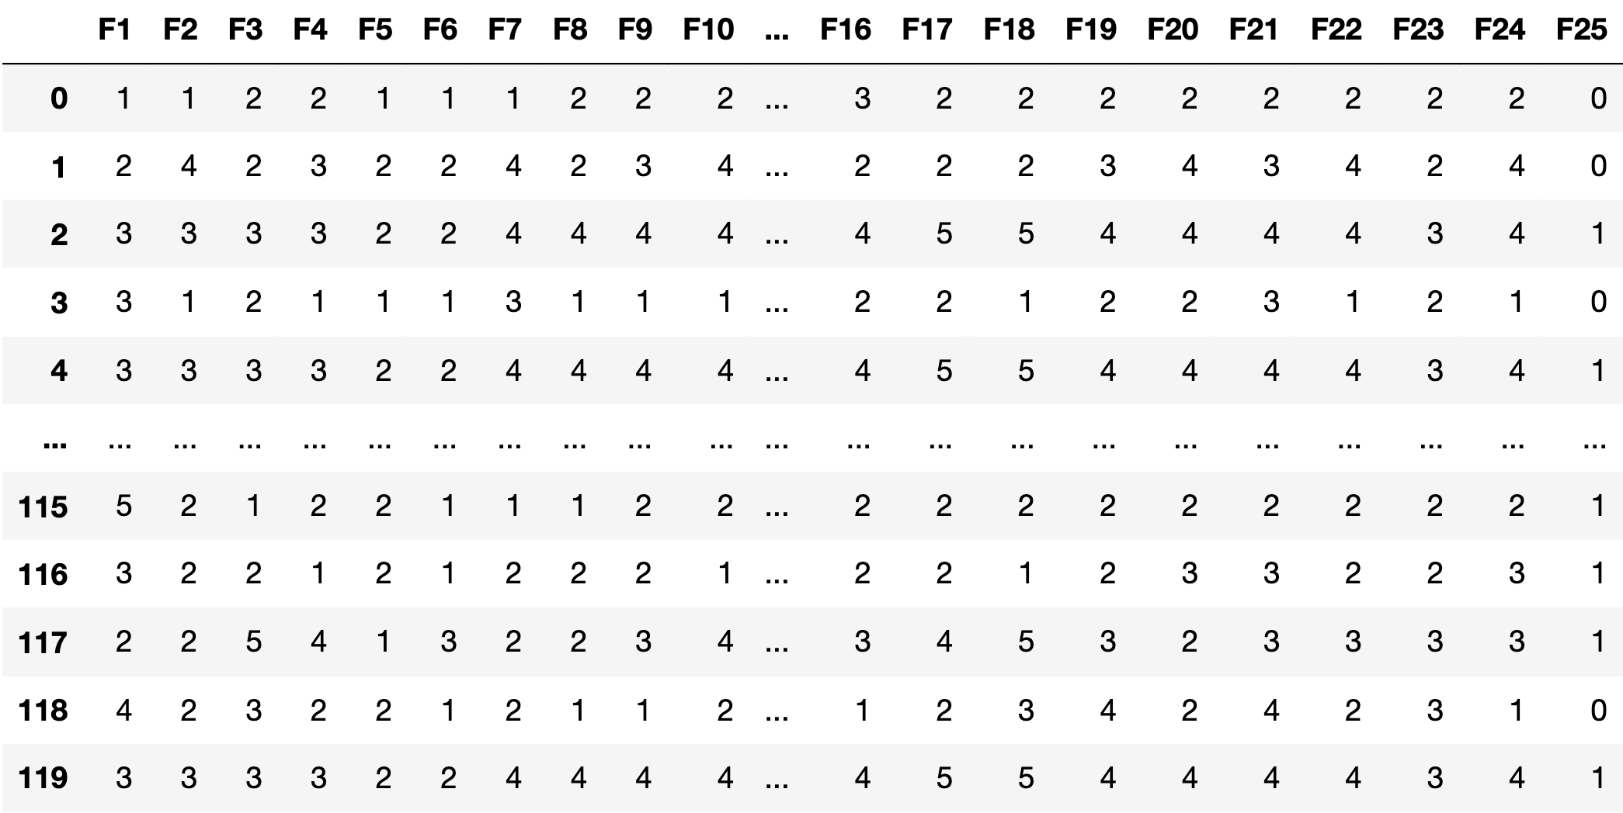
INTRODUCTION
The Literature Review identified 50 factors, 24 of which were considered.
A survey questionnaire was prepared, covering factors like project duration, work details, accidents, quality controls, late payment, unskilled labour, material supply, and project delay time span, analysing 120 responses.
Figure: A Concise Summary of the Dataset

Slide 6



Introduction
Software Tools
Used Anaconda Navigator IDE for launching Jupyter Notebook
Launched Jupyter Notebook in Google Chrome
Developed the ML predictive model in the Google Chrome for predicting contruction delay
Anaconda Navigator
Jupyter Notebook
Google Chrome
Figure04: Tools Necessary for Predicting Construction Delay

Slide 7
Objectives
To conduct literature review to identify common factors causing construction project delays, then interview experts to determine the most effective strategies.
To create hyperparameter-optimized prediction models, apply the factors that were determined in objective 1.
To combine the best predictive models from objective 2 to develop a high performant predictive model.

Slide 8
METHODOLOGY
Contruction Delay using ML
Identified Factors of Delays
Questionnaire Survey
Survey Participants Selection
Literature Review
Split Dataset
Dataset Pre-processing
Data Collection & Analysis
Dataset
75% Training
25% Testing
Apply ML Algorithm
Build ML Model
Evaluate Model
Is it the Best Model?
Yes
Best Model
No
Figure: Flow Chart Diagram of Construction Delay Predicting System

Slide 9
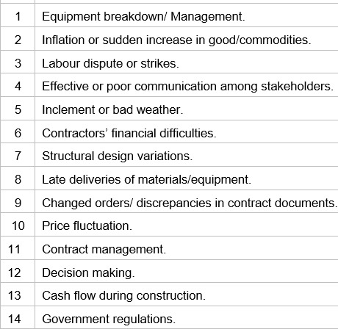
METHODOLOGY (Cont…)
Identifying Factors of Delays
From the Literature Review, a total of 50 different factors were identified.
Some factors were observed in multiple studies.
Finally, 24 factors were considered based on the number of instances they were identified by different studies.
Figure: Factors of Delays Identified from Various Studies

Slide 10
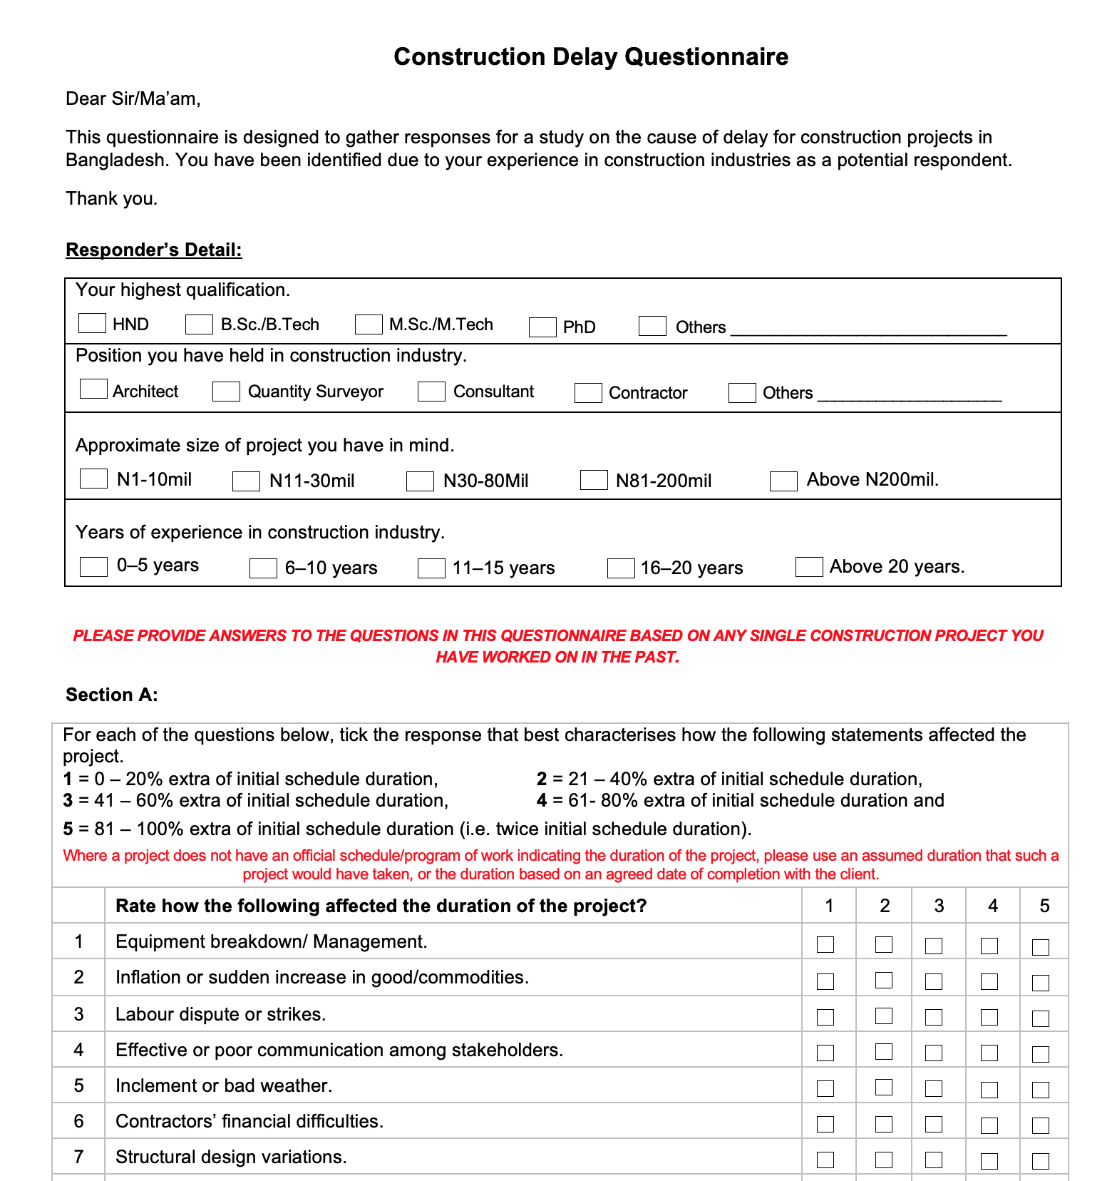
METHODOLOGY (Cont…)
Prepare Questionnaire
A Survey Questionnaire was prepared to record the responses with the help of a ‘5-point Likert scale’.
The questionnaire consists of five sections: project duration factors, work details, accidents, quality controls, late payment, unskilled labour, material supply, and project delay time span.
Figure: Survey Questionnaire Form

Slide 11
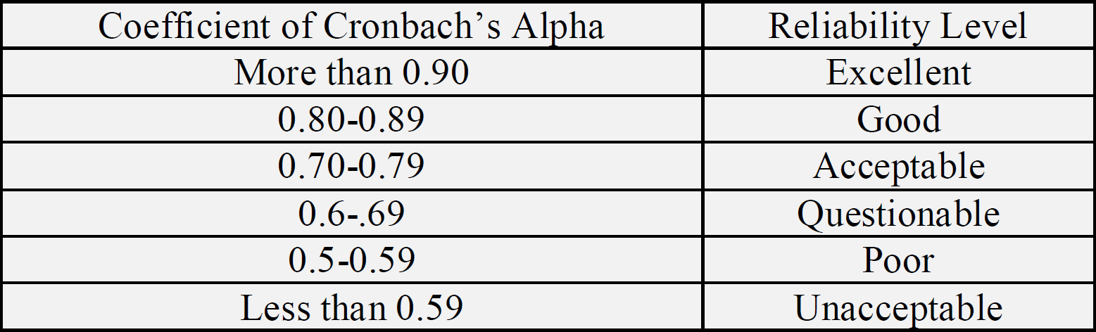
METHODOLOGY (Cont…)
Survey Response Analysis
120 responses were collected, which were then analyzed with the help of statistical analysis software, SPSS.
The reliability of the data was assessed by calculating the value of Cronbach’s Alpha.
The sample space of the survey was analyzed based on experience and location and plotted on bar graph using Origin software.
Figure: Range of Reliability and its Coefficient of Cronbach’s Alpha

Slide 12
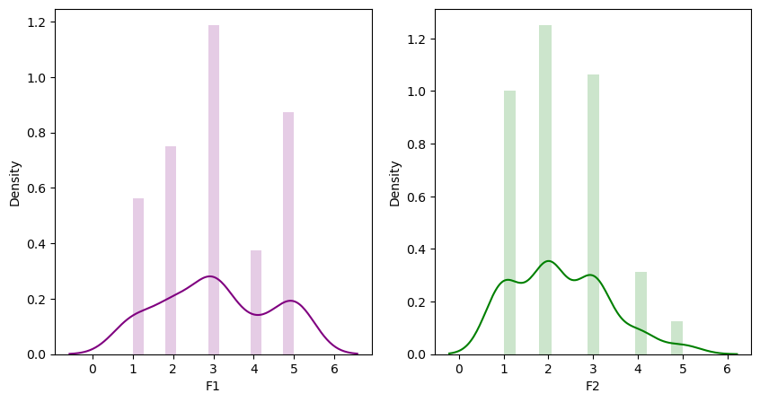
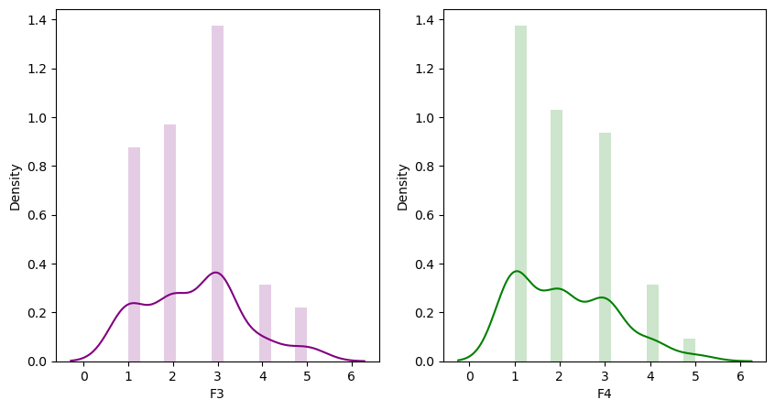
METHODOLOGY (Cont…)
The survey revealed the most significant factors causing construction delays in 5-point Likert scale
The effective reasons for these delays in 1-point Likert scale
Figure: Distribution Graph of the Factors

Slide 13
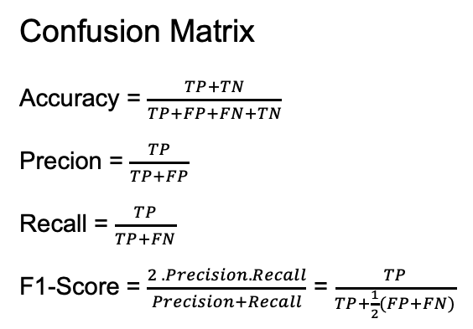
METHODOLOGY (Cont…)
Confusion Matrix
Accuracy = $\frac{TP+TN}{TP+FP+FN+TN}$
Precion = $\frac{TP}{TP+FP}$
Recall = $\frac{TP}{TP+FN}$
F1-Score = $\frac{2 . Precision. Recall}{Precision+Recall}$ = $\frac{TP}{TP+\frac{1}{2}(FP+FN)}$
Here,
TP = Number of True Positives
FP = Number of False Positives
FN = Number of False Negatives
TN = Number of True Negatives

Slide 14
METHODOLOGY (Cont…)
Initialization
Set Up Anaconda Navigator IDE
ML Model Development
Anaconda Navigator was chosen as the software to launch Jupyter Notebook
Python language was used to build the ML model for the delay prediction
Dataset (.csv) file were utilized for building the ML Model for the delay prediction, then the data’s were pre-processed, plotted and trained through various ML models for enhancing the prediction accuracy.
Open Google Chrome
Launch Jupyter Notebook
Create New Python Notebook File
Implement / Insert dataset (.csv) file
Train ML Models
Pre-process & Plot Dataset
Evaluate ML Models
End

Slide 15
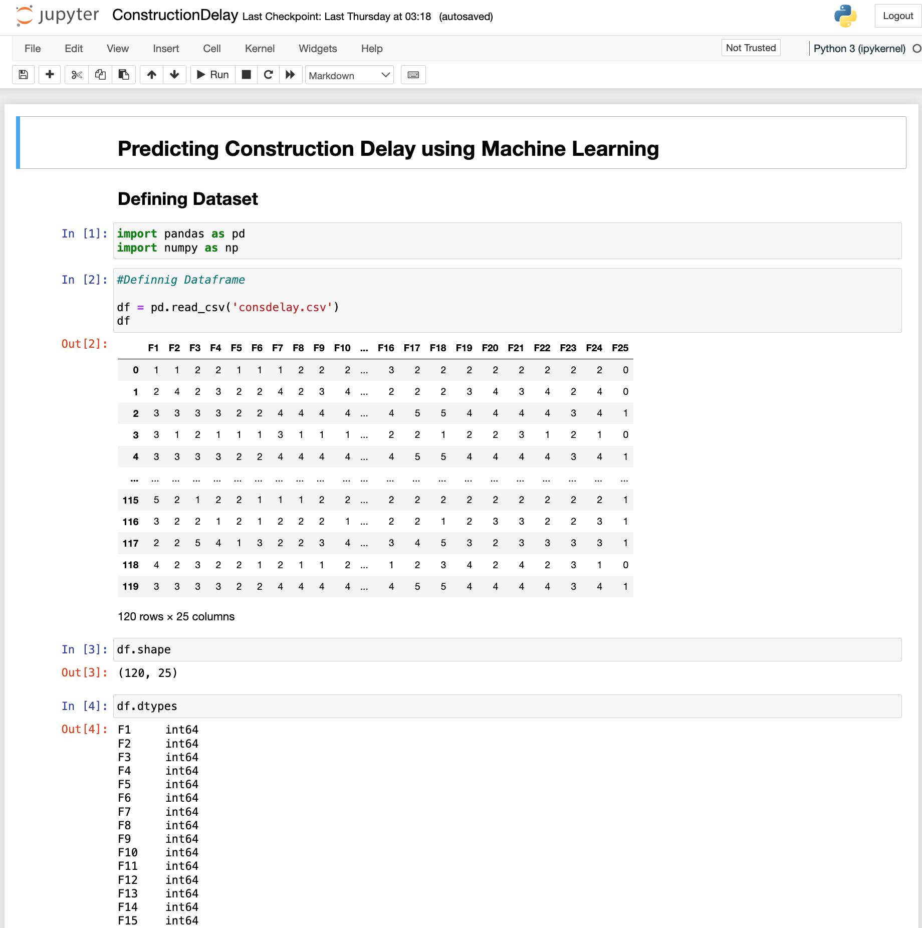
METHODOLOGY (Cont…)
ML Model Development
Concise source code of the development is shown here
The project model was built and the ‘.ipynb’ file was produced
The project development process is done in Jupyter Notebook.
Figure: Concise Source Code in Python in Jupyter Notebook

Slide 16
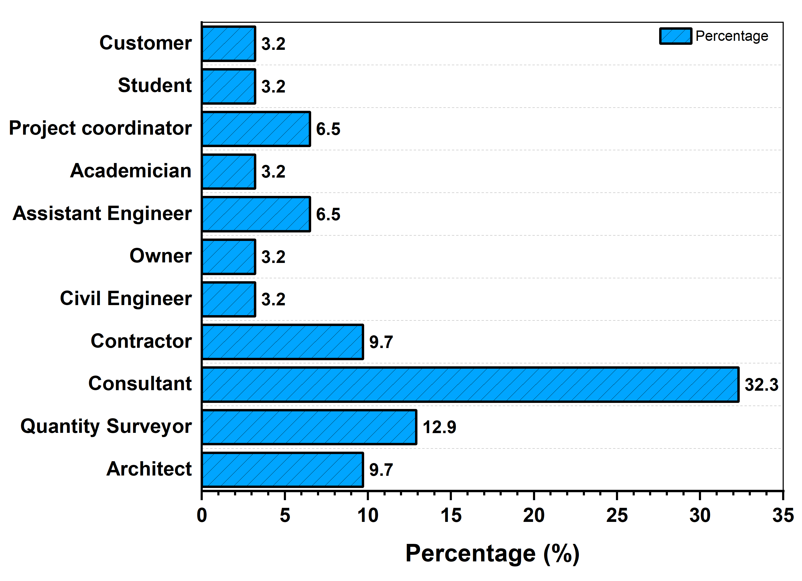
RESULT AND DISCUSSION
Sample Space Demographic
Figure: Analysis of Questionnaire Survey

Slide 17
RESULT AND DISCUSSION (Cont…)
Reliability Statistics
Cronbach’s Alpha | Cronbach’s Alpha Based on Standarized Items | N of Items
0.938 | 0.935 | 24
Reliability Analysis
The value for Cronbach’s Alpha was within the acceptable limit.
The delays were divided into 5 sections according to the responsible parties.
Figure: Cronbach’s Alpha Coefficient for the Survey Response

Slide 18
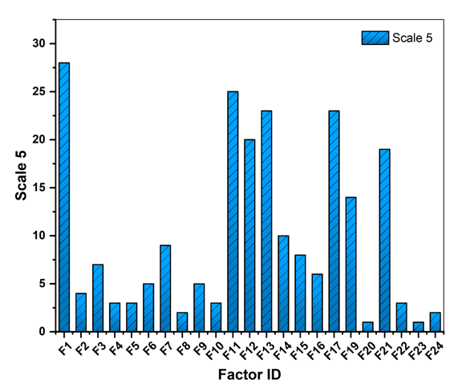
RESULT AND DISCUSSION (Cont…)
Analyzing Factors
Analysis of questionnaire survey identified the most influential factors causing construction delays, providing insights into critical determinants impacting project timelines
From the analysis, the value of Factor-1 was the highest; which was the eqipment breakdown / management
Figure: Analyzing the Factors of Scale 5

Slide 19
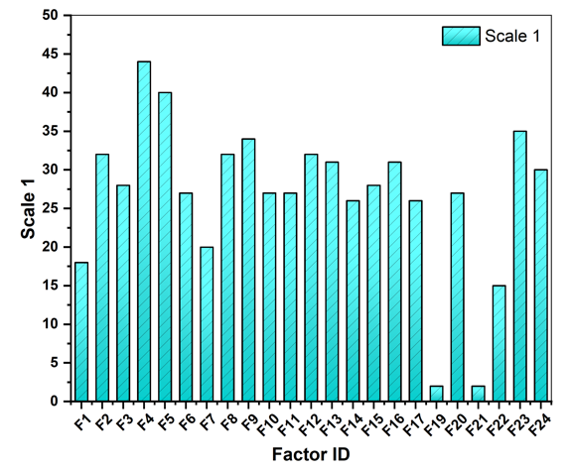
RESULT AND DISCUSSION (Cont…)
Analyzing Factors
Through a survey on construction delay factors, the analysis revealed fewer effective reasons contributing to delays in construction projects
From the analysis, the value of Factor-4 was the highest; which was the affective or poor communication among stakeholders
Figure: Analyzing the Factors of Scale 1

Slide 20
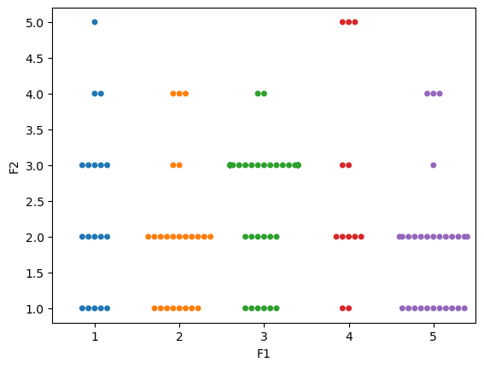
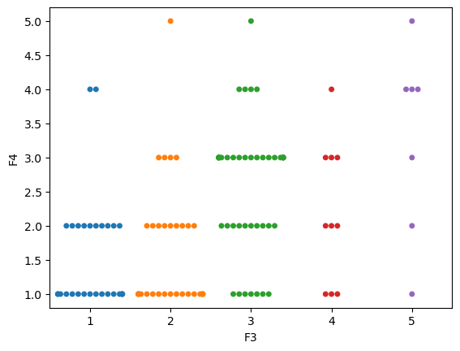
RESULT AND DISCUSSION (Cont…)
SWARMPLOT
Swarm plot is a type of categorical scatter plot used in data visualization
Swarm plots can be helpful in comparing distributions across multiple categories or groups, allowing for easy identification of differences or similarities in the data
Figure: Swarmplot of F1 vs F2 & F3 vs F4 using Seaborn

Slide 21
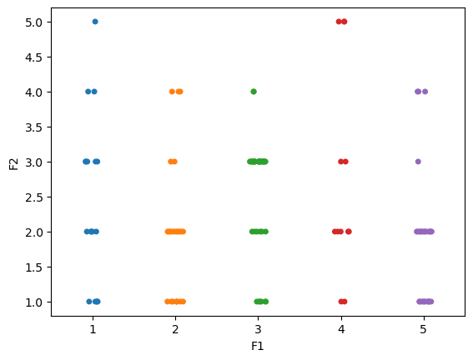
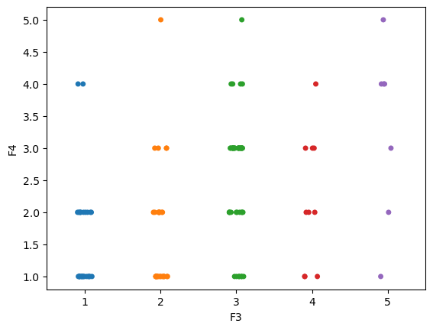
RESULT AND DISCUSSION (Cont…)
STRIPPLOT
Strip plot is another type of categorical scatter plot commonly used in data visualization
Strip plots are particularly useful when the precise location of each data point is important for analysis
Figure: Stripplot of F1 vs F2 & F3 vs F4 using Seaborn

Slide 22
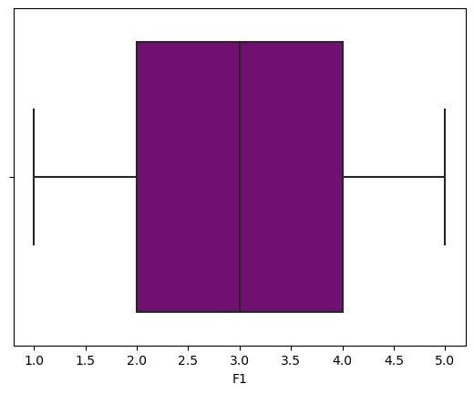
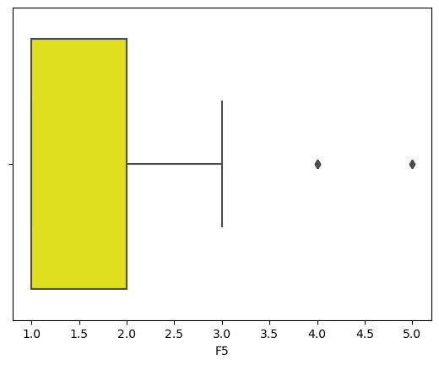
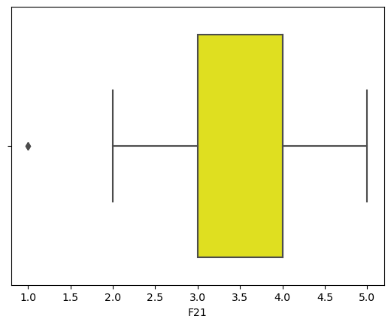
RESULT AND DISCUSSION (Cont…)
BOXPLOT
Boxplots are used for visualizing the distribution of numerical data and detecting potential outliers.
They provide a concise summary of the central tendency, variability, and skewness of the data distribution within each category or group.
Figure: Boxplot for F1, F5 and F21 of the Contruction Delay Prediction using ML

Slide 23
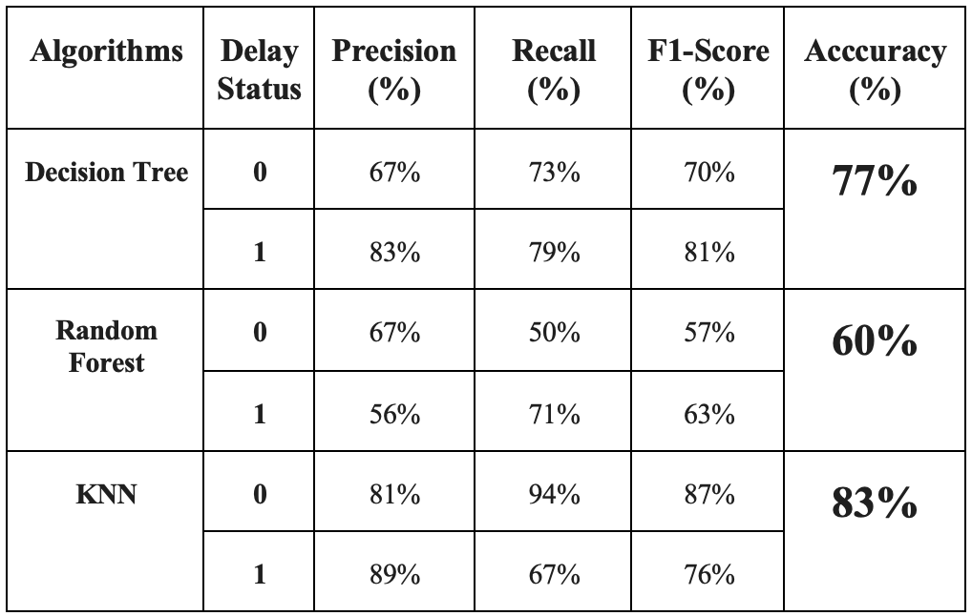
RESULT AND DISCUSSION (Cont…)
Machine Learning Models
1
Decision Tree
Precision (67%, 83%)
Recall (73%, 79%)
F1 Score (70%, 81%)
Accuracy (77%)
Evaluation Metrics
2
Random Forest
Precision (67%, 56%)
Recall (50%, 71%)
F1 Score (57%, 63%)
Accuracy (60%)
3
KNN
Precision (81%, 89%)
Recall (94%, 67%)
F1 Score (87%, 76%)
Accuracy (83%)
Table1. Performance Metrics of Various ML Models

Slide 24
CONCLUSION
Study highlights ML's efficacy in predicting delays, enhancing decision-making, while acknowledging dataset biases.
ML improves stakeholder insights, risk management, and planning, urging bias mitigation.

Slide 25
REFERENCES
[3] Hoque, M.I., et al., Analysis of construction delay for delivering quality project in Bangladesh. International Journal of Building Pathology and Adaptation, 2023. 41(2): p. 401-421.
[4] Aydin, D. and E. Mihlayanlar. Causes and Effects of Construction Project Delays: A Local Case Study in Edirne City Centre. in 5th International Project and Construction Management Conference (IPCMC 2018). Available at: https://www.researchgate.net/publication/329415192_Causes_and_Effects_of_Construction_Project_Delays_A_Local_Case_Study_in_Edirne_City_Centre. 2018.
[5] Elhusseiny, H.O., I. Nosair, and A.S. Ezeldin, Developing a user plug-in to assess delay causes’ impact on construction projects in Egypt. Ain Shams Engineering Journal, 2021. 12(4): p. 3553-3568.
[6] Venkatesh, P.K. and V. Venkatesan, Delays in construction projects: a review of causes, need and scope for further research. Malaysian Construction Research Journal, 2017. 23(3): p. 89-113.

Slide 26
THANK YOU

