Slide 2
“C” for code?
By - Mahadi Hasan Fardin​

Slide 3
Programming
Mahadi Hasan Fardin
What is programming?
Computer Programming is a medium for us to communicate with computers . Just like we use “Bangla” or “English” to communicate with each other. And Programming is a way for us to deliver our instruction to the compiler.

Slide 4
What is ‘c’ ?
C is a programming language. C is one of the oldest and finest programming language. C was developed by Dennis Ritchie at AT&T’S Bell Labs, USA in 1972.
Mahadi Hasan Fardin

Slide 5
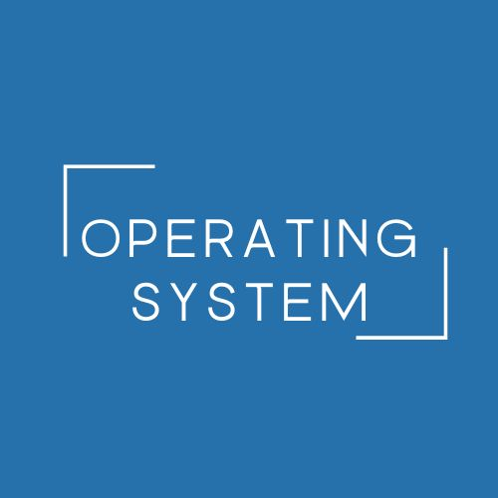


Uses of “c”
Mahadi Hasan Fardin
C language is used to program a wide variety of systems. Some of the uses of C are as follows:
Operating systems
Fast & Furious
Game development
Major parts of Windows, Linux and other operating systems are written in “C”.
C language is used to program embedded systems where need to run faster in limited memory (Microwave, Camera, etc…)
It is used to develop games where latency is a big problem.

Slide 6
Chapter-1
Mahadi Hasan Fardin
Variables, Constants & Keywords

Slide 7
Variables
A variable is a container which stores a “value”. In kitchen, we have container storing rice, dal, sugar, etc. Similar to that variables in c stores value of a constant.
a = 3 ; //a is assigned “3”
b = 4.7 ; //b is assigned “4.7”
c = “A”; //c is assigned “A”
Mahadi Hasan Fardin

Slide 8
Rules for naming variables in “c”
First character must be an alphabet or underscore ( _ )
No commas & blanks allowed
No special symbol allowed except ( - )
Variable names are case sensitive
[We must create meaningful variable names in our programs. This enhances readability of our programs.]
Mahadi Hasan Fardin

Slide 9
constants
An entity whose value doesn’t change is called as a constant.
A variable is an entity whose value can be changed.
Types of constants
Primarily, there are three types of constants.
Integer constant (-1, 34, 2, 536, …)
Real constant (324.4, 52.853, 2.4, -1.4, …)
Character constant (a, $, @, ! , . . .)
Mahadi Hasan Fardin

Slide 10
Keywords
These are reserved words, whose meaning is already known to the compiler. There are 32 keywords available in C.
auto | double | Int | struct | break | long | else | switch | case | char
const | continue | default | do | return | register | short | signed | size of | static
enum | extern | float | for | goto | if | typedel | union | unsigned | void
while | volatic
Mahadi Hasan Fardin

Slide 11
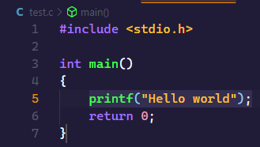
Our first c program
Mahadi Hasan Fardin

Slide 12
Basic structure of a c program
All c programs have to follow a basic structure. A c program starts with a main function and executes instructions present inside it.
Each instruction is terminated with a semicolon(;)
There are some rules which are applicable to all the C programs:
Every program execution starts from main() function.
All the statements are terminated with a semicolon.
Instructions are case-sensitive.
Instructions are executed in the same order in which they are written.
Mahadi Hasan Fardin

Slide 13
There are some rules which are applicable to all the C programs:
Every program execution starts from main() function.
All the statements are terminated with a semicolon.
Instructions are case-sensitive.
Instructions are executed in the same order they are written.
Mahadi Hasan Fardin

Slide 14
Comments
Comments are used to clarify something about the program in plain language. It is a way for us to add notes to our program. There are two types of comments in C.
1.Single line comments:
Demo-
//This is comment
2.Multiple line comments:
Demo-
/* This is multiple line
a comment */
--Comments in a C program are not executed and are ignored.
Mahadi Hasan Fardin

Slide 15
Comapilation and Execution
First.c
C compiler
First.exe
A compiler is a computer program which converts a C program into machine language so that it can be easily understood by the compiler.
A C program is written in plain text. This plain text is a combination of instructions in a particular sequence. The compilar performs some basic checks and finally converts the program into an executable file.
Mahadi Hasan Fardin

Slide 16
Library Functions
C language has a lot of valuable library functions which is used to carry out certain tasks. For instance “printf” function is used to print values on the screen.
printf(“This is %d”, i);
%d for integers
%f for real values
%c for characters
%lf for double
Mahadi Hasan Fardin

Slide 17
Types of variables
Integer variables → int a = 3;
Real variables → int a = 7.7; float a = 7.7;
Wrong as 7.7 is integer
3. Character variables → char a = ‘B’ ;
Mahadi Hasan Fardin

Slide 18
Receiving input from the users
In order to take input from the user and assign it to a variable, we use scanf function.
Scanf(“%d”, &i);
“&” is the “address of” operator and it means that the supplied value should be copied to the address which is indicated by variable i.
Mahadi Hasan Fardin

Slide 19
Practice Set
Write a C program to calculate area of a rectangle:
Using hard coded inputs.
Using inputs supplied by the user.
2. Calculate the area of a circle and modify the same program to calculate the volume of a cylinder given its radius and height.
3. Write a program to convert Celsius to Fahrenheit.
4. Write a program to calculate simple interest for a set of values representing principal, number of years and rate of interest.
Mahadi Hasan Fardin

Slide 20
Chapter - 3
Conditional Instructions

Slide 21
Conditions
Sometimes we want to watch comedy videos on YouTube if the day is Friday. Sometimes we order junk food if it is our friends birthday in the hostel.
You might want to buy an Umbrella if its raining and you have the money.
You order the meal if this is your favorite kacci from “Kacchi bai”.
All these are decisions which depends on a condition being met.
In C language too, we must be able to execute instructions on a conditions being met.
Mahadi Hasan Fardin

Slide 22
Decision Making instructions in c
Mahadi Hasan Fardin
If-else statement
Switch statement

Slide 23
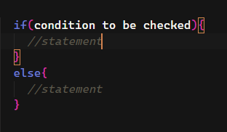
If-else statement
The syntax of an if-else statement in C looks like:
Mahadi Hasan Fardin

Slide 24
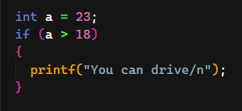
Code example:
[ Note that else block is not necessary but optional ]
Mahadi Hasan Fardin

Slide 25
Relational operators in C
Relational operators are used to evaluated conditions(true/false) inside the if statements. Some examples of relational operators are:
== , >= , > , < , <= , !=
equals
Greater then or equal to
Grater then
Less then
Less then or equal to
Not equal to
Mahadi Hasan Fardin

Slide 26
Logical Operators(&&, || and !)
&& → AND → is true when both the conditions are true.
|| → OR → is true when at least one of the conditions is true.
! → NOT → return true if given false or return false if given true.
Mahadi Hasan Fardin

Slide 27
Chapter - 4
Loop control instruction

Slide 28
Why loops?
Mahadi Hasan Fardin
Sometimes we want our programs to execute few set of instructions over and over again. For example:- Printing 1 to 100, first 100 even numbers etc.

Slide 29
Types of loops
For loop
While loop
Do-while loop
Mahadi Hasan Fardin

Slide 30
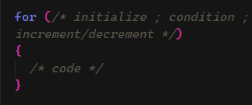
For loop
Mahadi Hasan Fardin

Slide 31
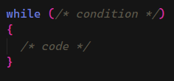
While loop
Mahadi Hasan Fardin

Slide 32
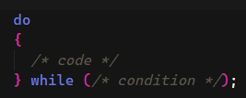
Do-while loop
Mahadi Hasan Fardin

Slide 33
Quic quiz
Mahadi Hasan Fardin
“
Write a program to print natural numbers from 10 to 20 when initial loop counter is initialized to 0.
“

Slide 34
The break statement in C
The “break” statement is used to exit the loop irrespective of whether the condition is true or false.
Whenever a “break” is encountered inside the loop, the control is sent outside the loop.
Let us see this with the help of an example:
for( i=0 ; i<1000; i++){
printf(“%d/n”, i);
if(i==5){
break;
}
}
Mahadi Hasan Fardin

Slide 35
The continue statement in c
The continue statement is used to immideately move to the next iteration of the loop.
The control is taken to the next iteration thus skipping everything below “continue” inside the loop for that iteration.
for( i=0 ; i<1000; i++){
printf(“%d/n”, i);
if(i==5){
continue;
}
}
Mahadi Hasan Fardin

Slide 36
Practice set
Write a program to print multiplication table of 8.
Write a program to sum first ten natural number using for/while/do-while loop.
Write a program to calculate the factorial of a given number using (for/while/do-while) loop.
Mahadi Hasan Fardin

Slide 37
Praise be to Allah
Thank you for your attention
Mahadi Hasan Fardin

