Slide 1
HTML
Chapter 0 - Introduction

Slide 2
HTML Hyper Text Markup Language
HTML is the language of the web. It is used to create website.
We use HTML tags to define look and feel of a Website.
With understanding of these tags and how to put them together, we can create beautiful website easily.

Slide 3
Then why CSS & JavaScript
HTML is used for defining layout of a page.
CSS is used to add styling to that page created using HTML.
JavaScript is used to program Logic for the page layout. Ex: What happens when a user hovers on a test, when to hide or show elements etc.

Slide 4
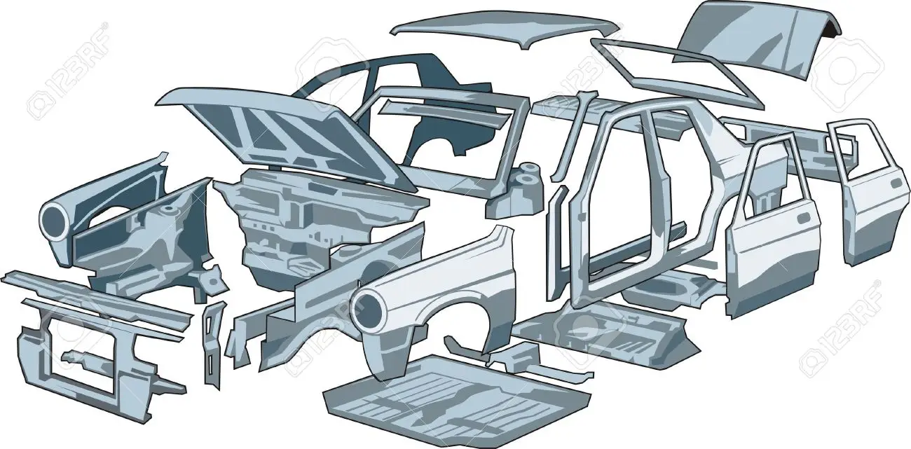
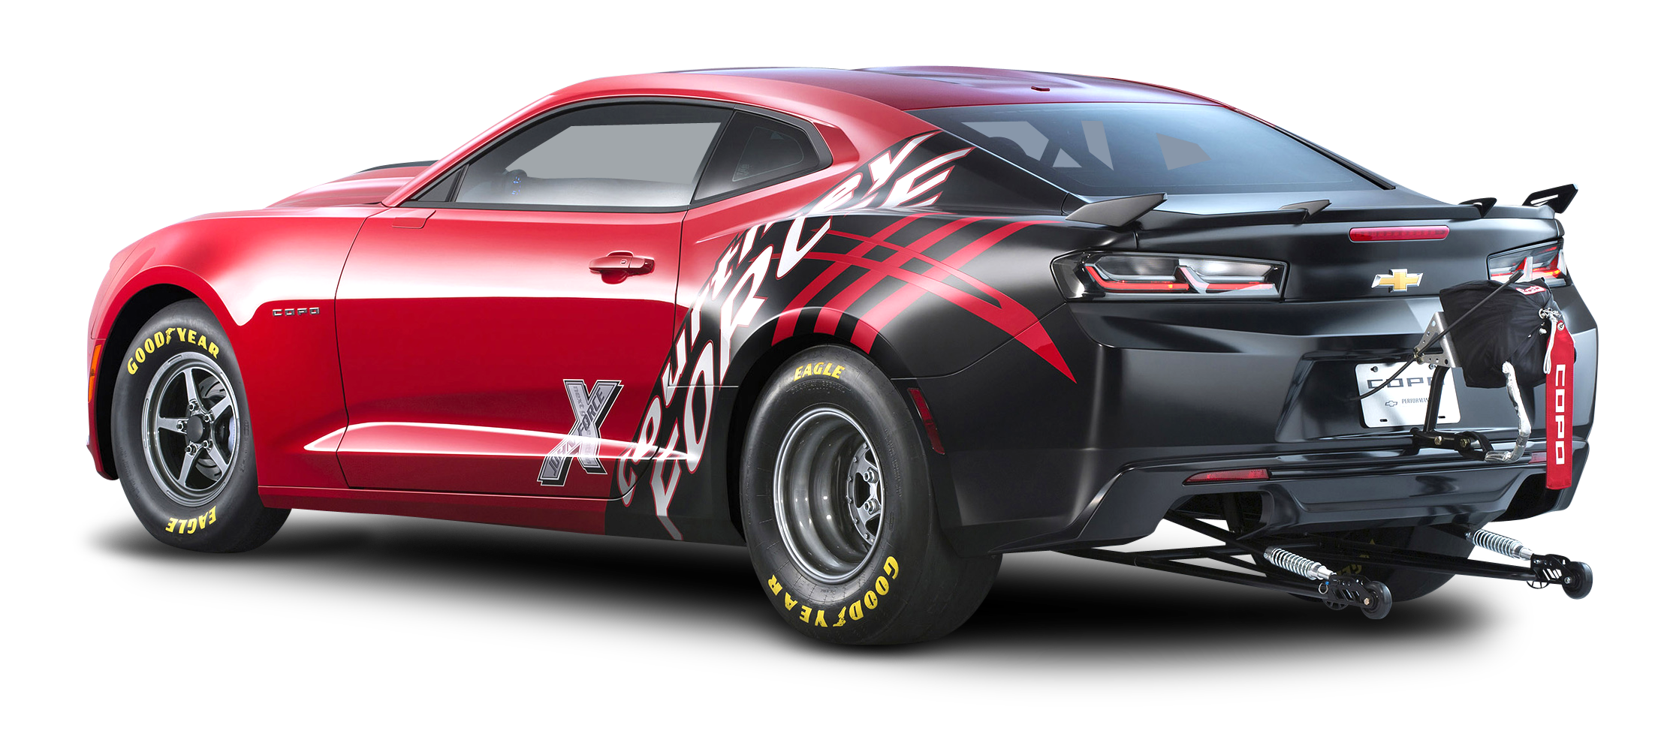
A beautiful analogy
HTML- Car boy(only metal)
CSS – Car paint, decoration etc

Slide 5

JavaScript
Car engine + Interior etc….

