Slide 1
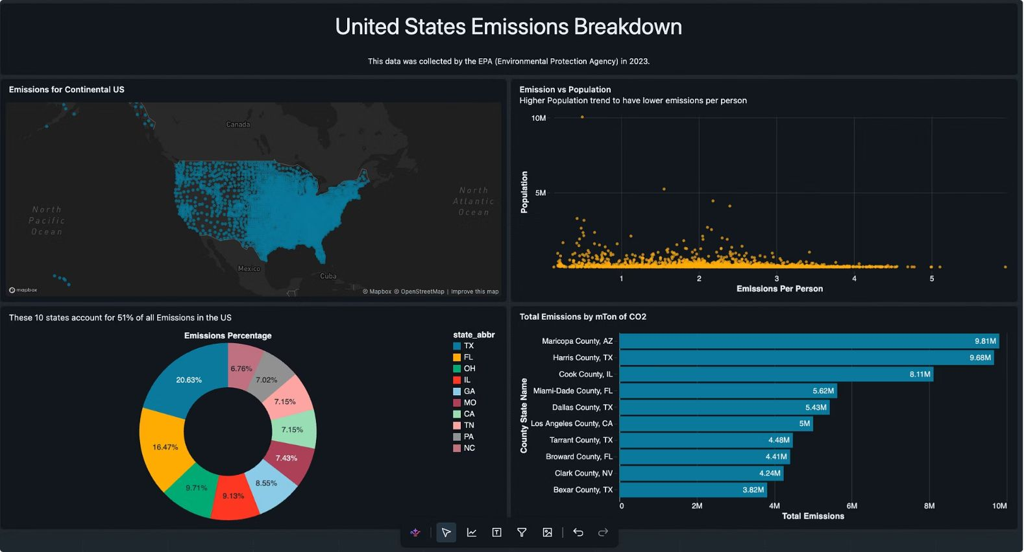
TECHNICAL AUDIT · 2023 EMISSIONS
United States Emissions Analysis & Findings Report
A focused review of source data, SQL logic, and dashboard visualizations
AUDIENCE
EVIDENCE BASE
Data and analytics team
CSV · dashboard definition · SQL · screenshots · chart exports
PREPARED FOR REVIEW

Slide 2
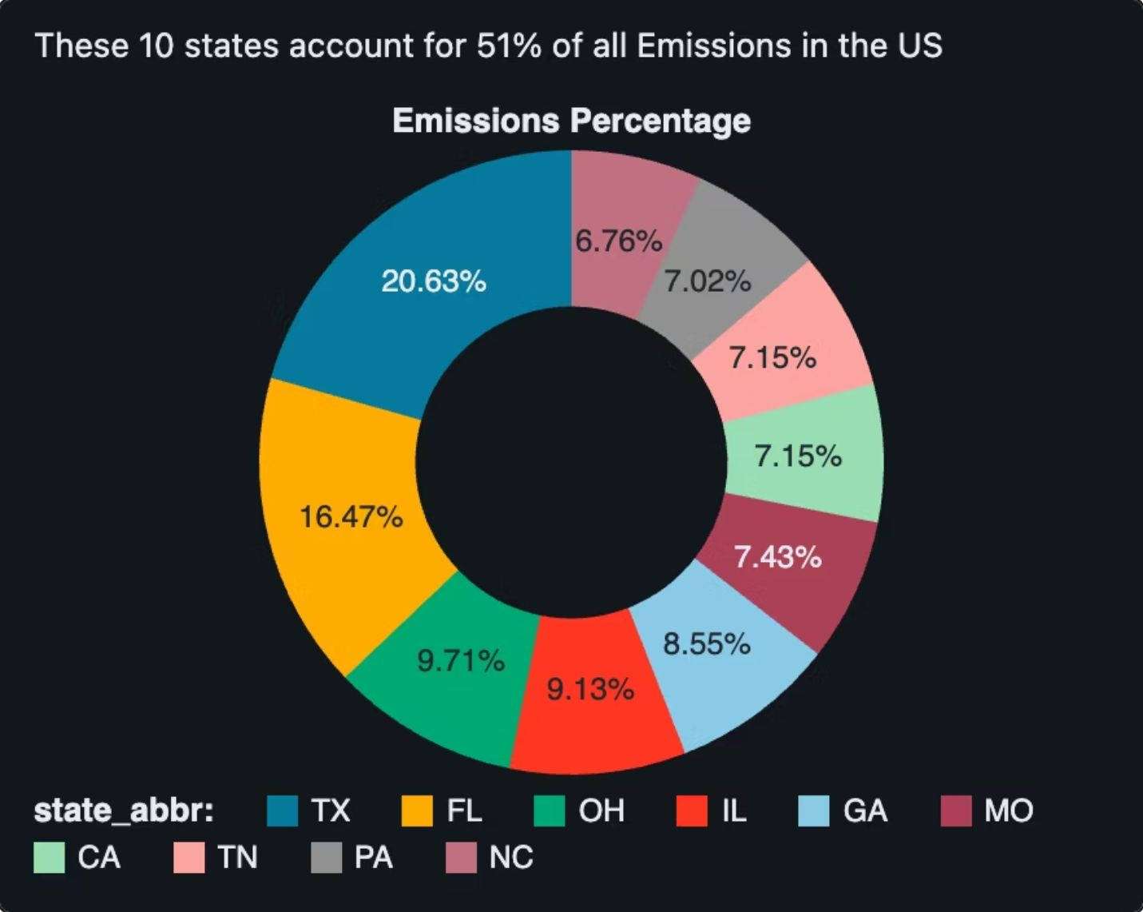
01 · EXECUTIVE READ
The dashboard has a credible first story, but its strongest claims need tighter definitions
The supplied data supports a useful exploratory narrative: emissions are concentrated geographically, county hotspots are visible, and per-person values vary widely. The risk is not that the underlying estimates are necessarily wrong. It is that labels, denominators, and encodings sometimes ask the reader to infer more than the SQL establishes.
WHAT HOLDS
Concentration: Texas is largest at 59.02M metric tons CO₂e; Florida is second at 47.11M.
Hotspots: Maricopa County, AZ and Harris County, TX lead at 9.81M and 9.68M.
Normalization: calculated Pearson correlation between emissions and population is approximately −0.22.
Trust risk: the map, donut percentages, and population narrative need explicit scope and units.
Top 10 state contributors · supplied 2023 emissions data. Together they account for 50.87% of modeled emissions.
2

Slide 3
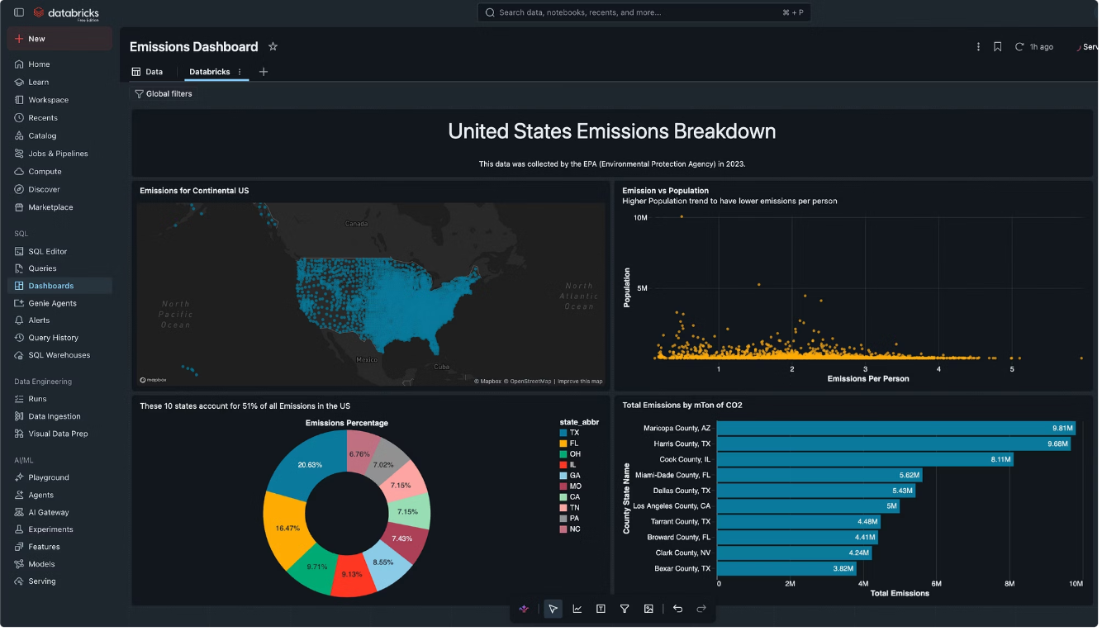
02 · SOURCE CONTRACT
The source file is broad enough for exploration, but not yet a clean analytical contract
The CSV is a useful discovery surface: it covers 3,141 county or county-equivalent records, 51 state abbreviations including DC, and 58 columns. But the file currently makes downstream meaning depend on analyst interpretation and repeated query logic.
CHECK | OBSERVED STATE | IMPLICATION
Rows | 3,141 county/area records | Good exploration base; add stable keys.
Columns | 58; repeated header families | Semantic joins and documentation are fragile.
GHG field | Text with commas; no blank/negative values observed | Cast upstream and validate at ingestion.
Missing fields | Buildings, area, establishments 100% empty | Remove, populate, or mark unavailable.
Data contract snapshot · supplied CSV and reviewed dashboard logic.
SCHEMA AMBIGUITY
INTERPRETATION GAP
Eight column-name families repeat, including consumption, expenditures, utility customers, and per-capita measures. Consolidated city-county is 98.9% missing.
The filename and dashboard subtitle point to 2023, but the SQL does not expose a year or source field. Time scope is implicit rather than query-enforced.
3

Slide 4
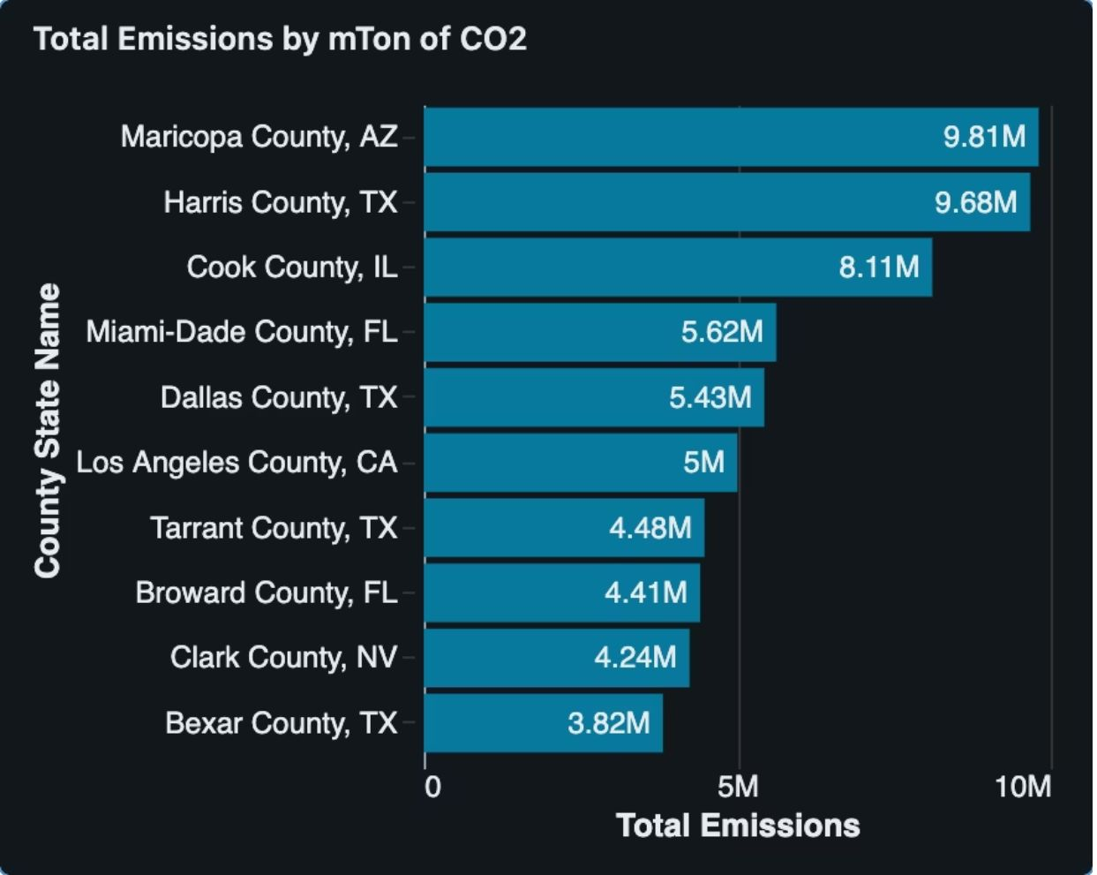
03 · DENOMINATORS
The concentration findings are useful, but the dashboard mixes two different denominators
The state query intentionally limits the result to the top 10 before the pie chart is rendered. The resulting slices are therefore percentages of the top-10 subtotal, not percentages of all U.S. emissions.
50.87%
20.63%
≈10.49%
Top 10 states' share of modeled emissions
Texas share of the top-10 subtotal
Texas share of all records
Make the denominator visible
Label the donut Composition of top 10 states.
Use a ranked bar for all-U.S. share, or expose the full state ranking.
Keep the 51% message as a separate KPI rather than letting the chart imply it.
Retain the county ranking, but state that it is a total-emissions view.
Supplied county ranking figure. Maricopa, Harris, Cook, Miami-Dade, and Dallas are the first five counties.
4

Slide 5
04 · SQL REVIEW
The SQL is readable, but several patterns make the logic brittle or easy to misread
The reviewed queries are understandable. Their main weakness is that data-model assumptions are repeated inside presentation logic, where they become harder to test and easier to mistake for definitions.
QUERY AREA | WHAT IT DOES | MAIN RISK | RECOMMENDED CHANGE
Location map | Returns latitude and longitude | No emissions measure selected for visual encoding | Add GHG measure, or rename to county locations.
Emissions per person | Sums GHG and divides by population | Stable grain and outliers are not explicit | Use county_id, validate population, add distribution views.
State totals | Aggregates states and limits to 10 | Name implies full state coverage | Separate full ranking from top-10 view.
County totals | Orders counties by GHG and limits to 10 | Assumes one row per county | Assert uniqueness and document county grain.
Query review · logic translated from the supplied SQL and dashboard definition.
REPEATED TEXT CASTING
POPULATION INFERENCE
Every query performs REPLACE on the GHG field. Create a typed numeric column once upstream instead.
A per-person outlier ranking is not evidence of a population trend. Add a trendline, correlation or rank statistic, and a clear annual definition.
5

Slide 6
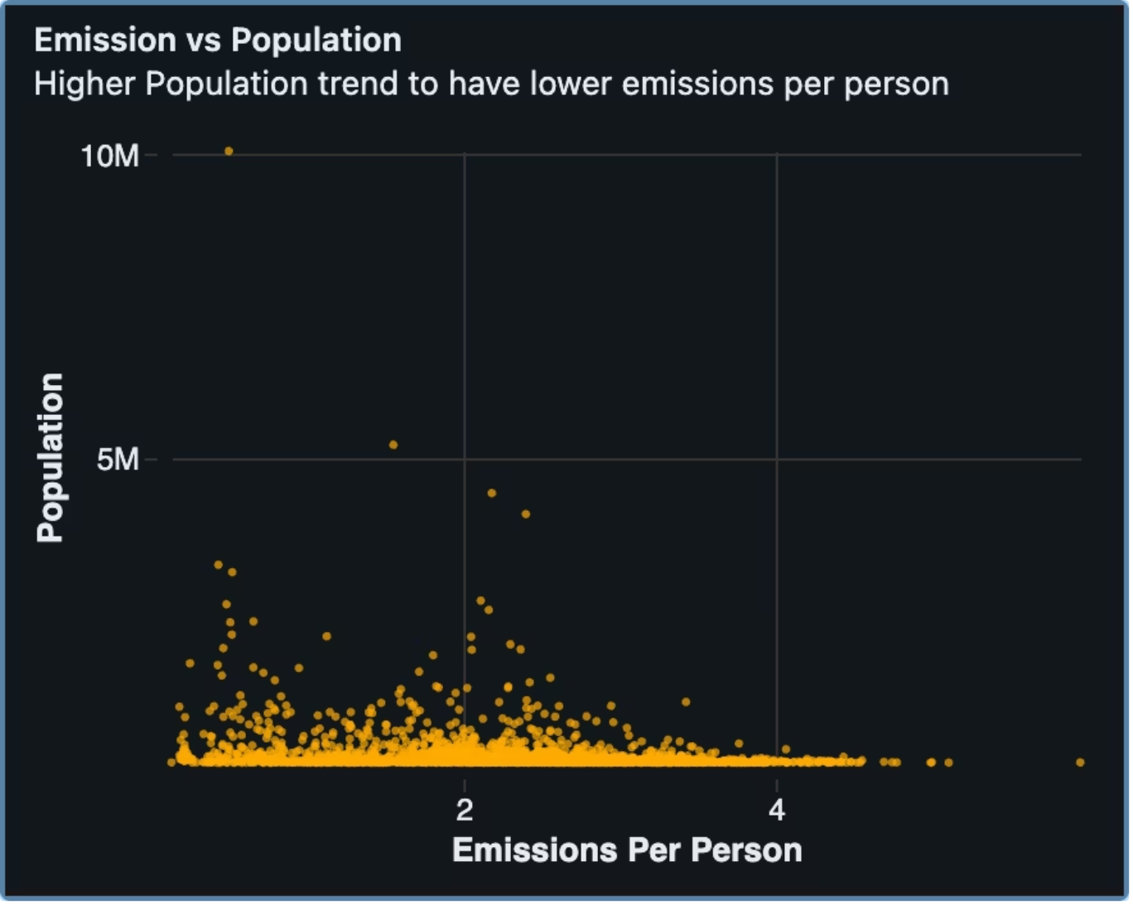
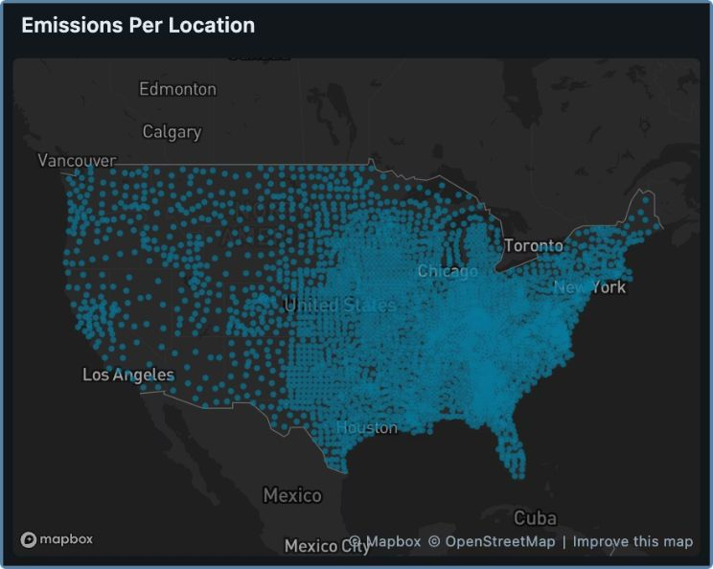
05 · VISUAL PRECISION
The visualizations communicate patterns, but three design choices weaken analytical precision
The dashboard's dark cyan and amber language is distinctive, but the visual system needs stronger contracts between title, query, encoding, and unit. The supplied scatter makes the issue visible: a large point cloud can suggest a story before the reader sees the statistic.
1 · Map encoding
The title says emissions, but the query selects only latitude and longitude and mark size is fixed. It communicates locations, not magnitude.
2 · Scatter scale
3,141 points compress near the baseline. Log scales, a trendline, and highlighted outliers would make the relationship testable.
Supplied scatter and location-map evidence. Pearson correlation is approximately −0.22; the map query still encodes locations rather than emissions magnitude.
3 · Label contract
Titles should state denominator, unit, year, and whether values are totals, shares, or per-person metrics.
6

Slide 7
06 · PROBLEM STATEMENTS
Problem statements to resolve before this becomes a decision system
These are not claims that the underlying emissions estimates are wrong. They identify where the current analytical contract is too implicit for operational or executive use.
1
Semantic model
Analysts cannot reliably distinguish repeated source columns or know which measure family each field belongs to.
2
Metric provenance
Year, source scope, unit, and aggregation grain are not explicit in the queries or chart subtitles.
3
Geographic truth
The map title, selected fields, and mark encoding do not agree on whether the visual shows locations or emissions.
4
Denominator truth
The state donut, top-10 KPI, and bar ranking use different denominators without a visible explanation.
5
Outlier governance
High per-person values may be real, but the current view cannot distinguish a meaningful hotspot from a small-population or data-quality outlier.
6
Maintenance
Repeated inline casts and implicit assumptions make the dashboard harder to extend, test, and audit when the dataset changes.
7

Slide 8
07 · RECOMMENDATION
Recommended path: fix the data contract first, then sharpen the story
Treat the current dashboard as exploratory. Make definitions visible now, then move the logic into a typed, documented analytical view before expanding the story.
Priority | Owner | Deliverable | Success check
P0 | BI / analytics | Correct chart labels and denominators | A reviewer can explain every percentage without opening SQL.
P1 | Data engineering | Typed, documented analytical view | No repeated string casts; keys and year are explicit.
P1 | Analytics | Robust population analysis | Trendline, correlation, outliers, and units are visible.
P2 | Data governance | Metric dictionary and refresh QA | Schema and quality checks run before dashboard publication.
Now: rename the pie subtitle to Top-10 state composition; add all-U.S. share beside it; rename the map to County locations unless emissions is encoded; add units, year, and denominator to every chart.
Next: create a typed analytical view with stable county_id, state_abbr, population, ghg_emissions_mtons_co2e, year, source, and quality flags; add uniqueness, non-null, numeric-range, and coordinate-bound checks.
Then: rewrite the population view around a validated county grain; show median and percentile bands, a log-scale scatter, a fitted trendline, and a top-outlier table with population thresholds.
Finally: add a metric dictionary and a small QA panel reporting row count, latest year, missingness, duplicate keys, total emissions, and top-10 share on every refresh.
Decision gate: treat the current dashboard as exploratory. Promote it to operational or executive use only after denominator labels, map encoding, time scope, and schema tests are made visible.
8

