Slide 1
PM ACCELERATOR · TECHNICAL ASSESSMENT
Weather Trend Forecasting
End-to-end analysis of the Global Weather Repository — cleaning, EDA, multi-model forecasting, and advanced climate, air-quality & spatial intelligence.
PM Accelerator Mission Supporting product managers through every career stage — from entry-level to leadership — via certified training, hands-on projects and career services, while fostering a diverse tech industry. Through PMA Kids it offers free PM education to underserved teens.
149,879 records · 211 countries · 268 cities · May 2024 – Jun 2026

Slide 2
PROJECT OVERVIEW
A four-stage analytics pipeline
149,879
211
268
~2 yrs
CLEAN RECORDS
COUNTRIES
CITIES TRACKED
DAILY HISTORY
1 Clean
Parse last_updated, de-duplicate, impute, winsorize outliers, normalize
2 Explore
Trends, correlations, seasonality; temperature & precipitation visuals
3 Forecast
5 models + ensemble on the daily global-mean series; MAE/RMSE/MAPE/R²
4 Advanced
Anomalies, climate, air quality, feature importance, spatial patterns

Slide 3
BASIC · STEP 1
Data Cleaning & Preprocessing
Timestamps
Duplicates
last_updated parsed to datetime for time-series indexing
Exact and (location, time) duplicates removed — kept latest
Missing values
Outliers
Median impute (numeric), mode impute (categorical)
Winsorized to the Tukey IQR fence — keeps every record
Normalization
Feature engineering
Z-score standardized copies added for modelling
year, month, dayofyear, season derived
Result: 149,880 → 149,879 clean rows · 0 missing · 0 duplicates

Slide 4
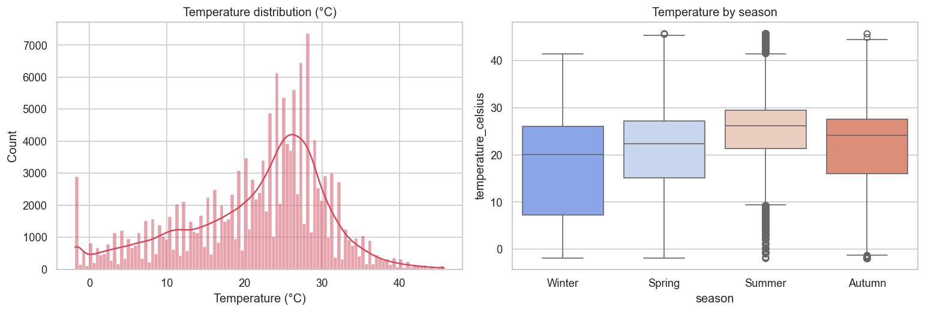
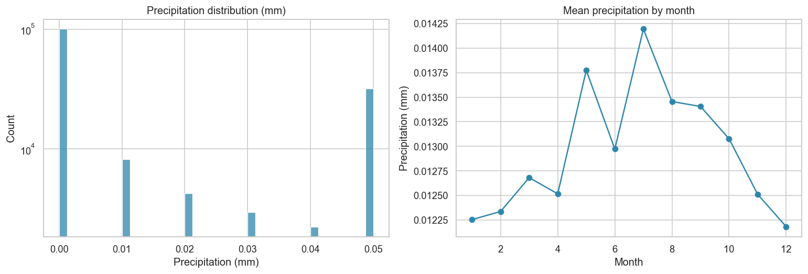
BASIC · STEP 2
EDA — Temperature & Precipitation
Temperature distribution & spread by season
Precipitation distribution (log) & monthly mean

Slide 5
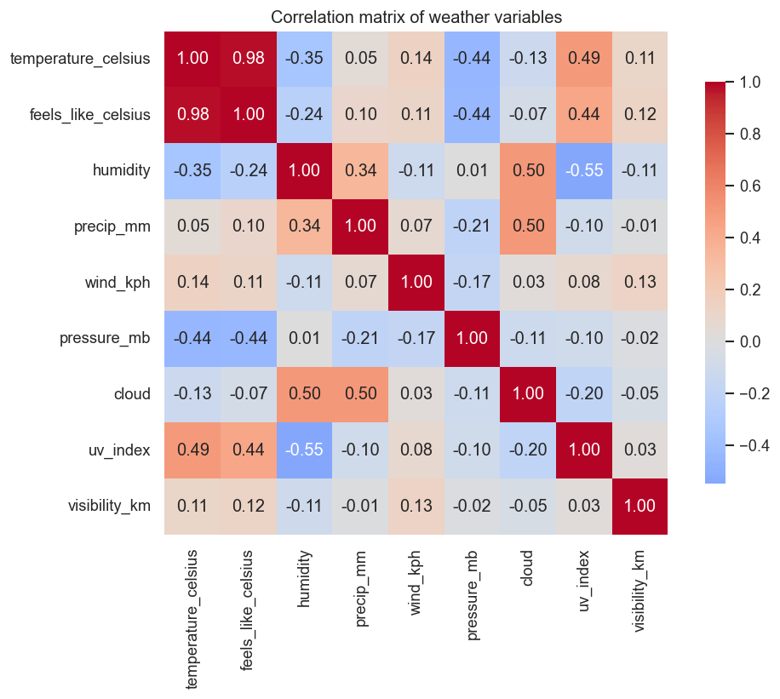
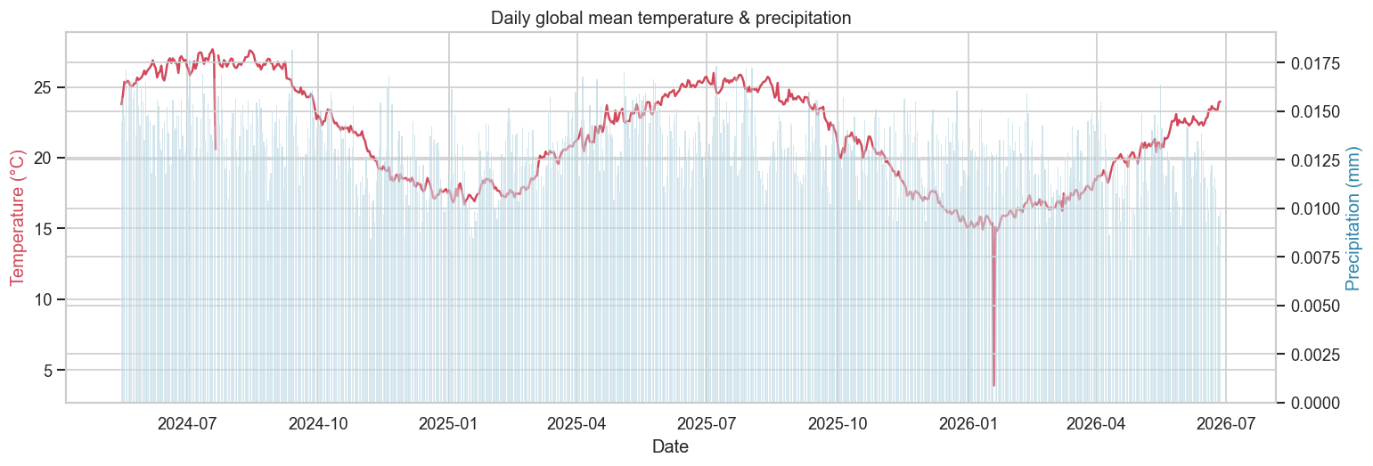
BASIC · STEP 2
EDA — Correlations & Global Trend
Daily global-mean temperature & precipitation
Key correlations with temperature: feels-like +0.98 · UV +0.49 · pressure −0.44 · humidity −0.35
Correlation matrix of weather variables

Slide 6
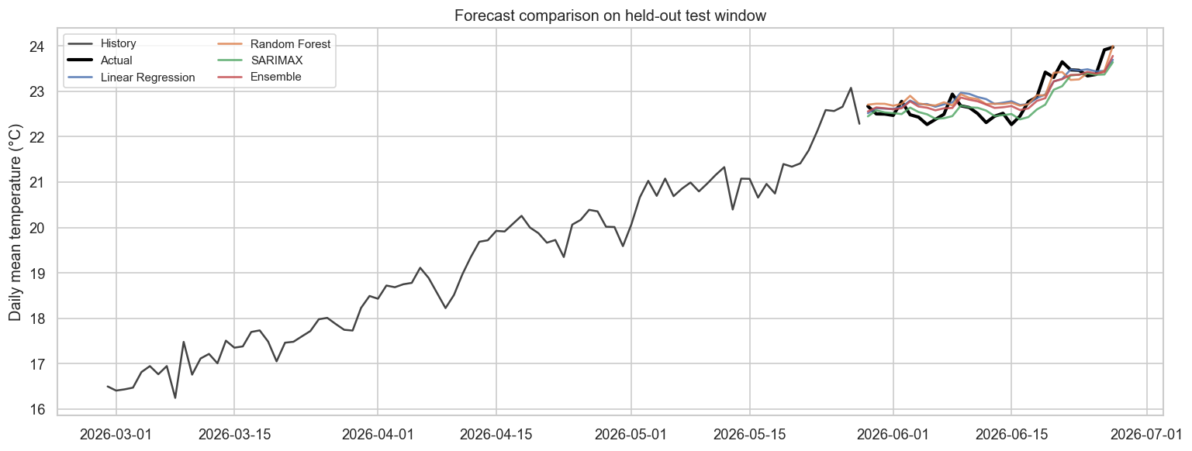
BASIC + ADVANCED · STEP 3
Forecasting — Models & Evaluation
5 models + ensemble · 1-step-ahead walk-forward (fair comparison)
Model | MAE | RMSE | MAPE | R²
Naive (lag-1) | 0.190 | 0.242 | 0.83 | 0.767
Ensemble | 0.212 | 0.249 | 0.93 | 0.752
SARIMAX | 0.193 | 0.265 | 0.84 | 0.719
Random Forest | 0.234 | 0.274 | 1.03 | 0.701
Linear Regression | 0.237 | 0.281 | 1.04 | 0.686
On a smooth planetary-mean series the naive baseline is strong; SARIMAX & the ensemble track within ~0.02 RMSE.
Each model vs. actuals on the held-out test window

Slide 7
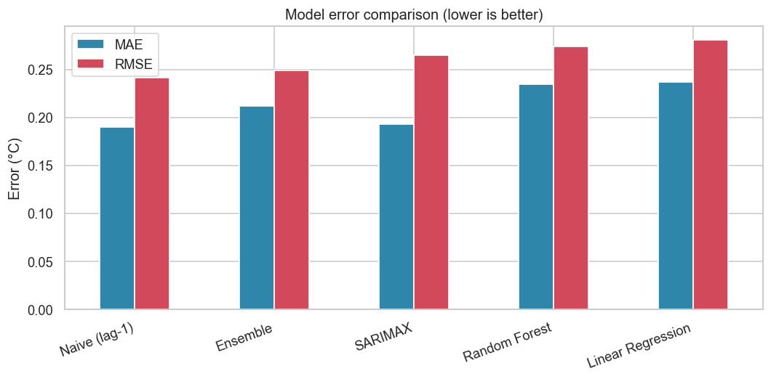
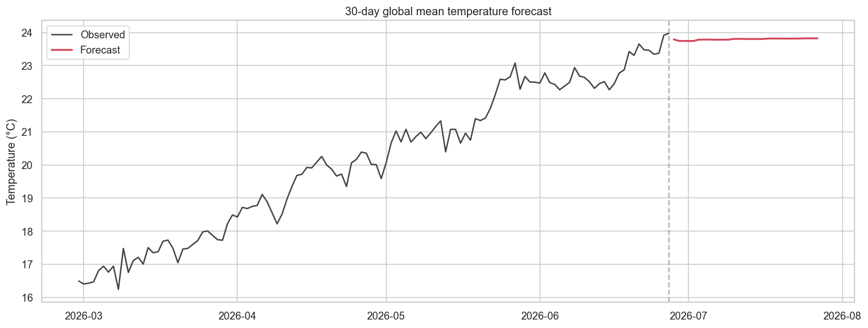
ADVANCED · STEP 3
Forecasting — Errors & 30-Day Outlook
MAE / RMSE by model (lower is better)
30-day-ahead global mean temperature forecast
Best RMSE 0.242 °C · 30-day forecast averages ≈ 23.8 °C

Slide 8
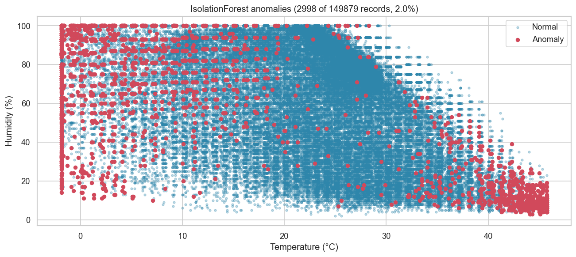
ADVANCED · ANOMALY DETECTION
Outlier & Anomaly Analysis
2,998
ANOMALIES (2.0%)
Three methods IsolationForest (multivariate) cross-checked with Z-score (>3σ) and the IQR rule. Agreement across methods raises confidence in each flag.
IsolationForest anomalies in temperature–humidity space

Slide 9
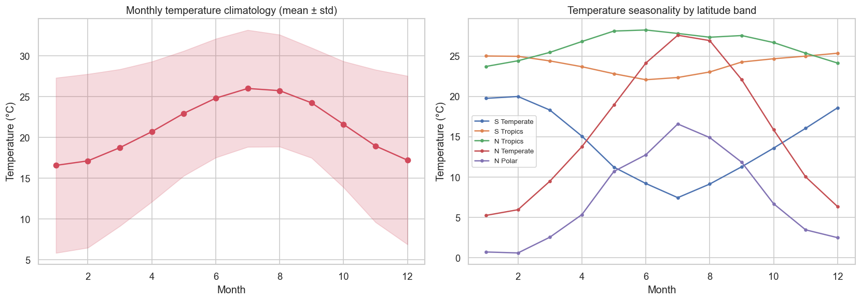
ADVANCED · UNIQUE ANALYSIS
Climate Analysis
What it shows Tropical zones stay warm year-round; temperate & polar zones swing strongly with the seasons — and the two hemispheres move in opposite phase.
Monthly climatology & seasonality by latitude band

Slide 10
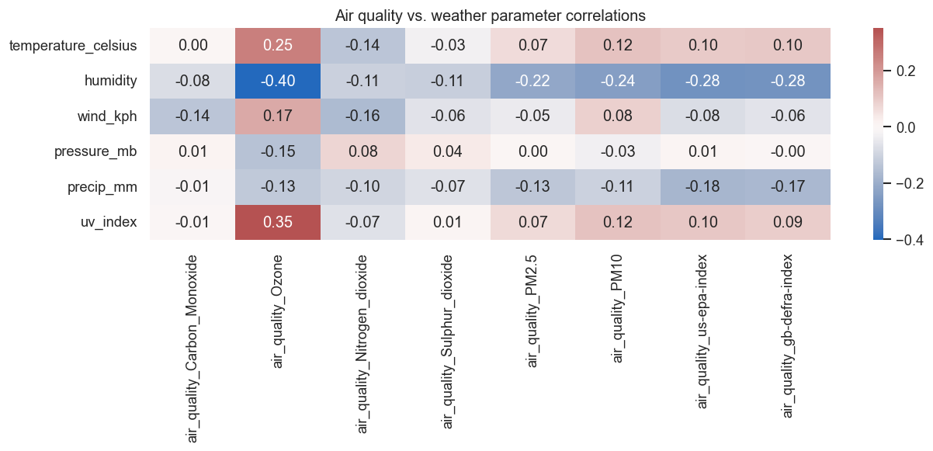
ADVANCED · ENVIRONMENTAL IMPACT
Air Quality vs. Weather
Weather shapes air quality Strongest links: humidity ↔ ozone −0.40 and UV ↔ ozone +0.35 — photochemical ozone forms in dry, sunny conditions. Humidity also anti-correlates with the EPA/DEFRA indices.
Pollutants vs. weather parameters (correlation)

Slide 11
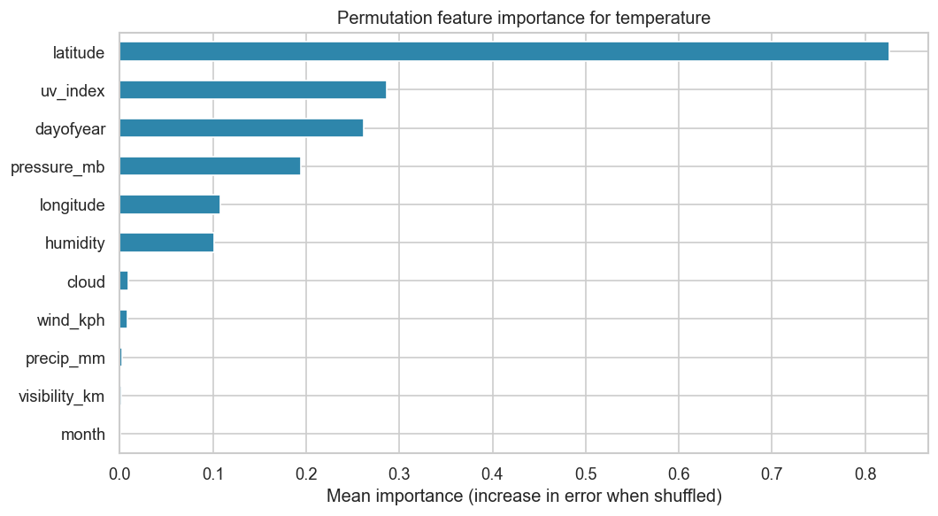
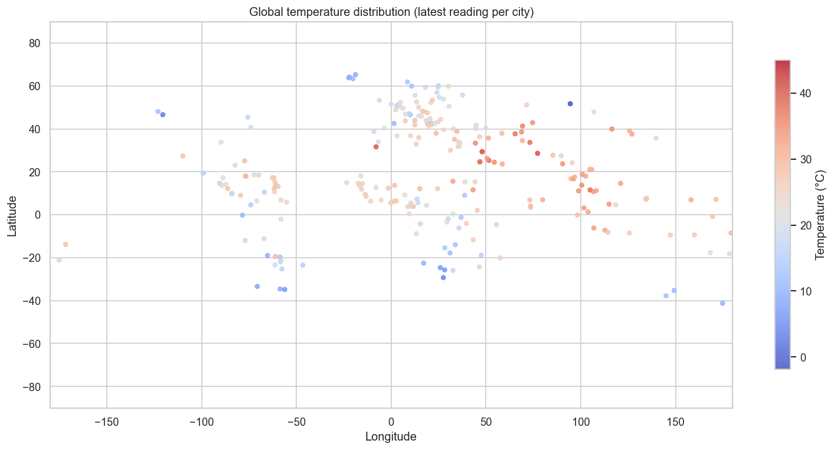
ADVANCED · FEATURE IMPORTANCE + SPATIAL
What Drives Temperature & Where
Permutation importance for temperature
Global temperature — latest reading per city
Latitude (0.83) dominates, then UV (0.29), day-of-year (0.26) & pressure (0.19)

Slide 12
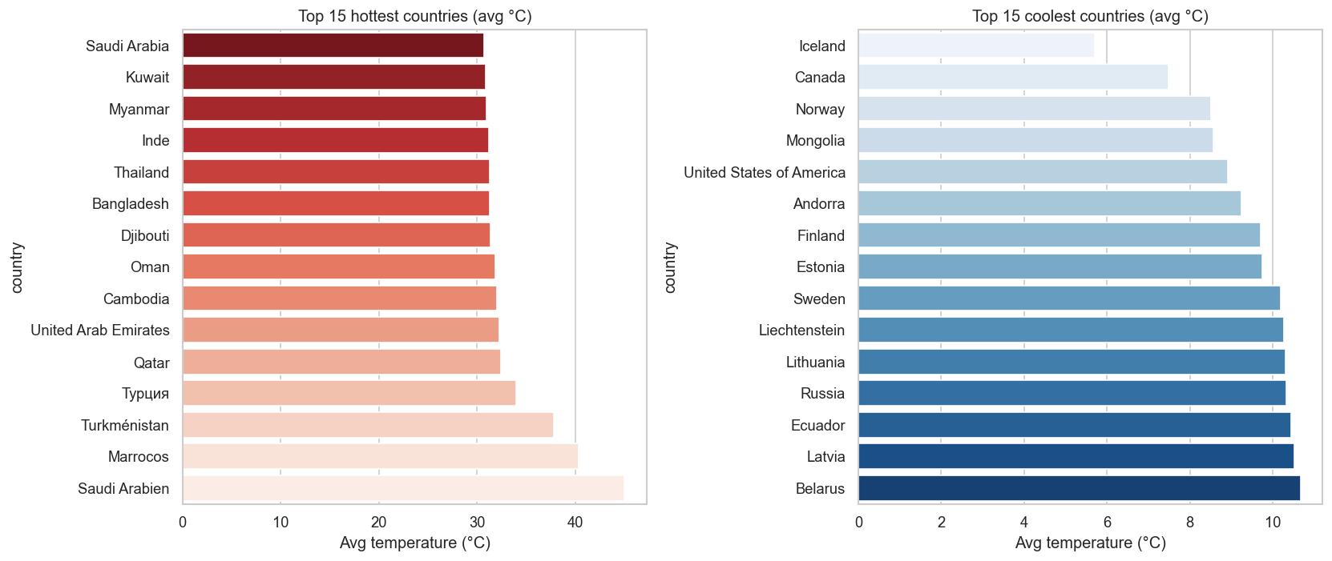
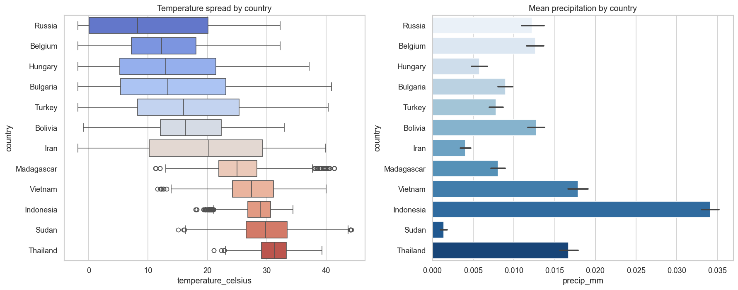
ADVANCED · GEOGRAPHICAL PATTERNS
How Weather Differs Across Countries
Hottest & coolest countries by mean temperature
Temperature spread & precipitation by country

Slide 13
KEY INSIGHTS & CONCLUSIONS
Persistence dominates the global daily-mean series — lag-1 R² ≈ 0.77; SARIMAX/ensemble track closely.
Geography is the master variable — latitude alone is the top temperature driver (0.83).
Weather shapes air quality — humidity is the strongest pollutant correlate (ozone −0.40).
Raw data is already complete (0 missing) — cleaning centres on de-duplication, IQR capping & features.
Anomaly detection isolates 2.0% of records for data-quality / extreme-event review.
Requirements ✓
✓ Cleaning · outliers · normalize
✓ EDA + temp/precip visuals
✓ Forecast + metrics (last_updated)
✓ Anomaly detection
✓ Multiple models + ensemble
✓ Climate analysis
✓ Air-quality impact
✓ Feature importance
✓ Spatial + geographical
Full report: report/REPORT.md · Interactive dashboard: streamlit run dashboard.py · pmaccelerator.io

