Slide 1
SMART STADIUM MONITORING SYSTEM

Slide 2
Course: Embedded IoT Systems
Fareena Shahbaz (23-NTU-CS-1024)
Fatima Shahzad (23-NTU-CS-1026)
Fiza Mehboob (23-NTU-CS-1026)
Fareena Shahbaz (23-NTU-CS-1024)
Fatima Shahzad (23-NTU-CS-1026)
Fiza Mehboob (23-NTU-CS-1026)
Submitted By:
Fiza Mahboob (23-NTU-CS-1027)
Fareena Shahbaz (23-NTU-CS-1024)
Fatima Shezad (23-NTU-CS-1026)
Professor: Dr. Nasir Mehmood
University: National Textile University

Slide 3
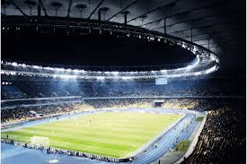
Introduction:
What is a Smart Stadium?
Modern stadiums host thousands of people.
Manual monitoring is inefficient and unsafe.
Smart Stadium uses IoT and automation.
Provides real-time crowd, environment, and energy monitoring.
Improves safety, comfort, and energy efficiency.

Slide 4

Problem Statement
Current stadiums face these problems:
No live crowd counting
Lights remain ON unnecessarily (energy waste)
No automated alerts for safety
No temperature & humidity tracking
No automated alerts for safety

Slide 5
Project Objectives
Automatic people counting
Smart lighting based on occupancy & light
Temperature & humidity monitoring
Crowd safety alerts using buzzer
Real-time cloud dashboard
Mini stadium prototype demonstration

Slide 6
Proposed Solution
ESP32 as central controller
Sensors collect real-time data
ESP32 processes & sends data to cloud
Blynk dashboard shows live status
Automated alerts & controls ensure safety

Slide 7
System Architecture
Step 1: Sensors
PIR → People counting
LDR → Smart lighting
DHT11 → Temperature & humidity
Step 2: Sensors → ESP32
Step 3: ESP32 → Cloud (Blynk/Firebase)
Step 4: User → Mobile App / Dashboard

Slide 8
Hardware Components
ESP32 Wi-Fi Microcontroller
PIR Motion Sensor
LDR + 10kΩ resistor
DHT11 Sensor
Sound Sensor (KY-037)
LEDs
Active Buzzer
Push Button
OLED Display
Breadboard & Jumper Wires
ESP32 Wi-Fi Microcontroller
PIR Motion Sensor
LDR + 10kΩ resistor
DHT11 Sensor
LEDs
Active Buzzer
Push Button
OLED Display
Breadboard
Jumper Wires

Slide 9

Software Stack
VS Code
Platform IO Project
ESP32 Libraries
Blynk Iot Platform
Serial Monitor

Slide 10
Pin Configuration
Component | ESP32 Pin | Purpose
PIR Sensor | GPIO 27 | People detection
LDR | GPIO 34 | Light sensing
DHT11 | GPIO 32 | Temp & humidity
Servo Motor | GPIO 2 | Gate control
Buzzer | GPIO 26 | Alerts
LEDs | GPIO 16–19 | Lighting
OLED SDA | GPIO 21 | I2C data
OLED SCL | GPIO 22 | I2C clock

Slide 11
Basic Features
Automatic Person Counting
PIR sensor detects entry
Counter increments automatically
Real-time crowd tracking
Helps prevent overcrowding
Crowd Limit Control
Maximum capacity defined
Servo motor closes gate when limit reached
Buzzer alerts for safety
Prevents dangerous overcrowding

Slide 12
Basic Features
Smart Lighting System
LDR senses ambient light
Lights turn ON in darkness
Lights turn OFF in brightness
Reduces electricity wastage
Temperature & Humidity Monitoring
DHT11 measures environment
Data shown on OLED
Data sent to Blynk dashboard
Improves audience comfort

Slide 13
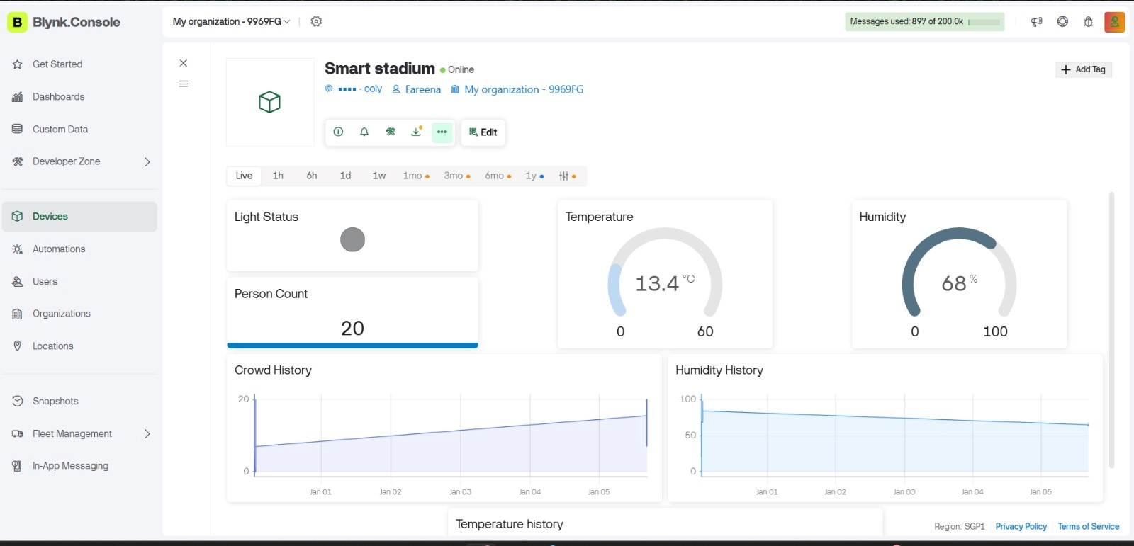
IoT Monitoring Using Blynk
Real-time cloud dashboard
Displays:
People count
Temperature
Humidity
Noise level
Light status
Remote monitoring via mobile app

Slide 14
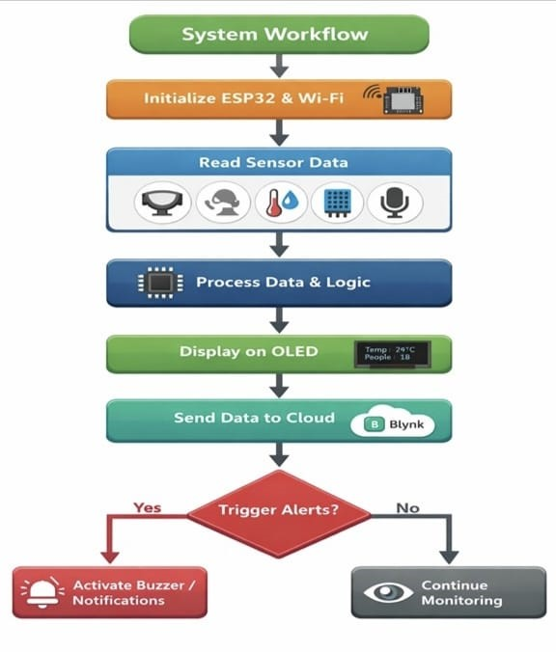
System Workflow
ESP32 initializes sensors & Wi-Fi

Slide 15







Programming & Libraries
Language: C++
Libraries Used:
Arduino.h
WiFi.h
BlynkSimpleEsp32.h
Wire.h
Adafruit_GFX.h
Adafruit_SSD1306.h
DHT.h
ESP32Servo.h

Slide 16

Advantages
Fully automated system
Improved safety
Energy efficient
Real-time monitoring
Scalable for large stadiums

Slide 17

Application
Stadiums & sports arenas
Auditoriums
Concert halls
Event venues
Smart buildings
njjhh

Slide 18
Conclusion
Smart Stadium automates monitoring & control
Enhances safety and comfort
Saves energy
Demonstrates real-world IoT application
Practical implementation of embedded systems

Slide 19
Thank You!

