Slide 1
Machine Learning Life Cycle
AWS SageMaker MasterClass

Slide 2
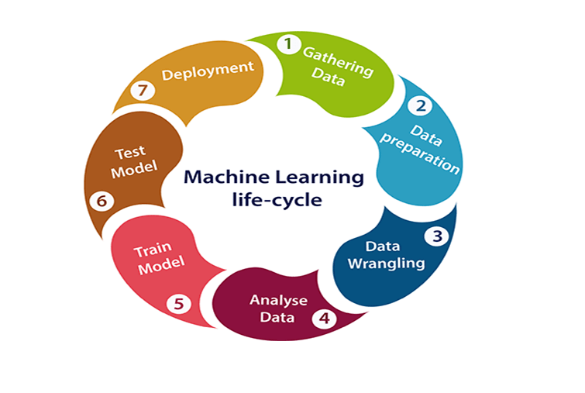

Slide 3
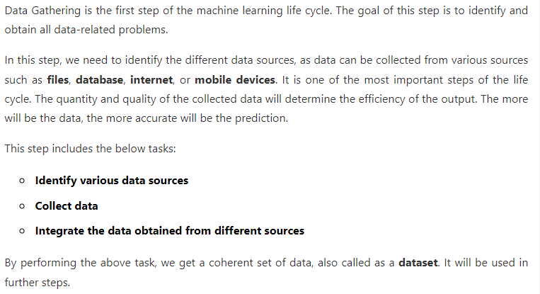

Slide 4
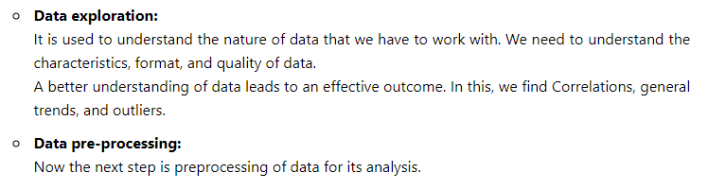

Slide 5
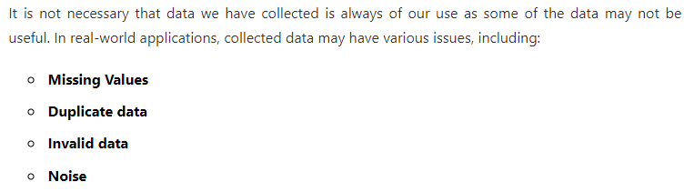

Slide 6
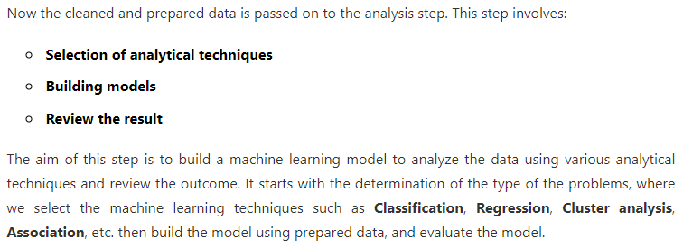

Slide 7
Model Training, Testing and Deployment
Once we are done with Data Preparation and Analysis, the next step is to train the Machine Learning model with training data and test it using testing data and evaluate it on the basis of different metrics like Accuracy, Precision, r2 score etc…
Once we are satisfied with the performance of model then we can go for deployment.

Slide 8
Thank You

