Slide 1
Activation Functions
Deep Learning MasterClass

Slide 2
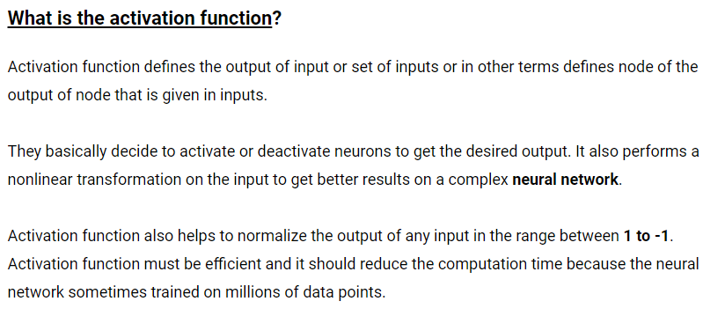

Slide 3
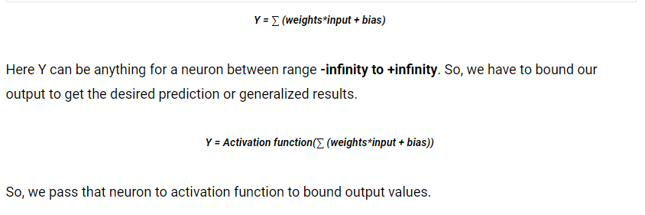

Slide 4
Why do we need Activation Functions ?
Without activation function, weight and bias would only have a linear transformation, or neural network is just a linear regression model, a linear equation is polynomial of one degree only which is simple to solve but limited in terms of ability to solve complex problems or higher degree polynomials.
But opposite to that, the addition of activation function to neural network executes the non-linear transformation to input and make it capable to solve complex problems such as language translations and image classifications.
In addition to that, Activation functions are differentiable due to which they can easily implement back propagations, optimized strategy while performing backpropagations to measure gradient loss functions in the neural networks.

Slide 5
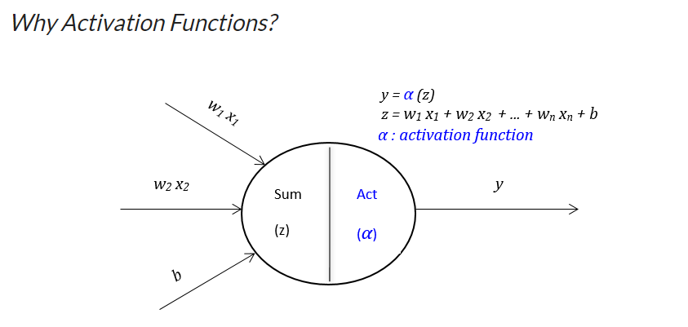

Slide 6
Different Activation Functions

Slide 7
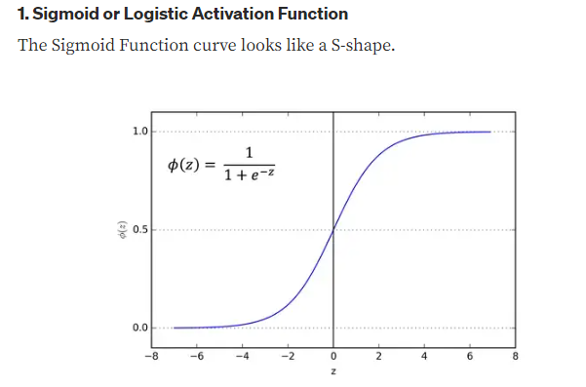

Slide 8
Sigmoid Activation Function
The main reason why we use sigmoid function is because it exists between (0 to 1). Therefore, it is especially used for models where we have to predict the probability as an output.Since probability of anything exists only between the range of 0 and 1, sigmoid is the right choice.The function is differentiable.That means, we can find the slope of the sigmoid curve at any two points.The function is monotonic but function’s derivative is not.The logistic sigmoid function can cause a neural network to get stuck at the training time.The softmax function is a more generalized logistic activation function which is used for multiclass classification.

Slide 9
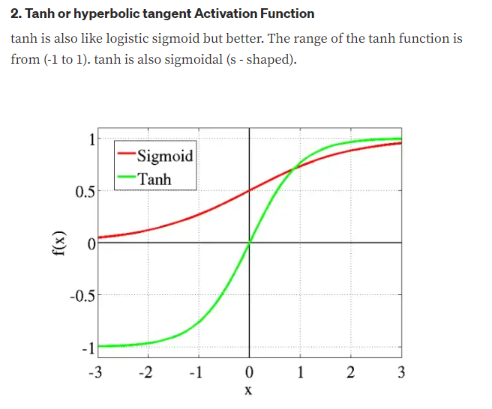

Slide 10
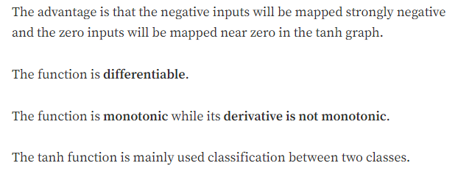

Slide 11
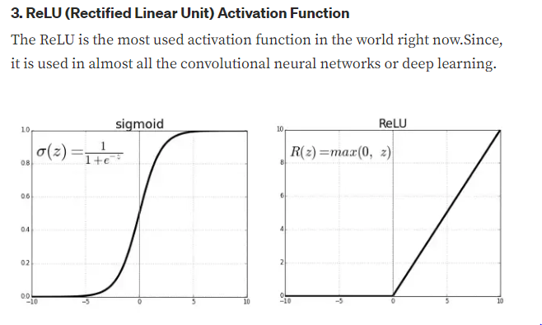

Slide 12
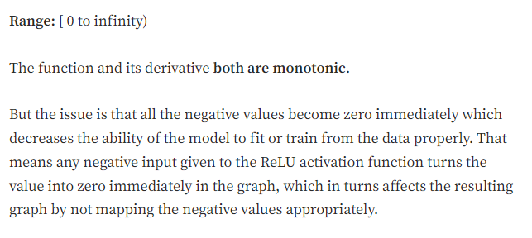

Slide 13
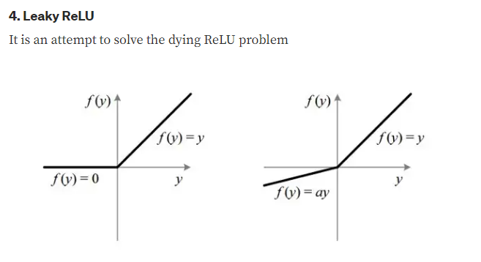

Slide 14
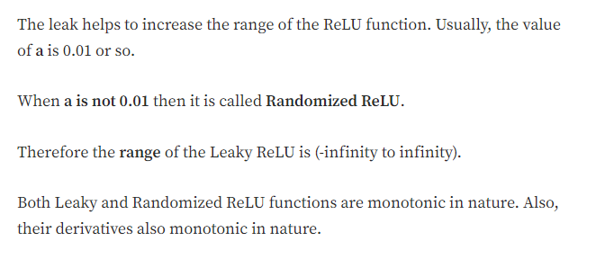

Slide 15
Thank You

