Slide 1
Optimizers
Deep Learning MasterClass

Slide 2
What are optimizers ?
Optimizers are algorithms or methods used to change the attributes of your neural network such as weights and learning rate in order to reduce the losses.

Slide 3
Different type of optimizers

Slide 4
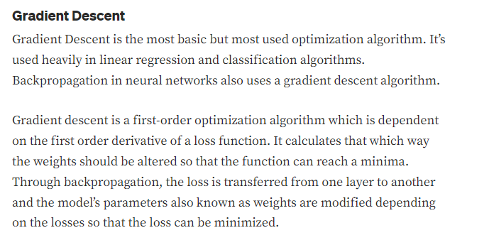

Slide 5
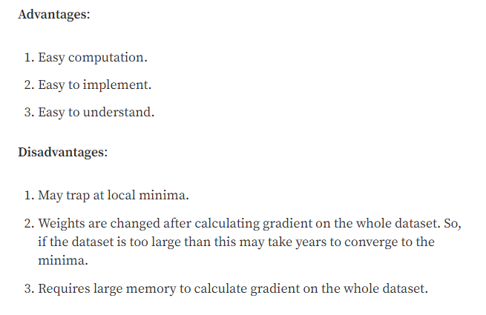

Slide 6
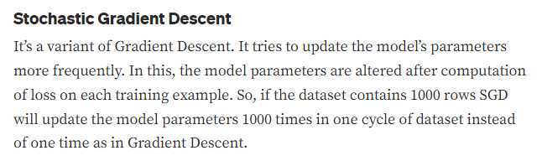

Slide 7
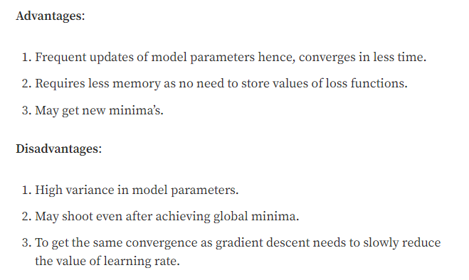

Slide 8
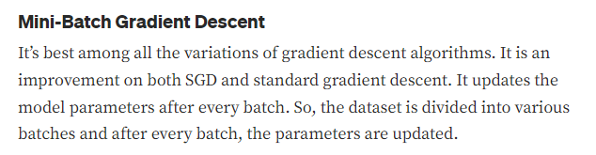

Slide 9
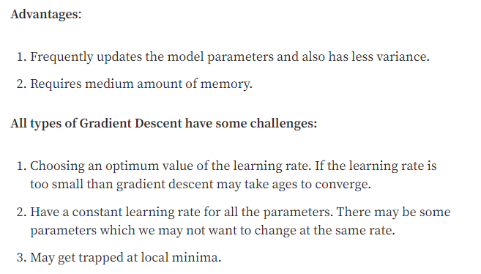

Slide 10
Adam
Adam is an optimization algorithm that can be used instead of the classical stochastic gradient descent procedure to update network weights iterative based in training data.
Adam is different to classical stochastic gradient descent.
Stochastic gradient descent maintains a single learning rate (termed alpha) for all weight updates and the learning rate does not change during training.
A learning rate is maintained for each network weight (parameter) and separately adapted as learning unfolds.

Slide 11
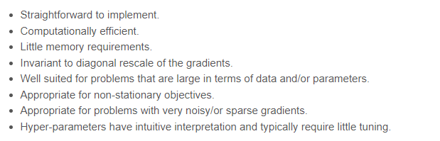
Advantages of Adam

Slide 12
Thank You

