Slide 1

USED-CAR AUCTIONS · DATA ANALYSIS PROJECT
From Raw Data to Dashboards
545,607 car sales, cleaned in Python, explored with EDA, and turned into Excel and Power BI dashboards.
SQL Server
Python
EDA
Excel
Power BI
One cleaned dataset · three deliverables · one story about used-car prices
Three files: notebook.ipynb (cleaning + EDA) · Cars_Dashboard.xlsx (3 Excel dashboards) · Cars_Dashboard.pbix (the same dashboards in Power BI)

Slide 2




THE PROJECT
What we built, and what we found
1
2
notebook.ipynb
Cars_Dashboard.xlsx
Loads the raw sales from SQL Server, cleans them in 7 steps (0 missing values left) and explores them in 10 EDA charts.
Interactive Excel dashboards on one Excel Table: KPI cards, PivotCharts, 4 slicers and a timeline.
558,837 → 545,607 rows
14 PivotTables · 3 dashboards
3
4
Cars_Dashboard.pbix
The insights
The same dashboards in Power BI: a Power Query + DAX model, synced slicers, a date slider and Top-N visuals.
What drives a used car’s price (age, mileage, condition, make) and how auction prices compare with the market estimate (MMR).
20 DAX measures · 3 pages
Cars sell 1.1% below MMR
QAi Academy · Data Analysis · Used-Car Auction Project
2

Slide 3








PART 1 · THE DATA
Where the data comes from
SQL Server
Python (pandas)
cleaned_cars.csv
Excel + Power BI
MotoDB.dbo.VehicleSales
notebook.ipynb
545,607 rows · 18 columns
both read the CSV
The car
Its condition
The sale
The prices
Year, Make, Model, Trim, Body, Transmission, VIN
Condition (1–5), Odometer (miles), Color, Interior
Seller, State, Sale date (Dec 2014 – Jul 2015)
MMR (the market’s price estimate) and the Selling price
One row = one car sold at auction. The raw table has 558,837 rows and 17 columns; the question behind every chart is simple: what is this car worth?
QAi Academy · Data Analysis · Used-Car Auction Project
3

Slide 4

PART 1 · DATA QUALITY
What was wrong with the raw data
Problem
How the notebook fixed it
26 rows shifted one column
"sedan" landed in Transmission and they have no price or date: dropped, with every row missing price, MMR or sale date.
Missing Make / Model / Trim (1.8–1.9%)
Filled from the VIN: its first 7 characters identify the car. Any gaps left use the same make + model.
Missing Transmission (11.7%) and Body (2.4%)
Filled from similar cars (next slides). Leftovers: Transmission = "unknown", Body rows dropped.
Two condition scales (1–5 and 11–49)
Values above 5 divided by 10, so every car is on one 1–5 scale.
Odometer 999,999 = placeholder
Treated as missing, then filled with the median of the same make + model + year.
Mixed case and broken symbols
Text lower-cased ("Ford" = "ford"); broken symbols in Color / Interior became "unknown".
Extreme prices
Kept cars sold for 0.35–1.69 × their MMR (about the 1st to 99th percentile).
QAi Academy · Data Analysis · Used-Car Auction Project
4

Slide 5

PART 1 · CLEANING
Seven cleaning steps, in order
1
Remove broken rows
5
Condition and Odometer
The 26 shifted rows and rows with no price, MMR or sale date.
One 1–5 scale; 999,999 = missing; fill with the make + model + year median.
2
Fill Make, Model, Trim
6
Remove price outliers
Most common value for the same VIN prefix (first 7 characters).
Keep prices between 0.35× and 1.69× the MMR.
3
Clean the text
7
Save cleaned_cars.csv
Lower-case and trim; broken symbols in Color / Interior mean missing.
Read by the EDA, the Excel workbook and Power BI.
4
Fill Body and Transmission
558,837 → 545,607 rows
From similar cars, the most specific group first.
97.6% of rows kept · 0 missing values · 60 makes, 45 body types
QAi Academy · Data Analysis · Used-Car Auction Project
5

Slide 6

PART 1 · SMART FILLING
Filling gaps from similar cars
A missing value takes the most common value of the most similar cars (same make, model and trim first), but only when that group is big enough and agrees.
notebook.ipynb · step 4 (Python)
Body: missing values left
raw data
13,195
fill_from_groups(df, "Body", [
Make + Model + Trim
6,666
(["Make", "Model", "Trim"], 2, 0.95),
Make + VIN part
3,903
Make + Model
1,771
(["Make", "VIN_PART"], 2, 1.00),
VIN prefix
957
(["Make", "Model"], 2, 0.98),
→ the last rows were dropped
(["VIN7"], 2, 1.00),
Transmission: missing values left
]) # (group, min cars, min agreement)
raw data
65,352
Make + Model + Trim + Year
10,619
Make + Model + Trim
7,840
Tested on hidden known values: learning only from real values is most accurate for Body; chained levels fill more Transmission.
Make + Model
5,941
→ the rest became "unknown"
QAi Academy · Data Analysis · Used-Car Auction Project
6

Slide 7




PART 2 · EDA · UNIVARIATE
One column at a time
$12,300
79%
67%
96%
median selling price
sell for under $20,000
are 5 years old or less
have an automatic gearbox
Selling price distribution
Most common makes
Number of cars in each $1,000 price band, $0–$60K
Cars sold, 10 most common makes
QAi Academy · Data Analysis · Used-Car Auction Project
7

Slide 8
PART 2 · EDA · BIVARIATE
Each feature against the price
Car age
Mileage
Condition
Median price by age at sale (years)
Median price by odometer (10k-mile steps)
Median price by condition (1 = worst, 5 = best)
Body type
0.99
price vs MMR correlation
Median price, 8 most common body types
Auctions price cars almost exactly at the market estimate. Among the 10 most common makes, BMW sells for the most (median $20,800).
QAi Academy · Data Analysis · Used-Car Auction Project
8

Slide 9
PART 2 · EDA · MULTIVARIATE
Three or more columns together
How the numbers move together
Price by age, per body type
Correlation between the numeric columns (−1 to 1)
Median selling price by car age (0–15 years)
Price
MMR
Odometer
Condition
Car age
Price
1.00
0.99
-0.59
0.53
-0.57
MMR
0.99
1.00
-0.59
0.48
-0.58
Odometer
-0.59
-0.59
1.00
-0.55
0.79
Condition
0.53
0.48
-0.55
1.00
-0.55
Car age
-0.57
-0.58
0.79
-0.55
1.00
Odometer and car age move together (r = 0.79), so they tell a similar story. SUVs and crew cabs keep their value best: at 10 years a crew cab still fetches $8,700, a sedan $3,400.
QAi Academy · Data Analysis · Used-Car Auction Project
9

Slide 10





THE BIG IDEA
What really drives a used car’s price
Four things explain most of the price. The numbers are the notebook’s medians; both dashboards show the same pattern.
Age
Mileage
Condition
Make and body
Median price $20.5K when new, $10.5K at 5 years, $4.1K at 10.
$19.6K under 10k miles vs $6.5K at 100k. Miles and age go together (r = 0.79).
At 5 years old, condition 5 sells for $18.0K vs $4.6K for condition 1: about 4× more.
BMW leads the common makes ($20.8K); SUVs and crew cabs hold value best.
Condition matters at every age: look after a car and it keeps its value.
QAi Academy · Data Analysis · Used-Car Auction Project
10

Slide 11




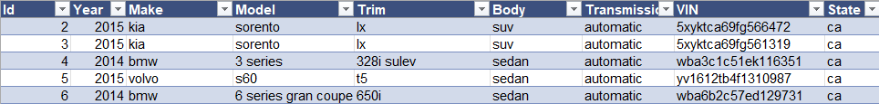


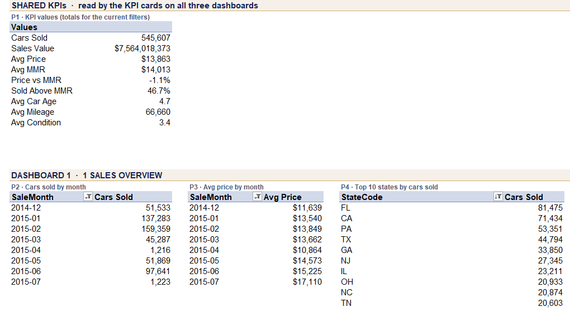


PART 3 · EXCEL DASHBOARD
How the Excel workbook works
Data sheet
One PivotCache
14 PivotTables
KPIs + PivotCharts
3 dashboards
Excel Table "SalesData"
545,607 rows + helper columns
shared by every pivot
on the Pivot Tables sheet
GETPIVOTDATA + charts
Sales · Price · Market value
Slicers + timeline
Page buttons
Brand, Body type, State and Transmission slicers and a Sale-date timeline, connected to all 14 pivots.
One click jumps between the 3 dashboards, the pivots and the data.
Data sheet: the Excel Table
Brand theme
Key insights box
Navy, slate, gold and cream; every box has rounded corners.
Three findings written from all the data, at the bottom of every page.
Pivot Tables sheet: P1–P14 (first pivots)
QAi Academy · Data Analysis · Used-Car Auction Project
11

Slide 12
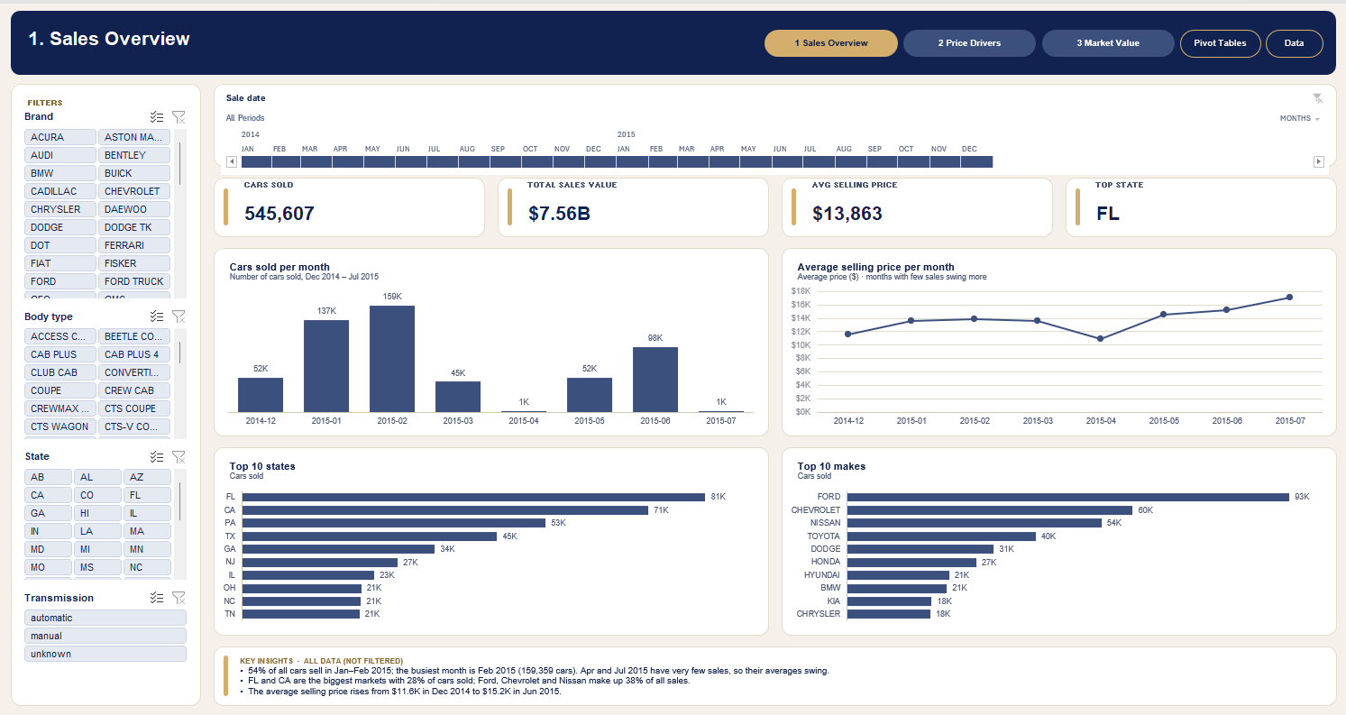
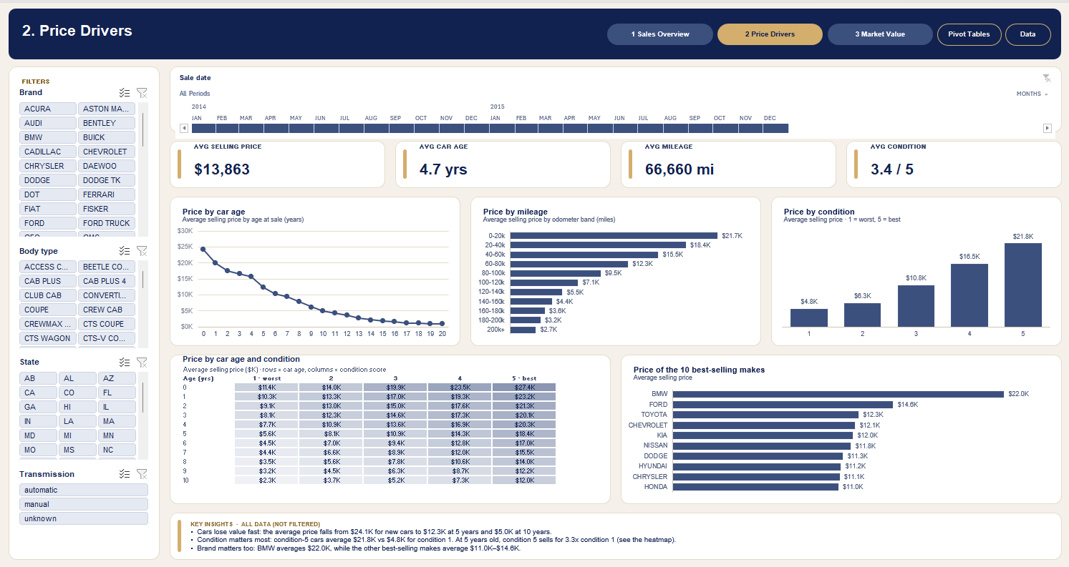
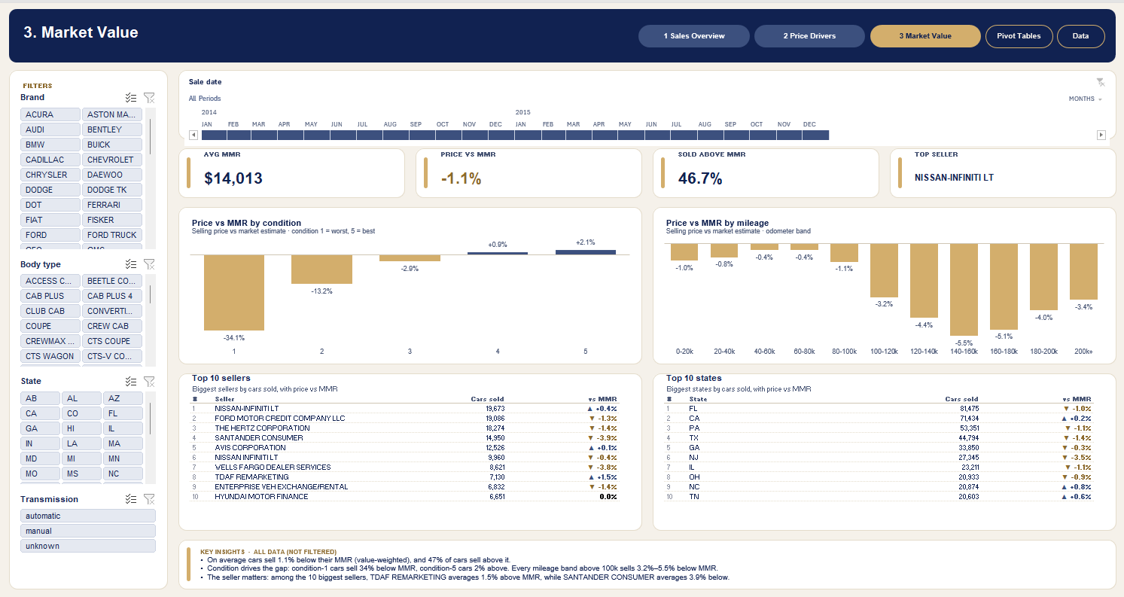

PART 3 · EXCEL DASHBOARD
Three linked Excel dashboards
Click a slicer or drag the timeline: every KPI, chart and table on all three pages updates together.
QAi Academy · Data Analysis · Used-Car Auction Project
12

Slide 13





PART 4 · POWER BI
How the Power BI report works
cleaned_cars.csv
Power Query
Data model
20 DAX measures
3 report pages
one data folder setting
types + 12 helper columns
Sales + Calendar tables
KPIs, colours, top lists
same layout as Excel
DAX · two of the measures
Synced slicers
Date slider
Price vs MMR =
Brand, Body type, State and Transmission filter every page at once.
Replaces Excel’s timeline, through a Calendar table.
VAR mmr = SUM(Sales[MMR])
RETURN IF(mmr > 0,
DIVIDE(SUM(Sales[SellingPrice]), mmr) - 1)
Top-N visuals
Brand theme
Cars Sold = COUNTROWS(Sales)
Top 10 states, makes and sellers follow every filter.
Navy, gold and cream, rounded white boxes, colour by sign.
-- format: "▲ +0.0%;▼ -0.0%"
QAi Academy · Data Analysis · Used-Car Auction Project
13

Slide 14
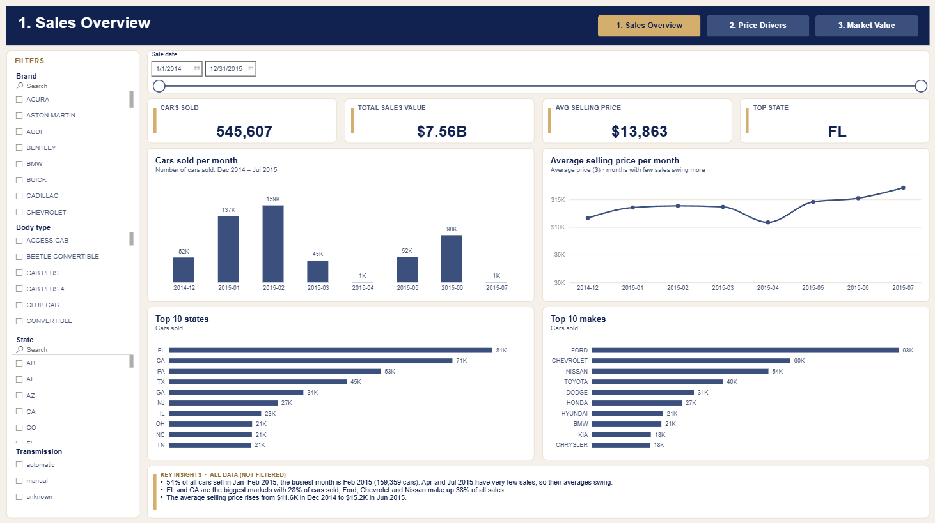
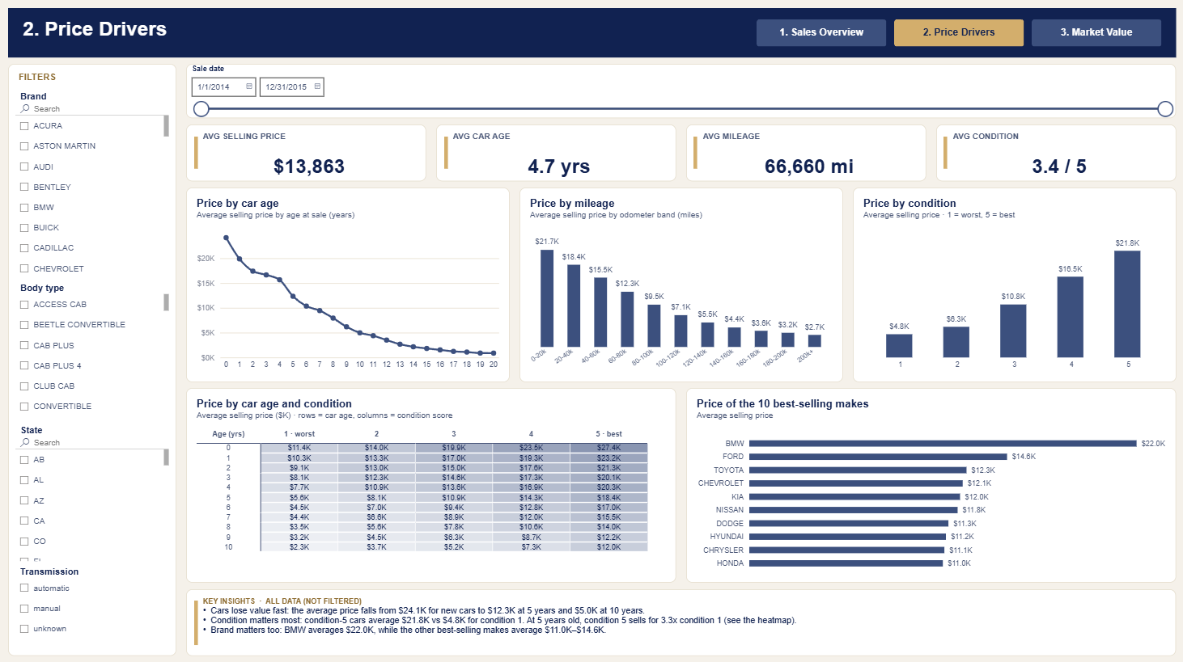
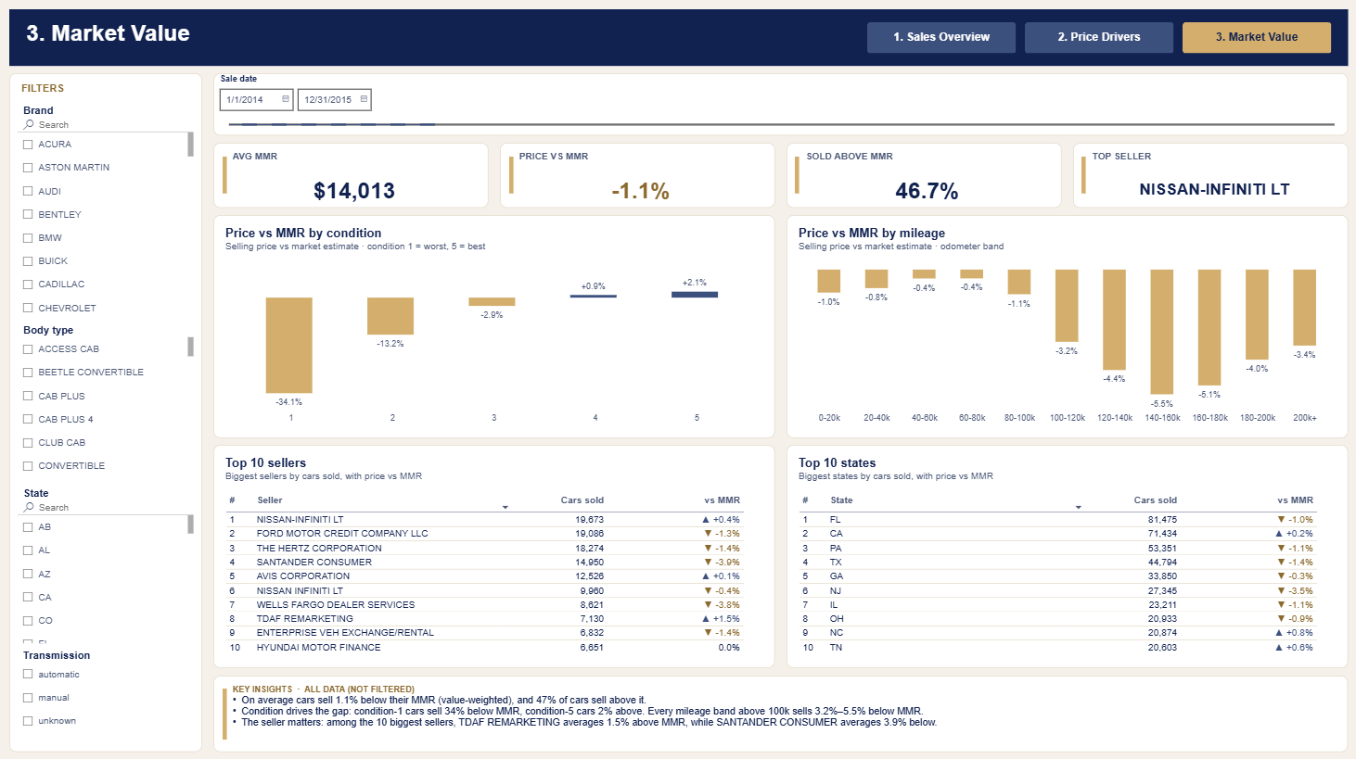

PART 4 · POWER BI
The same three pages in Power BI
The .pbix opens with the data already loaded (29 MB); Refresh reloads cleaned_cars.csv.
QAi Academy · Data Analysis · Used-Car Auction Project
14

Slide 15

PART 5 · COMPARE
Excel vs Power BI: same story, two tools
Excel dashboard
Power BI report
Data
Excel Table + one PivotCache
Power Query + a data model
Calculations
PivotTable fields and GETPIVOTDATA
20 DAX measures
Filters
4 slicers + a timeline
4 synced slicers + a date slider
Top-10 lists
Pivot Top-10 filters
Top-N filters that follow every slicer
Updating
Rebuild with build_dashboard.py
Click Refresh (reads cleaned_cars.csv)
File size
125 MB
29 MB
Best for
Quick analysis in a tool everyone has
Interactive reports to publish and share
QAi Academy · Data Analysis · Used-Car Auction Project
15

Slide 16

QUALITY
We checked every number
18 / 18
35 / 35
29 / 29
Notebook
Excel dashboard
Power BI report
The notebook’s findings, recomputed from cleaned_cars.csv: 545,607 rows, 0 missing values.
KPIs, top-10 pivots, heatmap cells, the sellers table, and the slicer and timeline filters vs pandas.
DAX measures, Power Query columns, top-10 lists, heatmap cells and filters vs pandas.
82 automated checks, 0 differences: the notebook, Excel and Power BI all tell the same story with the same numbers.
Every dashboard page was also checked by eye in Excel and Power BI Desktop: labels, colours, scrollbars and rounded boxes.
QAi Academy · Data Analysis · Used-Car Auction Project
16

Slide 17




RESULTS
What the dashboards tell us
A busy winter
Two big markets
Three makes lead
54% of sales happen in Jan–Feb 2015; Feb 2015 is the busiest month (159,359 cars).
FL and CA account for 28% of all cars sold.
Ford, Chevrolet and Nissan make up 38% of sales.
SEEN ON 1. SALES OVERVIEW
SEEN ON 1. SALES OVERVIEW
SEEN ON 1. SALES OVERVIEW
Prices rising
Close to market value
Sellers differ
The average price rises from $11.6K in Dec 2014 to $15.2K in Jun 2015.
Cars sell 1.1% below MMR on average; 47% sell above it.
Among the top 10 sellers, TDAF Remarketing gets 1.5% above MMR, Santander Consumer 3.9% below.
SEEN ON 1. SALES OVERVIEW
SEEN ON 3. MARKET VALUE
SEEN ON 3. MARKET VALUE
QAi Academy · Data Analysis · Used-Car Auction Project
17

Slide 18





WHAT’S NEXT
Next steps
Where this can go
DELIVERED
Three files
1
Predict the selling price with a regression model (age, mileage, condition, make).
notebook.ipynb
cleaning + EDA
2
Publish the Power BI report and refresh it straight from the SQL Server database.
Cars_Dashboard.xlsx
3 dashboards · 125 MB
3
Add a seller drill-through page to compare any seller with the market (MMR).
Cars_Dashboard.pbix
3-page report · 29 MB
From 558,837 raw rows to one clear answer: what is this car worth?
QAi Academy · Data Analysis · Used-Car Auction Project
18

