Slide 1

Presented by: - Faris abu3ram - Amir Altakroori
Project 1:
Sticky Notes
2019

Slide 2
Contents:
Planning
About project
Project features
Demo
Questions

Slide 3
Planning:
First of all we picked the easiest project to focus on team management not on implementing code itself.
We divided the project to small parts, then we used Trello tools to manage code life, assign tasks, computing time required and so,
After this level we concluded that we had enough time to add new features so we added password and background color features to our project.
We created a new repository on GitHub and we divided it to more than one branch, firstly we coded some project parts in sub branches.
After reviewing it from the second coder and putting comments on code and fixed them, we merged the sub branch to the master branch, and we repeated that step utile we finished coding.
Finally we reviewed the code and tested it on several tests case then we merge it to master branch for the last time and we published it.

Slide 4
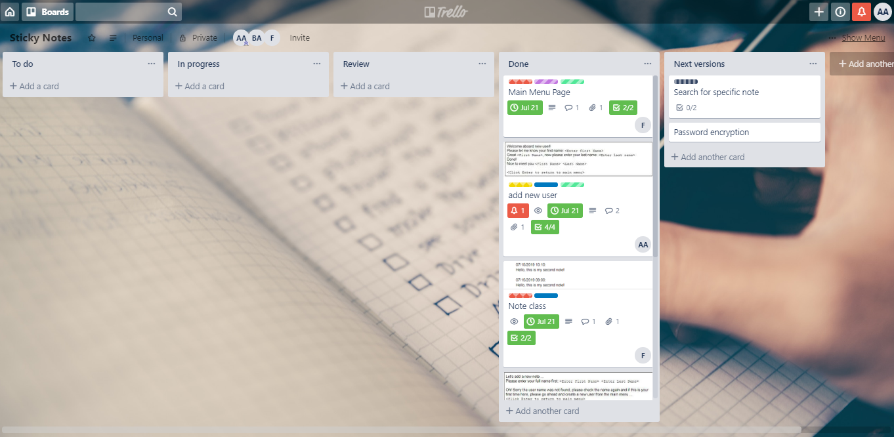
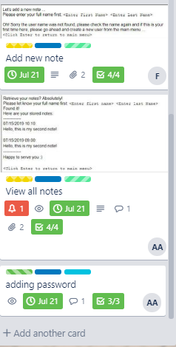

Slide 5
About Project
Languages: C++

Slide 6
Print all notes
Add new notes
Add user
Login
Write your note
Write another note or exit
Login
View notes
Add password
Add full name

Slide 7
Adding new user
Receiving first and last name.
Asking for password to assign it to user name.
Recording user name and password on external file.
Opening file that have the same user name if it is possible.

Slide 8
Password class
It just work as a functions collector.
This class doesn't have data members.
Functions:
bool checkWithAssigningPassword (string userName)
string getUserPassword(string fullNameUser)
bool askPassword(string userName)
string hiddenInputLine()

Slide 9
Adding new notes
Receiving first and last name (full name).
Asking for password and verify it.
Opening the user’s file.
Receiving the note’s text from the user
Generating a note
Printing the note on user’s file

Slide 10
Note class
This class just have a private string note as a data member.
Functions:
void getTime(int& year, int& month, int& day, int& hour, int& mins)
Note(string note)
string toStringNote()

Slide 11
Printing all notes
Receiving first and last name (full name).
Asking for password and verify it.
Opening the user’s file.
Printing all file’s contents.

Slide 12
Features:
Interactive background.
Adding Password.
Multiple notes.
Multiple lines.

Slide 13
Demo

Slide 14
Contact with us.
Email: 201426@ppu.edu.ps
Phone: 059-9999999
Trello link: https://trello.com/b/ntbspgT1
GitHub link: https://github.com/farisabu3ram/stickynote.git

