Slide 1
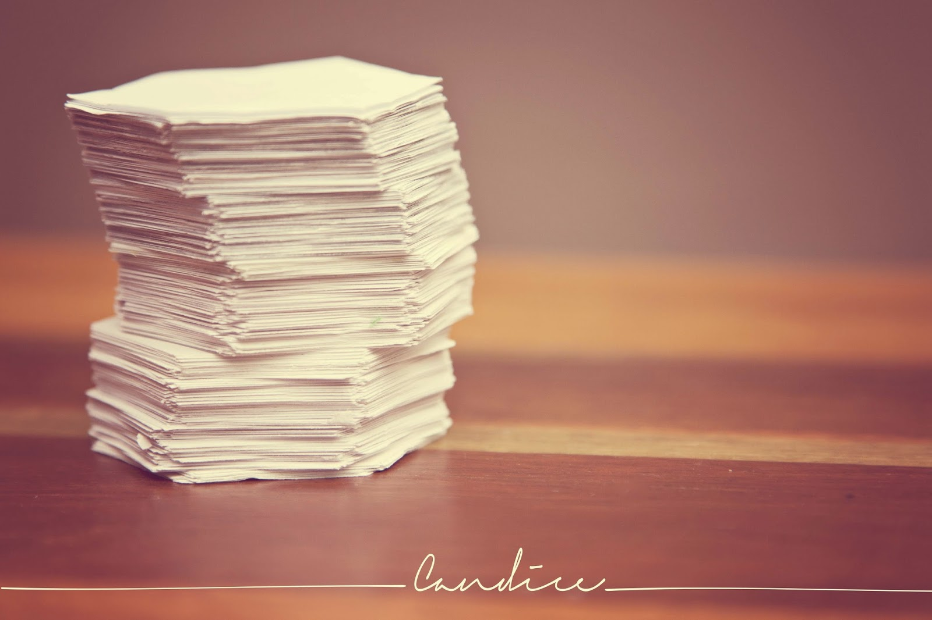
Sticky Notes

Slide 2

Presented by: - Faris abu3ram - Amir Altakroori
Project 1:
Sticky Notes
2019

Slide 3
Contents:
About project
Project features
Demo
Questions

Slide 4
Print all notes
Add new notes
Add user
Add password
Add full name
Login
Write your note
Write another note or exit
Login
View notes

Slide 5
Features:
Interactive background.
Adding Password.
Multiple notes.
Multiple lines.

Slide 6
Demo

Slide 7
Contact with us.
Email: 201426@ppu.edu.ps
Phone: 059-9999999

