Slide 1
Machine Learning in Credit Risk and in option pricing
Fares Djerourou

Slide 2
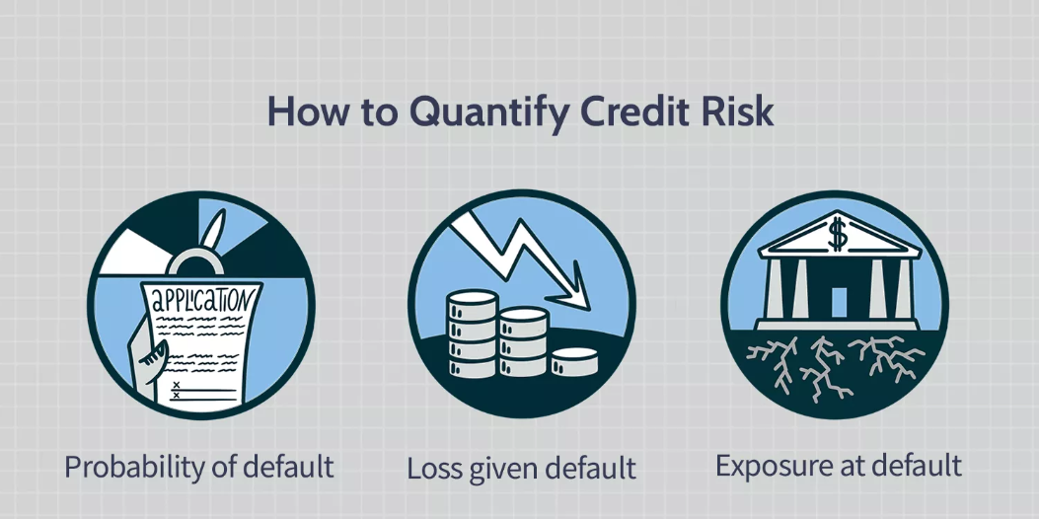
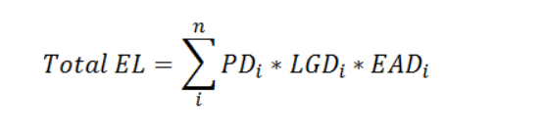
Expected and unexpected loss
Why do we care about credit risk in the first place?

Slide 3
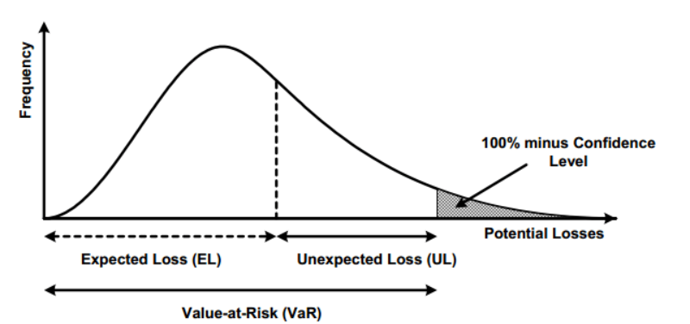
Expected and unexpected loss
Expected loss distribution and VaR

Slide 4
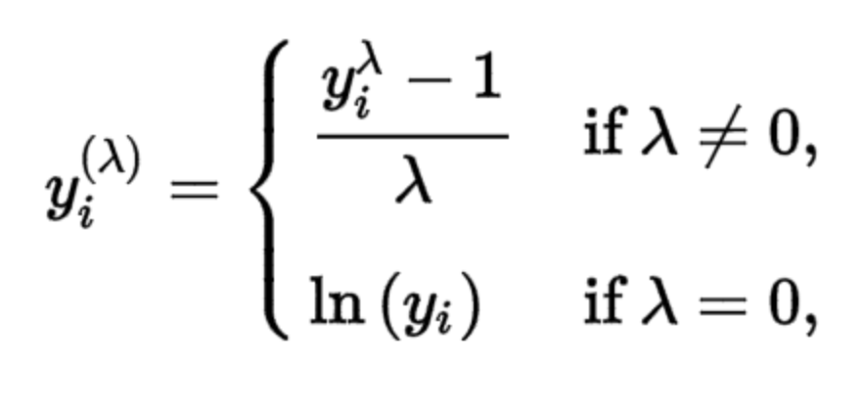
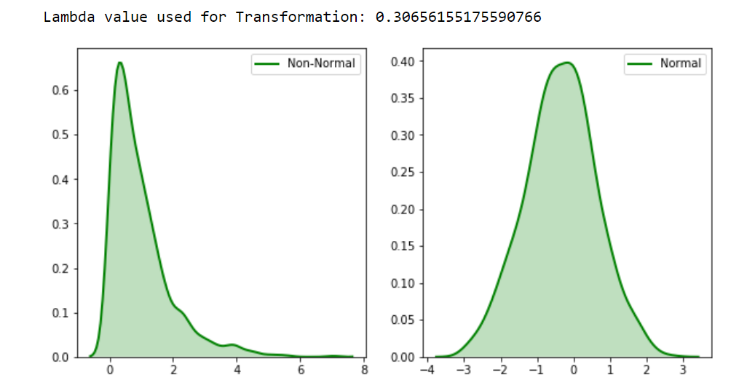
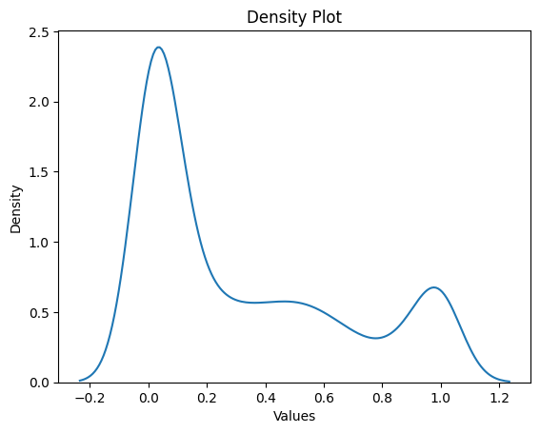
Target variable transformations

Slide 5
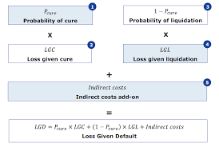
Machine learning in credit risk models and limitations
Decomposition of the risk parameters, for example, instead of looking directly at the loss given default we try to split it into a sum of random variables such as LGD Liquidation or LGD Cure weighted by the probabilities of going into each state.
Why? Because by doing a more granular analysis of the risk parameter we mind find more « normal » data, or to be more precise, data that fulfill the assumptions of simple and interpretable regression techniques.
Turns out it doesn’t work, data is never like we would like it to be.

Slide 6
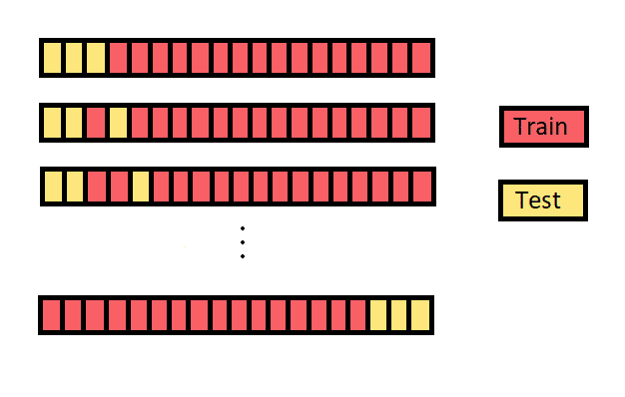
A philosophical dilemma
We naturally tend to go with what has previously worked
We can trust the confidence intervals and ‘correctly infer’ from data when the assumptions of simple regressions are met.
Shifting paradigm, instead of looking at the data and assuming it follows a particular distribution so we can generalize it to new data, we just train a model and test it on unseen data and assume it will generalize to new data based on that.

Slide 7
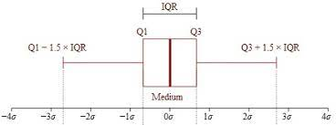
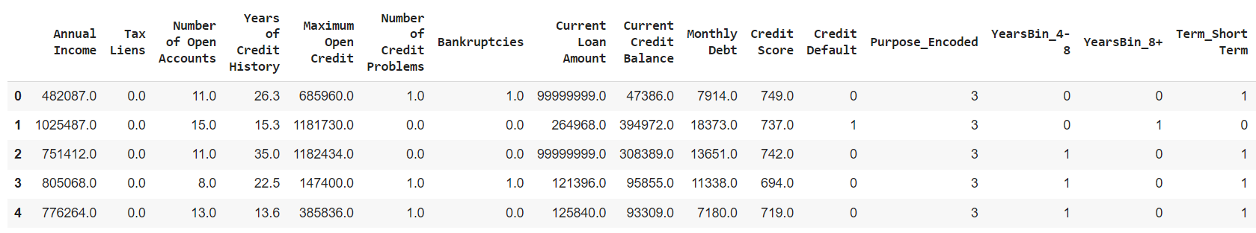
Data Preparation
Heatmap, correlation analysis to see if we can drop some redundant features.
Treating missing values of our dataset.
Encoding categorical variables
Outlier treatment (IQR/3sigma)
Scaling the features for some models

Slide 8
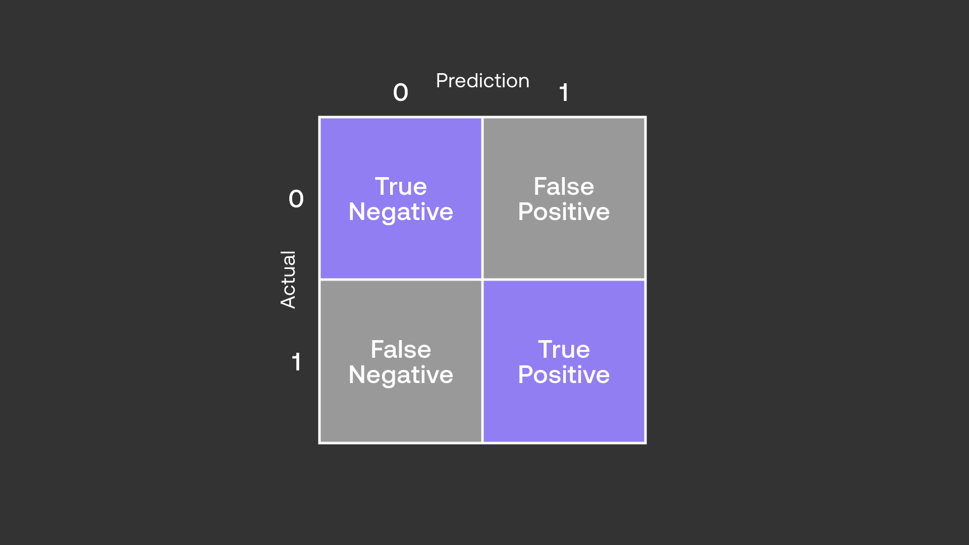
Models tested
Logistic Regression
Gradient Boosting
Random Forest
Feed Forward Neural Networks

Slide 9
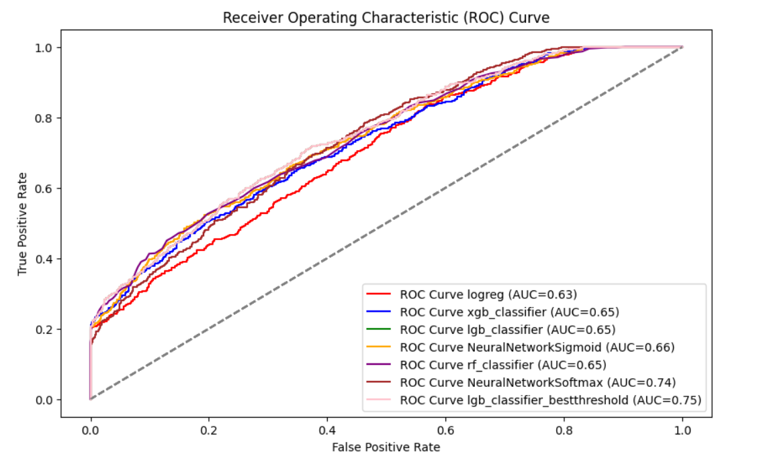
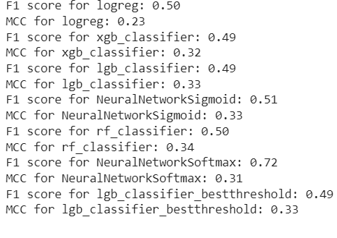
Comparison on the test set

Slide 10
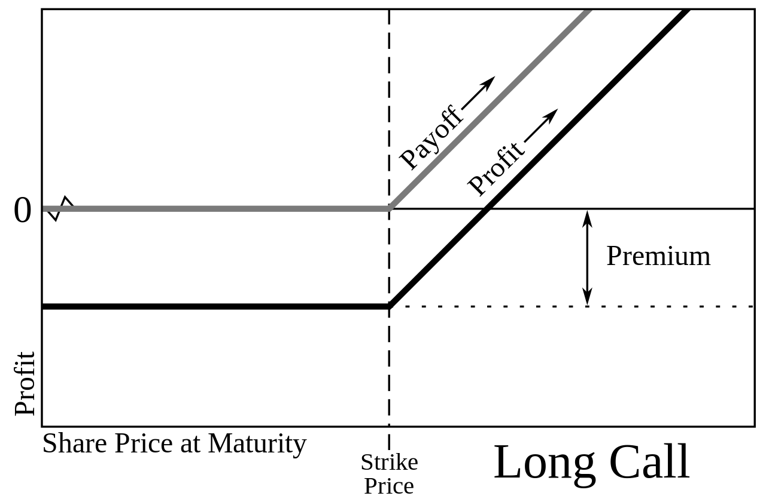
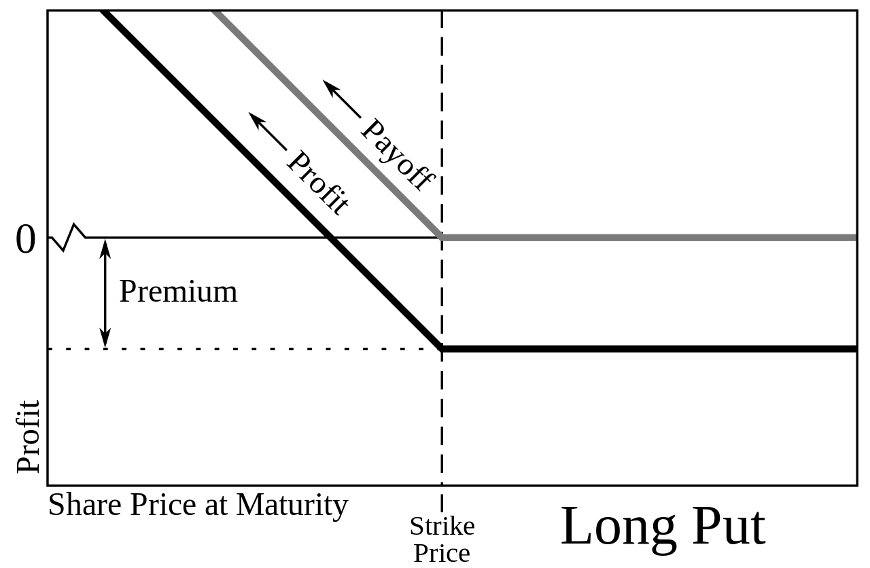
What is an option?
An option is a contract on some underlying instrument, an asset, an index, anything you would like really.
The most renowned options, also known as Vanilla options are the call option as well as the put option

Slide 11
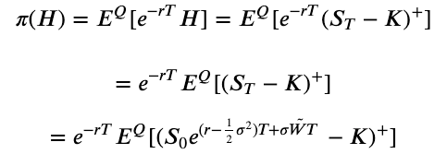

How do we value an option? Risk neutral pricing

Slide 12
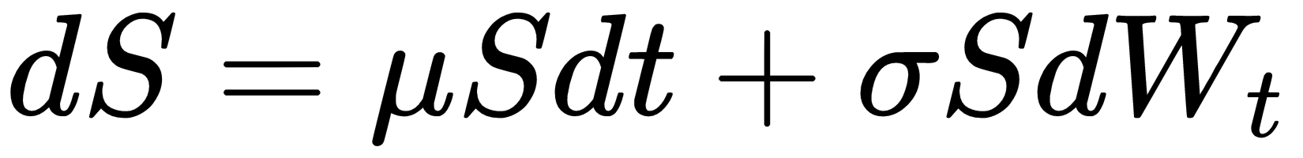
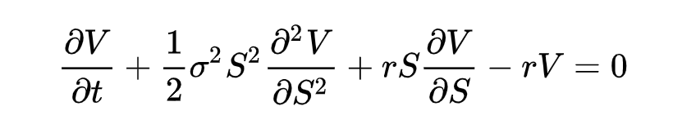
Quick dive into option pricing
Under this assumption for the dynamic of the asset price process, the price of the derivative on the underlying S will be given by the solution of the following PDE

Slide 13
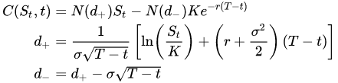
Quick dive into option pricing
We have a closed form solution, neat!
But wait…

Slide 14
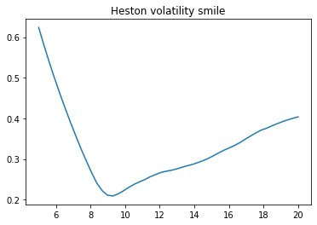
Volatility smile ☺
Volatility changes with different strike prices K for the same underlying.
Except in reality it does and it means the model is ‘wrong’, or imperfect rather.

Slide 15
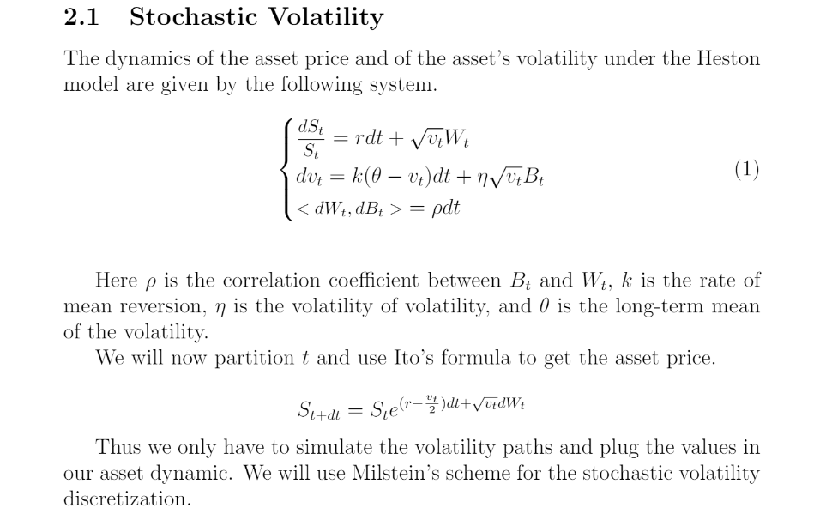
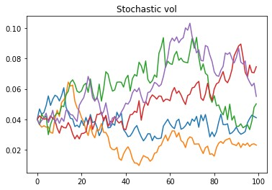
A possible solution: Stochastic Volatility

Slide 16
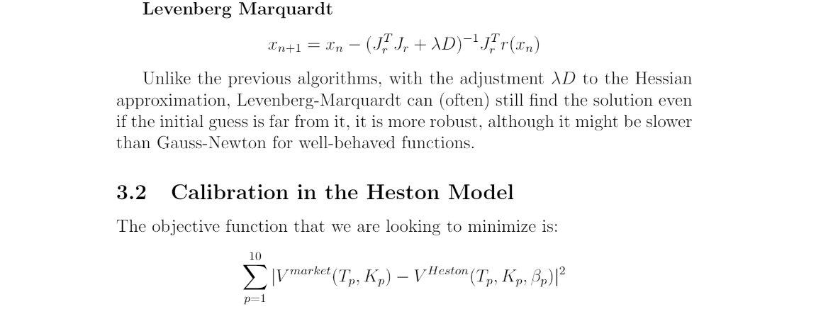
The problem with volatility models
Well they don’t, at least not completely. The most interesting stochastic or local volatility models take too long to calibrate, and hence are useless in practice.
The absence of a closed form, the need for Monte Carlo simulation (computationally expensive) and numerical approximations

Slide 17

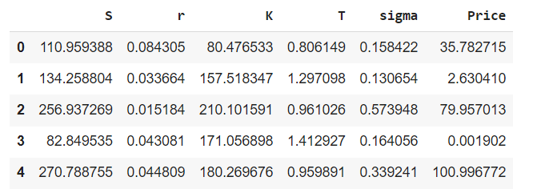
Neural networks in pricing
Deep neural networks can ‘learn’ the pricing functional or the volatility.
Neural network trained on the BS model:

Slide 18
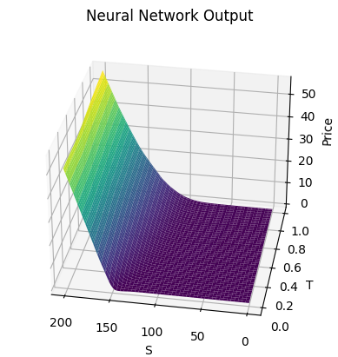
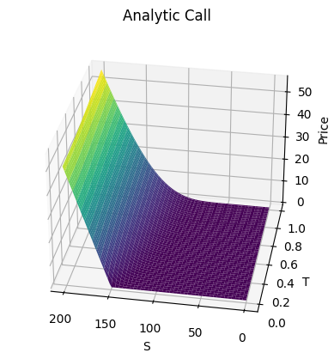
Neural networks in pricing

Slide 19
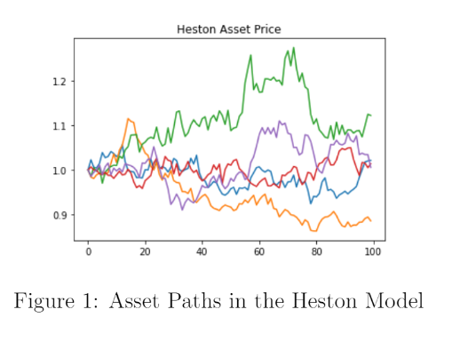

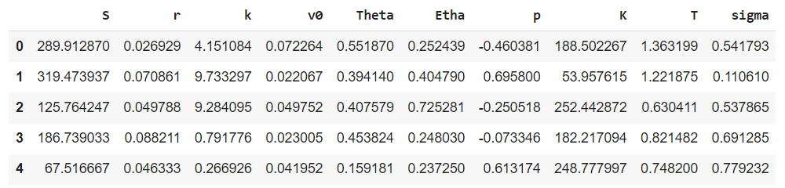
Deep neural networks in pricing

Slide 20
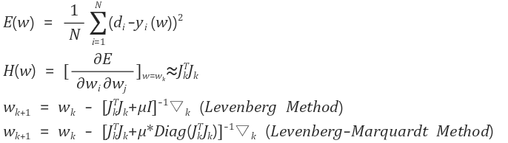
How does this help?
It’s mainly about speed:

Slide 21

References:
Basel II risk parameters, Bernd Engelmann, Robert Rauhmeier.
Credit risk analytics measurement techniques, applications, and examples in SAS.
Deep Learning Volatility Blanka Horvath, Aitor Muguruza, Mehdi Tomas
Lending club for the dataset.
Survival analysis in LGD Modelling, A.M.M Arents, for the data transformation plot.
Investopedia and Wikipedia for illustrations

