Slide 1
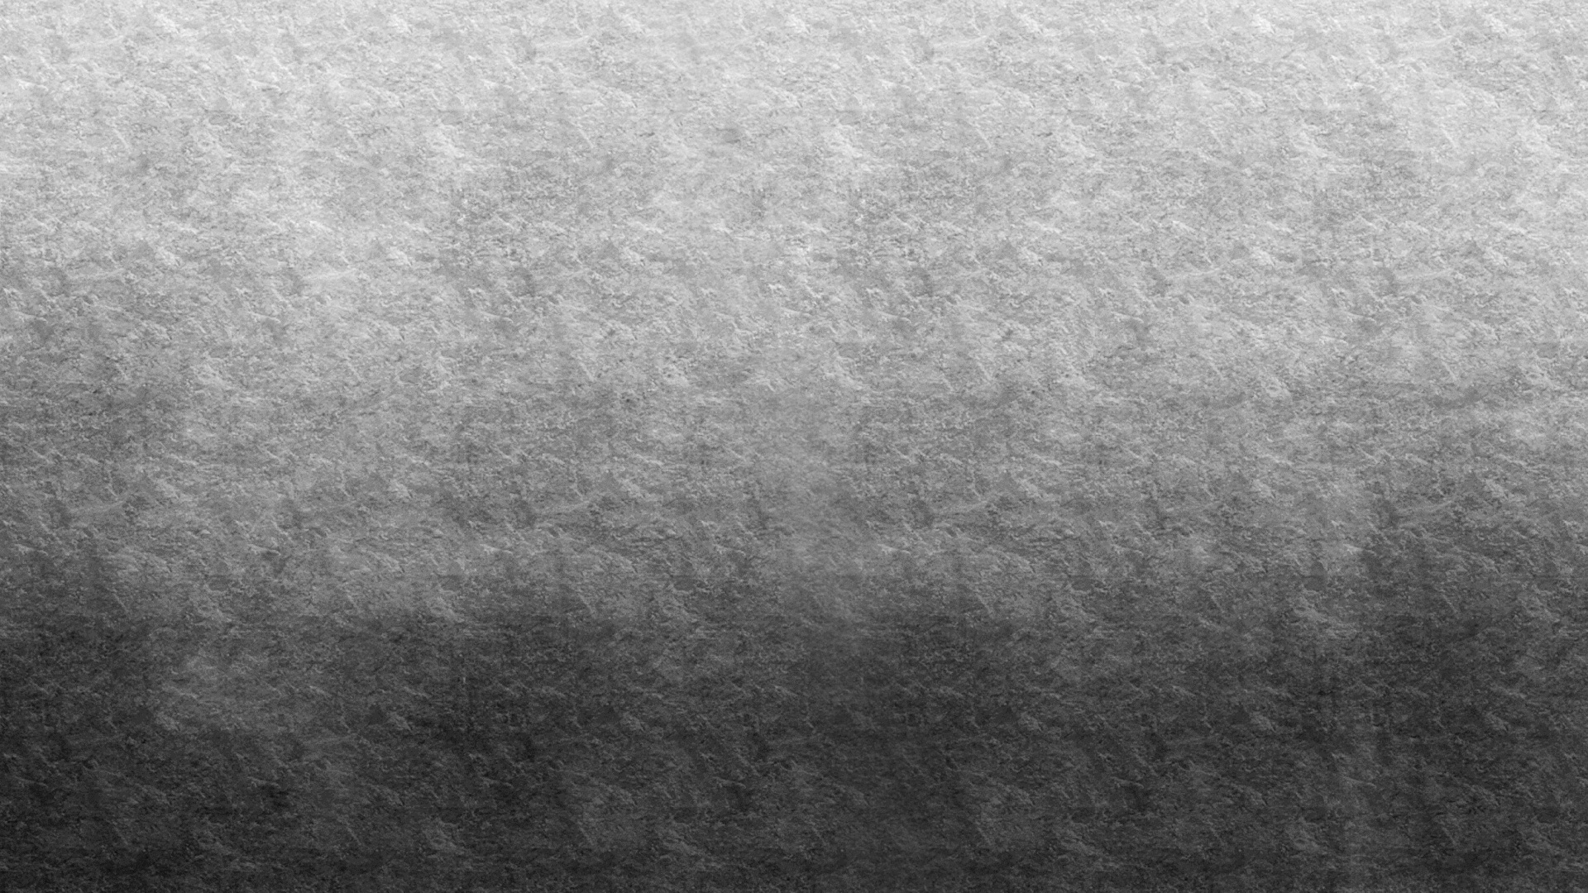
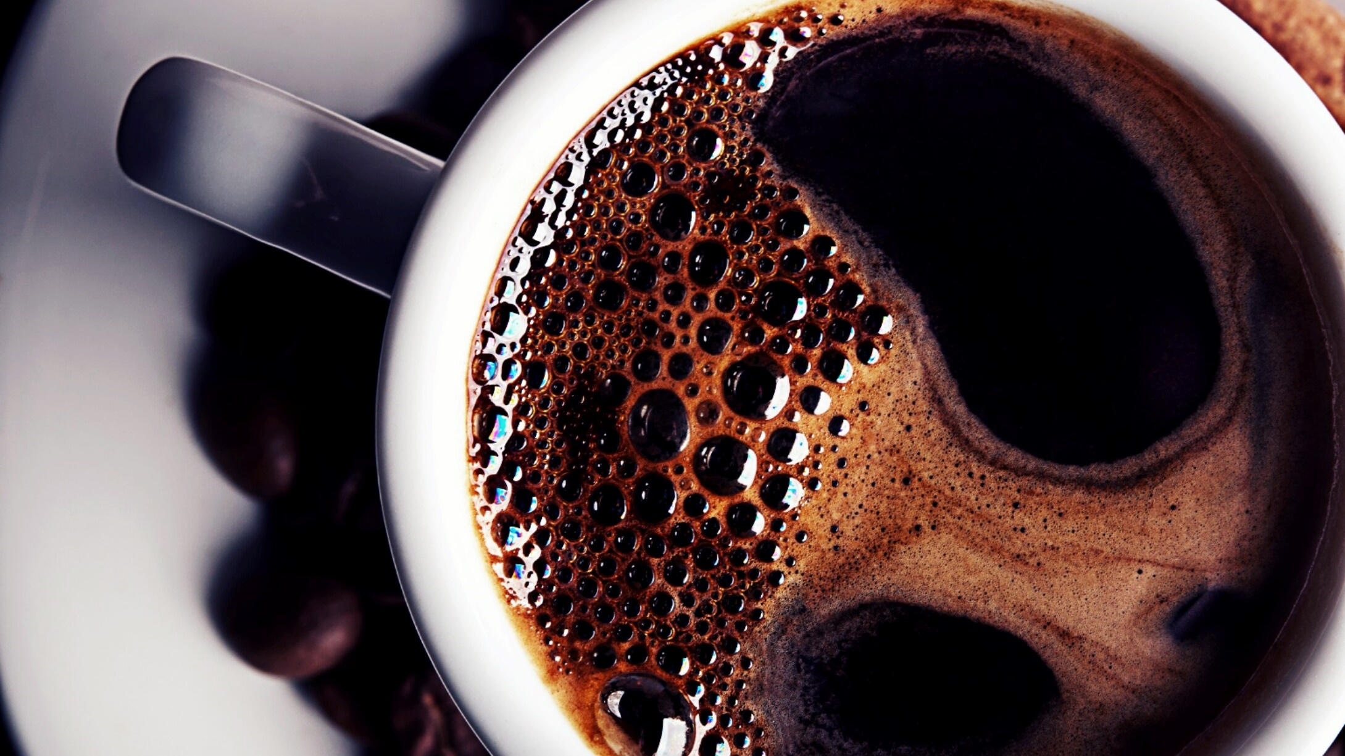
life after death and mysteries about life
Emanuele Filippo Farfariello

Slide 2
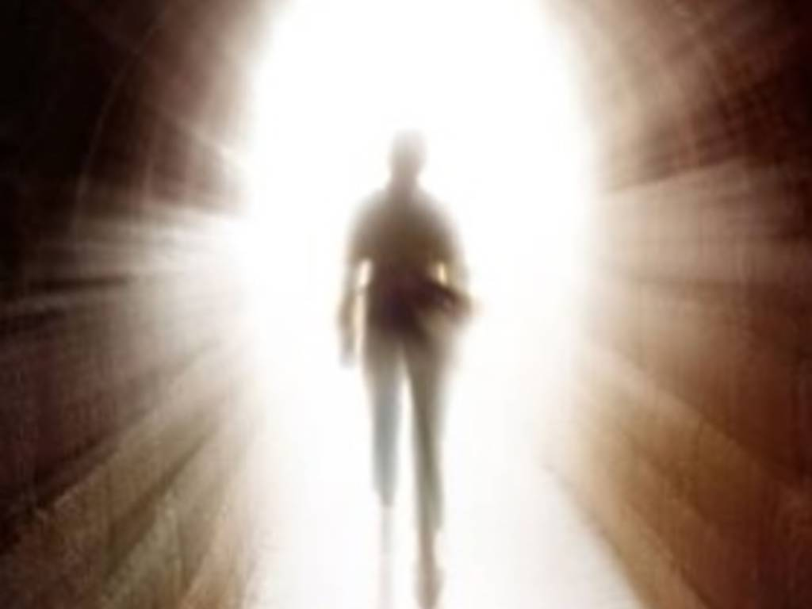
introduction
what happens once they die is a mystery still unsolved. today we will discuss everything and then discuss it in class
For me this is a difficult argument, because is It's my biggest fear. the important thing is not to judge

Slide 3
religious points of view
Christianity And islam:
affirms life after death, with beliefs in Heaven, Purgatory and Hell
01
Hinduism and Buddhism:
2 life every time
02
Emanuelism:
I hope there is a second life, but many times I think I'm in a simulation and that this life is fake
03

Slide 4
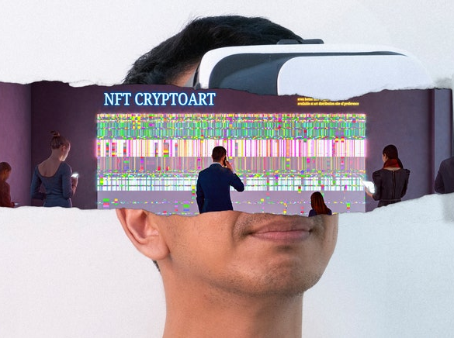
Are we living in a simulation?
one of the most beautiful and scary theories is this.
"Are we living in a simulation?“
"Does anyone command our actions? The alien?"
"What if at the end of life they took away our VR?"

Slide 5
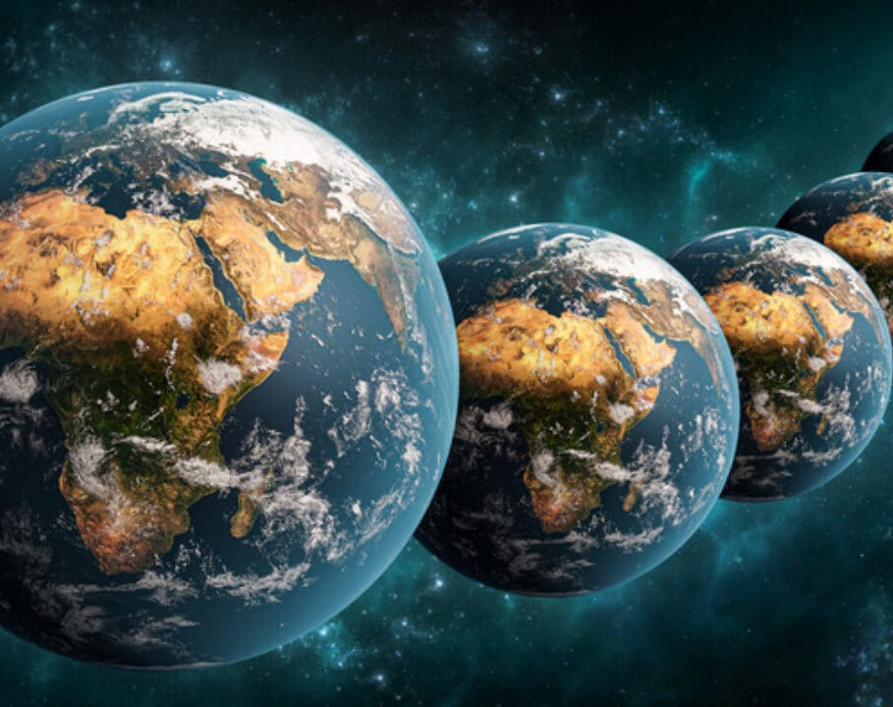
Requests whitout answer
does the multiuniverse exist?

Slide 6
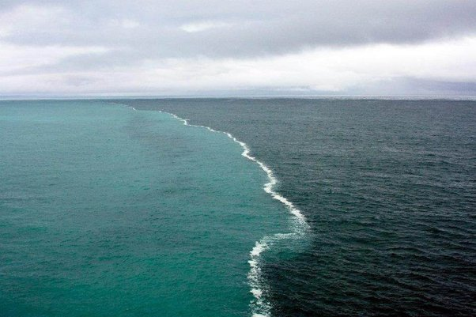
Is possible?

Slide 7
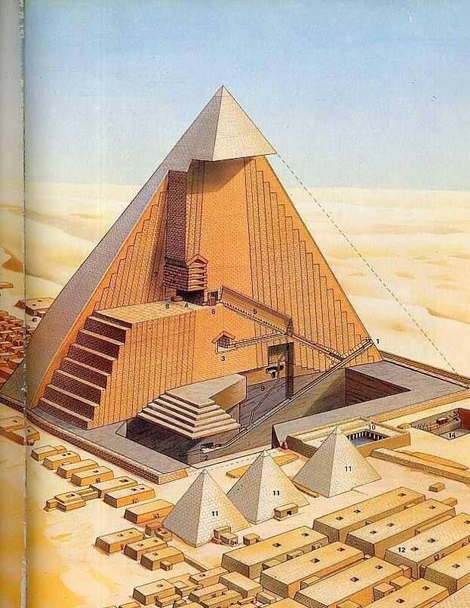
the pyramids
the pyramids are not just that triangle, they have a whole lower part. as in Egyptian structures. Could a human have done this?

Slide 8
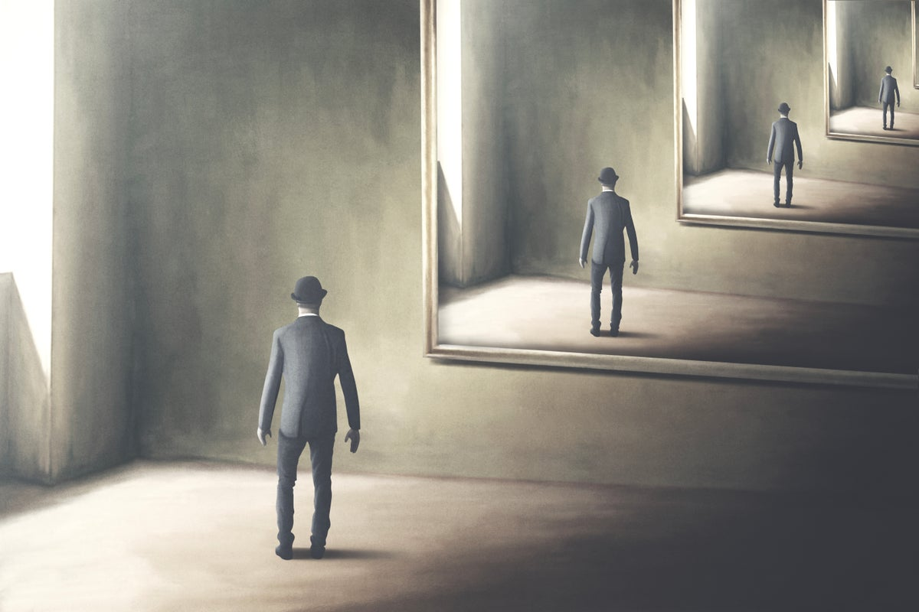
dejavu

Slide 9
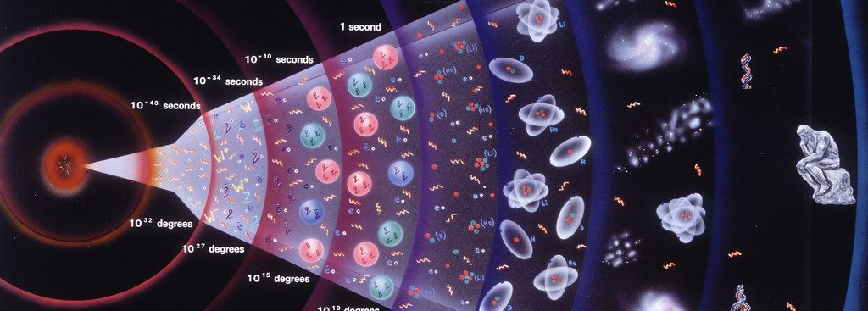
the big bang
Before?

Slide 10
for science
according to science there is nothing after death

Slide 11
the unsolved mysteries of humanity
Nikola Tesla = he had discovered how to generate free electricity
Danny Mullen = disappeared because he had talked about the fourth dimension on YouTube
Jacopo Grimberg and Pachita = disappeared because they had proven that the world was a lucid dream
Ricky web = at 3 years old he crossed 100 km alone in a cold forest. His face was different what did you see?
Franck Suarez and Marck smith = found dead, had cure for cancer and Mark for alzheimer

Slide 12
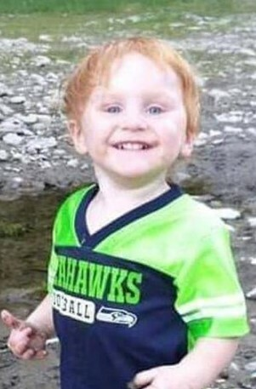
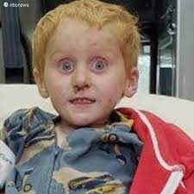
Ricky web, before and after

